Slide 1
TuneDB
Quick start guide

Slide 2
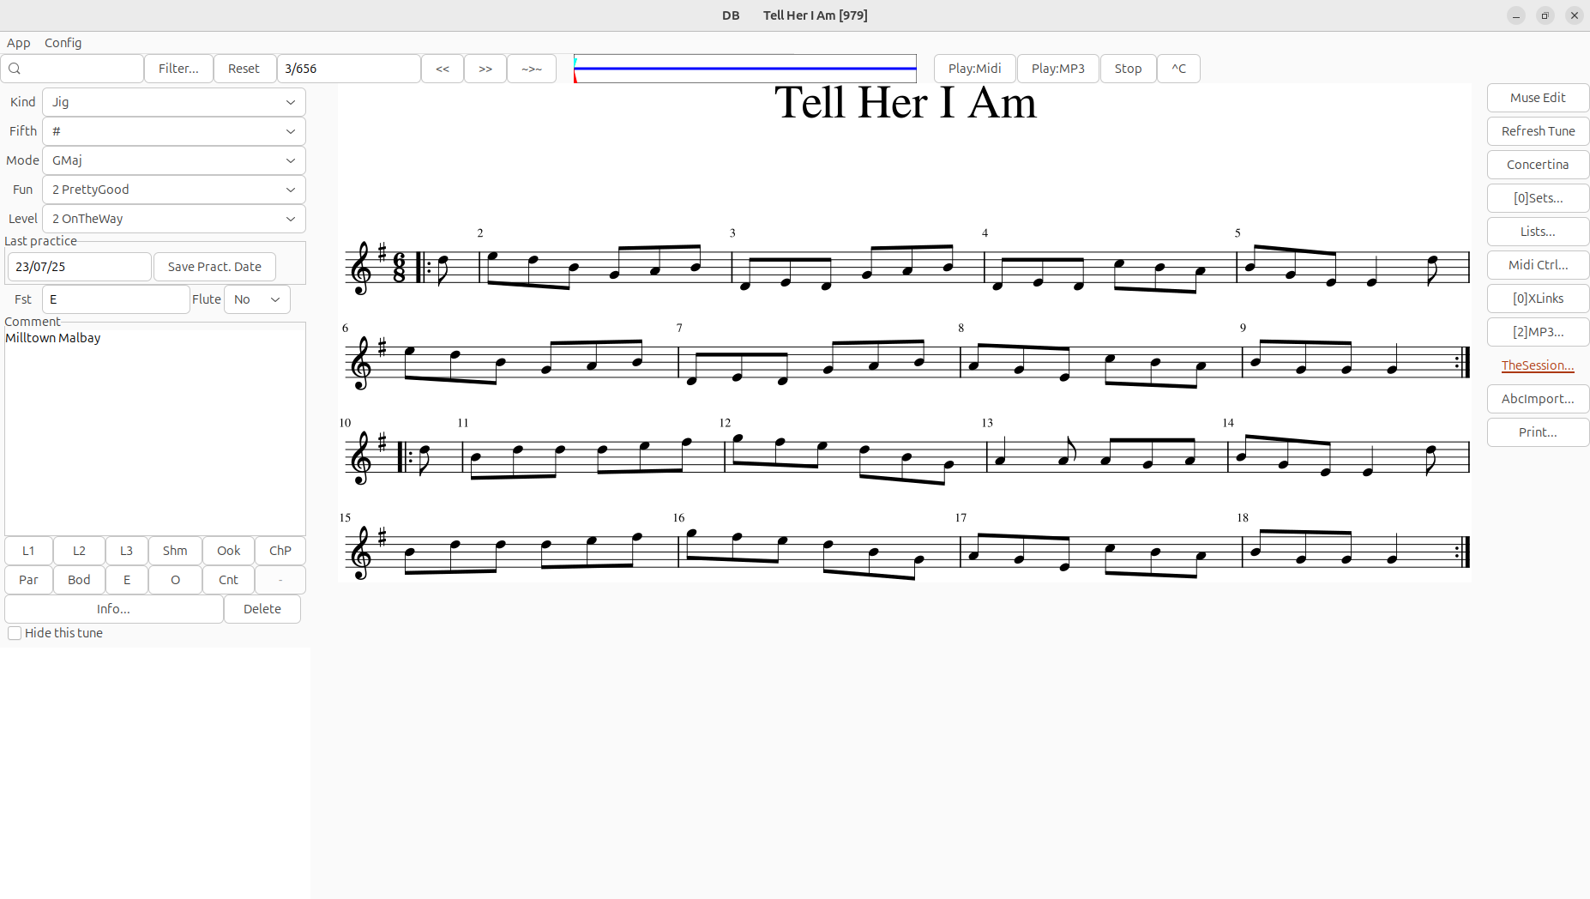
Main Screen
Menu bar
Title bar
Search panel
Quick play panel
Left
panel
Score View
Right
panel

Slide 3
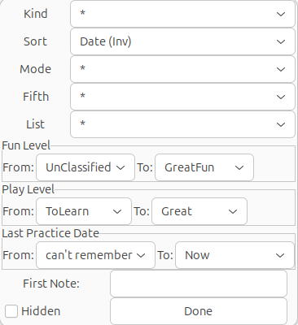
Search panel
Enter keywords
Rank of tune/
Count of found tunes
Previous tune
Next tune
Advance search criteria:
Clear advanced search
Start searching
Include hidden tunes in search

Slide 4
Quick play panel
MIDI play the tune
Stop MIDI/MP3
Copy tune title to clipboard
MP3 Progress bar
Play MP3 (if configured)

Slide 5
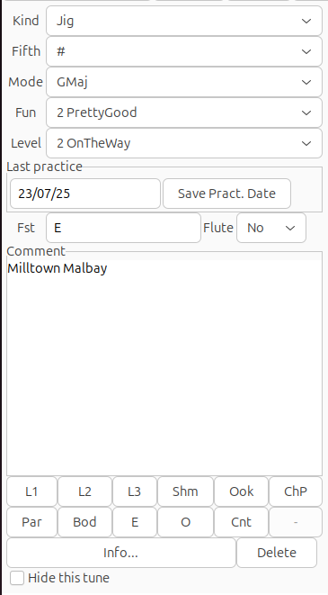
Left panel (Tune information)
Set the kind of tune
Set the mode of the tune
Rate how you like it
Rate how well you play it
Memorize the last time you practice it
Free comment area
Shortcuts to add/remove the tune from lists
Remove the tune from the database
Hide the tune => exclude it from search for any reason (ie: duplacate)

Slide 6
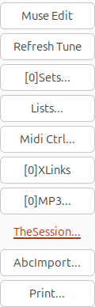
Right panel
Launch MuseScore to edit the tune
Refresh the display after the tune has be edited
Arrange tune sets
Create lists of tunes
MIDI Control Panel
Bookmark links related to the tune (ie: videos)
MP3 Play panel
Shortcuts to “thesession.org”
Import a new tune in ABC format

Slide 7
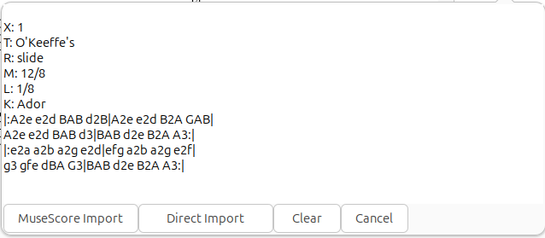
ABC import : Import a new tune
Typical use:
From “thesession.org” (or other), search a tune and copy it in ABC format
Paste it in “Abc Paste area”
ABC
Paste area
“MuseScore Import” Open MuseScore to edit/fix the tune before import.
Tune must be saved in directory related to its type (ie: ~/Music/MuseScore/Slide)
and then repository scanned for import Menu→App→Scan MuseScore Repository
“MuseScore Import” Open MuseScore to edit/fix the tune before import.
Tune must be saved in directory related to its type (ie: ~/Music/MuseScore/Slide)
and then repository scanned for import Menu→App→Scan MuseScore Repository
“Direct Import” : the ABC is converted to MuseScore format and
inserted in the database.

Slide 8
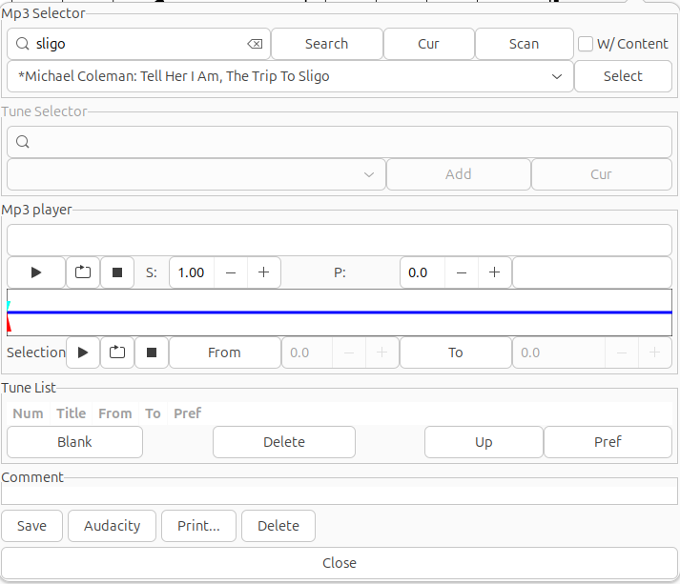
MP3 Panel : 1 Select an MP3
Search key words
Scan local repositories for new MP3
MP3 selection dropbox
Load selected MP3 file

Slide 9
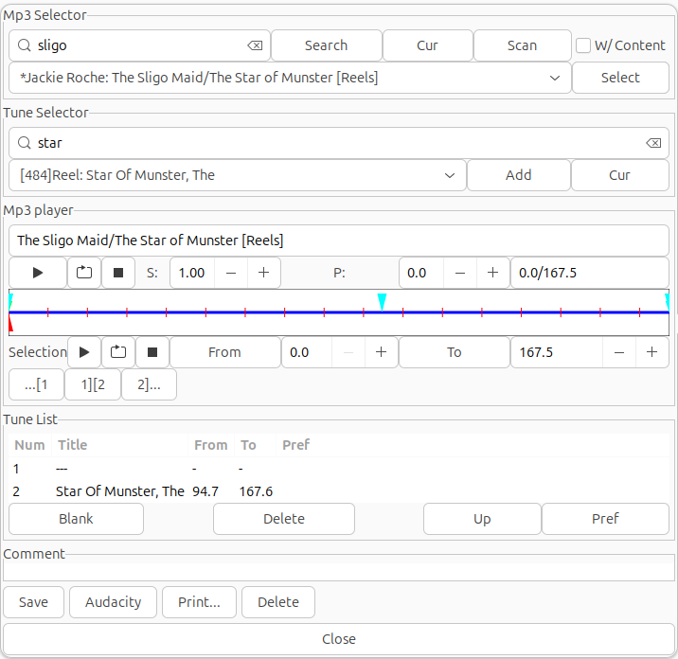
MP3 Panel : 2 Associate tunes to MP3
Enter key words for tune search
Tune selection
Add selected tune
List of tunes associated to MP3 file
For tune reordering
Save button

Slide 10
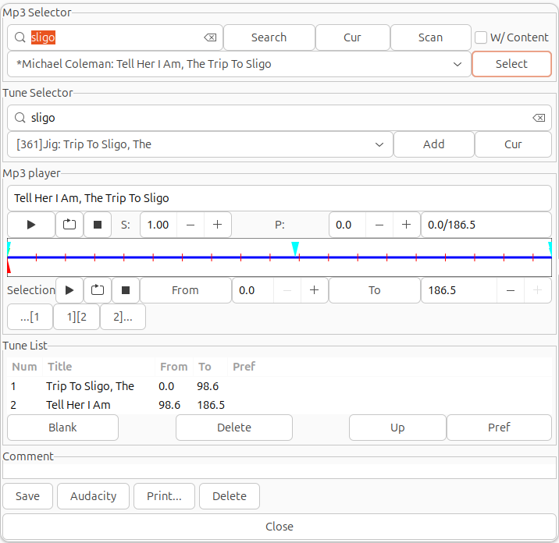
MP3 Panel : 3 Set tune boundaries
Click on progress bar to play the MP3
Set tune boundaries while playing:
When you hear the transition from one tune to another click on the button that set this transition
For example, “1][2” must be clicked when your hear the transition from the first tune to the second tune of the set
If adjustment is needed, click again on the progress bar before the boundary to set again the transition
Save it when OK

Slide 11
MP3 Panel : 4 Play the MP3
Play all MP3 once
Loop play the MP3
Speed adjustment
Pitch adjustment
Double click on the tune
to play the tune in loop
Set the preferred version (=>Quick play)

Slide 12
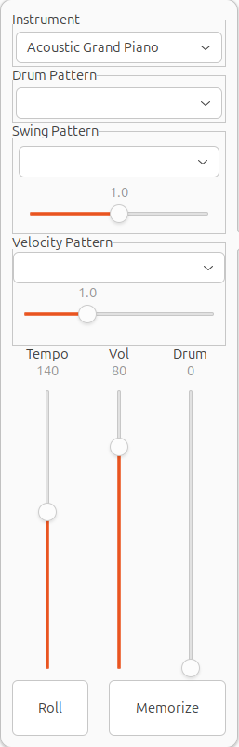
Midi Control
Instrument Selection
Add drum sequence (experimental)
Swing to be described
Stress pattern to be described
Change Tempo (Number of crotchets per minute (will change to true BPM some day))

