Slide 1




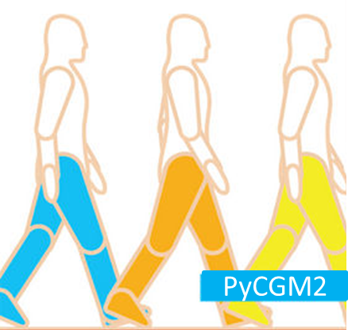
PyCGM2

Slide 2
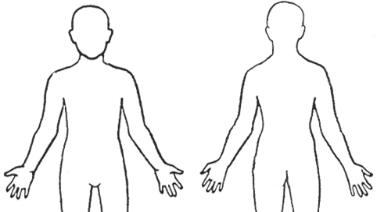
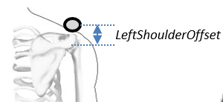
RPSI
LPSI
RASI
Calibration only
LASI
Optional
LTHAP
LTHI
LTHAD
LKNM
LKNE
LTIAP
LTIB
LTIAD
LMED
LHEE
LANK
LTOE
LBHD
RBHD
LSHO
C7
RBAK
CLAV
T10
STRN
LELB
LWRA
LWRB
LFIN
CGM2.3 marker set

Slide 3
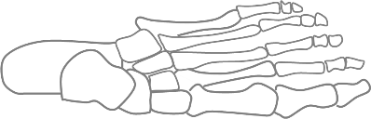
RPSI
LPSI
RASI
Calibration only
LASI
Optional
LTHAP
LTHI
LTHAD
LTOE
LVMH
LSMH
LKNM
LKNE
LTIAP
LFMH
LTIB
LTIAD
LMED
LHEE
LFMH
LTOE
LANK
LSMH
LVMH
LVMH
LBHD
RBHD
LSHO
C7
RBAK
CLAV
T10
STRN
LELB
LWRA
LWRB
LFIN
CGM2.4 marker set

Slide 4
RPSI
LPSI
RASI
Calibration only
LASI
Optional
LTHAP
LTHI
LTHAD
LTOE
LVMH
LSMH
LKNM
LKNE
LTIAP
LFMH
LTIB
LTIAD
LMED
LHEE
LFMH
LTOE
LANK
LSMH
LVMH
LVMH
GLAB
LMAS
RMAS
LSHO
T2
RBAK
CLAV
T10
LELB
LWRA
LWRB
LFIN
CGM2.5 marker set

