Slide 1
Model generation from scratch
Model generation from existing settings/data structures
Preliminary activities
1. Conceptual model definition
cvxlab.create_model_dir()
2. Generation of model directory
User data input
3. Fill model setup file/s
CVXlab model generation
model = cvxlab.Model()
4. Generation of model class instance
User data input
5. Fill sets data (model coordinates)
model.load_model_coordinates()
model.initialize_blank_data_structure()
6. Initialization of data structures
model.generate_input_data_files()
User data input
7. Fill/update exogenous model data
model.load_exogenous_data_to_sqlite_database()
model.initialize_problems()
8. Initialization of numerical problem/s
model.update_database_and_problem()
Model solution and results export
model.run_model()
9. Solution of numerical problem/s
model. load_results_to_database()
10. Export endogenous model data

Slide 2



Model()
Constants()
Logger()
FileManager()
Core()
PBIManager()
Logger()
Logger()
FileManager()
Logger()
SQLManager()
Index()
Database()
Problem()
Logger()
Logger()
FileManager()
Logger()
FileManager()
SQLManager()
Index()
Logger()
FileManager()
Index()
SetTable()
DataTable()
Variable()
Logger()
Logger()
Logger()
cvxlab.Model
cvxlab.Model.Core
Iteration
$$1$$
Endogenous / exogenous data exchange
Iteration
$$2$$
Iteration
$$2$$
Energy
model
Energy
model
Energy
model
Exogenous
parameters
(first guesses)
Economic
model
Economic
model
Economic
model
Database 1
Database 2
Database 3
Calculation of Norms, check for numerical convergence

Slide 3
Conceptual model definition
Generation of model directory
cvxlab.create_model_dir()
User data input
Fill model setup file/s
Model class instance generation
model = cvxlab.Model()
User data input
Fill sets data (model coordinates)
Initialization of data structures
model.initialize_model_environment()
User data input
Fill/update exogenous model data
Initialization of numerical problem/s
model.refresh_database_and_initialize_problem()
Solution of numerical problem/s
model.run_model()
Export endogenous model data
model.load_results_to_database()
Model class instance generation
model = cvxlab.Model(use_existing_data=True)
User data input
(updating existing data)
Fill/update exogenous model data
model.generate_input_data_files(...)
Initialization of numerical problem/s
model.refresh_database_and_initialize_problem()
Solution of numerical problem/s
model.run_model()
Export endogenous model data
model.load_results_to_database()

Slide 4





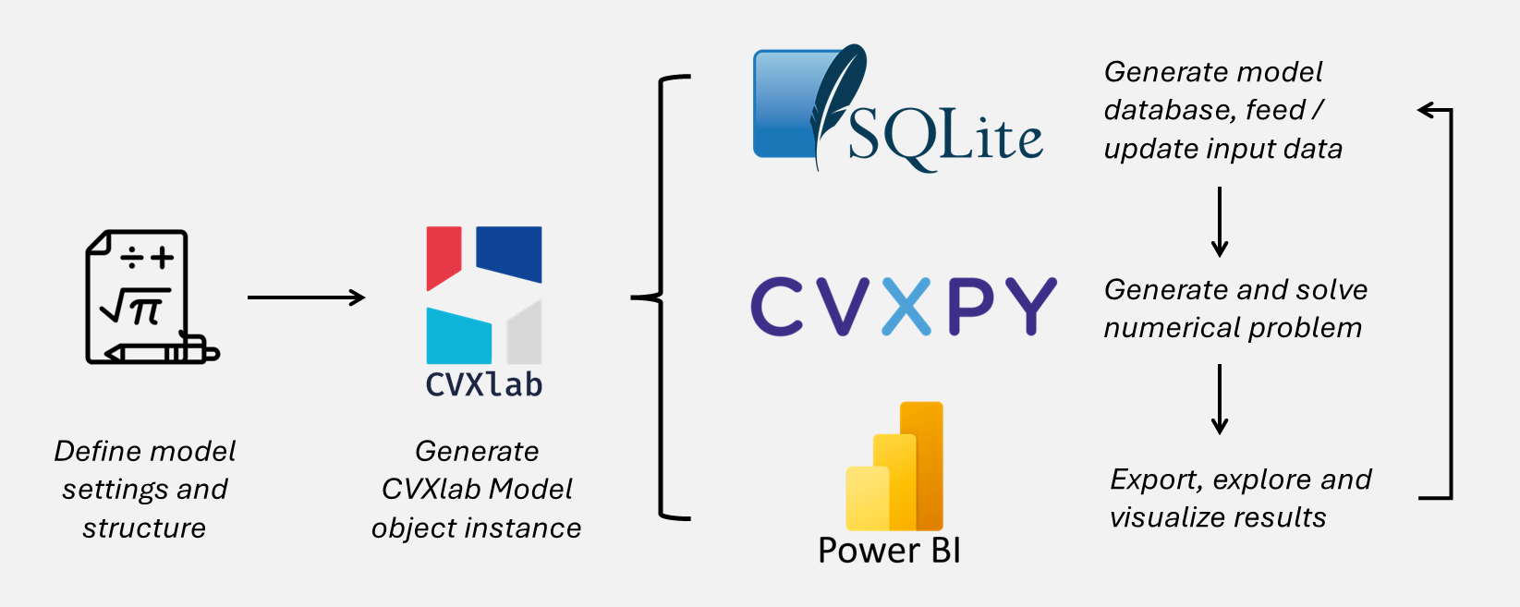

Generate model database, feed / update input data
Generate and solve numerical problem
Define model settings and structure
Generate CVXlab Model object instance
Export, explore and visualize results

