Slide 1
GSA Theory and Implementation in CVXLab
24.04.2025| Valeria Baiocco

Slide 2

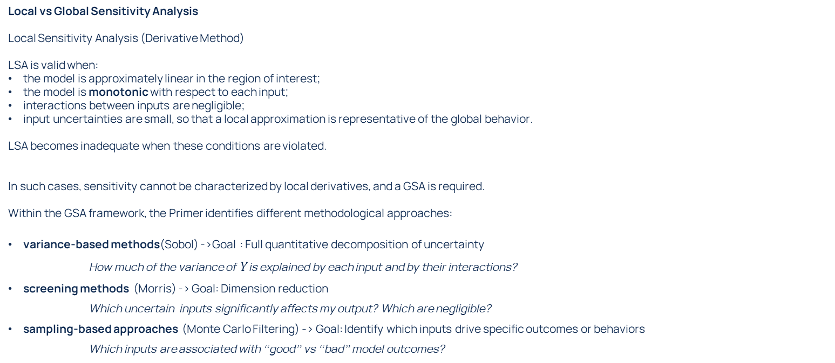

GSA - Theory
A monotonic model is a model in which the output $Y$ changes consistently in one direction as an input $X_{i}$varies, while all other inputs are held fixed.
Formally, for each input $X_{i}$:
the model is monotonically increasing in $X_{i }:$if increasing $X_{i}$never decreases $Y$;
the model is monotonically decreasing in $X_{i }:$if increasing $X_{i}$never increases $Y$.
This implies that the sign of the partial derivative:
$$\frac{∂Y}{∂X_{i}}$$
remains constant over the input space.
In practical terms, monotonicity means that the effect of an input on the output is directionally stable and does not depend on where you are in the input space.
Local vs Global Sensitivity Analysis
Local Sensitivity Analysis (Derivative Method)
LSA is valid when:
the model is approximately linear in the region of interest;
the model is monotonic with respect to each input;
interactions between inputs are negligible;
input uncertainties are small, so that a local approximation is representative of the global behavior.
LSA becomes inadequate when these conditions are violated.
In such cases, sensitivity cannot be characterized by local derivatives, and a GSA is required.
Within the GSA framework, the Primer identifies different methodological approaches:
variance-based methods(Sobol) ->Goal : Full quantitative decomposition of uncertainty
How much of the variance of $Y$is explained by each input and by their interactions?
screening methods (Morris) -> Goal: Dimension reduction
Which uncertain inputs significantly affects my output? Which are negligible?
sampling-based approaches (Monte Carlo Filtering) -> Goal: Identify which inputs drive specific outcomes or behaviors
Which inputs are associated with “good” vs “bad” model outcomes?

Slide 3
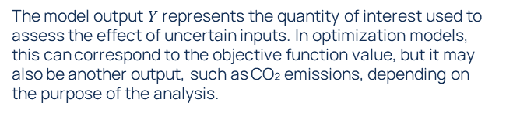
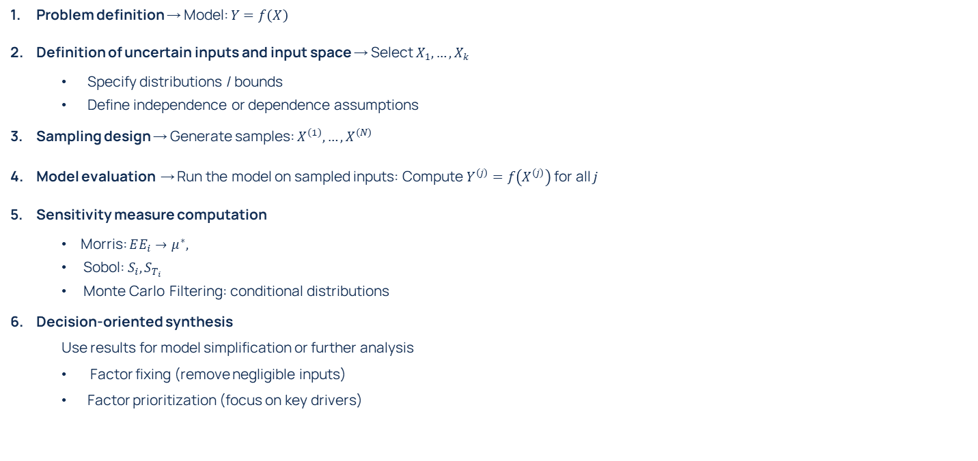
Operationalizing GSA
One-At-a-Time Sampling
Vary one input at a time while keeping others fixed, typically along trajectories in the input space. Computationally efficient but explore only a small portion of the space. They are mainly used in screening methods (e.g. Morris)
Fractional Factorial Sampling This is a structured design derived from full factorial experiments, where only a fraction of all possible combinations of input levels is evaluated. It allows estimation of main effects and some interactions with fewer runs than a full design. It is appropriate when inputs take a limited number of discrete levels and when interactions are assumed to be limited or structured.
Latin Hypercube Sampling (LHS) LHS is a stratified sampling method where each input range is divided into intervals and sampled once per interval. This ensures that each input is well covered across its range. It is used when the goal is to efficiently explore the input space and obtain stable estimates of output statistics with fewer samples than random sampling.
Multivariate Stratified Sampling This extends stratification to the joint input space rather than treating each variable independently. The space is partitioned into multidimensional regions (strata), and samples are drawn from each. It improves coverage of the joint space but becomes difficult to implement as dimensionality increases. It is mainly conceptual and less commonly used in high-dimensional problems.
Quasi-random Sampling (Low-discrepancy sequences) These are deterministic sequences designed to fill the input space more uniformly than random samples. They aim to reduce clustering and improve convergence of estimates. They are used in variance-based methods (e.g. Sobol indices), where good space-filling properties are important for accurate estimation.
Sampling Techniques:
One-At-a-Time sampling
Fractional Factorial Sampling
Latin Hypercube Sampling
Multivariate Stratified Sampling
Quasi-random Sampling
Problem definition → Model: $Y=f\left(X\right)$
Definition of uncertain inputs and input space → Select $X_{1},…,X_{k}$
Specify distributions / bounds
Define independence or dependence assumptions
Sampling design → Generate samples: $X^{\left(1\right)},…,X^{\left(N\right)}$
Model evaluation → Run the model on sampled inputs: Compute $Y^{\left(j\right)}=f\left(X^{\left(j\right)}\right)$ for all $j$
Sensitivity measure computation
Morris: $EE_{i}→μ^{∗},$
Sobol: $S_{i},S_{T_{i}}$
Monte Carlo Filtering: conditional distributions
Decision-oriented synthesis
Use results for model simplification or further analysis
Factor fixing (remove negligible inputs)
Factor prioritization (focus on key drivers)
The model output $Y$represents the quantity of interest used to assess the effect of uncertain inputs. In optimization models, this can correspond to the objective function value, but it may also be another output, such as CO₂ emissions, depending on the purpose of the analysis.

Slide 4

What is available in SALib
The features available in SALib are sufficient to perform the type of GSA needed in our field.
Problem definition → Model: $Y=f\left(X\right)$
Definition of uncertain inputs and input space → Select $X_{1},…,X_{k}$
Specify distributions / bounds
Define independence or dependence assumptions
Sampling design → Generate samples: $X^{\left(1\right)},…,X^{\left(N\right)}$
Model evaluation → Run the model on sampled inputs: Compute $Y^{\left(j\right)}=f\left(X^{\left(j\right)}\right)$for all $j$
Sensitivity measure computation
Morris: $EE_{i}→μ^{∗},$
Sobol: $S_{i},S_{T_{i}}$
Monte Carlo Filtering: conditional distributions
Decision-oriented synthesis
Use results for model simplification or further analysis
Factor fixing (remove negligible inputs)
Factor prioritization (focus on key drivers)
Sampling Techniques:
One-At-a-Time sampling
Fractional Factorial Sampling
Latin Hypercube Sampling
Multivariate Stratified Sampling
Quasi-random Sampling

Slide 5
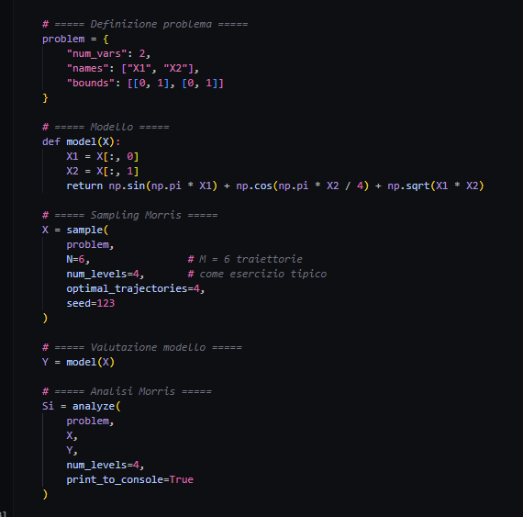
GSA in SALib
1
1
Provide uncertain inputs info, format: dictionary
sample inputs
run model, ouput: array of Y values
calculate sensitivity measures of Y
2
3
4

Slide 6

Operationalizing GSA in CVXLab
cut the variable as needed, i.e only in model years (25-50) the variable is uncertain
model = cl.Model(
model_dir_name=model_dir_name,
main_dir_path=root_path,
log_level='debug',
model_settings_from='xlsx',
multiple_input_files=True,
use_existing_data=False,
detailed_validation=True,
)
To do: add a GSA: True option that activates the GSA features
specify which coordinates I want to have in my GSA bound inputs, activates if not empty
To do: add 2 columns in sheet variables
select which tables are uncertain, column name: is_uncertain, value: uncertain coordinates
select which model outputs use for sensitivity measures computation, column name: GSA_measure, value: True/False
model_settings.xlsx
sheet: variables
model.load_model_coordinates()
model.initialize_blank_data_structure(GSA=True)
l'idea sarebbe creare una nuova classe dentro Core che Class: Uncertainty_manager che si occupa di gestire tutte le task in piu che ci sono in piu nel caso in cui rispetto ad un modello normale voglio fare una GSA le altre classi dentro core dovrebbero essere toccate il meno possibile, bisognrebbe usare i metodi e lo stesso procsesso esistente ma con una struttra diversa (i.e. db, modell settings) if GSA = True dove le differenze struttrali princpalmente sono controllate dai default La Classe GSA Manager si occupa di tutte le task della GSA richiamano Database e Problem quando serve La cosa che devo inquadrare meglio

Slide 7
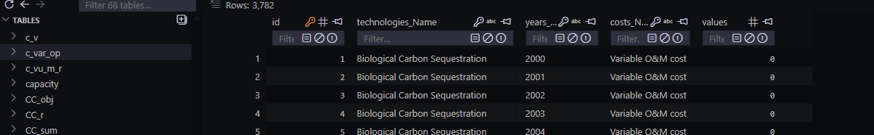
Operationalizing GSA in CVXLab
problem = {
"num_vars": 2,
"names": ["X1", "X2"],
"bounds": [[0, 1], [0, 1]],
“groups": [“G1”, “G2]
}
GSA Step 1: call SALib to sample the data
To do: implement a class function that takes the lb and ub values and creates a dictionary to feed SALib
- add possibility to group techs according to _agg that is specified in model settings
model.create_uncertain_params_dict()
model.sample(method=“Morris”)
from SALib.sample.morris import sample
X0 = sample(problem2, N=6, num_levels=4, seed=123)
To do: implement a class function that allows to select the sampling method and samples the data
Save the sampled data in a database_GSA.db
model.load_sampled_data_to_sqlite_database()
Add: Sample id
Sampled value
Table: uncertain variable
Table: GSA Measure
Run the model for each sample id
model.load_exogenous_data_to_sqlite_database()
Load deterministic data that do not change between runs
for r in [1, …, n_runs]
model.load_sampled_data_to_sqlite_database()
model.initialize_problems()
model.run_model()
model.load_measures_to_GSA_database()
Si = analyze(…)
Load sample_id=r data from GSA.db to database.db and run model and run model
Save the selected measures (listed in model settings) to GSA.db
Calcualte sensitivity indexes from GSA.db save indexed in xlsx or txt

Slide 8
1. Modifiche al file model settings
file model_settings.xlsx contiene le info su sets, variabili e problema
nel file model_settings.xslx ora nel foglio structure_variables ci saranno due nuove colonne:
is_uncertain: True/False che mi dice se la variabile (quindi quello che trovo nella colonna variables_info) è incerta o deterministica. Se is_uncertain è True allora nei dati di input dovrò dare oltre al valore di reference anche l'upper e lower bound, se è False non fa niente
GSA_measure: True/False che dice se la variabile serve per fare la sensitivity measure o no.Se is GSA_measure è True allora quel parametro deve essere salvato per ogni run del modello e deve essere uno scalare( non posso salvare tutti i risultati del modello per tutte le variabili per tutte le run perchè occupano troppa memoria), se è False non fa niente
2. Lettura del file model settings
cambiare la struttura della classe che legge il file di model settings in modo che sia adatta ad ricevere anche le colonne is_uncertain e GSA_measure, applicare a queste colonne la stessa logical della colonna nonneg in cui i booleani vengono letti in modo appropriato
3. Generazione input data
aggiungere alle colonne di default degli input data una colonna che si chiama type
per le tabelle (identificate da table_key in model_settings.xlsx file structure_variables) che non hanno nessuna variable incerta la tabella avrà in type sempre deterministic
per le tabelle che hanno variabili incerte (quindi hanno is_uncertain=True) nel file di input data avranno per lo stesso dato in type: deterministic, lower bound and upper bound (fondamentalmente per ogni variabile devo dare in input 3 dati invece che 1) 4. lettura file input data e creazione database
creazione database con nuova struttura speculare a quello che cambia in input data

Slide 9
Architecture
Model
Logger
File Manager
Core
SQL Manager
Index
Set Table
Data Table
Variable
Database
Problem
Uncertainty

Slide 10
lettura file con nuove colonne
Index.load_and_validate_structure(): carica sets e data_tables dal model_settings, sceglie la validation structure e poi istanzia DataTable/SetTable -> aggiungere validation structure per self.settings['Uncertainty'] is True
FileManager.load_data_structure(): richiamato dentro Index da FileManager, per YAML legge direttamente il .yml; per Excel legge il tab del setup, normalizza il dataframe e lo converte in dizionario con util.pivot_dataframe_to_data_structure(). Questo è il metodo che deve “vedere” correttamente le due nuove colonne Excel.
FileManager.validate_data_structure(): questo blocca le chiavi inattese. Quindi se is_uncertain e uncertainty_measure non sono nella validation structure usata in quel momento, fallisce.
Index.check_data_coherence(): anche se la validazione passa, questo controllo può ancora considerare quelle due proprietà come non ammesse dentro variables_info. Qui vanno aggiunte alle proprietà “speciali” consentite, insieme a value, blank_fill, nonneg.
Variable.rearrange_var_info(): è il metodo che prende le informazioni grezze da var_info e le porta negli attributi dell’oggetto Variable. Ora legge value, blank_fill, nonneg; deve leggere anche is_uncertain e uncertainty_measure.

Slide 11
creazione database
Model._initialize_blank_data_structure()
Database.generate_blank_sqlite_data_tables() importa i set nel db (dovrebbe andare bene così com’è)
Database.generate_blank_sqlite_data_tables(self) crea tabelle per table_key = Tab_i, mette come table_headers quello che trova nelle coordinate (la clolonna values la aggiunge dopo)
Database.sets_data_to_sql_data_tables() → generazione delle righe, prodotto cartesiano coordinate variabile, alla fine aggiugne la colonan values, ora se nella tabella c’è almeno una variabile incera aggiungerà anche le colonne upper_bound, e lower_bound e la colonna is_uncertain
Database.generate_blank_data_input_files() → export dei file input a partire della struttura del db, quindndi una volta sistemato db non dovrebbe cambiare niente
DataTable.fetch_tables_headers() / completamento data tables in Index.data_tables_completion() → da dove arrivano concretamente gli header delle data tables

Slide 12
Creazione e risoluzione problema normale
Model.refresh_database_and_initialize_problem()
├─ _load_exogenous_data_to_sqlite_database()
│ ├─ Database.load_data_input_files_to_database()
│ └─ Database.fill_nan_values_in_database()
└─ _initialize_problems()
├─ Core.load_and_validate_symbolic_problem()
├─ Core.check_exogenous_data_coherence()
└─ Core.generate_numerical_problem()
├─ Core.initialize_problems_variables()
├─ Core.data_to_cvxpy_exogenous_vars()
└─ Problem.generate_numerical_problems()
Model.run_model()
└─ Core.solve_numerical_problems()
Model.load_results_to_database()
└─ Core.cvxpy_endogenous_data_to_database()

Slide 13
note
Model.refresh_database_and_initialize_problem()
├─ _load_exogenous_data_to_sqlite_database() OK
│ ├─ Database.load_data_input_files_to_database()
│ └─ Database.fill_nan_values_in_database()
└─ _initialize_problems()
├─ Core.load_and_validate_symbolic_problem() loading and validation of symbolic problem, coherence check between data tablese and probkem definitions check_data_tables_and_problem_coherence
├─ Core.check_exogenous_data_coherence() checks that there are no NULL entries in the values
└─ Core.generate_numerical_problem()
├─ Core.initialize_problems_variables() pass from data table to cvxpy variable structure to fill
├─ Core.data_to_cvxpy_exogenous_vars() Fetch data from the database and assign it to cvxpy exogenous variables
└─ Problem.generate_numerical_problems() Generate numerical problems from symbolic problem.
Model.run_model()
└─ Core.solve_numerical_problems()
Model.load_results_to_database()
└─ Core.cvxpy_endogenous_data_to_database()

Slide 14
Creazione e risoluzione problema GSA
model.UncertaintyAnalysis()
|--- model.core.uncertainty.validate_sampling_config()
|--- model.uncertainty_analysis = UncertaintyAnalysisConfig(…)
model. run_uncertainty_analysis()
|--- model._sample_data()
|---model.core.uncertainty.sample_data()
|---model.core. load_and_validate_symbolic_problem()
├─ Core. check_exogenous_data_coherence(is_uncertain=True)
|--- model.core.initialize_problems_variables()
|--- model. data_to_cvxpy_exogenous_vars(deterministic_vars)
for run_id in n_runs:
|--- model. data_to_cvxpy_exogenous_vars(uncertain_vars, is_uncertain=True)
|--- core.uncertainty.inject_sampled_values()
|--- model.core.problem.generate_numerical_problems(force_overwrite=True) |--- model.core.solve_numerical_problems()

Slide 15
model.UncertaintyAnalysis()
|--- model.core.uncertainty.validate_sampling_config()
|--- model.uncertainty_analysis = UncertaintyAnalysisConfig(...)
model.run_uncertainty_analysis()
|--- samples_df = model._sample_data()
|--- mapping_df = model.core.uncertainty.collect_uncertain_parameters()
|--- model.core.load_and_validate_symbolic_problem()
|--- model.core.check_exogenous_data_coherence(is_uncertain=True, samples_df=..., mapping_df=...)
|--- model.core.initialize_problems_variables()
|--- deterministic_cache = model.core.build_deterministic_exogenous_data_cache(mapping_df)
for run_id in run_ids:
|--- model.core.data_to_cvxpy_exogenous_vars_for_run(
run_id,
samples_df,
mapping_df,
deterministic_cache,
)
|--- model.core.problem.generate_numerical_problems(force_overwrite=True)
|--- model.core.solve_numerical_problems(...)
|--- model._save_uncertainty_run_outputs(run_id)

Slide 16
error managment da mettere
model = cvxlab.Model(
log_level='debug',
use_existing_data=False,
detailed_validation=True,
GSA=True
)
cvxlab.create_model_dir(
settings_file_type='xlsx',
include_user_defined_templates=True,
GSA=True
se a uno metto GSA=True e all’altro no mi deve dire ao che vuoi fare
c’è lo stesso problema per settings_file_type
caso in cui faccio mode.run normale ma ho input data con bouds, fare che gira caso derterministico solo se ho messo i values in tutti gli input data

Slide 17
pacchetti aggiunti
Salib
pyarrow
fastparquet

