Slide 1
Cython
Notes:
[toc]
level = 1
title = Cython
# end config

Slide 2
Cython by example
PYTHON
C / C++
def fib(n):
a,b = 0,1
for i in range(n):
a, b = a+b, a
return a
int fib(int n)
{
int tmp, i, a=0, b=1;
for(i=0; i<n; i++) {
tmp = a; a += b; b = tmp;
}
return a;
}

Slide 3
Cython by example
PYTHON
C / C++
def fib(n):
a,b = 0,1
for i in range(n):
a, b = a+b, a
return a
int fib(int n)
{
int tmp, i, a=0, b=1;
for(i=0; i<n; i++) {
tmp = a; a += b; b = tmp;
}
return a;
}
CYTHON
def fib(int n):
cdef int i, a, b
a,b = 0,1
for i in range(n):
a, b = a+b, a
return a

Slide 4
Cython by example
PYTHON 1x
C / C++ 70x faster
def fib(n):
a,b = 0,1
for i in range(n):
a, b = a+b, a
return a
int fib(int n)
{
int tmp, i, a=0, b=1;
for(i=0; i<n; i++) {
tmp = a; a += b; b = tmp;
}
return a;
}
CYTHON 70x faster
def fib(int n):
cdef int i, a, b
a,b = 0,1
for i in range(n):
a, b = a+b, a
return a

Slide 5
For the record...
HAND-WRITTEN EXTENSION MODULE
#include "Python.h"
static PyObject* fib(PyObject *self, PyObject *args)
{
int n, a=0, b=1, i, tmp;
if (!PyArg_ParseTuple(args, "i", &n))
return NULL;
for (i=0; i<n; i++) {
tmp=a; a+=b; b=tmp;
}
return Py_BuildValue("i", a);
}
static PyMethodDef ExampleMethods[] = {
{"fib", fib, METH_VARARGS, ""},
{NULL, NULL, 0, NULL} /* Sentinel */
};
PyMODINIT_FUNC
initfib(void)
{
(void) Py_InitModule(“fib", ExampleMethods);
}

Slide 6
For the record...
HAND-WRITTEN EXTENSION MODULE 40x faster
#include "Python.h"
static PyObject* fib(PyObject *self, PyObject *args)
{
int n, a=0, b=1, i, tmp;
if (!PyArg_ParseTuple(args, "i", &n))
return NULL;
for (i=0; i<n; i++) {
tmp=a; a+=b; b=tmp;
}
return Py_BuildValue("i", a);
}
static PyMethodDef ExampleMethods[] = {
{"fib", fib, METH_VARARGS, ""},
{NULL, NULL, 0, NULL} /* Sentinel */
};
PyMODINIT_FUNC
initfib(void)
{
(void) Py_InitModule(“fib", ExampleMethods);
}

Slide 7
What is Cython?
Cython is a Python-like language that:
Improves Python’s performance: 1000x speedups not uncommon
wraps external code: C, C++, Fortran, others...
The cython command:
generates optimized C or C++ from Cython source,
the C/C++ source is then compiled into a Python extension module.
Other features:
built-in support for NumPy,
integrates with IPython,
Combine C’s performance with Python’s ease of use.
http://www.cython.org/

Slide 8
Cython in the wild
Project | Cython files | KLOC
sage | 761 | 420
numpy | 14 | 5.6
scipy | 28 | 19
pandas | 21 | 24
sympy | 12 | 12 (cythonized python)
scikits-learn | 35 | 10
scikits-image | 48 | 10
mpi4py | 48 | 12
Projects master branches as of July 1, 2013

Slide 9
Speed up Python
GENERATED C
PYTHON
static PyObject *__pyx_pf_5cyfib_cyfib(PyObject *__pyx_self, int __pyx_v_n) {
int __pyx_v_a; int __pyx_v_b;
PyObject *__pyx_r = NULL; PyObject *__pyx_t_5 = NULL;
const char *__pyx_filename = NULL;
...
for (__pyx_t_1=0; __pyx_t_1<__pyx_t_2; __pyx_t_1+=1) {
__pyx_v_i = __pyx_t_1;
__pyx_t_3 = (__pyx_v_a + __pyx_v_b);
__pyx_t_4 = __pyx_v_a;
__pyx_v_a = __pyx_t_3;
__pyx_v_b = __pyx_t_4;
}
...
}
def fib(n):
a,b = 0,1
for i in range(n):
a, b = a+b, a
return a
CYTHON
def fib(int n):
cdef int i, a, b
a,b = 0,1
for i in range(n):
a, b = a+b, a
return a

Slide 10
Wrap C / C++
GENERATED WRAPPER
C / C++
static PyObject *__pyx_pf_5cyfib_cyfib(PyObject *__pyx_self, int __pyx_v_n) {
int __pyx_v_a; int __pyx_v_b;
PyObject *__pyx_r = NULL; PyObject *__pyx_t_5 = NULL;
const char *__pyx_filename = NULL;
...
for (__pyx_t_1=0; __pyx_t_1<__pyx_t_2; __pyx_t_1+=1) {
__pyx_v_i = __pyx_t_1;
__pyx_t_3 = (__pyx_v_a + __pyx_v_b);
__pyx_t_4 = __pyx_v_a;
__pyx_v_a = __pyx_t_3;
__pyx_v_b = __pyx_t_4;
}
...
}
int fact(int n)
{
if (n <= 1)
return 1;
return n * fact(n-1);
}
CYTHON
cdef extern from “fact.h”:
int _fact “fact”(int)
def fact(int n):
return _fact(n)

Slide 11
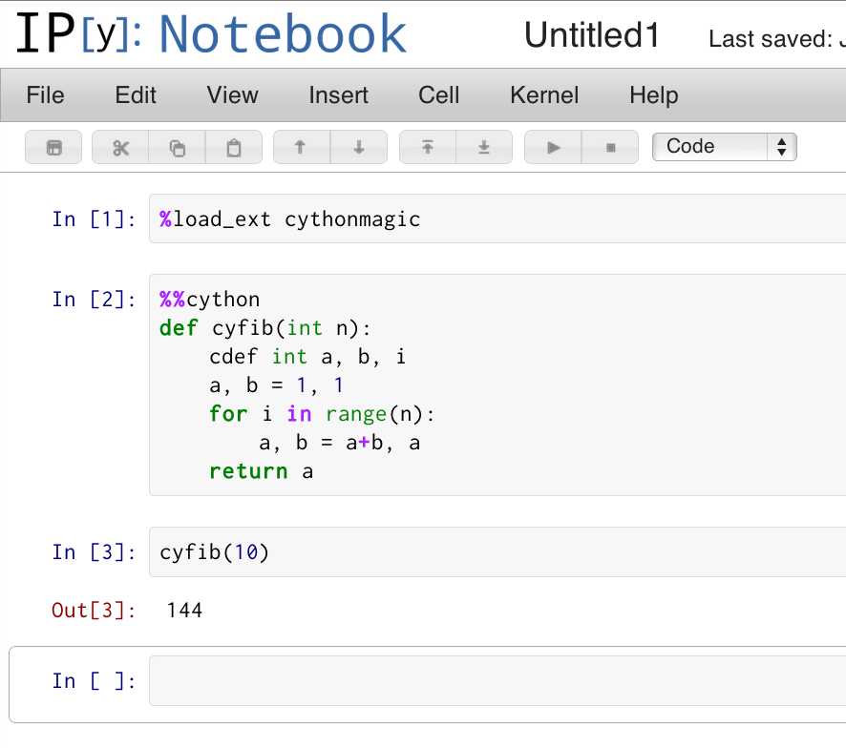
Cython + IPython
IPython provides cython magic commands, the most useful of which is %%cython.
IPYTHON / IPYTHON NOTEBOOK
In [10]: %load_ext cythonmagic
In [11]: %%cython
....: def cyfib(int n):
....: cdef int a, b, i
....: a, b = 0, 1
....: for i in range(n):
....: a, b = a+b, a
....: return a
....:
In [12]: cyfib(10)
Out[12]: 55

Slide 12
Cython pyx files
cython generates this.
Cython source file
fib.pyx
C Extension File
fib.c
cython
You write this.
compile
Library Files (if wrapping)
Python Extension Module
fib.so
*.h files
*.c files
compile

Slide 13
Compiling with distutils
FIB.PYX
# Define a function. Include type information for the argument.
def fib(int n):
...
SETUP.PY
# Cython has its own "extension builder" module that knows how
# to build cython files into python modules.
from distutils.core import setup
from distutils.extension import Extension
from Cython.Distutils import build_ext
ext = Extension(”fib", sources=[”fib.pyx"])
setup(ext_modules=[ext],
cmdclass={'build_ext': build_ext})

Slide 14
Compiling an extension module
CALLING FIB FROM PYTHON
# Mac / Linux
$ python setup_fib.py build_ext –-inplace
# Windows
$ python setup_fib.py build_ext –-inplace –c mingw32
$ python
>>> import fib
>>> fib.fib()
Traceback (most recent call last):
File "<stdin>", line 1, in ?
TypeError: function takes exactly 1 argument (0 given)
>>> fib.fib("dsa")
Traceback (most recent call last):
File "<stdin>", line 1, in ?
TypeError: an integer is required
>>> fib.fib(3)
2

Slide 15
pyximport
pyximport: import a Cython source file as if it is a pure Python module.
Detects changes in Cython file, recompiles if necessary, loads cached module if not.
Great for simple cases.
RUN_FIB.PY
import pyximport
pyximport.install() # hooks into Python’s import mechanism.
from fib import fib # finds fib.pyx, automatically compiles.
print fib(10)

Slide 16
cdef: declare C-level object
LOCAL VARIABLES
C FUNCTIONS
def fib(int n):
cdef int a, b, i
...
cdef float distance(float *x,
float *y,
int n):
cdef:
int i
float d = 0.0
for i in range(n):
d += (x[i] – y[i])**2
return d
EXTENSION TYPES
cdef class Particle(object):
cdef float psn[3], vel[3]
cdef int id
Typed function arguments are declared without cdef.

Slide 17
def, cdef, cpdef
DEF FUNCTIONS: AVAILABLE TO PYTHON + CYTHON
def distance(x, y):
return np.sum((x-y)**2)
CDEF FUNCTIONS: FAST, LOCAL TO CURRENT FILE
cdef float distance(float *x, float *y, int n):
cdef:
int i
float d = 0.0
for i in range(n):
d += (x[i] – y[i])**2
return d
CPDEF FUNCTIONS: LOCALLY C, EXTERNALLY PYTHON
cpdef float distance(float[:] x, float[:] y):
cdef int i
cdef int n = x.shape[0]
cdef float d = 0.0
for i in range(n):
d += (x[i] – y[i])**2
return d

Slide 18
cimport: access C stdlib functions
# uses Python’s sin implementation
# Incurs Python overhead when calling
from math import sin as pysin
# NumPy’s sin ufunc: fast for arrays, slower for scalars
from numpy import sin as npsin
# uses C stdlib’s sin from math.h: no Python overhead
from libc.math cimport sin
# other headers are supported
from libc.stdlib cimport malloc, free
Notes:
[toc]
level = 2
title = Def vs. CDef
# end config

Slide 19
cimport and pxd files
To reuse Cython code in multiple files, create a pxd file of declarations for a corresponding pyx file and cimport it elsewhere.
FIB.PXD – LIKE C HEADER FILE
USES_FIB.PYX
cdef int fib(int n)
# Access fib() in fib.pyx
from fib cimport fib
def uses_fib(int n):
print "calling fib(%d)" % n
res = fib(n)
print "fib(%d) = %d" % (n, res)
return res
FIB.PYX – LIKE C IMPL. FILE
cdef int fib(int n):
cdef int a, b, i
a, b = 1, 1
for i in range(n):
a, b = a+b, a
return a
PXD FILES PROVIDED WITH CYTHON
from libc.stdlib cimport malloc, free # C std library
cimport numpy as cnp # numpy C-API
from libcpp.vector cimport vector # C++ std::vector
Notes:
[toc]
level = 2
title = Using NumPy with Cython
[exercise]
title = cython
# end config

Slide 20
Wrapping external C functions
LEN_EXTERN.PYX
# First, "include" the header file you need.
cdef extern from "string.h":
# Describe the interface for the functions used.
int strlen(char *c)
def get_len(char *message):
# strlen can now be used from Cython code (but not Python)…
return strlen(message)
CALL FROM PYTHON
>>> import len_extern
>>> len_extern.strlen
Traceback (most recent call last):
AttributeError: 'module' object has no attribute 'strlen'
>>> len_extern.get_len("woohoo!")
7
Notes:
[toc]
level = 2
title = Functions from C Libraries
# end config

Slide 21
Wrapping external C structures
TIME_EXTERN.PYX
cdef extern from "time.h":
# Declare only what is necessary from `tm` structure.
struct tm:
int tm_mday # Day of the month: 1-31
int tm_mon # Months *since* january: 0-11
int tm_year # Years since 1900
ctypedef long time_t
tm* localtime(time_t *timer)
time_t time(time_t *tloc)
def get_date():
""" Return a tuple with the current day, month, and year."""
cdef time_t t
cdef tm* ts
t = time(NULL)
ts = localtime(&t)
return ts.tm_mday, ts.tm_mon + 1, ts.tm_year
CALLING FROM PYTHON
>>> extern_time.get_date()
(8, 4, 2011)
Notes:
[toc]
level = 2
title = Structures from C Libraries
# end config

Slide 22
Python classes, extension types
PYTHON / CYTHON PARTICLE CLASS
class Particle(object): # Inherits from object; can use multiple inh.
def __init__(self, m, p, v): # attributes stored in instance __dict__
self.m = float(m) # creating / updating attribute allowed anywhere.
self.vel = np.asarray(v) # All attributes are Python objects.
self.pos = np.asarray(p)
def apply_impulse(self, f, t): # can be defined in or out of class.
newv = self.vel + t / self.m * f
self.pos = (newv + self.vel) * t / 2.
self.vel = newv
def speed(self):
...
Notes:
[toc]
level = 2
title = Classes
# end config

Slide 23
Python classes, extension types
PARTICLE EXTENSION TYPE IN CYTHON
cdef class Particle: # Creates a new type, like list, int, dict
cdef float *vel, *pos # attributes stored in instance’s struct
cdef public float m # expose variable to Python.
def __cinit__(self, float m, p, v): # allocate C-level data,
self.m = m # called before __init__()
self.vel = malloc(3*sizeof(float))
self.pos = malloc(3*sizeof(float))
# check if vel or pos are NULL...
for i in range(3):
self.vel[i] = v[i]; self.pos[i] = p[i]
cpdef apply_impulse(self, f, t): # methods can be def, cdef, or cpdef.
...
def __dealloc__(self): # deallocate C arrays, called when gc’d.
if self.vel: free(self.vel)
if self.pos: free(self.pos)
Notes:
[toc]
level = 2
title = Classes
# end config

Slide 24
Python classes, extension types
PYTHON CLASS
EXTENSION TYPE
>>> vec = arange(3.)
>>> p = Particle(1.0, vec, vec)
# can access attributes
>>> print p.vel
array([0., 1., 2.]
>>> p.apply_impulse(vec, 1.0)
>>> p.vel
array([0., 2., 4.])
# Can set new attributes.
>>> p.charge = 4.0
>>> vec = arange(3.)
>>> p = Particle(1.0, vec, vec)
# attributes are private by default
>>> print p.vel
AttributeError: ...
# But can access if readonly/public.
>>> print p.m
1.0
# can call def or cpdef methods.
>>> p.apply_impulse(vec, 1.0)
# Cannot set new attributes.
>>> p.charge = 4.0
AttributeError: ...
Notes:
[toc]
level = 2
title = Classes
# end config

Slide 25
Wrap C++ class
PARTICLE_EXTERN.H
class Particle {
public:
Particle(float m, float c, float *p, float *v);
~Particle();
float getMass();
void setMass(float m);
float getCharge();
const float *getVel();
const float *getPos();
void applyImpulse(float *f, float t);
};

Slide 26
Wrap C++ class
PARTICLE.PYX
cdef extern from ”particle_extern.h":
cppclass _Particle “Particle”:
_Particle(float m, float c, float *p, float *v)
float getMass()
void setMass(float m)
float getCharge()
const float *getVel()
const float *getPos()
void applyImpulse(float *f, float t)
# continued on next slide...
Notes:
[toc]
level = 2
title = Classes
# end config

Slide 27
Wrap C++ class
PARTICLE.PYX
cdef class Particle:
cdef _Particle *thisptr # ptr to C++ instance
def __cinit__(self, m, c, float[::1] p, float[::1] v):
if p.shape[0] != 3 or v.shape[0] != 3:
raise ValueError(“...”)
self.thisptr = new _Particle(m, c, &p[0], &v[0])
def __dealloc__(self):
del self.thisptr
def applyImpulse(self, float[::1] v, float t):
self.thisptr.applyImpulse(&v[0], t)
Notes:
[toc]
level = 2
title = Classes
# end config

Slide 28
Wrap C++ class
PARTICLE.PYX
# ...continued
property mass: # Cython-style properties.
def __get__(self):
return self.thisptr.getMass()
def __set__(self, m):
self.thisptr.setMass(m)
Notes:
[toc]
level = 2
title = Classes
# end config

Slide 29
Classes from C++ libraries
SETUP.PY
from distutils.core import setup
from Cython.Distutils import build_ext
from distutils.extension import Extension
sources = [‘particle.pyx’, particle_extern.cpp’]
setup(
ext_modules=[Extension(”particle",
sources=sources, language="c++")],
cmdclass = {'build_ext': build_ext}
)

Slide 30
Classes from C++ libraries
CALLING FROM PYTHON
>>> p = Particle(1.0, 2.0, arange(3.), arange(1., 4.))
>>> print p.mass # can access a __get__-able property.
1.0
>>> p.mass = 5.0 # can assign to a __set__-able property.
>>> p.apply_impulse(arange(3.), 1.0)
>>> del p # calls __dealloc__(), which calls C++ delete.

Slide 31
Cython, NumPy, memoryviews
Typed memoryviews allow efficient access to memory buffers (such as NumPy arrays) without any Python overhead.
TYPED MEMORYVIEWS
def sum(double[::1] a): # a: contiguous 1D buffer of doubles.
cdef double s = 0.0
cdef int i, n = a.shape[0]
for i in range(n):
s += a[i]
return s
USE JUST LIKE NUMPY ARRAYS
In[1]: from mysum import sum
In[2]: a = arange(1e6)
In[3]: %timeit sum(a)
1000 loops, best of 3: 998 us per loop
In[4]: %timeit a.sum()
1000 loops, best of 3: 991 us per loop
Notes:
[toc]
level = 2
title = Using NumPy with Cython
[exercise]
title = cython
# end config

Slide 32
Cython, NumPy, memoryviews
ACQUIRING BUFFERS
cdef int[:, :, :] mv # a 3D typed memoryview, can be assigned to...
# 1: a C-array:
cdef int a[3][3][3]
# 2: a NumPy-array:
a = np.zeros((10,20,30), dtype=np.int32)
# 3: another memoryview
cdef int[:, :, :] a = b
USING MEMORYVIEWS
# indexing like NumPy, but faster, at C-level.
mv[1,2,0] # → integer
# Slicing like NumPy, but faster.
mv[10] == mv[10, :, :] == mv[10,...] # → a new memoryview.
Notes:
[toc]
level = 2
title = Using NumPy with Cython
[exercise]
title = cython
# end config

Slide 33
Cython, NumPy, memoryviews
STRIDED AND CONTIGUOUS MEMORYVIEWS
# uses strided lookup when indexing
cdef int[:, :, :] strided_mv
# can acquire buffer from a non-contiguous np array.
strided_mv = arr[::2, 5:, ::-1]
# faster than strided, but only works with C-contiguous buffers.
cdef int[:, :, ::1] c_contig
c_contig = np.zeros((10, 20, 30), dtype=np.int)
c_contig = arr[:, :, :5] # non-contiguous, so ValueError at runtime.
# faster than strided, only works with Fortran-contiguous.
cdef int[::1, :, :] f_contig
f_contig = np.asfortranarray(arr)
Notes:
[toc]
level = 2
title = Using NumPy with Cython
[exercise]
title = cython
# end config

Slide 34
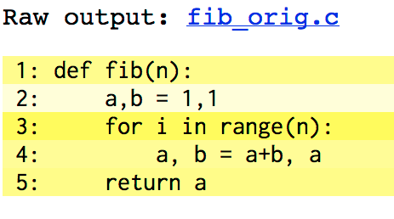
Profiling with annotations
FIB_ORIG.PYX: NO CDEFS
FIB_ORIG.HTML
def fib(n):
a,b = 1,1
for i in range(n):
a, b = a+b, a
return a
$ cython –a fib_orig.pyx
$ open fib_orig.html
CREATE ANNOTATED SOURCE
The darker the highlighting, the more lines of C code are required for the given line of Cython code.
Notes:
[toc]
level = 2
title = Def vs. CDef
# end config

Slide 35
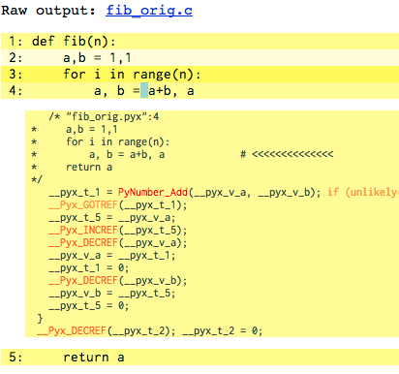
Profiling with annotations
Notes:
[toc]
level = 2
title = Def vs. CDef
# end config

Slide 36
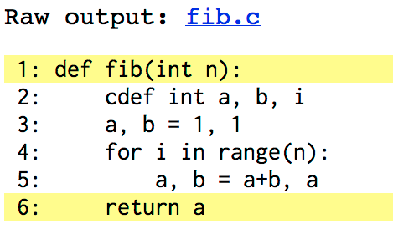
Profiling with annotations
FIB.PYX: WITH CDEFS
FIB.HTML
def fib(int n):
cdef int i, a, b
a,b = 1,1
for i in range(n):
a, b = a+b, a
return a
$ cython –a fib.pyx
$ open fib.html
CREATE ANNOTATED SOURCE
Notes:
[toc]
level = 2
title = Def vs. CDef
# end config

Slide 37
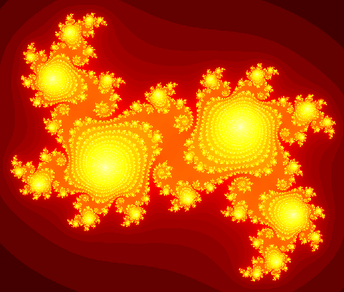
Capstone demo: compute Julia set
PURE-PYTHON VERSION
# julia_pure_python.py
def kernel(z, c, lim):
count = 0
while abs(z) < lim:
z = z * z + c
count += 1
return count
def compute_julia(cr, ci, N, bound, lim):
julia = np.empty((N, N), dtype=np.uint32)
grid_x = np.linspace(-bound, bound, N)
grid_y = grid_x * 1j
c = cr + 1j * ci
for i, x in enumerate(grid_x):
for j, y in enumerate(grid_y):
julia[i,j] = kernel(x+y, c, lim)
return julia
Notes:
37

Slide 38
Add Type Information
def abs_sq(float zr, float zi):
...
def kernel(float zr, float zi,
float cr, float ci,
float lim, double cutoff):
cdef int count
...
def compute_julia(float cr, float ci, int N,
float bound, float lim, double cutoff):
...
Notes:
38

Slide 39
Use Cython C Functions
cdef float abs_sq(...):
...
cdef int kernel(...):
...
Notes:
39

Slide 40
Use typed memoryviews
def compute_julia(...):
cdef int[:,::1] julia # 2D, C-contiguous.
cdef float[::1] grid # 1D, C-contiguous.
...
julia = empty((N,N), dtype=int32)
grid = array(linspace(...), dtype=float32)
# all array accesses and assignments faster.
Notes:
40

Slide 41
Add Cython directives
cimport cython
...
# don’t check for out-of-bounds indexing.
@cython.boundscheck(False)
# assume no negative indexing.
@cython.wraparound(False)
def compute_julia(...):
...
Notes:
41

Slide 42
Parallelization using OpenMP
from cython.parallel cimport prange
cdef float abs_sq(...) nogil:
...
cdef int kernel(...) nogil:
...
def compute_julia_parallel(...):
...
# release the GIL and run in parallel.
for i in prange(N, nogil=True):
...
Notes:
42

Slide 43
Parallelization using OpenMP
Extension("julia_cython", ["julia_cython.pyx"],
extra_compile_args=[“-fopenmp”],
extra_link_args=[“-fopenmp”])
Notes:
43

Slide 44
Conclusion
Solution | Time (s) | Speed-up
Pure Python | 630 | x 1
Cython (Step 1) | 2.8 | x 230
Cython (Step 2) | 2.0 | x 320
Cython+Numpy (Step 3) | 0.40 | x 1600
Cython+Numpy+prange (Step 4) | 0.24 | x 2600
Timing performed on a 2.3 GHz Intel Core i7 MacBook Pro with 8GB RAM using a 2000x2000 array and an escape time of n=100. [July 20, 2012]
Notes:
[exercise]
title = cython_rankdata
# end config
44

