Slide 1
Classification of EEG P300 ERPs using quantum computation
Anton Andreev (Gipsa-lab France), Gregoire Cattan (IBM Poland)

Slide 2
Overview
Quantum computing advantages
in terms of computational time and outcomes
for pattern recognition or when using limited training sets
Objective: classify two states (P300 ERPs) from a BCI experiment using a Quantum Classifier
EEG dataset
Riemannian Geometry + Tangent Space
Quantum classifier
Notes:
Literature on quantum computing suggests it may offer an advantage as compared with classical computing in terms of computational time and outcomes, such as for pattern recognition or when using limited training sets.

Slide 3
Projects and Tools
MOABB - helper project
pyRiemann - state of the art ERP classification
QISKIT - IBM Python wrapper around Quantum Computing
pyRieamann-qiskit - PyRiemann + QISKIT + MOABB
Notes:
pyRieamann-qiskit combines the 3 projects above,so that we can easily apply Quantum computing on EP EEG signals.

Slide 4
MOABB
Github project page:
https://github.com/NeuroTechX/moabb
Reproducible research
same performance evaluation code and datasets
EEG/MEG datasets and specifically P300 ERPs
Automatic download

Slide 5
PyRiemann (1)
Github project page:
https://github.com/pyRiemann/pyRiemann
Python ML framework
Provides very good classification for BCI (P300, motor imagery)
No preprocessing is needed
Multi channel and Multiclass
Works well between different sessions and subjects
It won several BCI challenges
Notes:
PyRiemann provides state of the art classification of ERP signals.

Slide 6
PyRiemann (2)
Uses Riemannian Geometry
Can use a matrix as in input
Methods:
Covariance matrices + Tangent Space + standard classifier
Own MDM (Minimum Distance to Mean) classifier
similar to K-means classifier, but supervised
centroids are calculated for each class
specific “distance” and “mean” used
no manual parameter tuning
Other methods
Notes:
K-means is unsupervised in general, but here in MDM we use labeled data to build the two clusters for the classes: with or without P300 ERP.
We need to properly define the distance and mean we are going to use. “distance” as defined using Riemannian Geometry.
Inherited from the geometric distance, the geometric mean is an appropriate descriptor of the central tendency (expected value) for the variance, while, inherited from the Euclidean distance, the arithmetic mean is not.

Slide 7
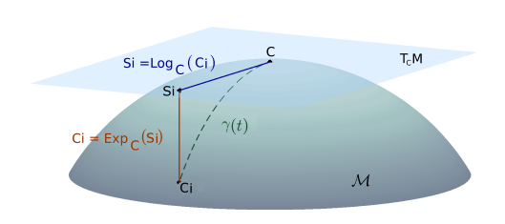
Covariance matrices + Tangent Space + standard classifier
P300 Epochs
Covariance matrices
Definition of Riemannian manifold
Point on the manifold
Definition of Tangent space
Mapping to Tangent space
Good representation of the input data
Any Classifier
The workflow can be used by a Quantum Classifier
Notes:
From each P300 epoch we calculate a “covariance matrix”. We want to preserve the spatial information in the covariance matrix. Usually the covariance matrix is vectorized (all rows of the matrix are put one after another) to form a single input vector to be used by any classifier, but here this is avoided. The spatial covariance matrix Cp is calculated using the single trail Xp (channels x samples): Cp = 1 / (T-1) * Xp * Xp(transposed).
Cp is symmetric by definition
With sufficient data Cp becomes positive definitive, otherwise it must be regularized (there are known algorithms for that)
Next the space of SPDs creates a manifold (based on the training data)
This manifold becomes Riemannian manifold M by adopting an Affine Invariant Metric
Now we can apply Riemannian Geometry for M
Each Cp can be represented in M
For each point on the manifold M a tangent space T can be defined
We need to select a reference point C as to where to construct the tangent space T. Usually this reference point is the Geometric Mean. The Geometric Mean might not be the best reference point, but usually is a very good choice. The Geometric mean is calculated iteratively
Each point on the manifold (each covariance matrix) can be projected on T using log mapping (and back using exponential mapping). A kind of optimization is C to become the identity matrix and to use parallel transport (parallel translation)
So the Riemannian distance in M is well approximated by Euclidean distance in T – so T (which is 2 dimensional) acts as a very good approxomation of M
Any classifier can be used in T

Slide 8
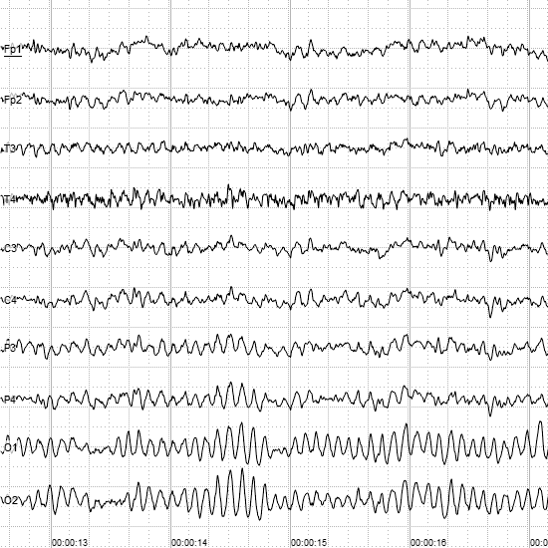
Riemannian representation of the ERP data
Good feature vector
EGG signal epoch
Notes:
By using PyRiemann we get a good a feature vector that can be used for Classical or Quantum Classification.

Slide 9

Qiskit (1)
Github project page: https://github.com/Qiskit/qiskit
Launched in 2017 by IBM Research
Provides access to IBM’s cloud quantum computing service
Where can it be used?
Qiskit Finance
Qiskit Optimisation
Qiskit Nature
Qiskit Machine Learning (<- we are here)
Emulated vs Real Quantum computer
Notes:
We are in the exploration phase of Quantum computers. But the fact that anyone can access a real quantum computer is impressive and will help progress the domain.
Qiskit framework can be used on two levels: at a low level for Quantum models (as shown on the next slide) or at a higher level where a Quantum classifier is already provided (and we can focus on the hyper parameters).
Qiskit has 3 ML algorithms: QSVM (Quantum-enhanced Support Vector Machine) and VQC (Variational Quantum Classifier) and QGAN (Quantum Generative Adversarial Network).

Slide 10
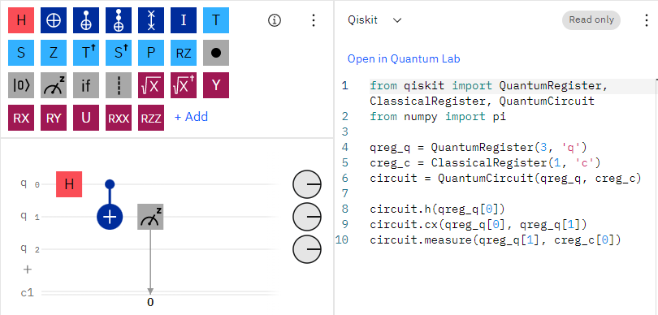
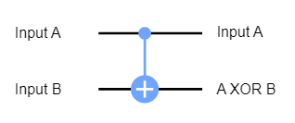
Qiskit (2)
Quantum circuit
Quantum bits
Operations
Registers:
Quantum (q1,q2)
Classical (c1)
Code generated:
Python
QASM
Result is the measurement of q1 available c1
https://quantum-computing.ibm.com
Notes:
With Qiskit we are doing Quantum Programming.
Qiskit compiles an algorithm to a quantum circuit.
Quantum bits can be manipulated in ways that can only be described by quantum physics.
Each quantum bit can seen as a “quantum register”. Classical bits form “classical register”.
Quantum circuit is a combination of operations on these registers. Here the quantum circuit is comprised from the quantum bits q0, q1, q2 and a normal bit c1.
Quantum operations include quantum gates, such as the Hadamard gate, as well as operations that are not quantum gates, such as the measurement operation.
From the Web interface you can generate either Qiskit python code or QASM (Open Quantum Assembly Language).
Qubits are always initialized to give the output 0.
Quantum operations:
https://qiskit.org/textbook/ch-states/atoms-computation.html
H – is a Hadamard gate
+ - is a CX (CNOT) gate on control qubit 0 and target qubit 1 (a classical XOR gate). It looks at its two input bits to see whether they are the same or different. Next, it overwrites the target qubit with the answer. The target becomes 0 if they are the same, and 1 if they are different. Another way of explaining the CNOT is to say that it does a NOT on the target if the control (the first quantum bit) is 1, and does nothing otherwise.
X – is a NOT gate (circle with + inside, exactly after Hadamard gate)
Textbook on Qiskit: https://qiskit.org/textbook/preface.html

Slide 11
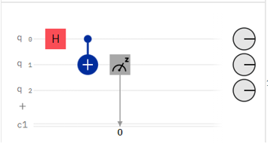
Quantum-enhanced Support Vector Machine (QSVM)
Quantum Kernel
Generated based on the input data and the Quantum Feature Map (QFM)
QFM
Maps classical data to Quantum states in Quantum Hilbert space
Implemented as Quantum Circuit
Can be used in SVM, Kernel Spectral Clustering or Kernel Ridge Regression
QSVM
QSVM inherits from ScikitLearn.svm.SVC (conventional SVM)
Uses the Quantum Kernel
Size of input vectors = n of qubits
Notes:
Going to the higher dimensional space called “Feature Space” is done using a “kernel”. The job of the kernel is to transform linearly inseparable data to linearly separable space.
A Quantum Feature Map V(Φ(𝑥⃗)) converts classical data to quantum data. It maps to quantum Hilbert space with specific property of the dot product. The reason of choosing a QFM is to get the quantum advantage.
Based on the QFM we construct a quantum kernel (during the training phase).
The QFM is modeled using a quantum circuit and quantum operations as shown in the previous slide.
A different QFM will produce a different kernel. The default Quantum Feature Map (QFM) is ZZFeatureMap: https://qiskit.org/documentation/stubs/qiskit.circuit.library.ZZFeatureMap.html
Links and extras:
The Quantum Kernel python class in Qiskit is: qiskit_machine_learning.kernels.quantum_kernel
Check also on IBM web-site: qiskit-tutorials/qiskit-machine-learning/03_quantum_kernel.ipynb
QSVC code: https://github.com/Qiskit/qiskit-machine-learning/blob/1f01764186ad5e6fd4b88deb4dfec1e5cbb05d03/qiskit_machine_learning/algorithms/classifiers/qsvc.py
Article Quantum Feature Map: https://shubham-agnihotri.medium.com/quantum-machine-learning-102-qsvm-using-qiskit-731956231a54

Slide 12
Diagram with real Quantum Computer
ZZFeatureMap
Quantum Computer
Input data
Precomputed Quantum Kernel Matrix
Scikit Learn SVC
Notes:
The algorithm starts on your laptop, then the model representing the kernel and the data are sent to a real quantum computer. The result is a kernel that is compatible with Scikitlearn’s implementation of Support Vector Machines.

Slide 13
PyRiemann-qiskit
Github project page: https://github.com/pyRiemann/pyRiemann-qiskit
Facilitates the classification of ERP signals with Quantum Computing
Trying to get the best of both PyRiemann and Qiskit

Slide 14
Classification
Dataset: bi2012 – P300, Gipsa-lab BCI game Brain Invaders, MOABB
Two ML pipelines:
Both using Riemannian Geometry and Tangent Space
Quantum bits = PCA components
But the final classifier is different
Evaluation
Provided by MOABB
k-fold cross-validation
Per session
Experience on a real IBM quantum computer
RG + Tangent Space
LDA classifier
RG + Tangent Space
QSVM classifier
Notes:
The following pipeline “Xdawn spatial filter, Riemannian Geometry, Tangent Space, PCA” is used to generate the same feature vectors before applying a simple LDA or QSVM.
One subject can have several recorded sessions playing the BCI game Brain Invaders.
“Within-session” evaluation uses k-fold cross-validation to determine train and test sets for each separate session for each subject http://moabb.neurotechx.com/docs/generated/moabb.evaluations.WithinSessionEvaluation.html

Slide 15
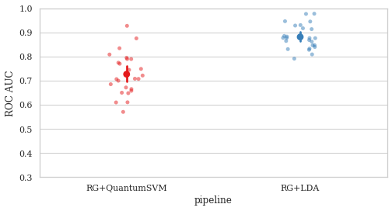
Evaluation using Quantum Emulation
Dataset: bi2012
Subjects: 25
Classes: 2
Accuracy:
- RG+LDA: 0.88
- RG+QuantumSVM: 0.72
Quantum emulation is
3 times slower
Notes:
Evaluation of the two pipelines.
Both finish in 5 minutes on a regular laptop.

Slide 16
Experience on real IBM Quantum computer
Training is slow due to usage restrictions
Many quantum jobs are needed
Each quantum job is queued
Classification score can be low due to:
Low number of “shots”
Too small feature vector (depends on available quantum bits)
Noise in quantum computers
Not sufficient data
Notes:
Training is slow because many users are “fighting” for the same “quantum computer”. Building the Quantum Feature Map is done by performing many “Quantum jobs” (a unit of work executed on a Quantum computer).
“Shots” – the number of times the circuit is executed. More shots gives more confidence in the result, but it also takes much longer to process.
The size of the generated feature vector (based on RG + Tangent Space) is limited to the number of available quantum bits.
A real quantum computer should perform less accurately than an emulated one. Although an emulated quantum computer can include emulation of quantum noise.
Adding more data (P300 ERP epochs) means more quantum jobs and more time to complete. But limiting the input data however means less training of the QSVM.

Slide 17
Resources
[1] A. Blance and M. Spannowsky, ‘Quantum machine learning for particle physics using a variational quantum classifier’, J. High Energ. Phys., vol. 2021, no. 2, p. 212, Feb. 2021, doi: 10.1007/JHEP02(2021)212.
[2] P. Rebentrost, M. Mohseni, and S. Lloyd, ‘Quantum Support Vector Machine for Big Data Classification’, Phys. Rev. Lett., vol. 113, no. 13, p. 130503, Sep. 2014, doi: 10.1103/PhysRevLett.113.130503.
[3] ‘Classification of covariance matrices using a Riemannian-based kernel for BCI applications’ Alexandre Barachant, Stéphane Bonnet, Marco Congedo, Christian Jutten
[4] ‘Riemannian geometry for EEG-based brain-computer interfaces; a primer and a review’ Marco Congedo, Alexandre Barachant, Rajendra Bhatia
[5] ‘Supervised learning with quantum enhanced feature spaces’ Vojtech Havlicek1 , ∗ Antonio D. C´orcoles1 , Kristan Temme1 , Aram W. Harrow2 , Abhinav Kandala1 , Jerry M. Chow1 , and Jay M. Gambetta1
Notes:
[1,2] Advantages of Quantum Computing
[3.4] Classification with the state of art method using Riemannian geometry
[5] Quantum Support Vector Classifier

Slide 18

Questions?

