Slide 1
Hands-on session “users”
Exercises

Slide 2
Exercise 1: Install and configure pysteps in Colab
Install pysteps dependencies by using pip or conda-colab & mamba, see environment.yml
Install pysteps by using pip & git
Download example data to Google drive
Create pystepsrc and configure pysteps

Slide 3
Exercise 2: Read, visualize and process input data
Install pysteps with helper_setup.ipynb notebook
Read the example data downloaded above, pick either fmi or mch dataset
Plot precipitation fields on top of a basemap
Try different preprocessing methods:
upsampling
clipping
unit conversions
Logarithmic transformation
normal quantile transformation

Slide 4
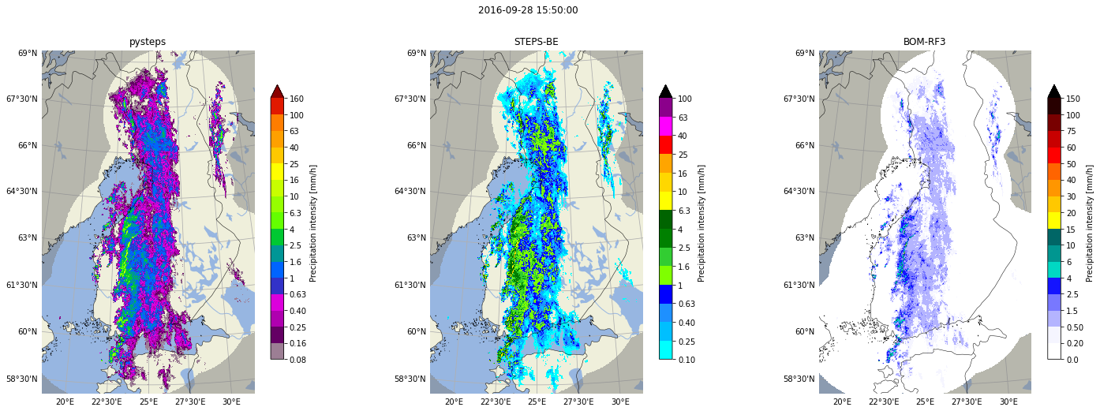
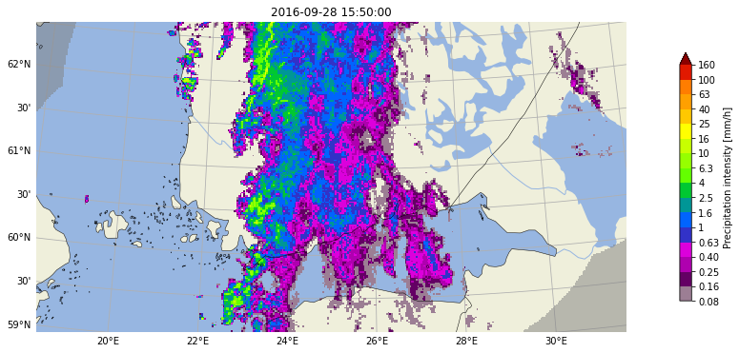
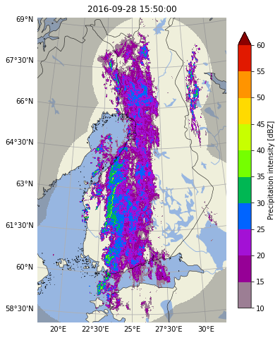
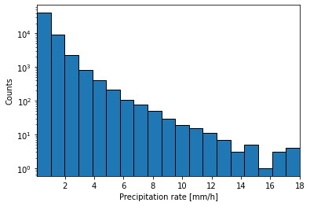
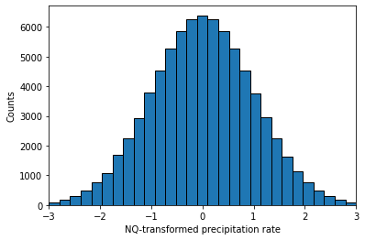
Exercise 2: Read, visualize and process input data
Basemap + precipitation with different colormaps
Clipping
Conversion:
rain rate <-> reflectivity
Distribution of precipitation rates
After NQ transformation

Slide 5
Exercise 3: Optical flow and extrapolation
Load example data with helper_input_data.ipynb notebook
Try different optical flow methods: Lucas-Kanade, VET and DARTS. Questions:
What the advection fields look like? Which one would you trust?
What is the effect of data transformations (e.g. log-transform) before applying the optical flow?
Apply semi-Lagrangian extrapolation and plot the extrapolated precipitation fields for lead times of 15, 30, 45 and 60 minutes
Apply extrapolation with time steps that are different from the input data

Slide 6
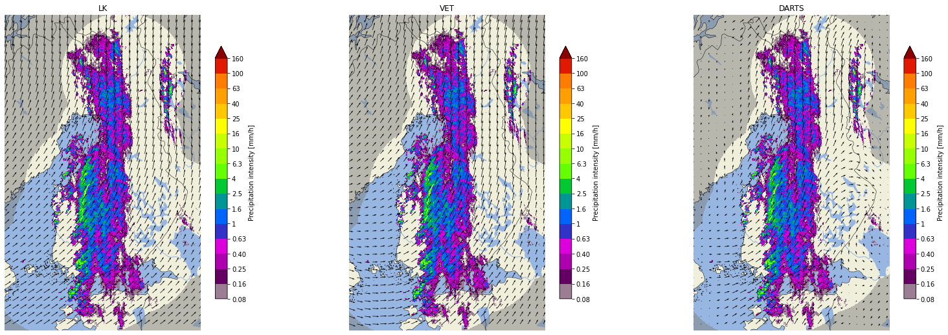
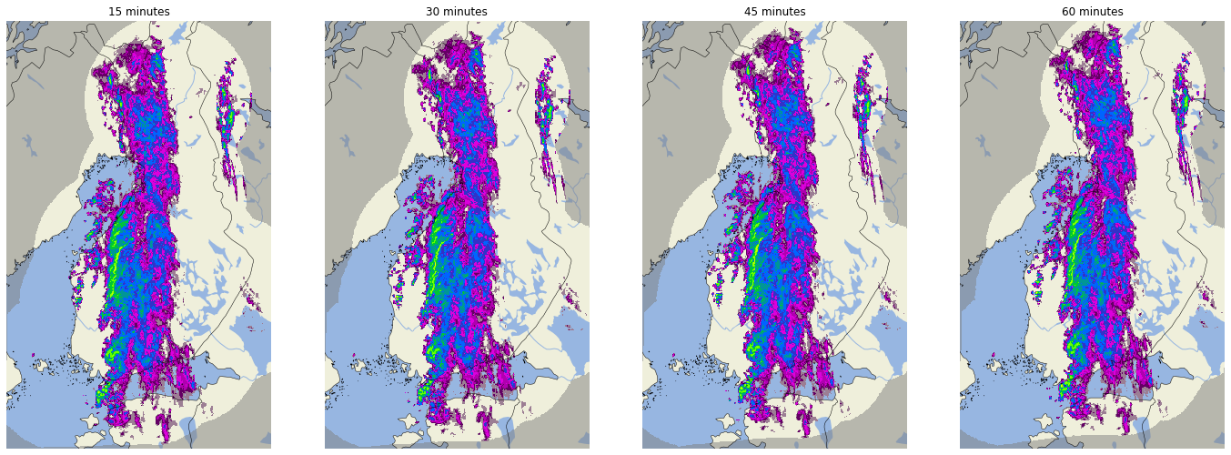
Exercise 3: Optical flow and extrapolation
Different optical flow methods
Lucas-Kanade
VET
DARTS
15 minutes
30 minutes
45 minutes
60 minutes
Extrapolation

Slide 7
Exercise 4: Deterministic nowcasting
Load example data with helper_nowcasting_methods.ipynb notebook
Create & visualize nowcasts with at least extrapolation method
Calculate verification metrics between observations and nowcasts
Export the created nowcast to NetCDF file
Deterministic nowcasting methods in pysteps:
Extrapolation
ANVIL
LINDA
S-PROG
Notes:
ML benchmark link: https://pysteps.readthedocs.io/en/latest/user_guide/machine_learning_pysteps.html.

Slide 8
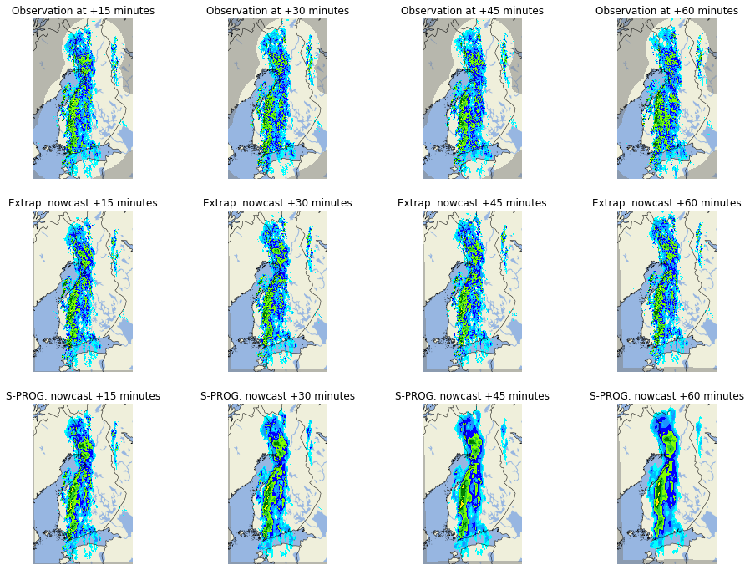
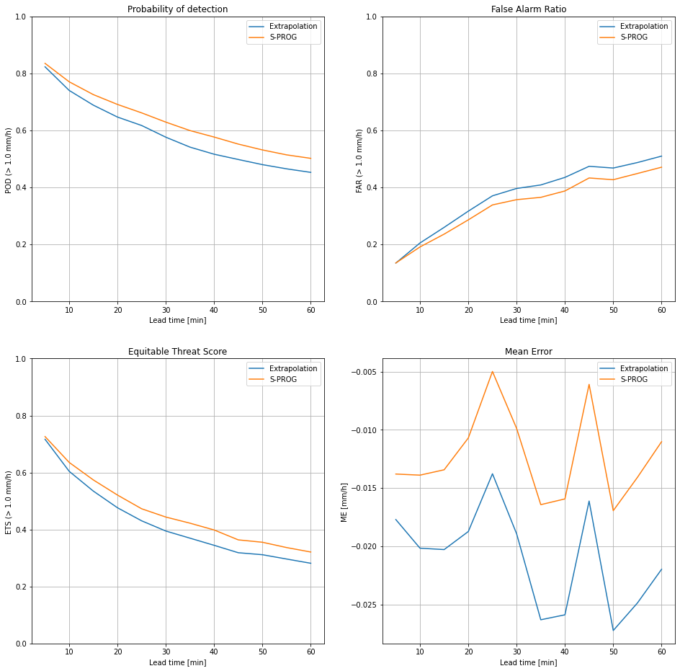
Exercise 4: Deterministic nowcasting
Remember to check parameter values for each nowcasting method (default values not necessarily good for all datasets)!
Notes:
ML benchmark link: https://pysteps.readthedocs.io/en/latest/user_guide/machine_learning_pysteps.html.

Slide 9
Exercise 4: Probabilistic nowcasting
Load example data with helper_nowcasting_methods.ipynb notebook
Create an ensemble STEPS nowcasts with 20 ensemble members and 12 lead times (+1 h)
Visualize output, ensemble members and probabilities
Calculate probabilistic verification metrics between observations and nowcasts
If time allows: Try out a LINDA-P nowcast
Probabilistic nowcasting methods in pysteps:
Lagrangian probability
STEPS
LINDA-P
Notes:
ML benchmark link: https://pysteps.readthedocs.io/en/latest/user_guide/machine_learning_pysteps.html.

Slide 10
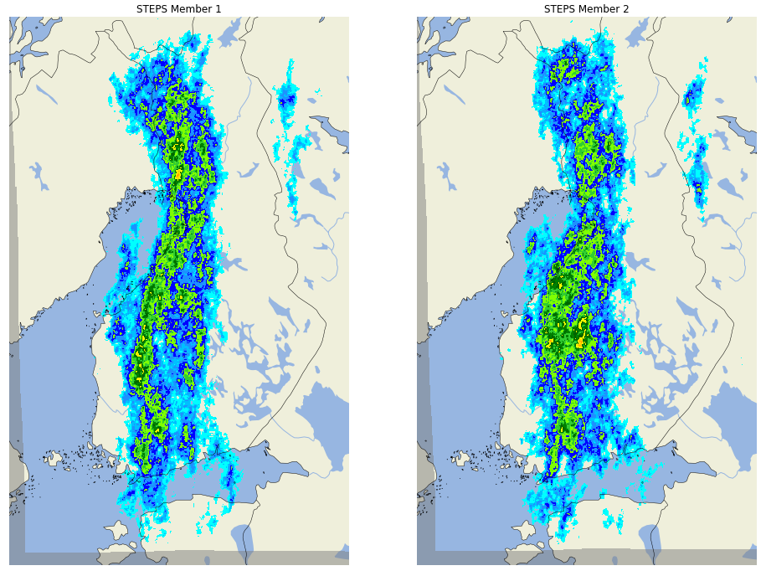
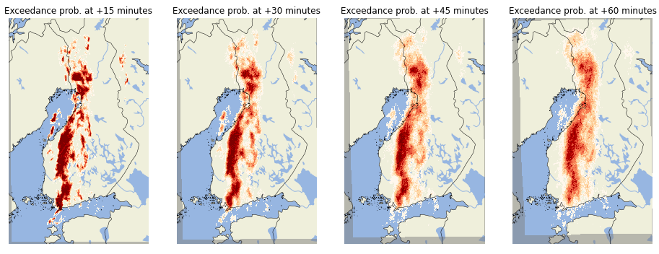
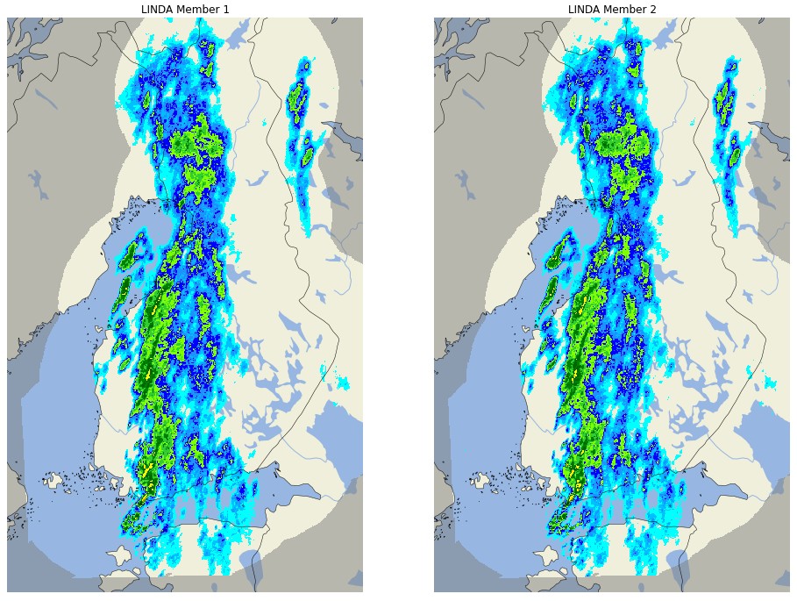
Exercise 4: Probabilistic nowcasting
Notes:
ML benchmark link: https://pysteps.readthedocs.io/en/latest/user_guide/machine_learning_pysteps.html.

Slide 11
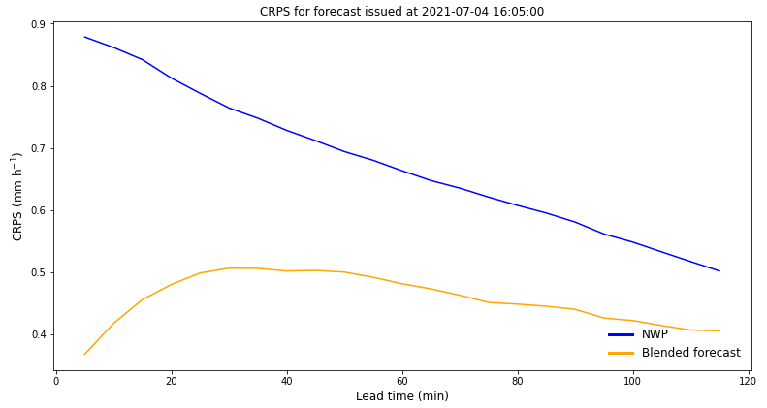
Exercise 5: Blending with NWP
Make sure to use helper_blending.ipynb as starting point for this exercise.
Try out a linearly, saliency-based and STEPS blended nowcast. Feel free to play around with it!
Linear blending - adjustable settings:
Start and end time blending
Nowcasting method
Probabilistic forecast
Saliency-based blending: better preservation of high-intensity rainfall cells during blending
STEPS blending - other adjustable settings:
Weights determination method
Skill window size
Option to store decomposed NWP forecast
Blend ensemble nowcast with ensemble NWP

