Slide 1
Data Hackathon 2019-11 Sonal M., Jennifer S., Matthew L.

Slide 2
Overview & Goal

Slide 3
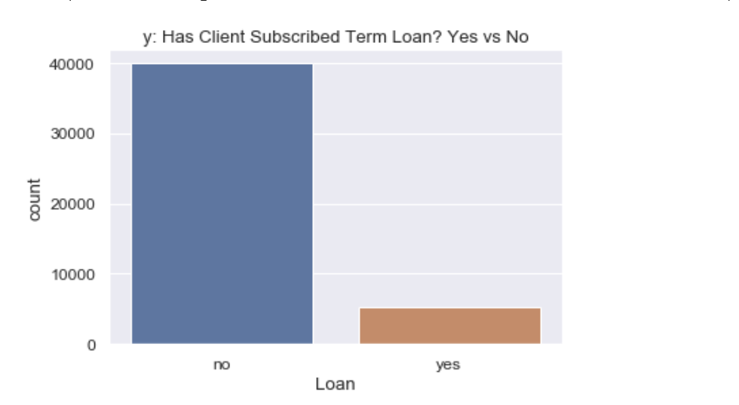
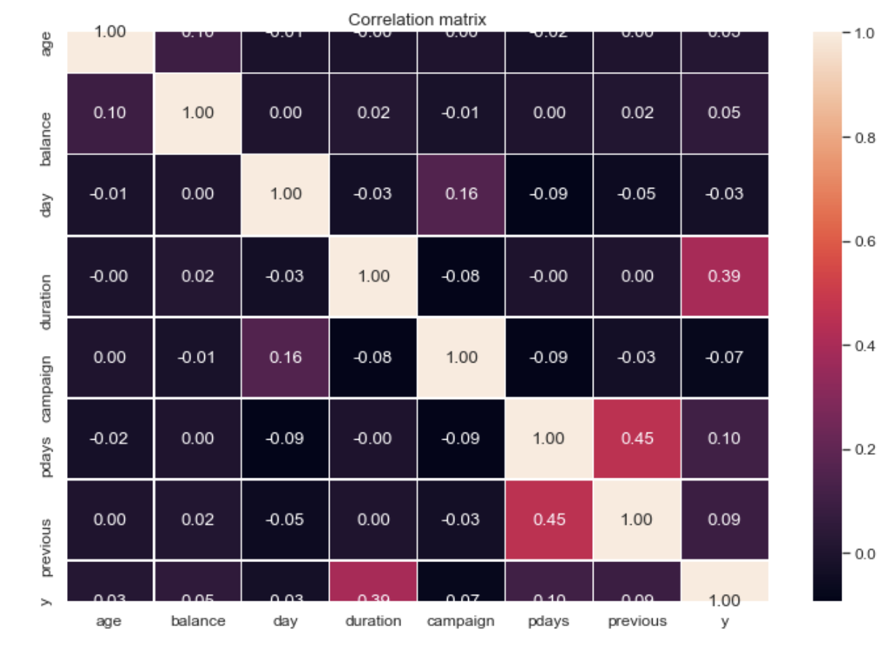
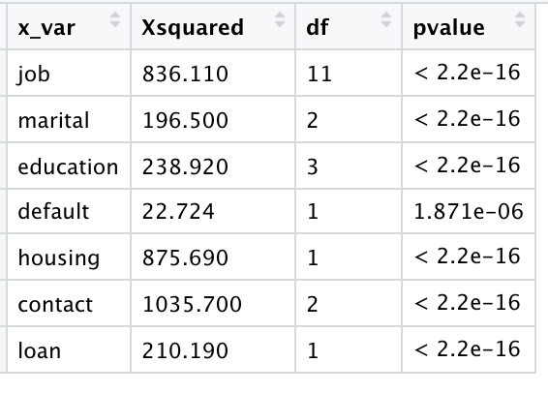
Correlation & Chi Squared Test for Independent Variables in Relation to The Dependent variables(y)
Yes = 11.70%
No = 88.30%

Slide 4
EDA and Feature Engineering

Slide 5
Approach 1 : Handling Unbalance Data to Train and Test Model

Slide 6
Approach 2
: Model 1

Slide 7
Approach 3 : Model 2

Slide 8
Approach 3 : Accuracy, Loss, and ROC

Slide 9
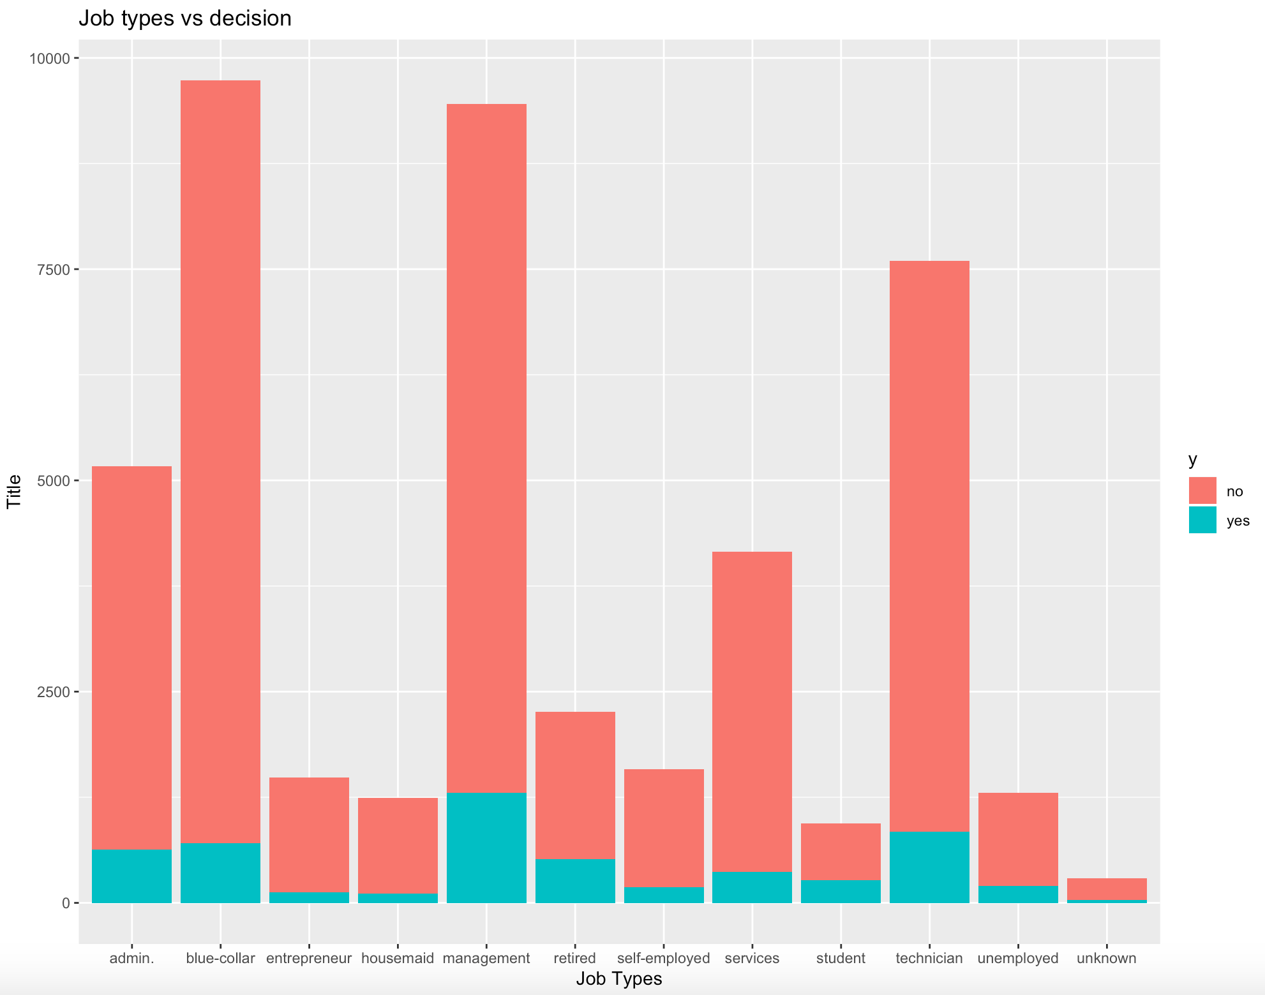
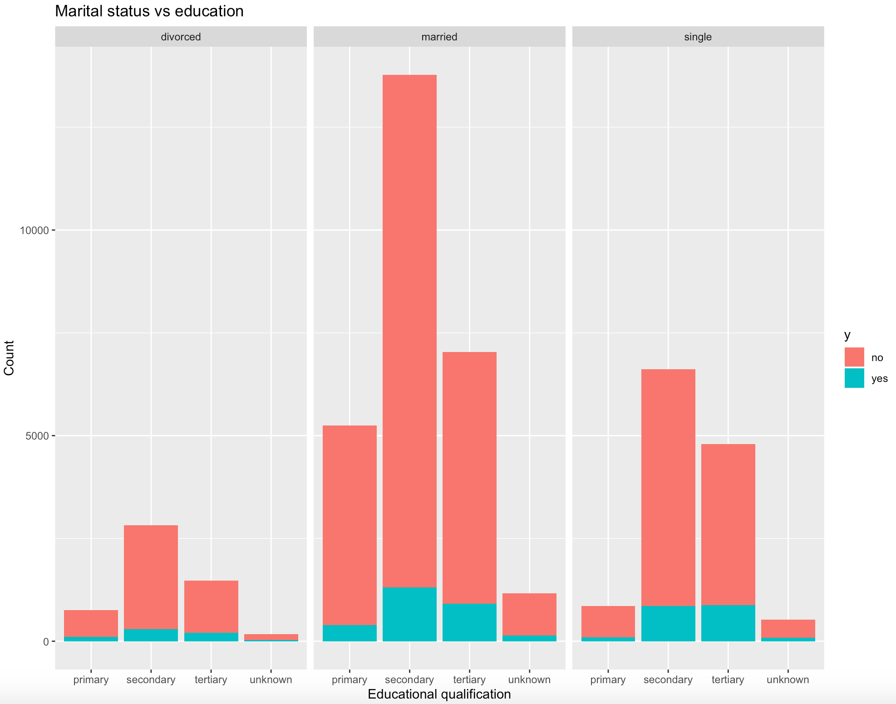

Slide 10
