Slide 1
Data Hackathon 2019-11 Jennifer S., Matthew L. Sonal M.,Priya C., Tikiri S.

Slide 2
Overview & Goal

Slide 3
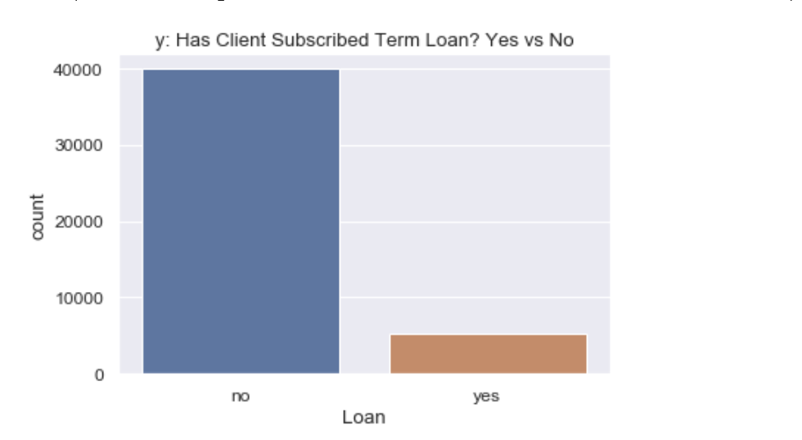
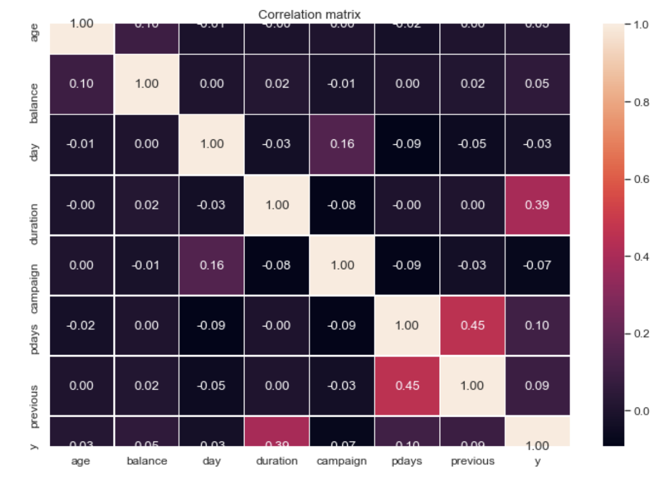
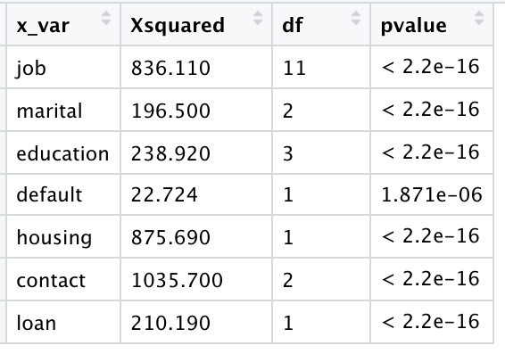
Correlation & Chi Squared Test for Independent Variables in Relation to The Dependent variables(y)
Yes = 11.70%
No = 88.30%

Slide 4
EDA and Feature Engineering
Outlier Treatments
Create Dummy Variables for all the categorical variables

Slide 5
Model 1
Accuracy, Loss, and ROC

Slide 6
Approach : Generate Synthetic Samples to Handle Imbalance Data

Slide 7
Model 2
Accuracy, Loss, and ROC

Slide 9
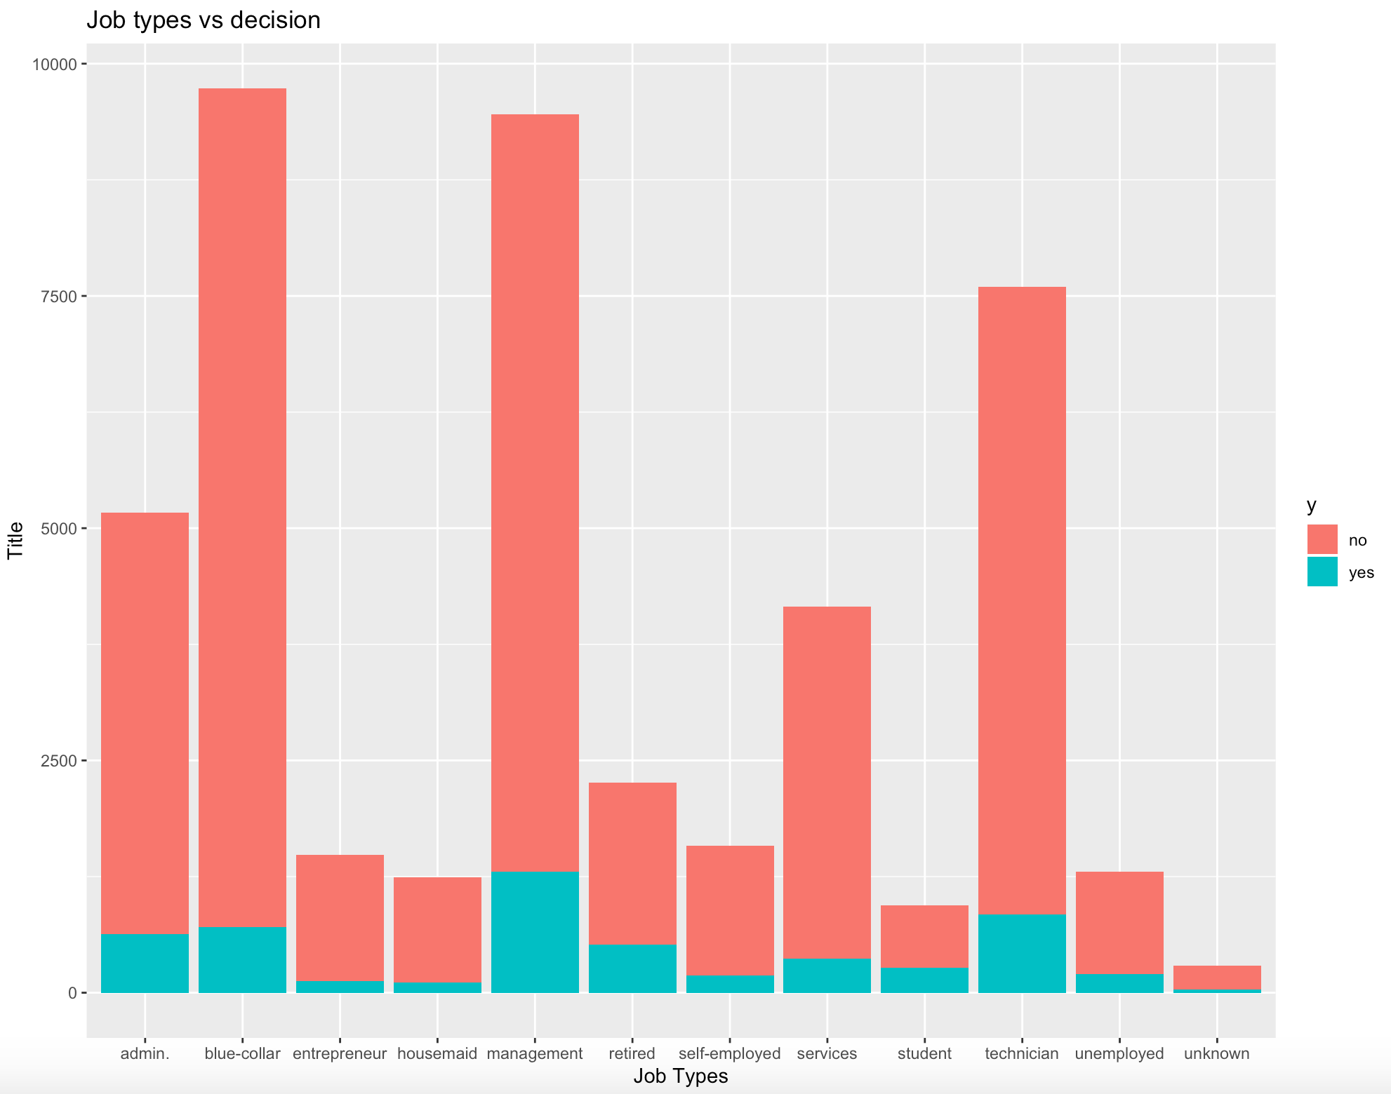
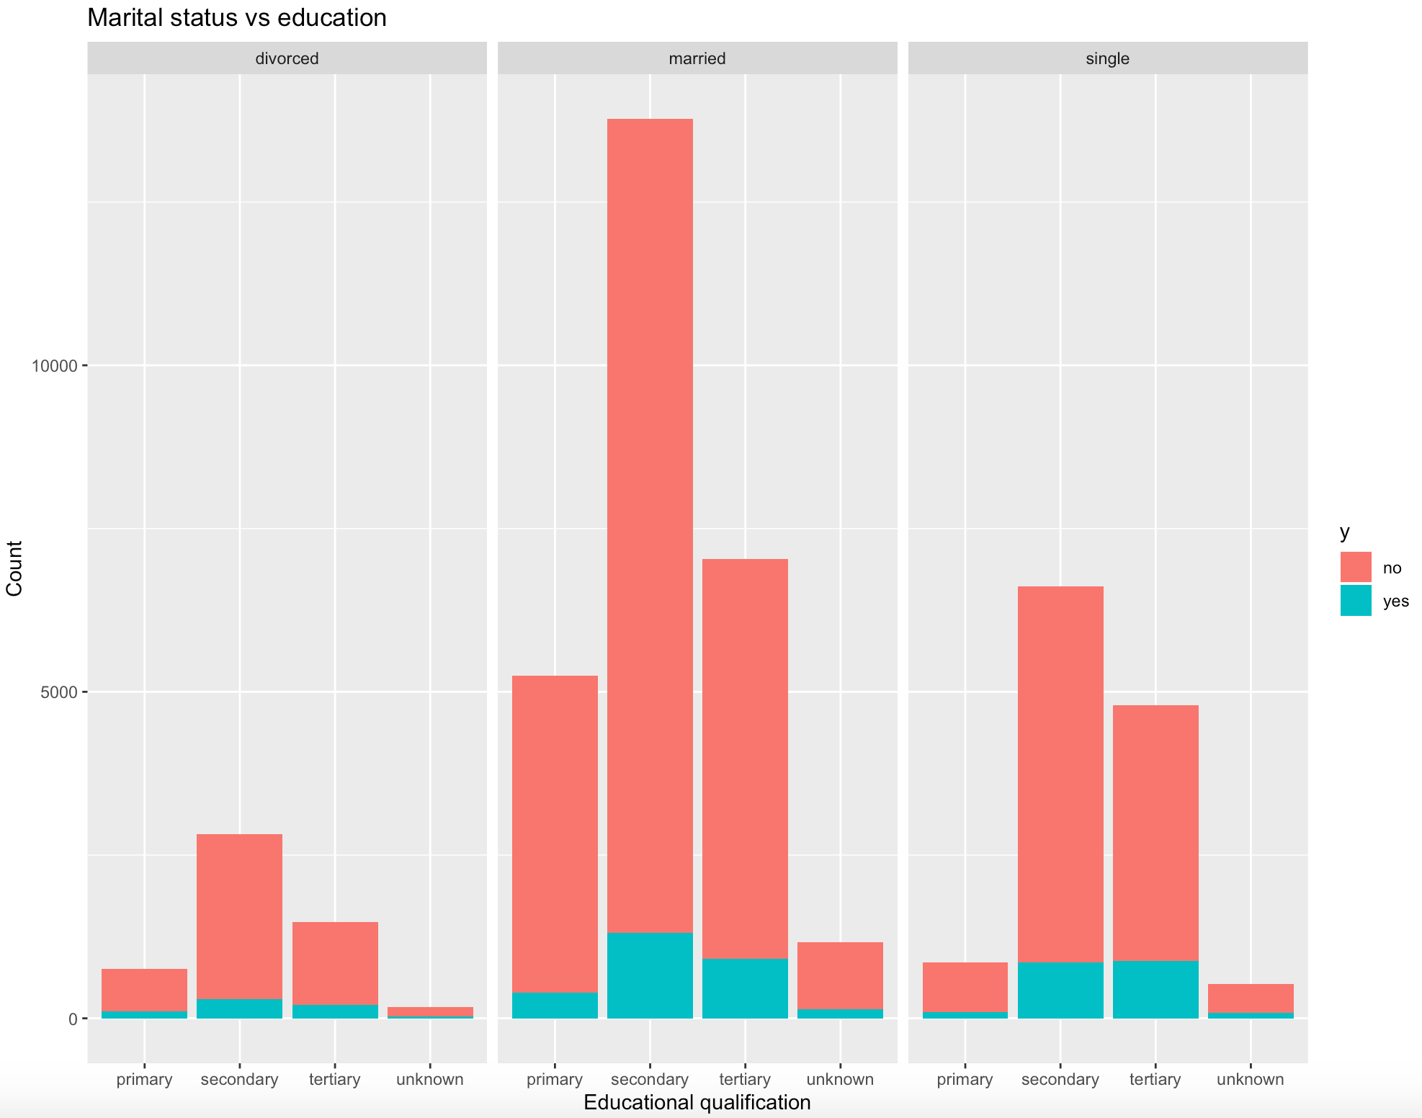

Slide 10
