Slide 1
Git and R
Version Control for R / R Studio

Slide 2
What is Git?
Short Version:
Version control
Code review
From Wikipedia:
Git is software for tracking changes in any set of files, usually used for coordinating work among programmers collaboratively developing source code during software development.
Its goals include speed, data integrity, and support for distributed, non-linear workflows (thousands of parallel branches running on different systems)*

Slide 3
Essential git commands
Git clone – clone (copy) a repository (directory) from A to B
i.e. copy directory on github.com to C: drive on your machine
Git status – check any files that have changed in your repository
Git commit – prepare files that have been changed to be upload
Git push / pull
Pull – pull any changed files from remote (A) to local (B)
Push – push any committed changes from local (B) to remote(A)

Slide 4
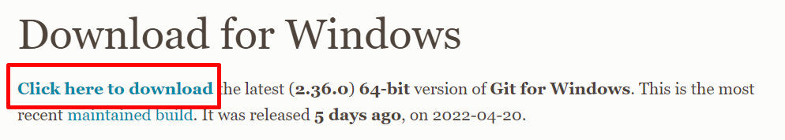

Install Git
https://git-scm.com/download/win Windows
https://git-scm.com/download/mac Mac
Download exe:
Run installer exe:

Slide 5
Cloning in R Studio
This process is cloning a remote repository to a local location
It also creates an R Studio project (.Rproj)
There is now a tab called ‘Git’ in the Environment Pane
*Don’t use git clone if you already have the repo locally. Use git pull instead (more later)

Slide 6
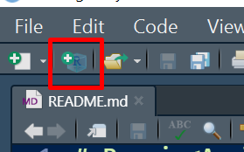
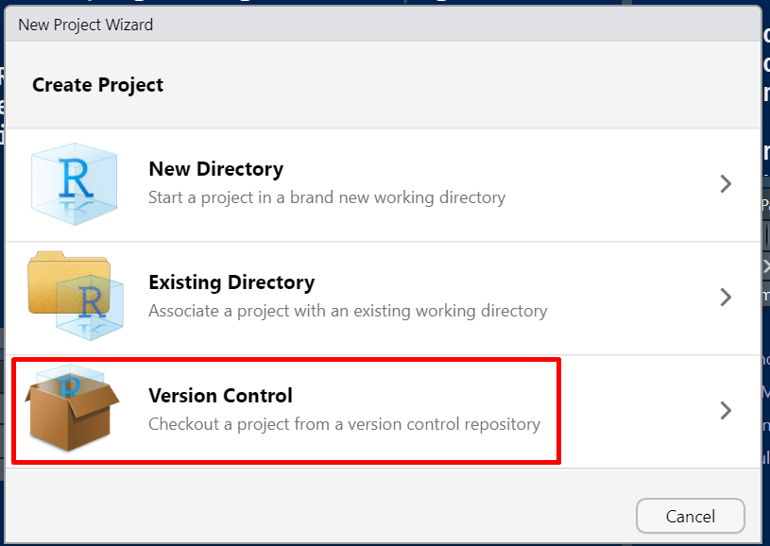
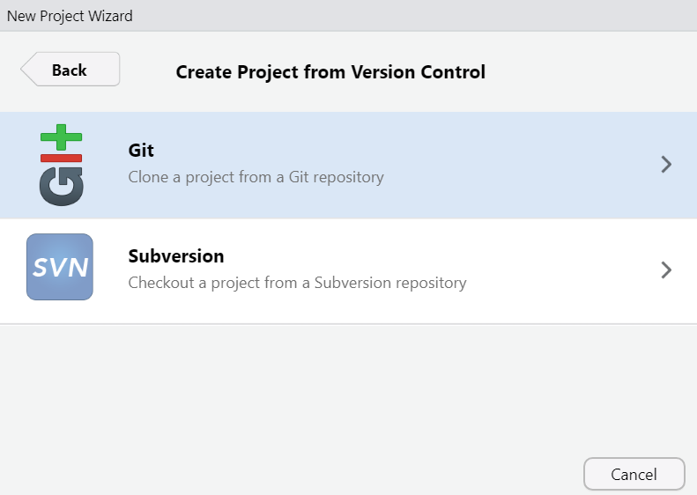
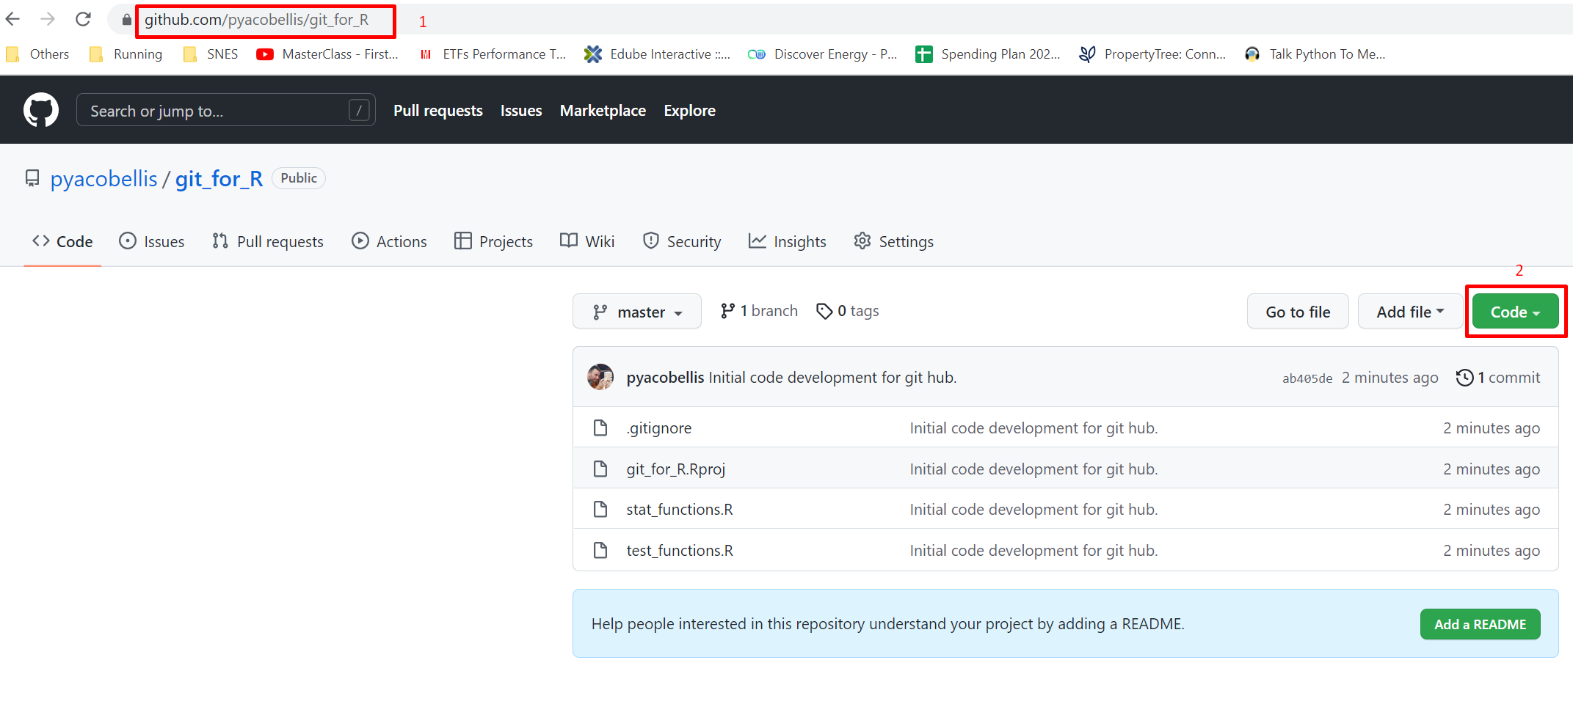
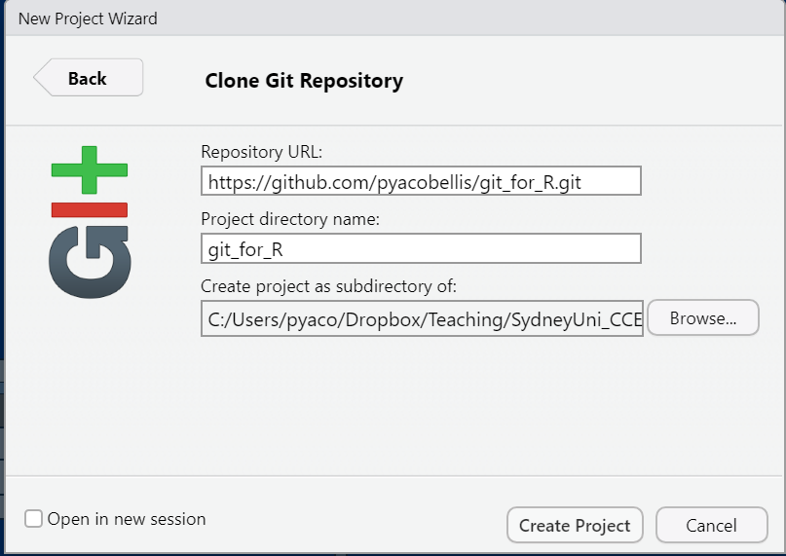
Cloning in R Studio

Slide 7
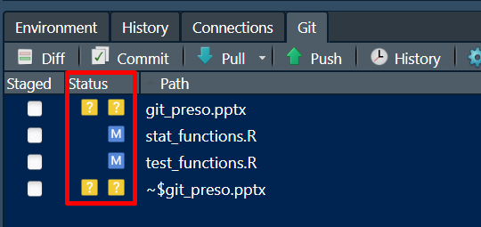
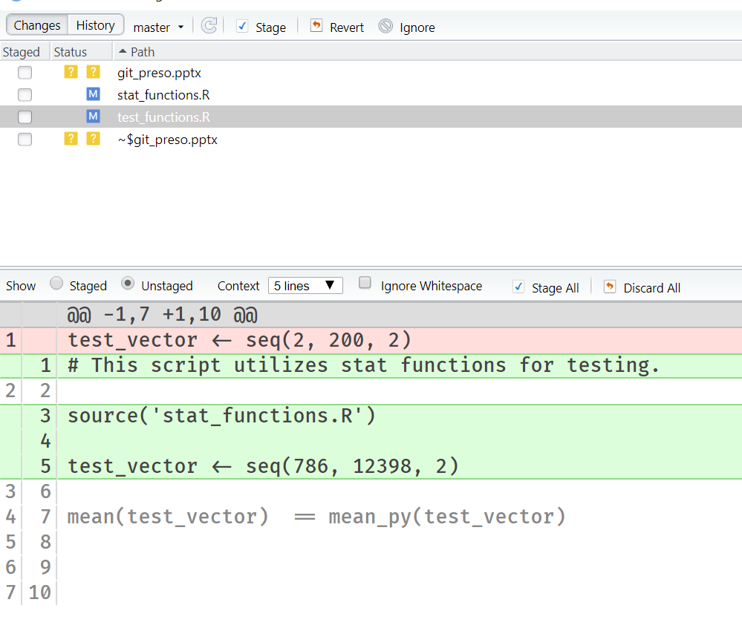
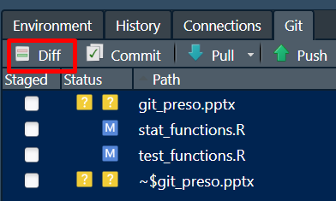
Git Commit
First use Git Status to check which files have been Modified (changed)
Use Diff to examine changes/differences
Green = new
Red = deleted/removed

Slide 8
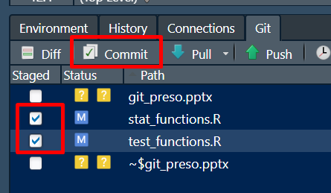
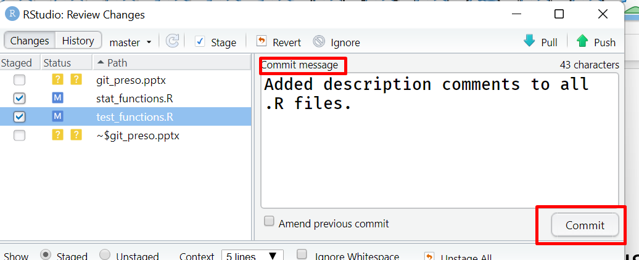
Git Commit
Next, Commit files for Pushing (uploading).
Commit stores any changes as a current local snapshot
Committing does not mean uploaded. Means excepting all the changes and now ready for upload (push)
Provide commit message to summarize changes.

Slide 9
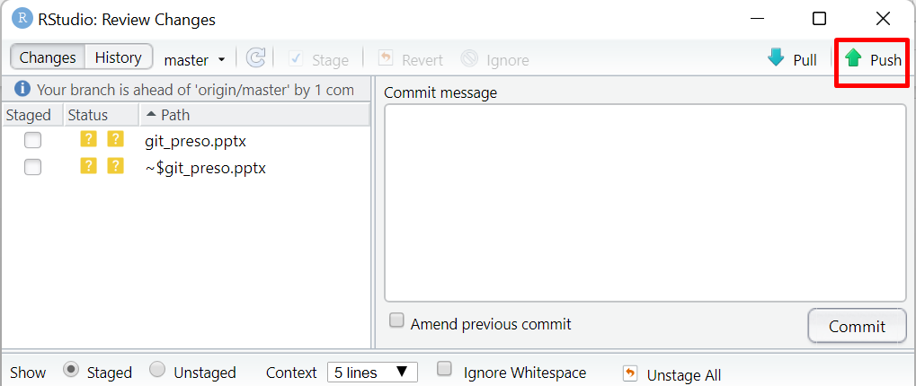
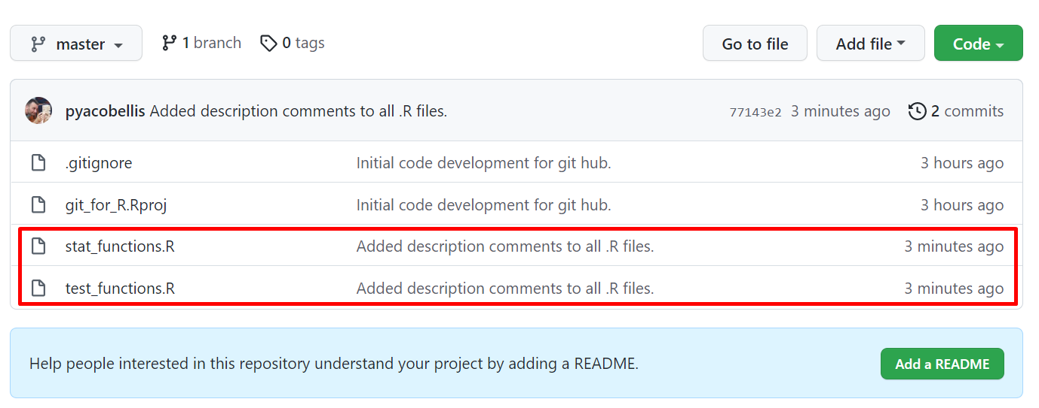
Git Push
Finally, after all changes have been committed locally, push to the remote repository
Reviewing the remote repository will reflect commit message and time/date

Slide 10
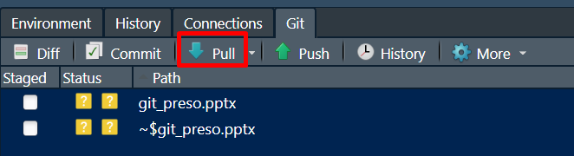
Git Pull
Already have a local repo and need to pull from remote?
Perhaps someone else made changes to code and pushed to remote
Use git pull
Will pull locally only files that have been changed in remote repo

Slide 11
Advanced topics
Branching / Merging
Keep main code/project in Master Branch
Use other branches for new development
Merge separate branch back to Master once complete
Forking
Independent copy of a repo (unlike dependent copy of Clone
Pull Requests
Made changes and want someone else to review? Use a pull request
Merge Conflicts
Need to be resolved when multiple changes

Slide 12
Resources
Pro Git – free online book
Atlassian Tutorial

