Slide 1
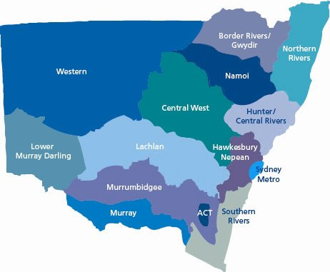
Exploratory Analysis of Reservoir Water Quality and Catchment Conditions
Paul Yacobellis, Data Scientist

Slide 2
Today
Objective – What Are We Trying to Achieve?
Data Analysis Approach
Results and Key Insights
Data Science Skills
Use of AI

Slide 3
Objective
What Are We Trying to Achieve?
a) enhance understanding of drinking reservoir conditions
b) generate actionable insights from data that drive impact and value for Water NSW
c) to assist water modellers, engineers, and operators to make better decisions

Slide 4
Data Analysis Approach
  clarified requirements of stakeholders and business
  performed exploratory data analysis to understand data quality and real-world behaviour
  analysed temporal patterns, lag effects
  validated findings with standard statistical techniques
  sensed check interpretations with former colleagues: flood modeller and water economist

Slide 5
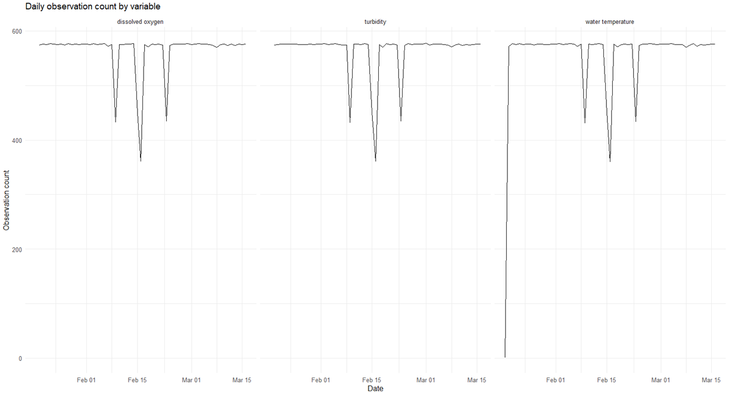
Data Coverage / Bias Considerations
  Daily WQ reading counts
    Drop in sensor counts on same days
    Dates line up with peak rain events
    True WQ values biased downward
    Missing water temp won’t have material impact

Slide 6
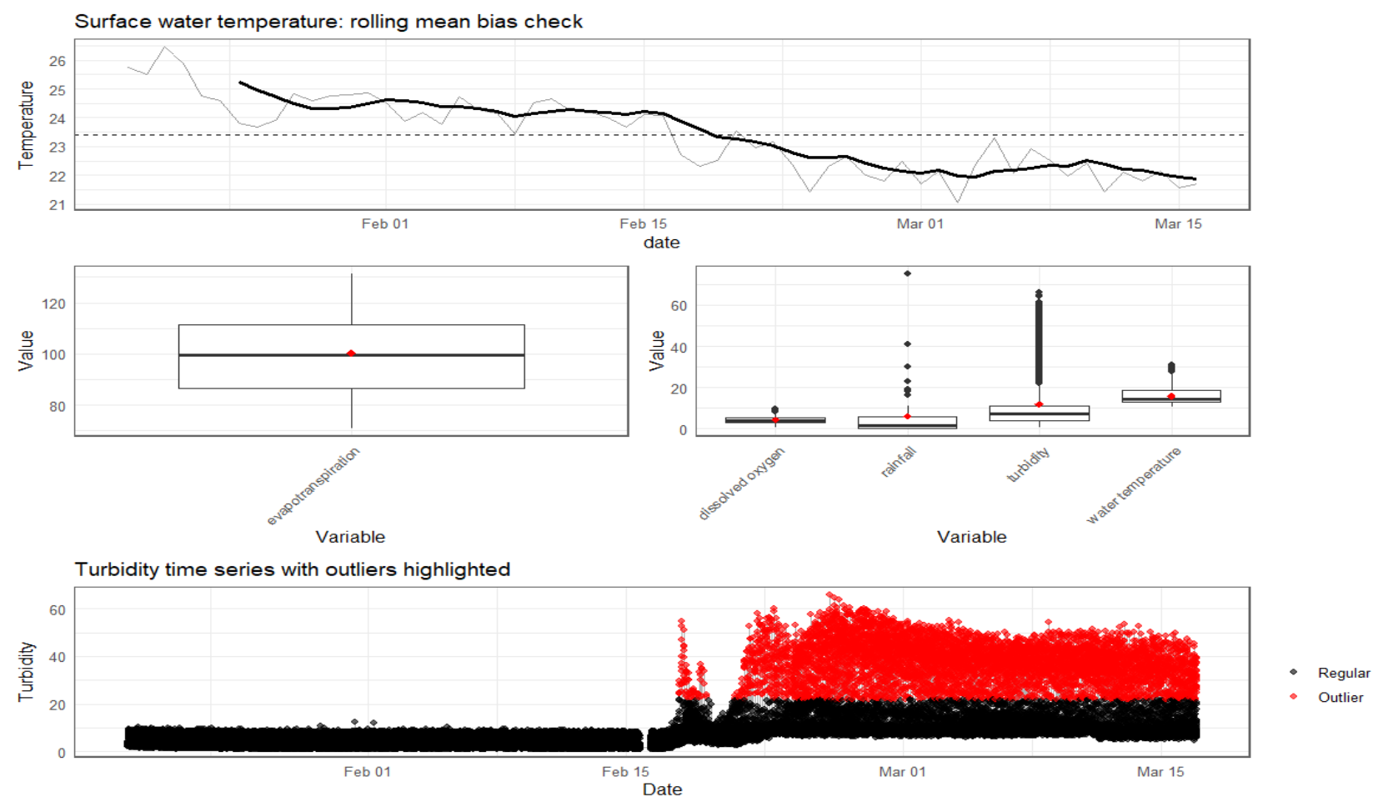
Data Coverage / Bias Considerations
  Bias detection
    surface temp rolling average
  Box Plot analysis
    skewness, outlier detection
  Outlier analysis
    Turbidity time series

Slide 7
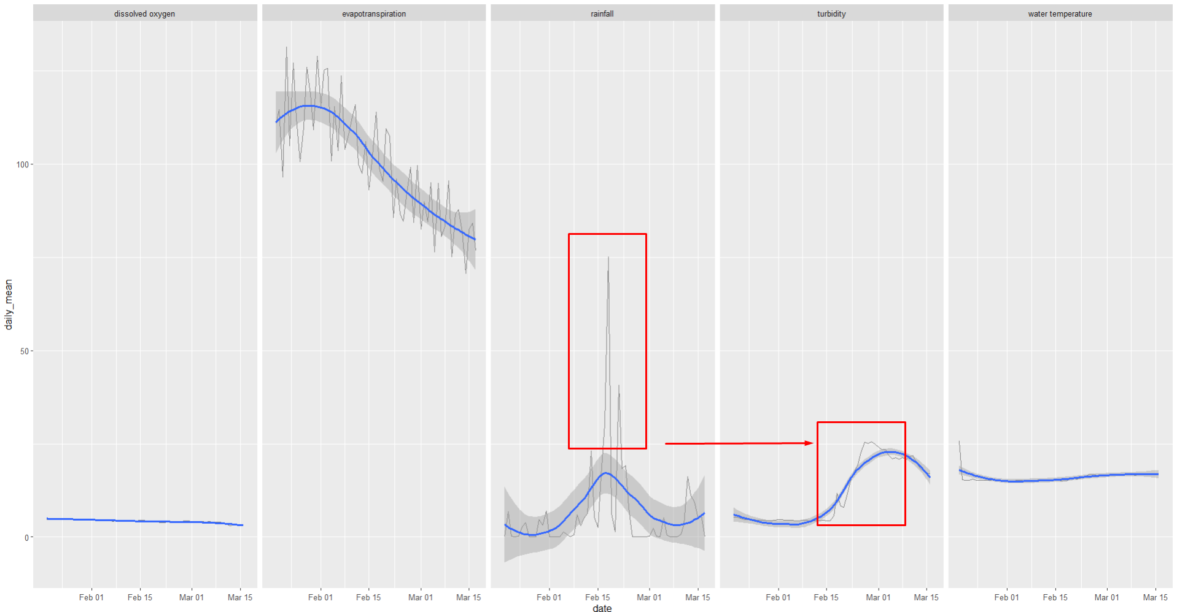
Key Patterns Observed
  DO and Water Temp constant
    But different story at depth
  Evapotranspiration
    normal seasonal decline
  Lag effect from rainfall -> turbidity

Slide 8
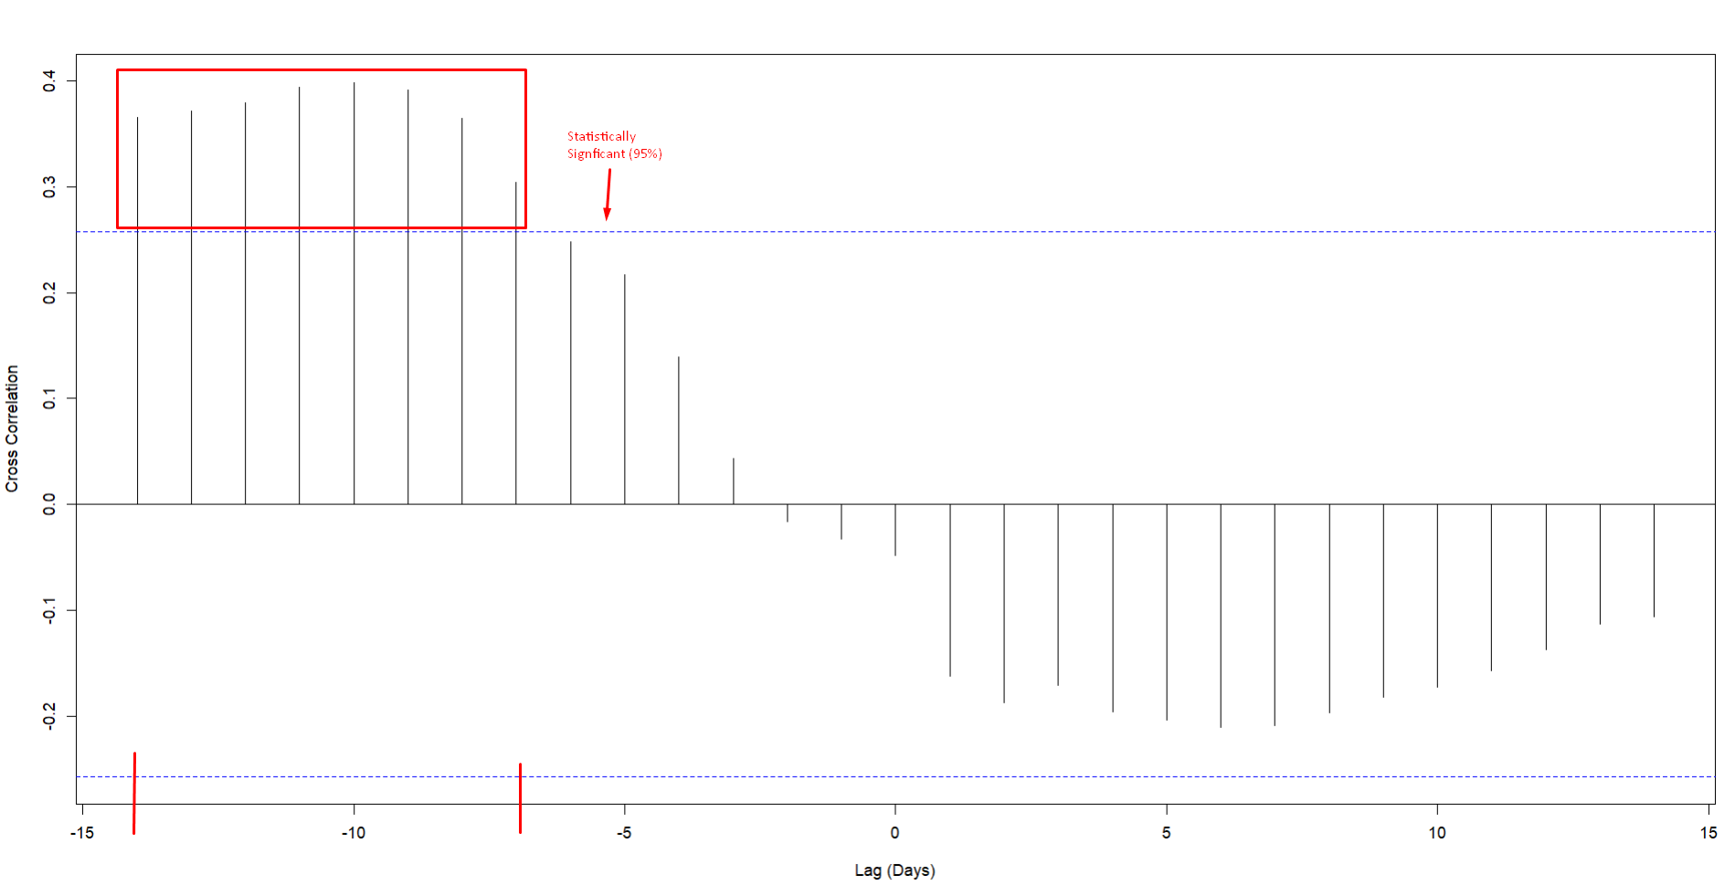
Key Patterns Observed
Rainfall – Turbidity Cross Correlation
  Cross Correlation
    Positive lagged relationship 7-14
    days after rainfall

Slide 9
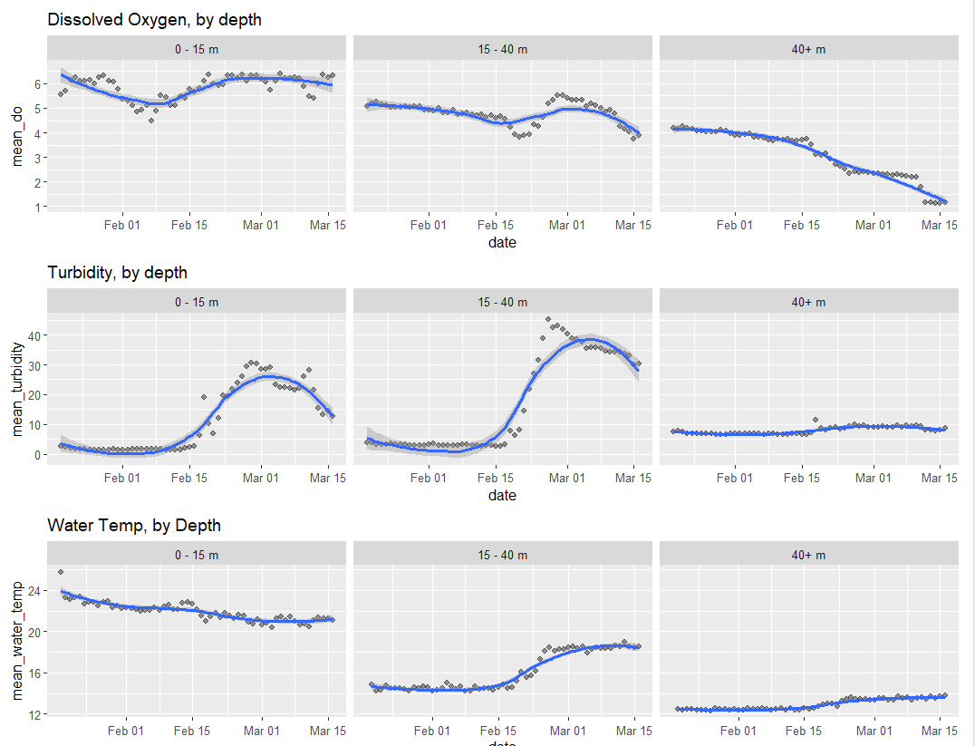
Key Patterns Observed
  DO
    stable at surface (lower risk of Algal Blooms)
    DO declines at depth; warrant further investigation
    with hydrologist
  Turbidity
    spikes consistent with rainfall lag story
  Water Temp
    spike at middle depth – requires further investigation

Slide 10
Results , Key Insights, Recommendations
1. rainfall → turbidity is delayed
  creates opportunity to mitigate risk
2. spikes in turbidity are event-driven
  driven by rainfall, not randomness
3. WQ at depth warrants further investigation
  water temperature and DO

Slide 11
Future Data Science Applications
1. more data
  other reservoir same time
  same reservoir, different time
  longer time horizon
2. ARIMAX forecast of turbidity (use rainfall as input to model)
  only if more data available
3. spatial modelling – examine upstream catchment profiles
  land use analysis to isolate higher nutrient loading source
4. self-service application
  lightweight Streamlit app for repeated exploration / analysis for nontechnical users

Slide 12
Use of AI
1. used to generate some boiler plate code
  decision and judgement human led
  manually revised for better precision
  unexplainable outputs discarded
2. middleman of sense checking:
  results -> hypothesis -> AI sense check -> flood modeller sense check
3. conservative, incremental approach

