Slide 1


WANTED AI – Powered Roommate & Accomodation Finder
Final Year Project – CHP2524
BSc (Hons) Applied Computing
🏠 🤝 ✨
Presented by: Pyae Sone Aung(Mitch)
Supervisor: Dr. Gary Allen
Date: 14th May 2026

Slide 2
1. Project Introduction
LOGIN
Product Summary
A desktop-first web application that helps users:
Find compatible roommates
Browse accommodation listings
Message safely inside the platform
Control what personal information they share
Complete Quiz
Compatibility Score
Discover Users
Browse/Make Listings
Like/Pass
Enquire
Mutual Match
Manage Listings
Message & Share/Hide Profile details

Slide 3
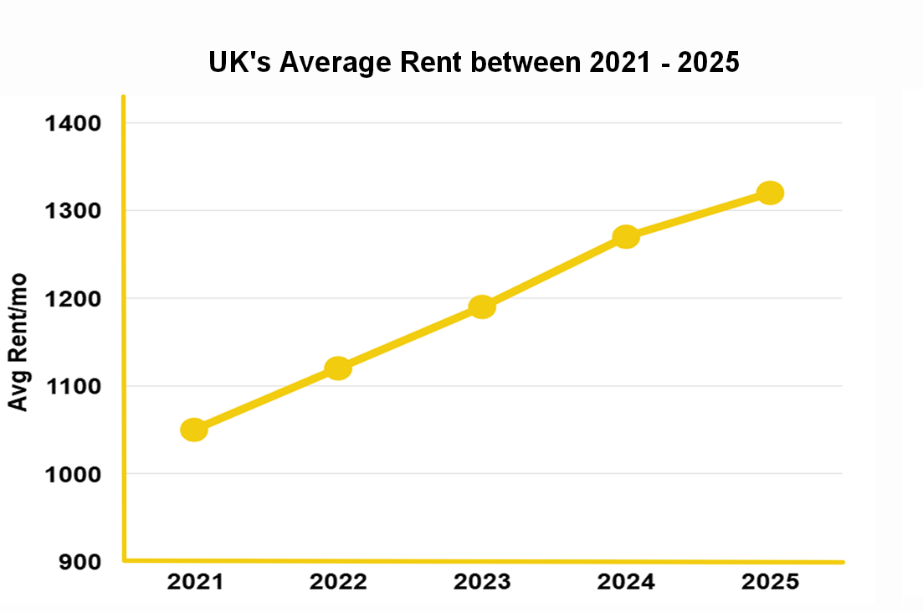
2. Background & Problem
Increased Rent Pressure in UK
UK private rents rose by 5.5% year-on-year
Around 35.2% of UK rent 2024-2025
Average UK private rent £1,254/month
Sharing rent reduces ~£1,200 to ~£749 (-37%)
“Sharing accommodation becomes a practical way to reduce cost pressure”

Slide 4
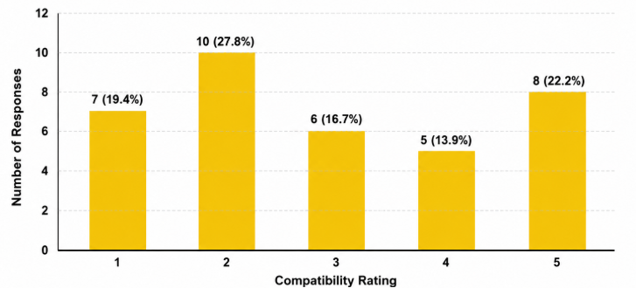
2. Background & Problem
Sharing is common yet incompatibly is normalized
Many students and young professionals live with people they barely know
Conflicts are often caused by different habits and expectations, not bad intentions
Most current platforms focus on rooms and listings, not the people living together
This leaves roommate decisions to luck, trial-and-error, or informal judgement
Public Survey (36 Responses)
47.2% were incompatible
16.7% neutral
Only 36.1% were compatible

Slide 5
3. Proposed Solution
Problem | Wanted’s Solution
❓Users do not know flat mates before moving in | 💡Browse & Connect with other users
❓Different preferences cause stress/conflicts | 💡Compatibility ranked using habits/preferences
❓Other platforms focus mainly on rooms | 💡Roommate matching features with basic listings

Slide 6
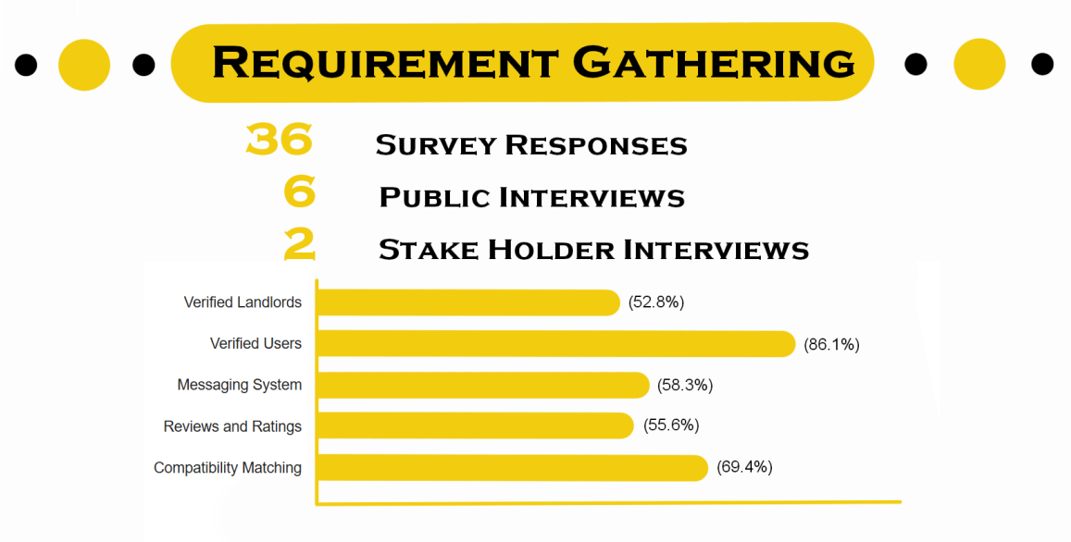
4. Surveys

Slide 7
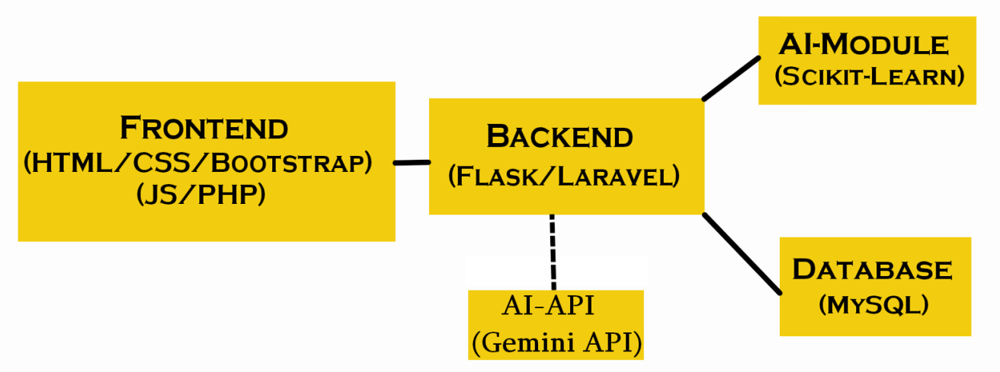
5. System Architecture
Laravel / PHP: framework for routing and controllers
MySQL: stores users' data in 13 tables
Bootstrap + JavaScript: desktop-first and interactive UI
Gemini API: auto bio generation
Flask + scikit-learn: beta AI scoring service
XAMPP: local development and testing environment

Slide 8
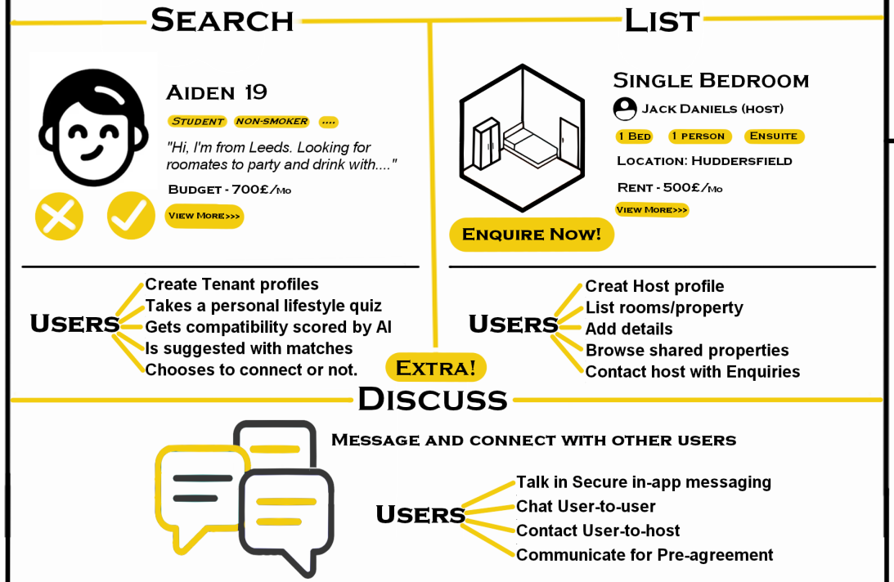
6. Product Features

Slide 9
7. Testing
Feedback Ratings (avg. out of 5)
Participants
Private Sharing Feature
👤
👤
👤
👤
4.5
4 Local Students
Compatibility Scoring
🌍
🌍
🌍
🌍
4.4
4 International Students
Quiz Usefulness
4.4
Testing Process
1
Ease of Use
Free Exploration of the app
4.1
2
Swiping against 20 prepared profiles
Creative UI
4.0
3
Anonymous online feedback form
✅ Iteration 1: Auto Bio · Second Chance · Listing Dashboard · AI Mode

Slide 10
8. Evaluation
Fully Implemented
Partially Implemented
✅ Core Functional Requirements
⚠️ Known Limitations
Registration/Login
Quiz Onboarding
Public Profile
Private Profile
Compatibility Scoring
Ranked Discover
Card Browsing
Like/Pass
Mutual Matching
In-app Messaging
Listing Management
Private Sharing
⚠ Beta AI — needs more data
⚠ No full user verification
⚠ Desktop only (no mobile)
⚠ UI Tested in Chrome
Not Implemented
❌ Deferred Ideas
✕ Collaborative Room Planning
✕ Tag System
✅ Non-Functional Requirements
Password Hashing
CAPTCHA Protection
Data Separation
Reliable Storage
Prototype Performance
MVC Structure
Desktop Interface
Privacy Control

Slide 11
8. Testing & Evaluation
Future Work
01
🏷️
02
🏠
03
🔔
Tag System
Inbox Notification
Shared Listing Planning
Searchable tags to improve browsing and user discovery.
Allow matched users to collaborate and search listings
Notify users for new activity in the system.
04
🪪
05
🤖
06
📱
Improved AI Model
Mobile Version
Stronger
Verification
Train the beta AI model with more quality and balanced data
Develop a mobile version or app for and convenience.
Use email or phone OTP verification to reduce fake accounts.

Slide 12
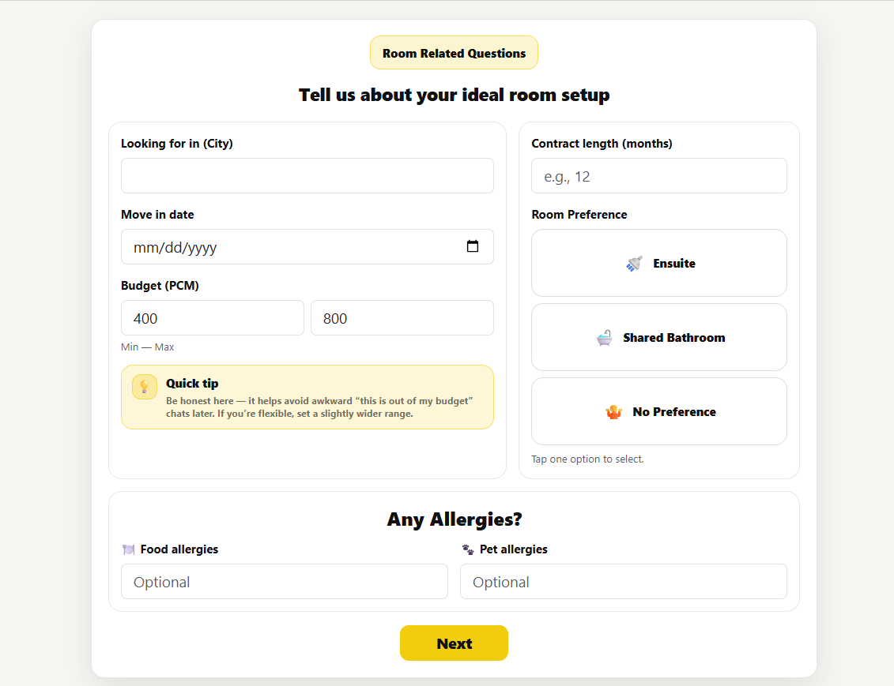
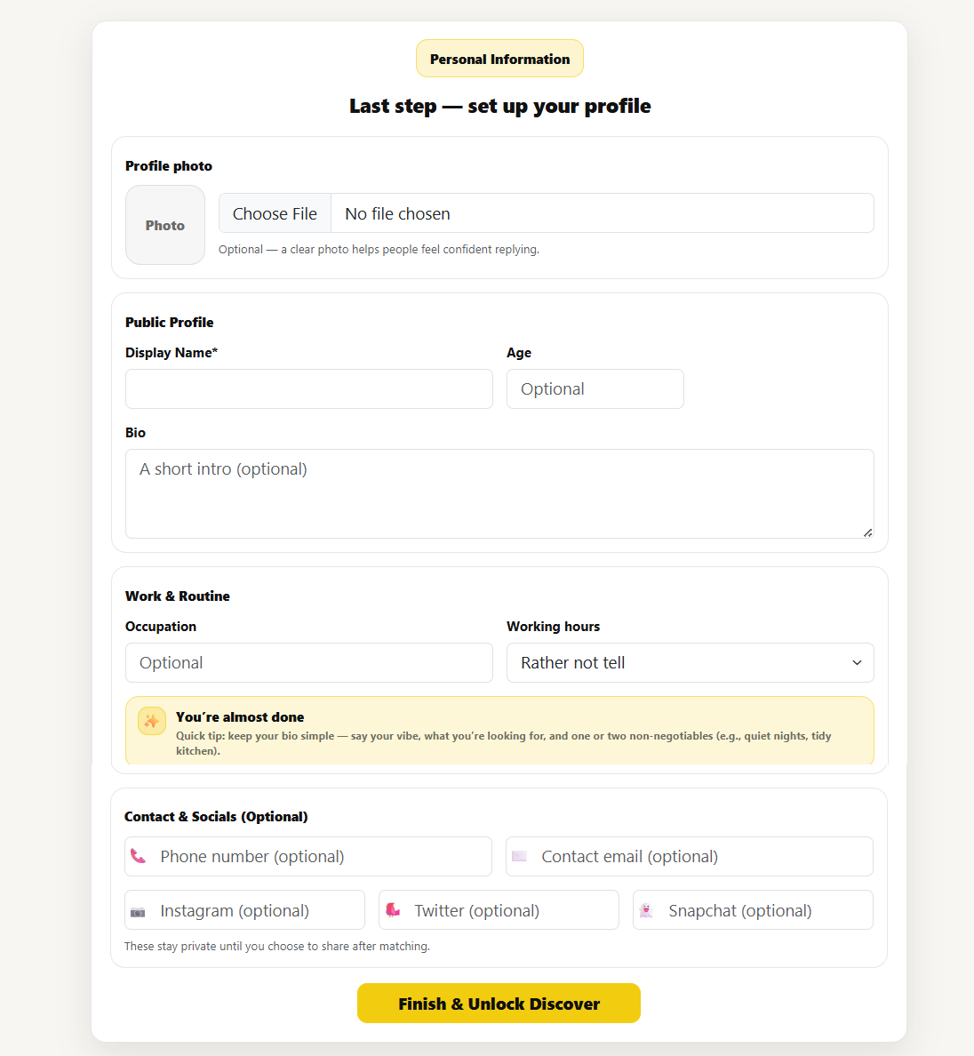
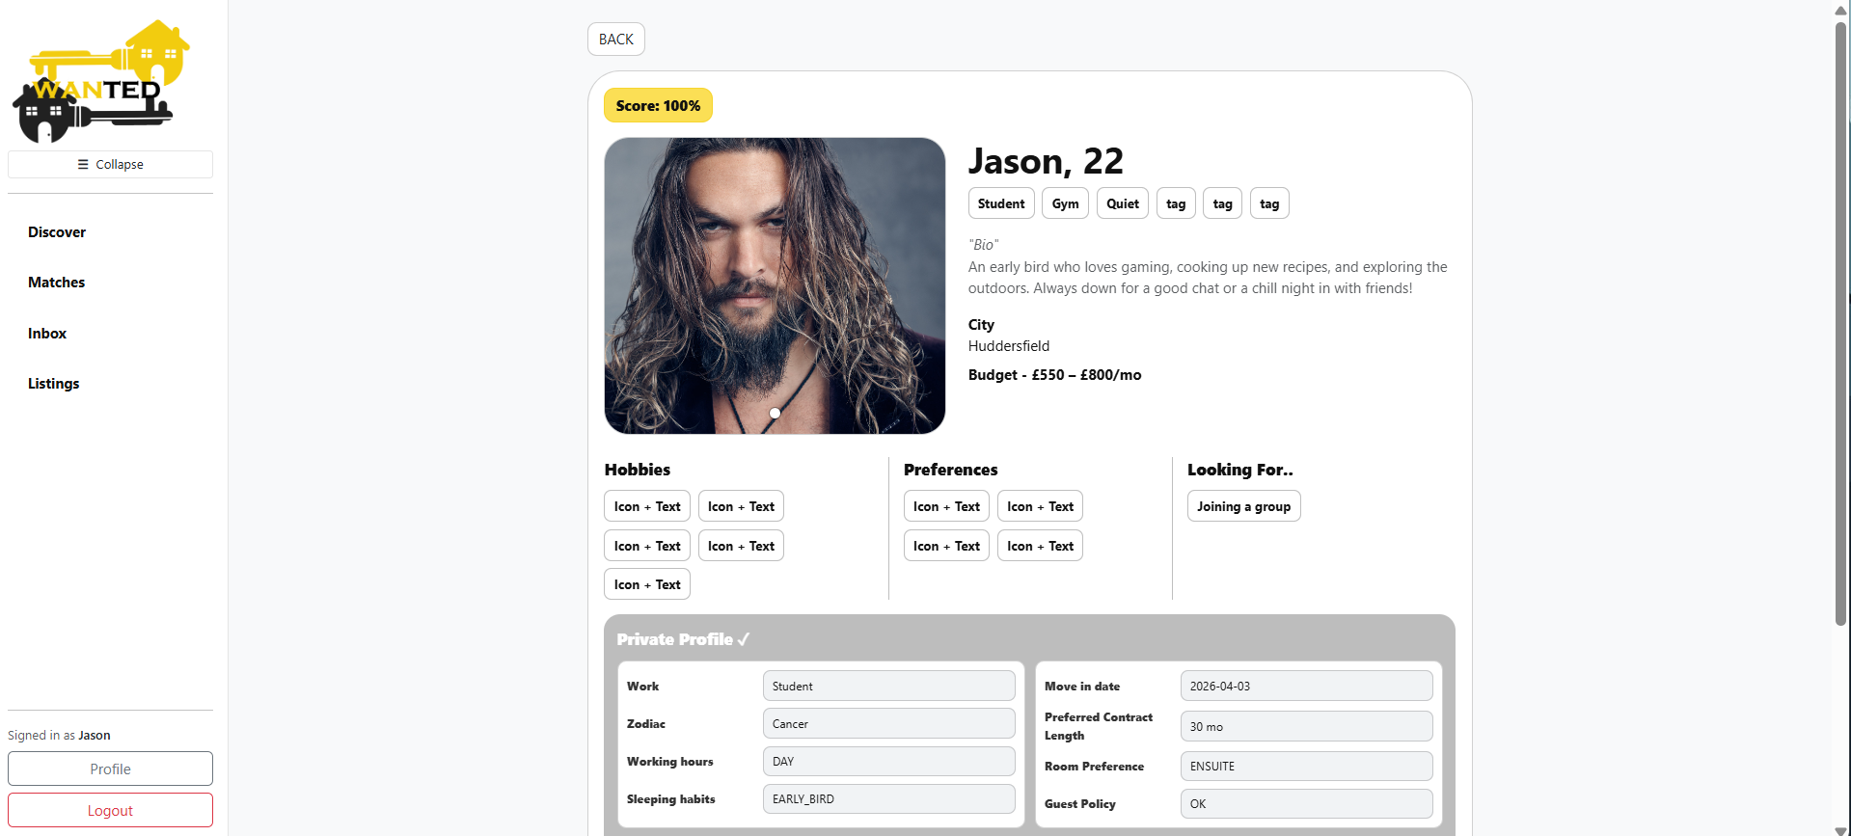
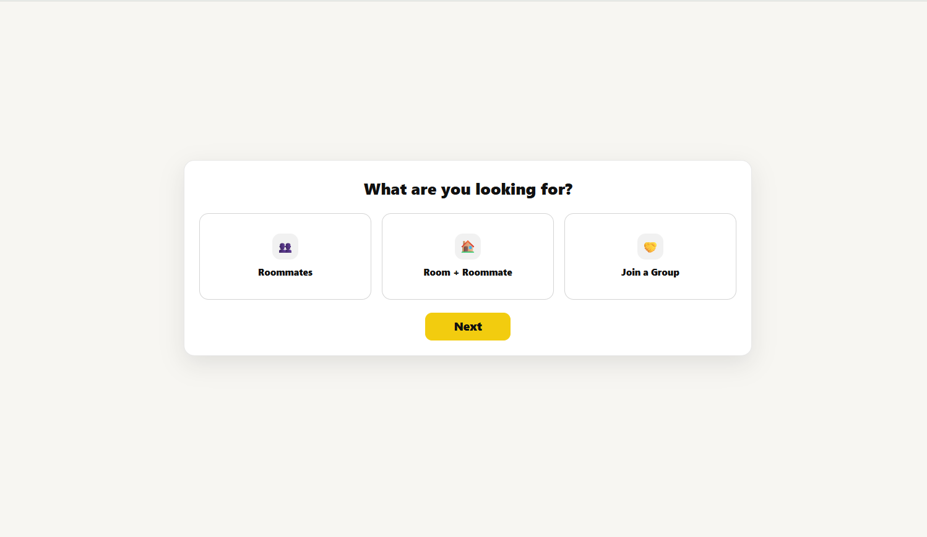
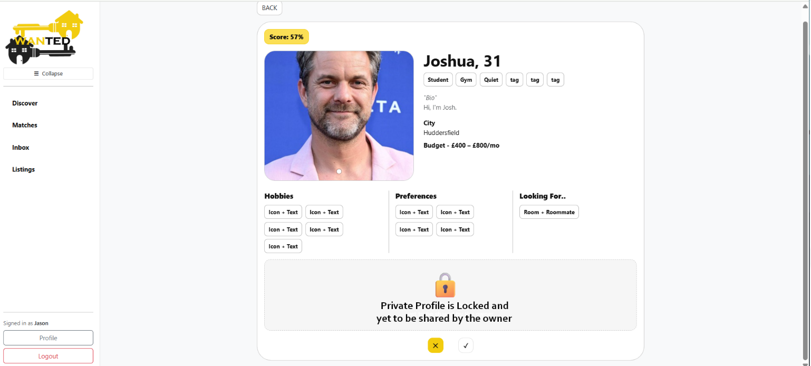
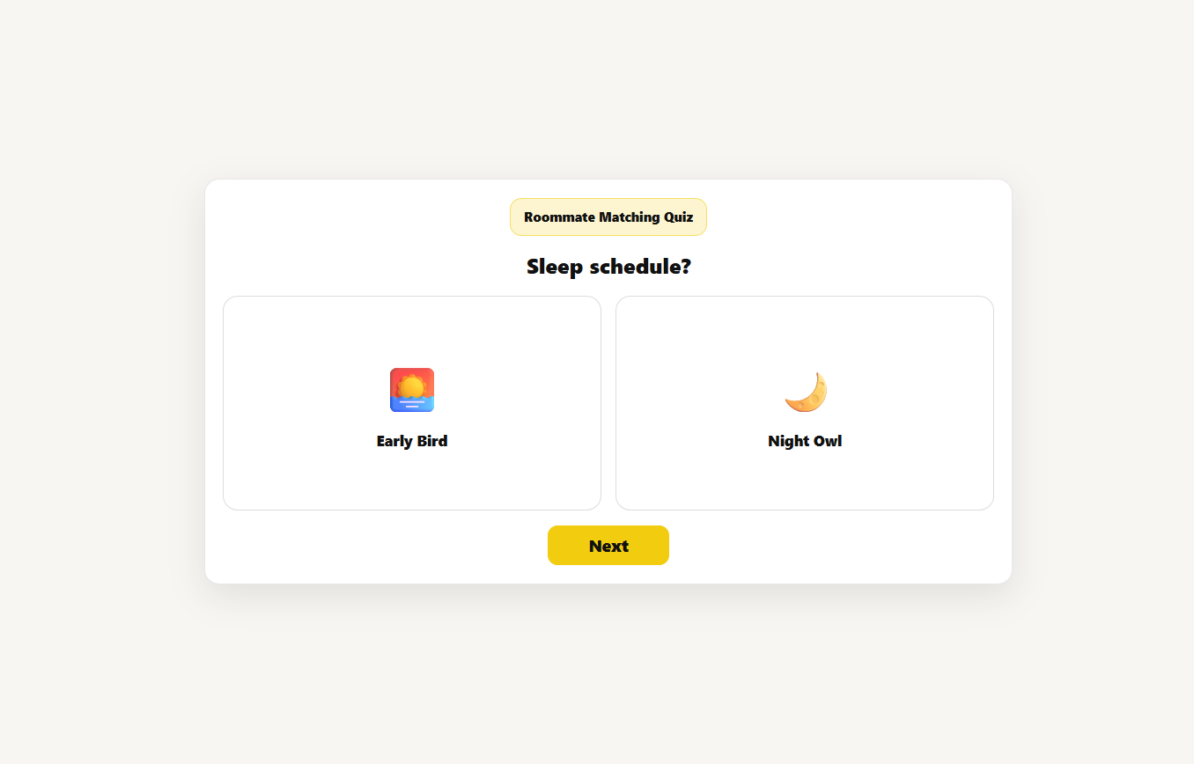
1: Quiz based Onboarding
4-step quiz wizard
Profile photo upload
Quiz gate before Discover access
Public profile creation
Private profile creation

Slide 13
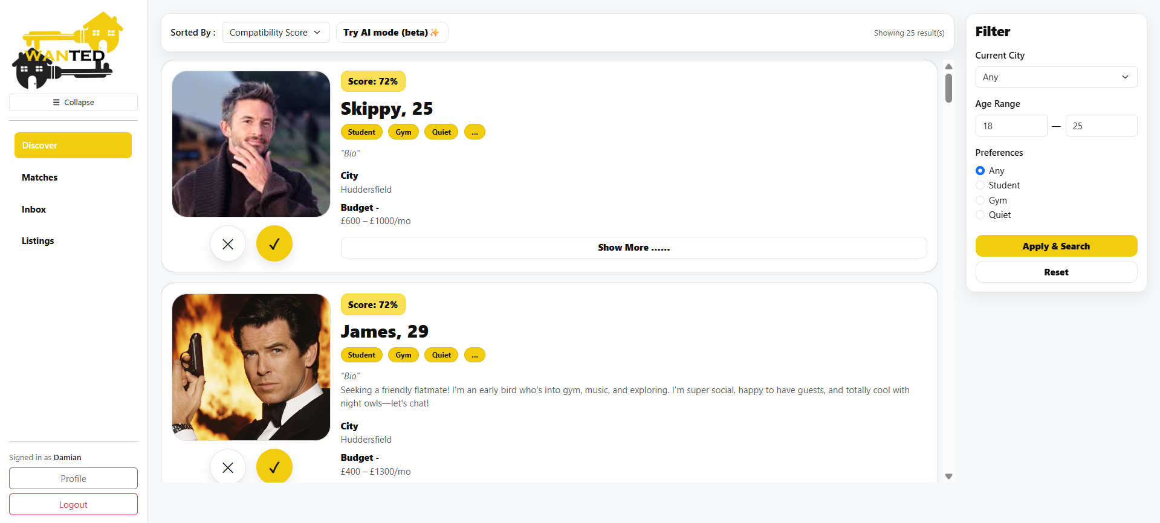
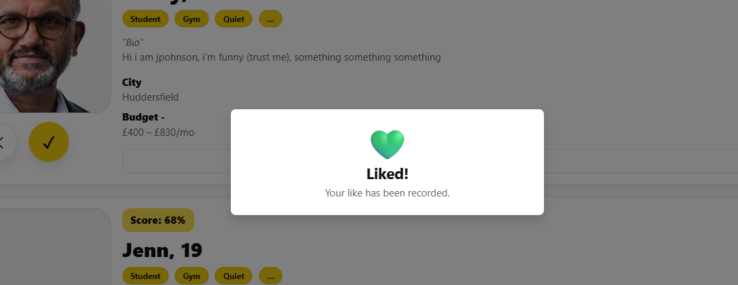
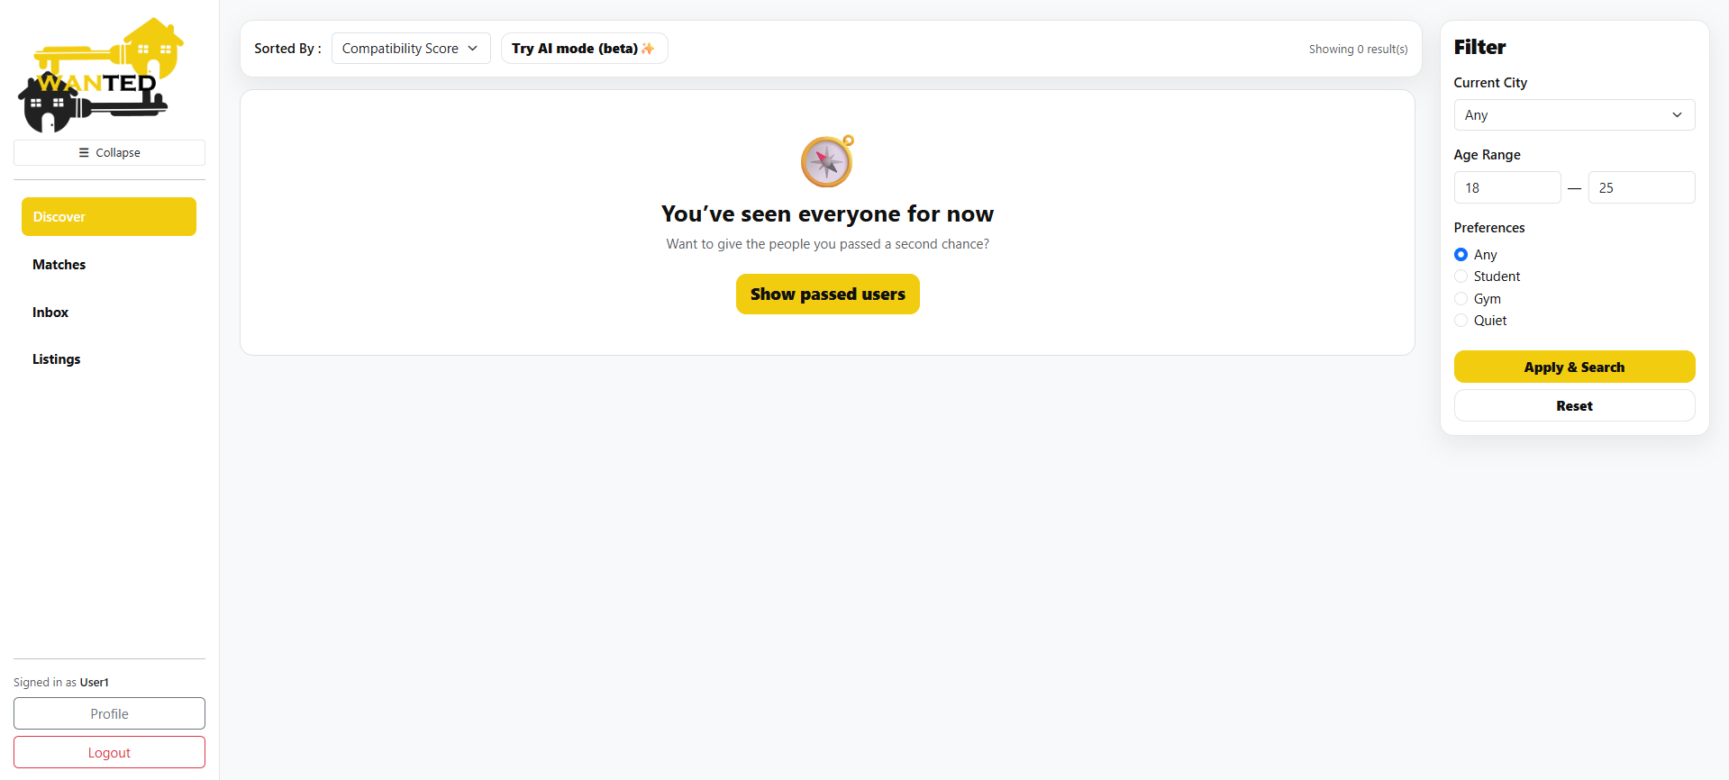
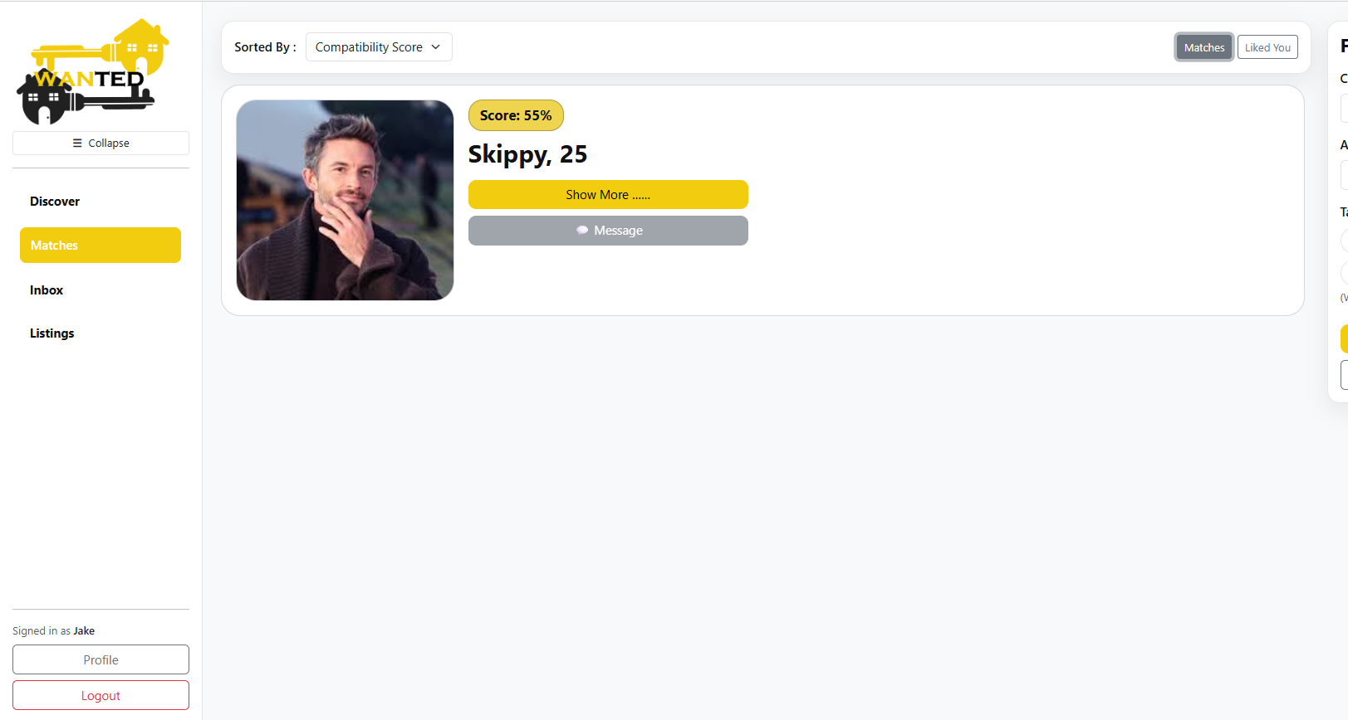
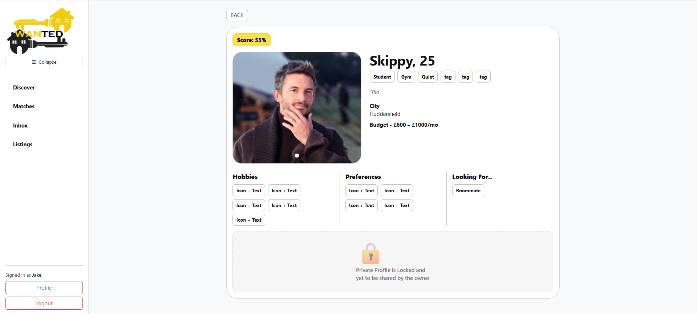
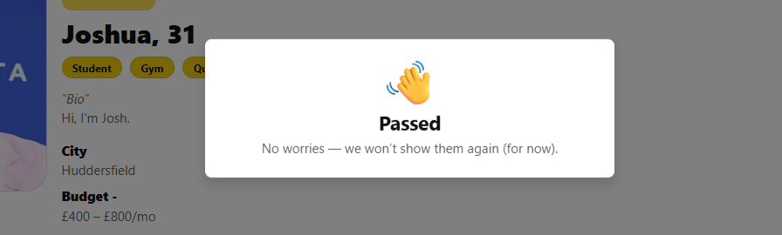
2: Compatibility Matching
Compatibility scores
Ranked user pool
Like/Pass interaction
Mutual match
Second Chance
Sort and Filter

Slide 14
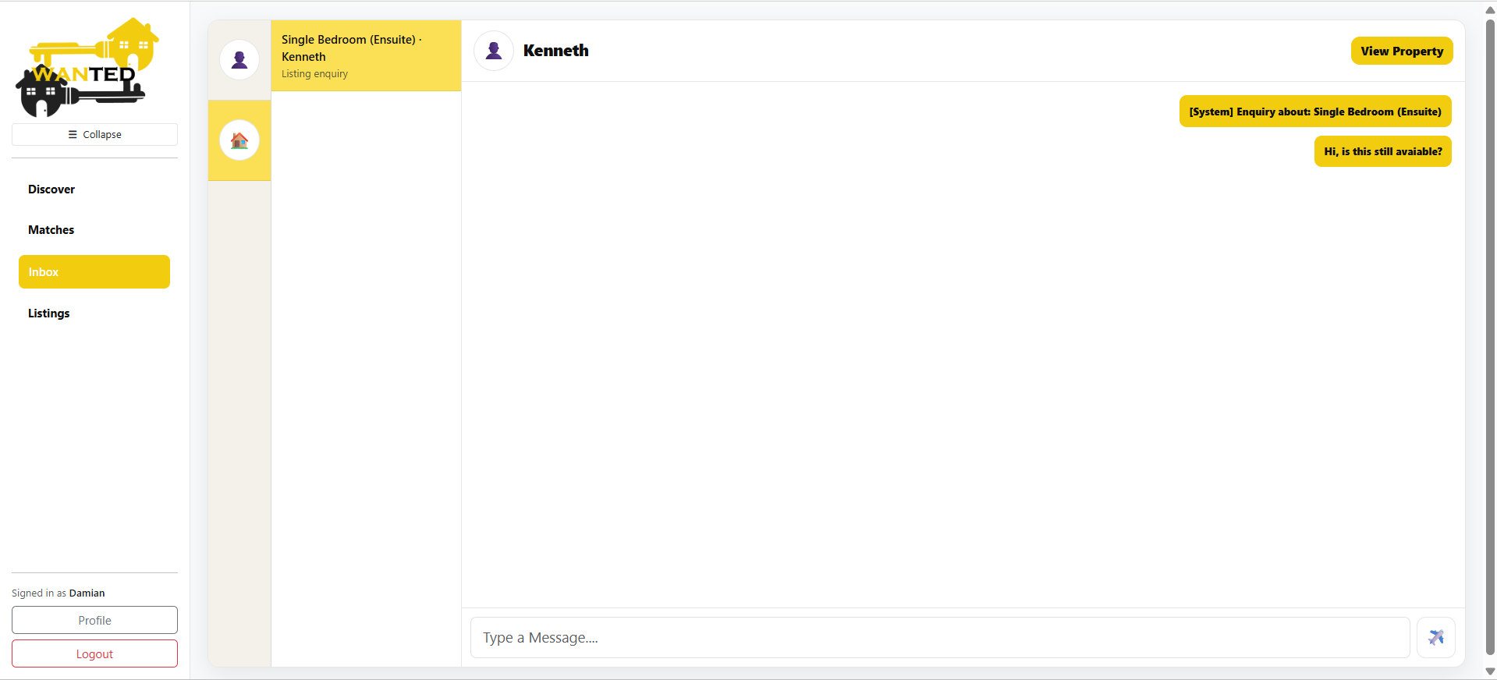
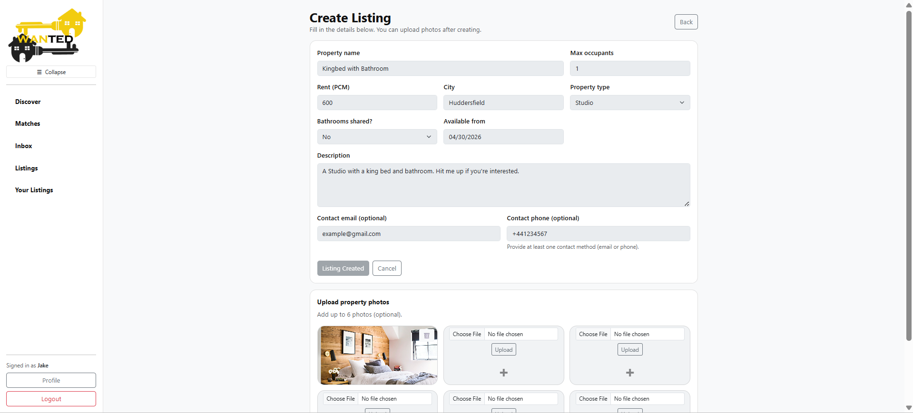
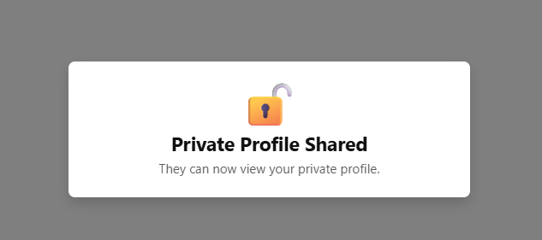
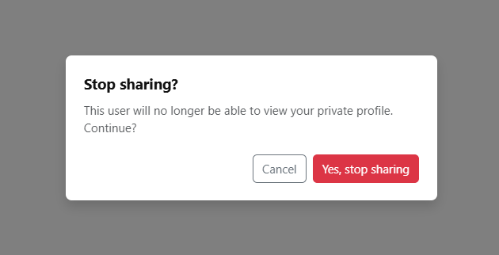
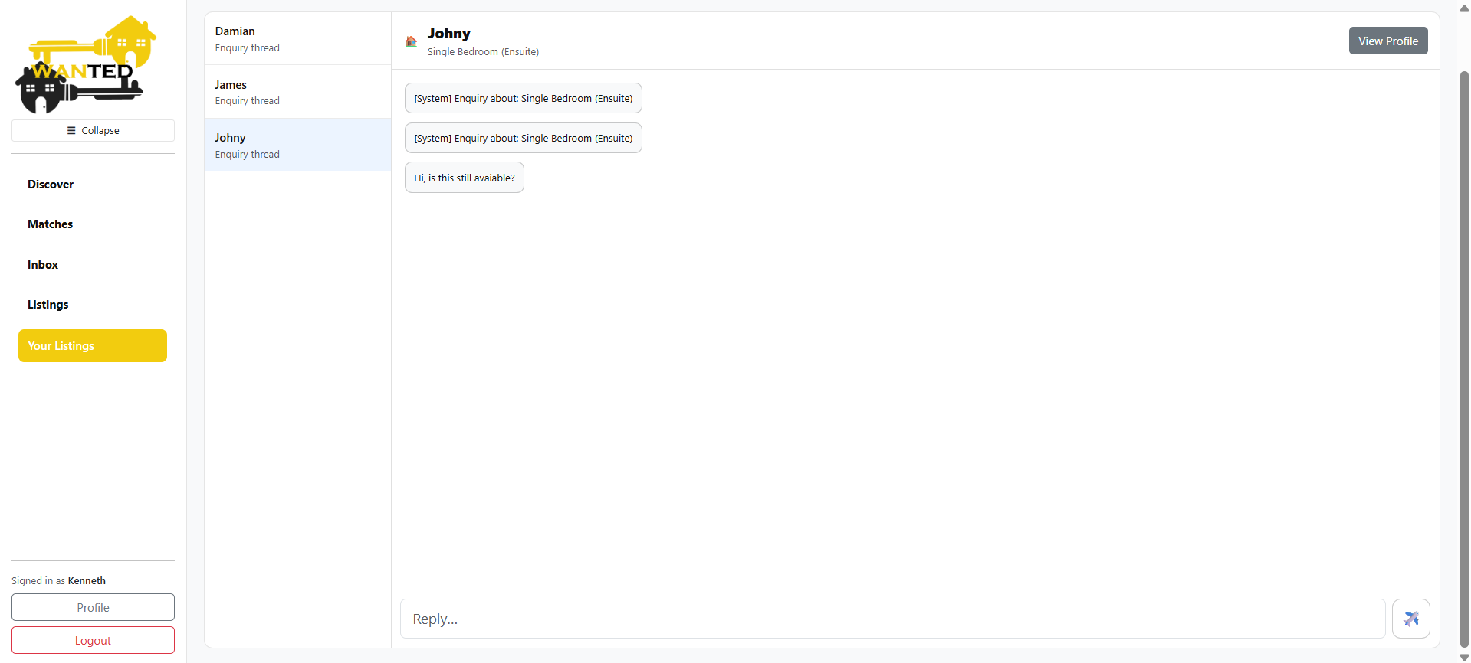
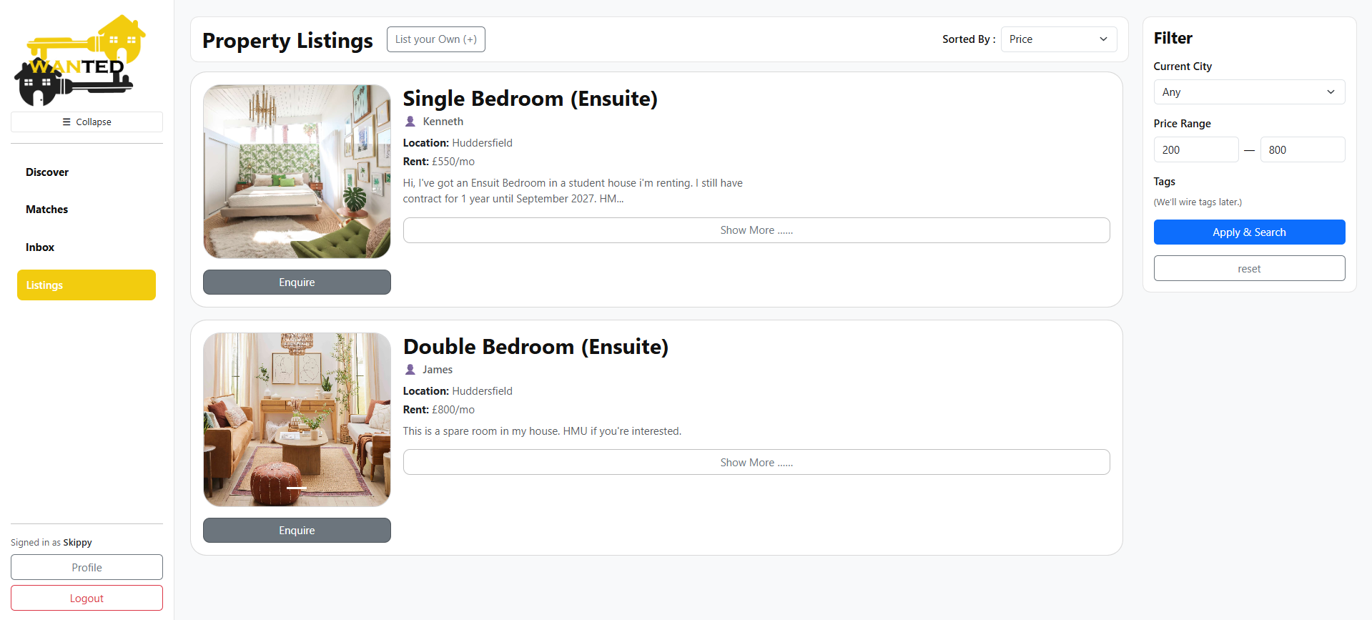
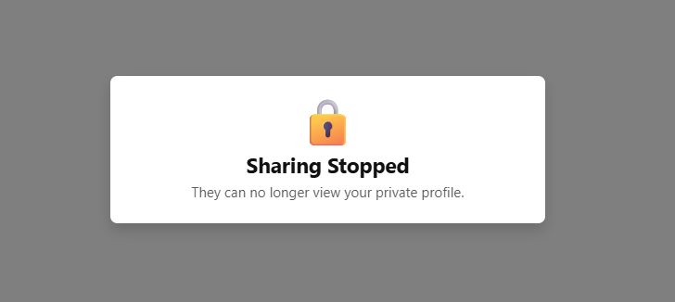
3: Communication & Accommodation Listing
MATCH and LISTING inbox
Match-based messaging
Listing enquiry messaging
Listing dashboard
Private profile sharing/hiding

Slide 15
Thank you

Slide 16
