Slide 1
Project Report template
Robotic Process Automation (CAI2C01)
AY2026/2027 April Semester
Notes:
Good morning. Today I am going to present my RPA project, called ApplyPilot.
ApplyPilot is a recruitment automation robot. It helps recruitment staff process job applications faster and with less repeated manual work.
I will first explain the problem, then show how ApplyPilot solves it step by step.

Slide 2
Problem statement
Recruitment staff receive many job applications for technical roles such as Junior Software Engineer. They check each application email, download the résumés, read both PDF and scanned files, compare technical skills like Python, Java and SQL, check for duplicate applicants, and record every candidate’s details by hand.
The main problem: Recruitment staff spend too much time repeating the same manual tasks for every application. This makes the process slow and may also cause typing mistakes, missed information and inconsistent candidate screening.
ApplyPilot improves this process by automatically collecting applications from Gmail, extracting and validating candidate information, scoring applicants with Python, checking duplicate emails in MySQL and generating a ranked Excel report. This allows recruitment staff to focus on reviewing suitable candidates instead of repeating administrative tasks.
Notes:
First, I would like to explain the main problem behind my project.
Recruitment staff may receive many applications for technical roles such as Junior Software Engineer. For every applicant, they need to check the email, download and read the résumé, compare important skills, check whether the applicant has applied before, and record the candidate details manually.
The main issue is that these same tasks are repeated for every single application. When there are many applicants, this takes a lot of time and can also lead to typing mistakes, missed information, and inconsistent screening.
So I created ApplyPilot to automate these repeated tasks and give the recruiter a more organised and consistent result.
Based on these problems, I designed the workflow shown in the next slide.

Slide 3
Process
How ApplyPilot works — five stages across five applications
Collect
Read
Score
01
02
03
Gmail
PDF / OCR
Python
Download unread email attachments and marks the email as read.
Read digital PDFs, scanned PDFs and image files.
Give each candidate a score and priority level.
Report
Store & Route
05
04
Excel
MySQL + Folders
Sorts candidates by priority and score, then creates the final ranked candidate report.
Checks the candidate’s email for duplicates, saves new applicants and moves each résumé to Processed, Duplicate or Failed.
03
Notes:
Based on the problem I explained earlier, I designed ApplyPilot as a five-stage process.
It starts by collecting applications from Gmail, then reads the résumé using PDF extraction or OCR. After that, Python scores the candidate, MySQL checks and stores the result, and finally Excel creates the ranked report.
So this slide shows how the whole process connects from the application email to the final result.
I will now explain each part in more detail.

Slide 4
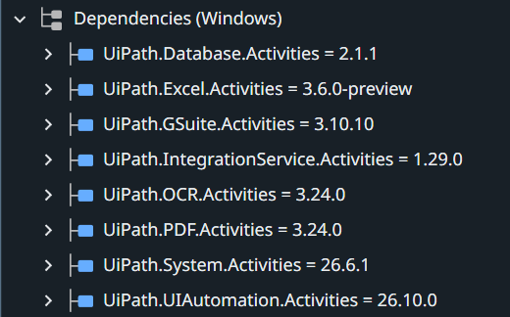
Packages (Project Dependencies) used
Database
MySQL duplicate check and insert
Excel
Ranked candidate workbook
GSuite
Gmail collection and attachments
Integration Service
Supports Google Workspace connection
OCR
Scanned PDF / image text reading
PDF
Digital résumé text reading
System
If, Assign, Try Catch, logging and file moving
UI Automation
Supports image/OCR-related activities
Notes:
This slide shows the main UiPath packages I used in ApplyPilot.
For Gmail, I use the GSuite package, with activities such as Google Workspace Scope, Get Mail Messages, Download Email Attachments, and Mark Email as Read or Unread. The Integration Service package supports the Google Workspace connection.
For résumé reading, I use the PDF package for Read PDF Text, and the OCR package for scanned PDFs and image files.
For MySQL, I use the Database package for activities such as Connect to Database, Run Query, and inserting new applicant records.
For the final report, I use the Excel package, mainly to write the sorted candidate results into the workbook.
Finally, the System package supports the main workflow logic, such as If, Assign, Try Catch, logging, and Move File.
So each package supports a specific part of the ApplyPilot process, and the next slide starts with the Gmail collection stage.

Slide 5
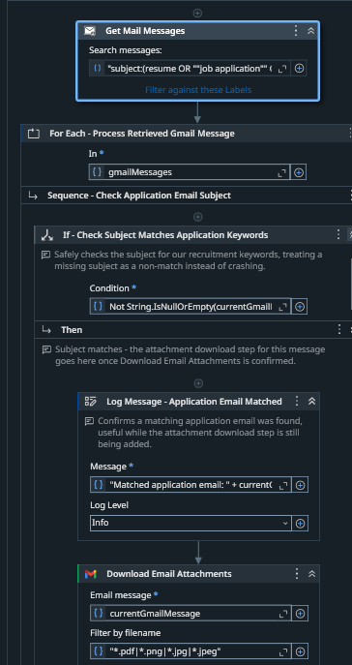
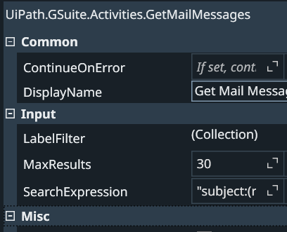
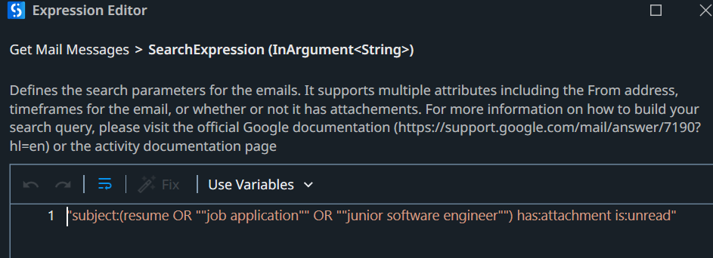
Step 1: Collecting applications from Gmail
Activities used
Google Workspace Scope,
Get Mail Messages
For Each, If,
Download Email Attachments and
Mark Email as Read or Unread.
How it works
ApplyPilot retrieves up to 30 unread emails that contain attachments and use the subject keywords “resume,” “job application,” or “junior software engineer.”
For each matching email, it downloads only PDF, PNG, JPG and JPEG résumé files. The email is then marked as read so it will not be processed again during the next run.
Notes:
The first pain point is checking application emails manually.
If many applications arrive, the recruiter has to keep opening emails and downloading attachments one by one.
ApplyPilot solves this by using Google Workspace Scope and Get Mail Messages to find unread application emails with keywords such as resume, job application, or junior software engineer.
For each matching email, the robot downloads only supported résumé files and then marks the email as read.
This reduces repeated inbox checking and also prevents the same email from being processed again.

Slide 6
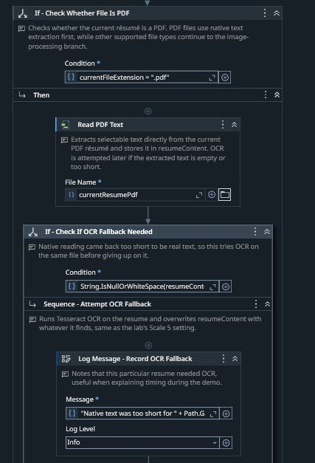
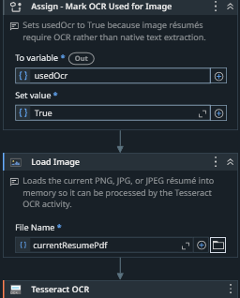
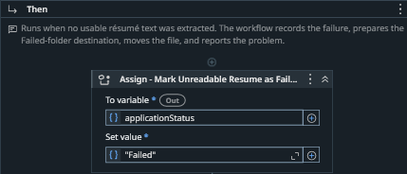
Step 2 : Reading, extracting and validating résumés
How it works
ApplyPilot first checks the résumé file type. For a digital PDF, it uses Read PDF Text. If the extracted text is empty or too short, it uses OCR instead. PNG, JPG and JPEG files are loaded as images and read using OCR.
After the text is collected, the robot extracts the candidate’s name, email, phone, education, experience and skills. It then checks that the required information is available. If the résumé is unreadable or important details are missing, the application is marked as Failed and the reason is recorded
Notes:
After collecting the résumé, the next challenge is reading different file formats.
For a normal digital PDF, ApplyPilot first uses Read PDF Text. But if the PDF is scanned and the extracted text is empty or too short, the robot automatically switches to OCR.
For PNG, JPG, and JPEG files, it uses OCR directly.
After reading the résumé, the robot extracts important details such as the candidate's name, email, education, experience, and skills.
I also added validation here. If important information is missing, or the résumé cannot be read properly, the application is marked as Failed and the reason is recorded instead of stopping the whole process.
Once the candidate information is successfully extracted, the next step is to score the candidate using Python.

Slide 7
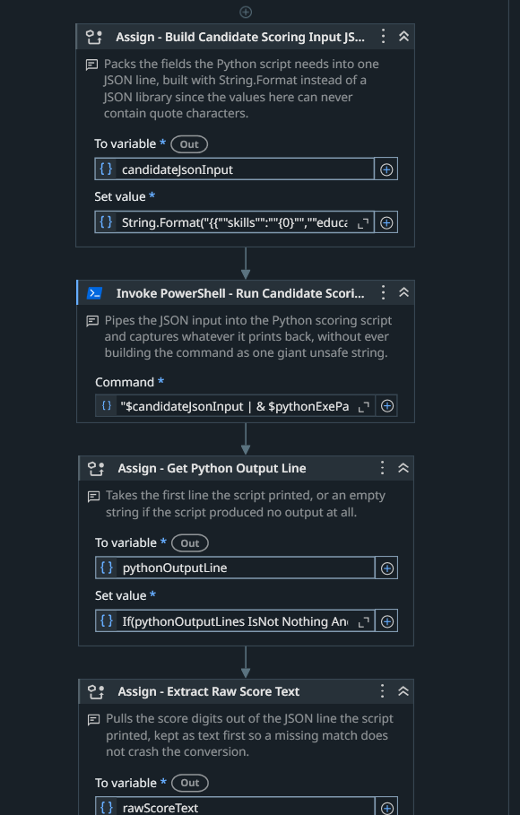
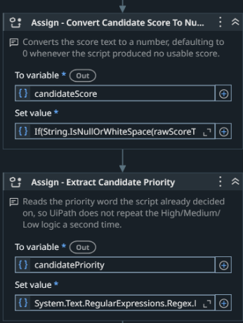
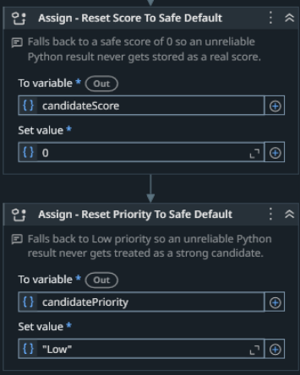
Step 3 : Scoring candidates with Python
How it works
ApplyPilot prepares the candidate’s skills, education and experience as JSON and sends the information to score_candidate.py using Invoke PowerShell.
The Python script returns a candidate score and a priority of High, Medium or Low. UiPath extracts these values and stores them with the candidate’s result.
If the Python output is missing, invalid or outside the accepted range, the robot logs a warning and safely uses a score of 0 with Low priority instead of stopping the workflow.
Notes:
After the résumé is read, the next problem is keeping the screening consistent.
So ApplyPilot sends the candidate’s skills, education, and experience to my Python file using Invoke PowerShell.
The Python script applies the same scoring rules to every candidate and returns a score and a priority of High, Medium, or Low.
I also added validation here. If the Python output is missing or invalid, ApplyPilot safely uses a score of 0 and Low priority instead of stopping the workflow.
After scoring, the next step is to check whether the applicant already exists in MySQL.

Slide 8
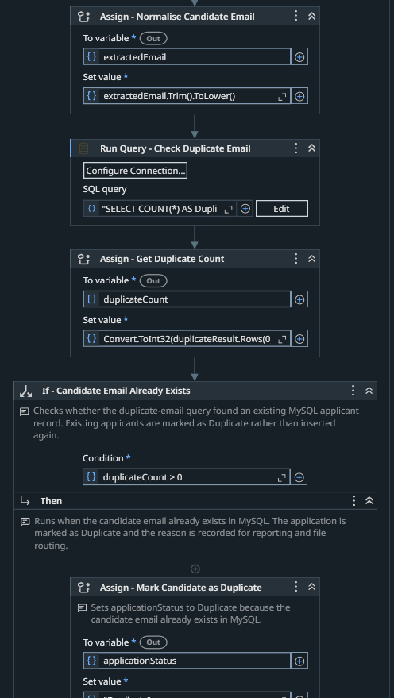
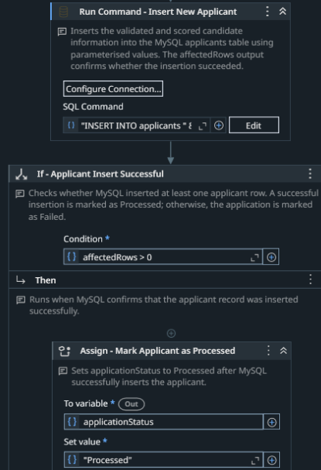
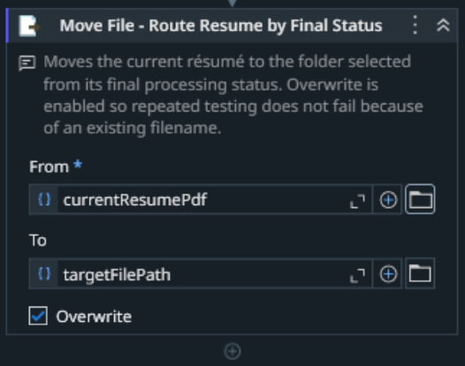
Step 4 : Storing and routing applications
How it works
ApplyPilot first cleans the candidate’s email by removing extra spaces and changing it to lowercase. It then checks MySQL to see whether the same email already exists.
If the email is new, the candidate’s details, score and priority are inserted into the database. The robot checks that the insertion was successful before marking the application as Processed.
Finally, the résumé is moved to the correct folder based on its result: Processed, Duplicate or Failed.
Notes:
After scoring, the next problem is checking for duplicate applicants and keeping the files organised.
ApplyPilot first cleans the candidate’s email by removing extra spaces and changing it to lowercase. Then it checks MySQL to see whether the same email already exists.
If the email already exists, the application is marked as Duplicate. If it is a new applicant, the candidate details, score, and priority are inserted into MySQL, and the robot checks that the insert was successful.
Finally, the résumé is moved into the correct folder: Processed, Duplicate, or Failed.
.

Slide 9
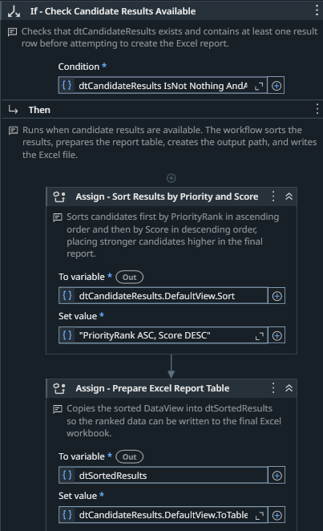
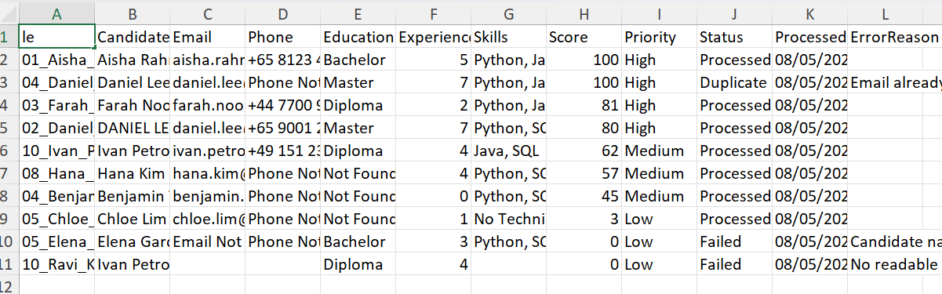
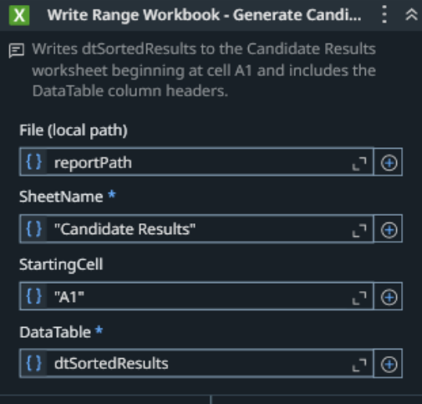
Step 5 : Creating the ranked Excel report
How it works
After all résumés have been processed, ApplyPilot checks whether candidate results are available. It sorts the records using PriorityRank ASC, Score DESC, so higher-priority candidates appear first, followed by the highest scores within each priority group.
The sorted results are then written to the Candidate Results worksheet starting from cell A1, including the column headings. Finally, the robot records a message confirming that the Excel report was created successfully.
Notes:
After all the applications are processedApplyPilot first checks that candidate results are available, then sorts them by priority first and score second. So High-priority candidates appear before Medium and Low, and within the same priority, the higher score comes first.
After sorting, the robot writes the results into the Candidate Results worksheet starting from cell A1.
The final report includes the candidate details, score, priority, status, and error reason.
This gives the recruiter one clear ranked report instead of checking all the applications again.

Slide 10
YouTube link for demo
https://youtu.be/KqSb8rVNgWc

Slide 11
References
https://docs.uipath.com/activities/other/latest/productivity/gsuite-get-mail-messages
https://docs.uipath.com/activities/other/latest/document-understanding/read-pdf-text
https://docs.uipath.com/activities/other/latest/document-understanding/read-pdf-with-ocr\
https://docs.uipath.com/activities/other/latest/workflow/invoke-power-shell
https://docs.uipath.com/activities/other/latest/developer/about-the-database-activities-pack
https://docs.uipath.com/activities/other/latest/workflow/try-catch
https://docs.uipath.com/activities/other/latest/productivity/about-the-excel-activities-pack
https://docs.uipath.com/activities/other/latest/workflow/get-robot-credential

