Slide 1
Short-Term load Forecasting

Slide 2
LOAD FORECASTING:
Forecasting in the problem of determining the future values of a time series from the current and past values.
Load forecasting is about estimating future consumptions based on various data and information available as per consumer behaviour.
Short-term Load Forecasting can help to estimate the load flows and to make decisions that can prevent overloading. Timely implementations of such decisions lead to improvement of network reliability and to reduced occurrences of equipment failures or blackout.

Slide 3
Role of load forecasting:
For proper planning of Power System.
      To determine the potential need for additional new generating facilities.
      To determine the size of the plants.
      On correct values of demand, load forecasting will prevent over designing of conductor sizes.
For proper planning of Transmission and Distribution facilities.
      Wastage due to unplanning like the purchase of equipment which is not immediately required can be avoided.
For proper Financing.
For proper Grid Formation.

Slide 4
Load Curves:
Variations in load on power station from time to time.
  Daily load curves.
  Monthly load curves.
  Annual load curves.
Load curves give –
  Variation of load during different times.
  Total no. of units generated.
  Maximum demand.
  Average load on a power station.
  Load Factor.

Slide 5
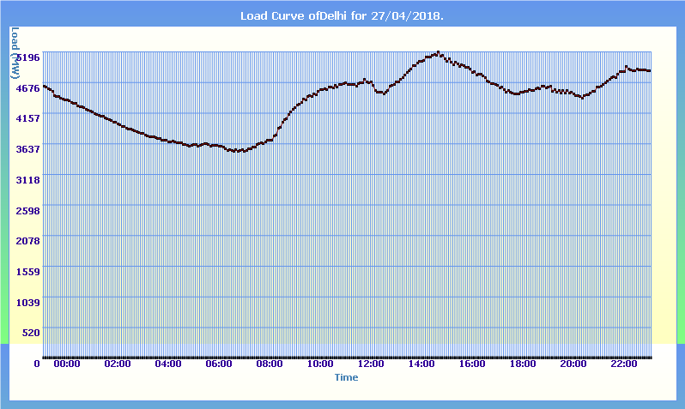
Daily Load Curve sample:

Slide 6
Factors affecting Load Forecasting:
Time factors such as:
  Hours of the day (day/night).
  Days of the week (weekday/ weekend).
  Time of the year (season).
Weather conditions (Temperature and Humidity).
Class of customers (residential, commercial, industrial, agricultural, public, etc).
Special Events (public holidays, etc).
Electricity price.

Slide 7

Data ?

Slide 8
Data Used:
We have used Delhi Electricity Board’s Data which can be found at https://www.delhisldc.org/Loaddata.aspx?mode=29/04/2018 the above site provides load values (MW) in time step of 5 minutes.
We have collected corresponding Humidity and Temperature data from wunderground.
Features Used
  Time of the day.
  Day of the week.
  Temperature at the corresponding time.
  Humidity at the corresponding time.

Slide 9

Data scraping:
Hourly Scraping
Hourly Update Request
SLDC
Our Database
Database Updating
Automation

Slide 10
Our Website Model:
Our Database
https://13.126.97.91
Predicting Algorithms:
1. SMAVG
2. WMAVG
3. SES
Our Website

Slide 11
Website Features:
Daily Load Prediction
http://13.126.97.91
Different Features
Day wise comparison between Real Load Data
Comparison between Different Algorithms

Slide 12
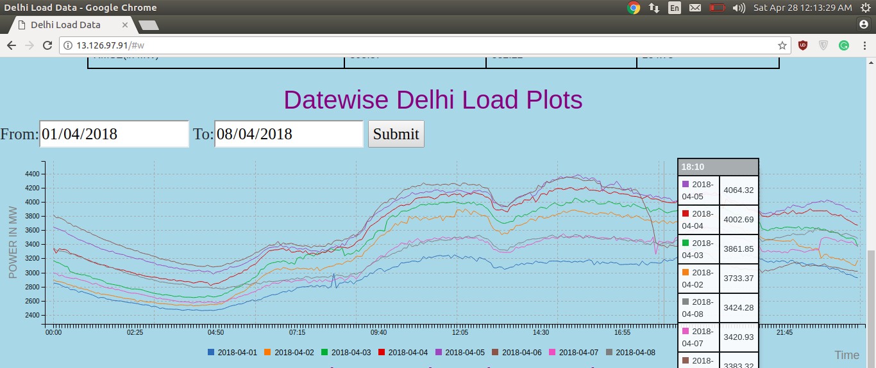
Date wise comparison of Load curves

Slide 13
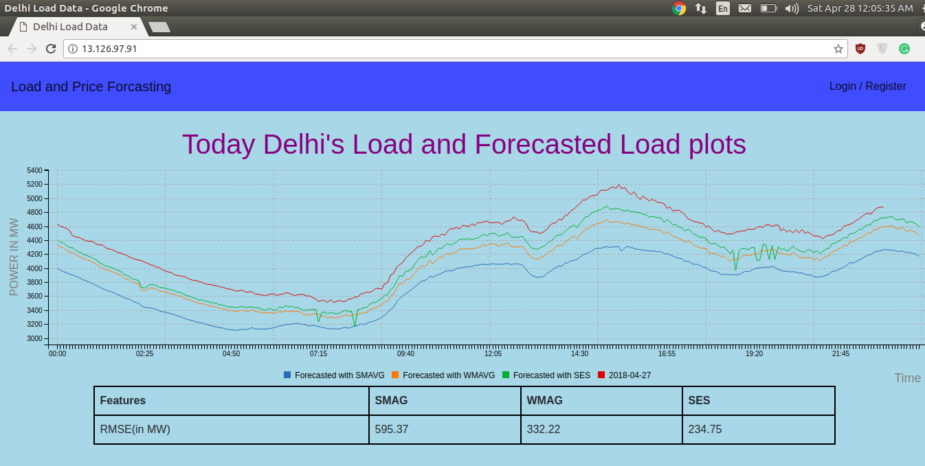
Comparison of Forecasts using SMAG, WMA and SES

Slide 14
Simple Moving Average (SMA):
In this method, the new forecasted value will be equal to the average of last n observations.
A moving average forecast of order k is given by
F_{t+1} = (Y_{t} + Y_{t-1} +….+Y_{i}+….+ Y_{t-k+1})/k
where Y_{i} is the actual occurrence at i^{th} interval.
It deals only with the latest k periods of known data.
It cannot handle trend or seasonality very well.
The greater the number of periods in the moving average, the greater the smoothing effect.

Slide 15
Limitations of SMA:
Equal weighting is given to each of the values used in the moving average calculation, whereas it is reasonable to suppose that the most recent data is more relevant to current conditions.
The use of the unadjusted moving average as a forecast can cause misleading results when there is an underlying seasonal variation.
The moving average calculation takes no account of data outside the period of average, so full use is not made of all the data available.

Slide 16
Weighted Moving Average (WMA):
The simple moving average gives equal weight to each component of the moving average database, while a weighted moving average allows any weights to be placed on each element.
The sum of all weights should be equal to 1.
The weighted moving average forecast is given by
F_{t+1} = w₁Y_{t} + w₂Y_{t-1} +….+w_{t-i+1}Y_{i}+….+ w_{n}Y_{t-n+1}
where n = the total number of periods in the forecast,
w_{i} = the weight to be given to the actual occurrence for the period t-i+1.
Y_{i} is the actual occurrence at i^{th} interval

Slide 17
Choosing Weights for WMA:
Experience and trial and error are the simplest ways to choose weights.
As a general rule, the most recent past is the most important indicator of what to expect in the future, and, therefore, it should get higher weighting.
However, if the data are seasonal, then weights should be established accordingly.
We can even use linear regression to choose weights.

Slide 18
Simple Exponential Smoothing(SES)
This method involves the automatic weighting of past data with weights that decrease exponentially with time, i.e. the most current values receive a decreasing weighting. So, it is called exponential smoothing.
The simple exponential smoothing forecast is given by
F_{t+1} = F_{t} + α (Y_{t-1} – F_{t})
i.e F_{t+1} = α Y_{t-1} + (1- α) F_{t}
where F_{i} is the exponentially smoothed forecast for i^{th} interval,
Y_{i} is the actual occurrence at i^{th} interval,
α is the desired response rate, or smoothing constant.

Slide 19
We can also represent the forecast in following way
F_{t+1} = α Y_{t-1} + α(1- α) Y_{t-1} +α (1- α)² Y_{t-1} +.....+α (1- α)^{t-1} Y₁ +(1- α)^{t} F₁
Smoothing constant lies between 0 and 1.
In this method, to calculate the forecast only previous forecast and the last actual occurrence is required.
In order to choose α, we calculate mean square error for each α belonging to [0.1,0.2,....0.9] and we select the α for which mean square error is minimum.

Slide 20
Comparing SMA, WMA and SES:
In between simple moving average and weighted moving average, the WMA is better than SMA because in SMA, we take the weights of all the occurrence are equal. But in reality, the actual value might depend more on one occurrence than other.
Weighted moving average is more inconvenient and costly to use than the exponential smoothing method

