Slide 1
Short-Term load Forecasting

Slide 2
LOAD FORECASTING:
Forecasting in the problem of determining the future values of a time series from the current and past values.
Load forecasting is about estimating future consumptions based on various data and information available as per consumer behaviour.
Short-term Load Forecasting can help to estimate the load flows and to make decisions that can prevent overloading. Timely implementations of such decisions lead to improvement of network reliability and to reduced occurrences of equipment failures or blackout.

Slide 3
Role of load forecasting:
For proper planning of Power System.
      To determine the potential need for additional new generating facilities.
      To determine the size of the plants.
      On correct values of demand, load forecasting will prevent over designing of conductor sizes.
For proper planning of Transmission and Distribution facilities.
      Wastage due to unplanning like the purchase of equipment which is not immediately required can be avoided.
For proper Financing.
For proper Grid Formation.

Slide 4
Load Curves:
Variations in load on power station from time to time.
  Daily load curves.
  Monthly load curves.
  Annual load curves.
Load curves give –
  Variation of load during different times.
  Total no. of units generated.
  Maximum demand.
  Average load on a power station.
  Load Factor.

Slide 5
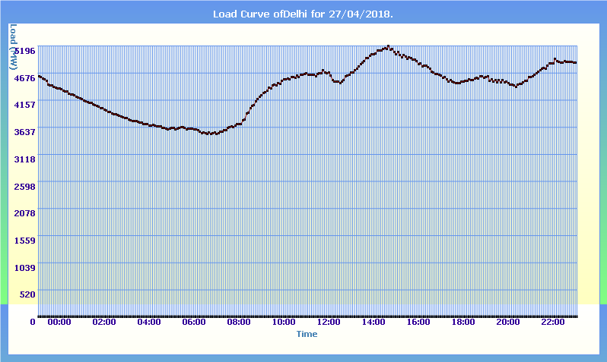
Daily Load Curve sample:

Slide 6
Factors affecting Load Forecasting:
Time factors such as:
  Hours of the day (day/night).
  Days of the week (weekday/ weekend).
  Time of the year (season).
Weather conditions (Temperature and Humidity).
Class of customers (residential, commercial, industrial, agricultural, public, etc).
Special Events (public holidays, etc).
Electricity price.

Slide 7

Data ?
Notes:
<number>

Slide 8
Data Used:
We have used Delhi Electricity Board’s Data which can be found at https://www.delhisldc.org/Loaddata.aspx?mode=29/04/2018 the above site provides load values (MW) in time step of 5 minutes.
We have collected corresponding Humidity and Temperature data from wunderground.
Features Used
  Time of the day.
  Day of the week.
  Temperature at the corresponding time.
  Humidity at the corresponding time.

Slide 9
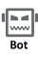
Data scraping:
Hourly Scraping
Hourly Update Request
SLDC
Our Database
Database Updating
Automation
Notes:
<number>

Slide 10
Implemented Algorithms

Slide 11
Traditional Algorithms:
Simple Moving Average (SMA)
Weighted Moving Average (WMA)
Simple Exponential Smoothing (SES)

Slide 12
Simple Moving Average (SMA):
In this method, the new forecasted value will be equal to the average of last n observations.
A moving average forecast of order k is given by
F_{t+1} = (Y_{t} + Y_{t-1} +….+Y_{i}+….+ Y_{t-k+1})/k
where Y_{i} is the actual occurrence at i^{th} interval.
It deals only with the latest k periods of known data.
It cannot handle trend or seasonality very well.
The greater the number of periods in the moving average, the greater the smoothing effect.

Slide 13
Limitations of SMA:
Equal weighting is given to each of the values used in the moving average calculation, whereas it is reasonable to suppose that the most recent data is more relevant to current conditions.
The use of the unadjusted moving average as a forecast can cause misleading results when there is an underlying seasonal variation.
The moving average calculation takes no account of data outside the period of average, so full use is not made of all the data available.

Slide 14
Weighted Moving Average (WMA):
The simple moving average gives equal weight to each component of the moving average database, while a weighted moving average allows any weights to be placed on each element.
The sum of all weights should be equal to 1.
The weighted moving average forecast is given by
F_{t+1} = w₁Y_{t} + w₂Y_{t-1} +….+w_{t-i+1}Y_{i}+….+ w_{n}Y_{t-n+1}
where n = the total number of periods in the forecast,
w_{i} = the weight to be given to the actual occurrence for the period t-i+1.
Y_{i} is the actual occurrence at i^{th} interval

Slide 15
Choosing Weights for WMA:
Experience and trial and error are the simplest ways to choose weights.
As a general rule, the most recent past is the most important indicator of what to expect in the future, and, therefore, it should get higher weighting.
However, if the data are seasonal, then weights should be established accordingly.
We can even use linear regression to optimise the weights.

Slide 16
Simple Exponential Smoothing (SES)
This method involves the automatic weighting of past data with weights that decrease exponentially with time, i.e. the most current values receive a decreasing weighting. So, it is called exponential smoothing.
The simple exponential smoothing forecast is given by
F_{t+1} = α Y_{t} + (1- α) F_{t}
where F_{i} is the exponentially smoothed forecast for i^{th} interval,
Y_{i} is the actual occurrence at i^{th} interval,
α is the desired response rate, or smoothing constant.

Slide 17
We can also represent the forecast in following way
F_{t+1} = α Y_{t} + α(1- α) Y_{t-1} +α (1- α)² Y_{t-2} +.....+α (1- α)^{t-1} Y₁ +(1- α)^{t} F₁
Smoothing constant lies between 0 and 1.
In this method, to calculate the forecast only previous forecast and the last actual occurrence is required.
In order to choose α, we calculate mean square error for each α belonging to [0.1,0.2,....0.9] and we select the α for which mean square error is minimum.

Slide 18
Comparing SMA, WMA and SES:
In between simple moving average and weighted moving average, the WMA is better than SMA because in SMA, we take the weights of all the occurrence are equal. But in reality, the actual value might depend more on one occurrence than other.
Weighted moving average is more inconvenient and costly to use than the exponential smoothing method

Slide 19
Non-Traditional Algorithms:
Auto Regressive Integrated Moving Average (ARIMA)
Feed forward Neural network
Recurrent Neural Network (RNN)
Long Short-Term Memory (LSTM)
Gated Recurrent Unit (GRU)

Slide 20

Auto Regressive Integrated Moving Average (ARIMA)
An ARMA(p, q) model is a combination of AR(p) and MA(q) models and is suitable for univariate time series modelling.
However the ARMA model can only be implemented on stationary data. Non-stationary data often shows trend or seasonality or both in its waveform.
Since our load data has both trend and seasonality we implemented ARIMA on our data.

Slide 21

Auto Regressive Integrated Moving Average (ARIMA)
The mathematical formulation of the ARIMA model using lag polynomials is given below.
The ARIMA model is for non-seasonal non-stationary data.
For the case of seasonal data we use Seasonal ARIMA. In this model seasonal differencing of appropriate order is used to remove non-stationarity from the series.

Slide 22
Feed forward Neural Network:
These networks can be trained with sequential data by giving the time stamp and other dependencies such as weather data at that time as input.
They have no memory of the input they received previously and are therefore bad in predicting what’s coming next.
They simply can’t remember anything about what happened in the past, except their training.
Based on the above constraints, it is evident that the model overfits and gives a bad prediction.

Slide 23
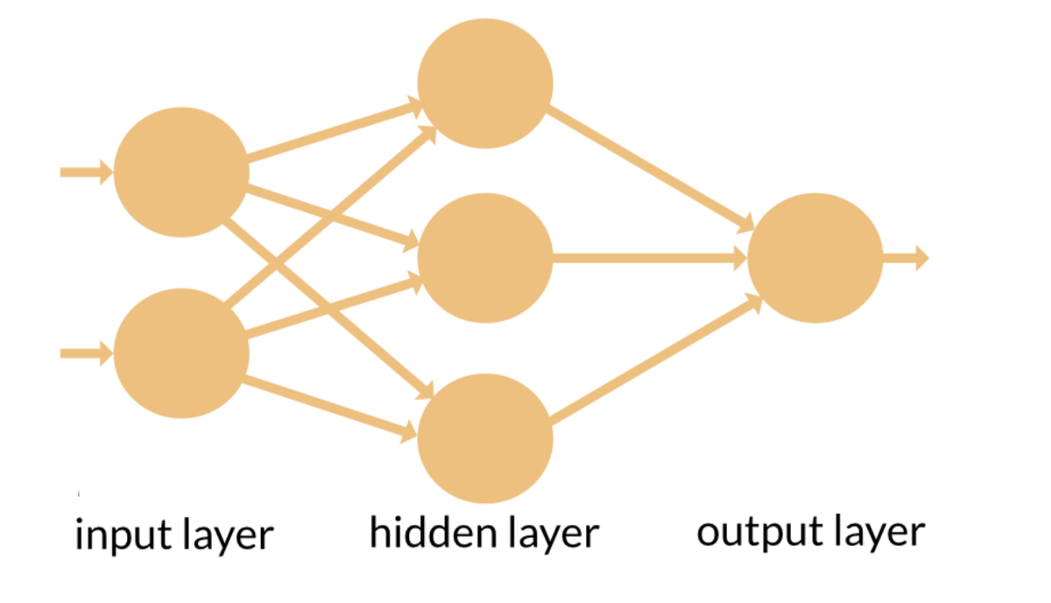
Feed forward Neural Network:
Time stamp
Weather data

Slide 24
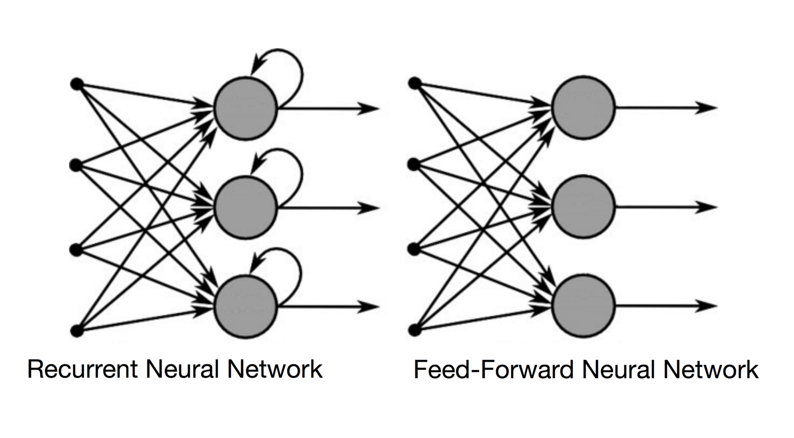
Recurrent Neural Networks (RNN):
In RNN, the information cycles through a loop. When it makes a decision, it takes into consideration the current input and also what it has learned from the inputs.
This is important because the sequence of data contains crucial information about what is coming next

Slide 25
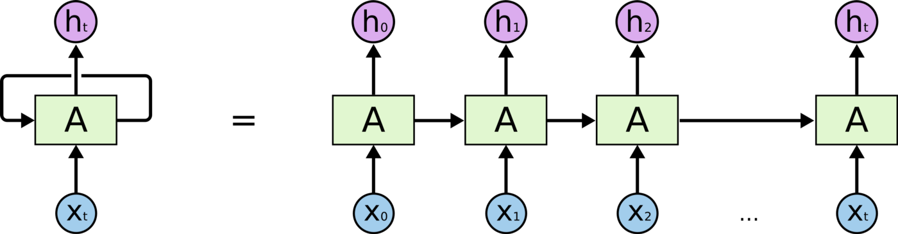
The error is back-propagated from the last to the first time step, while unrolling all the time steps.
Issues with standard RNNs:
Exploding Gradients,
Vanishing Gradients,
Long-term Dependencies.

Slide 26
Long Short Term Memory (LSTM):
These networks are an extension for recurrent neural networks, which basically extends their memory.
LSTMs enable RNNs to remember their inputs over a long period of time as contain their information in a memory.
This memory can be seen as a gated cell, where gated means that the cell decides whether or not to store or delete information (e.g. if it opens the gates or not), based on the importance it assigns to the information.

Slide 27
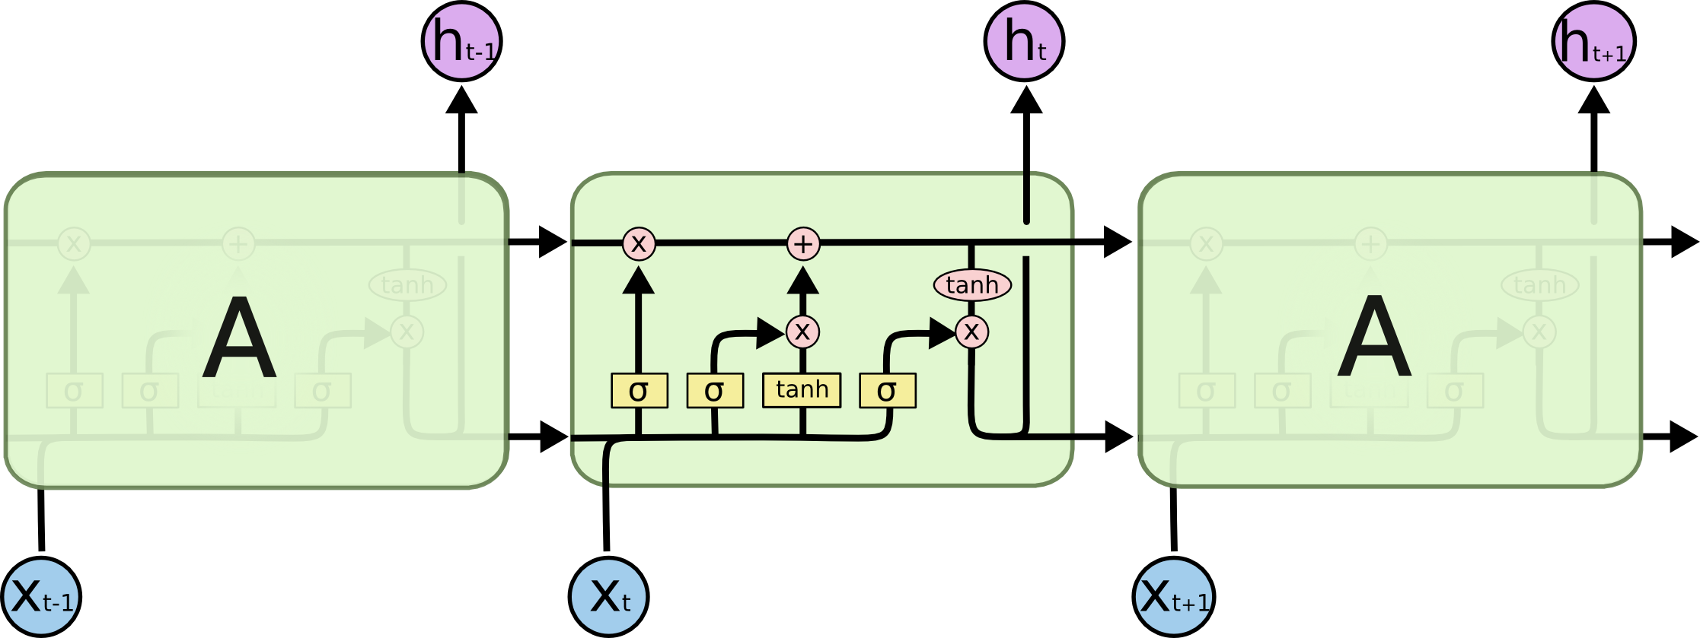
In an LSTM you have three gates: input, forget and output gate.
These gates determine whether to let new input in (input gate), delete the information because it isn’t important (forget gate) or to let it impact the output at the current time step (output gate).

Slide 28
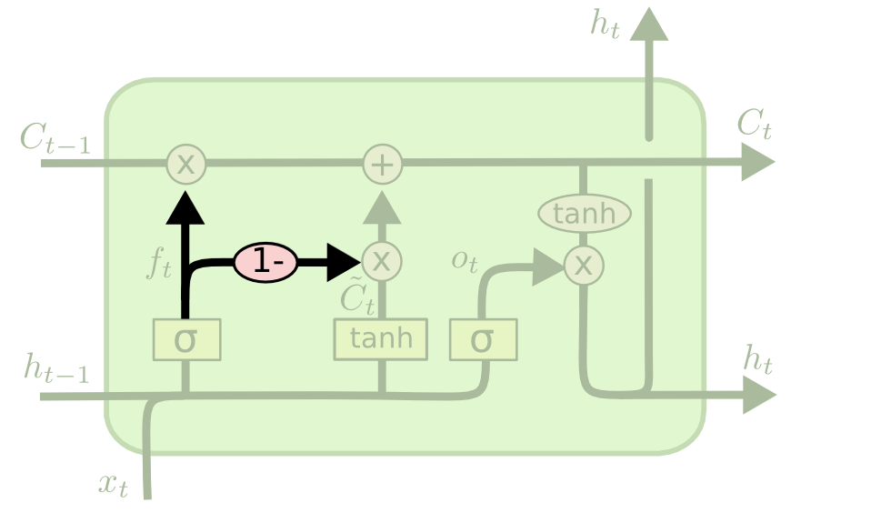
Gated Recurrent Unit (GRU):
Another variation of LSTM is to use coupled forget and input gates. Instead of separately deciding what to forget and what we should add new information to, we make those decisions together.
We only forget when we’re going to input something in its place. We only input new values to the state when we forget something older.

Slide 29
Website

Slide 30
Our Website Model:
Our Database
http://13.126.97.91
Predicting Algorithms:
1. SMA
2. WMA
3. SES
Our Website
Notes:
<number>

Slide 31
Website Features:
Daily Load Prediction
http://13.126.97.91
Different Features
Day wise comparison between Real Load Data
Comparison between Different Algorithms
Notes:
<number>

Slide 32
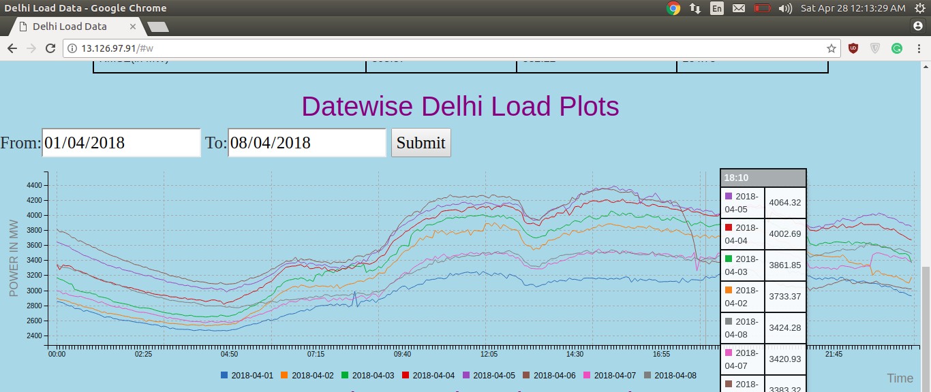
Date wise comparison of Load curves
Notes:
<number>

Slide 33
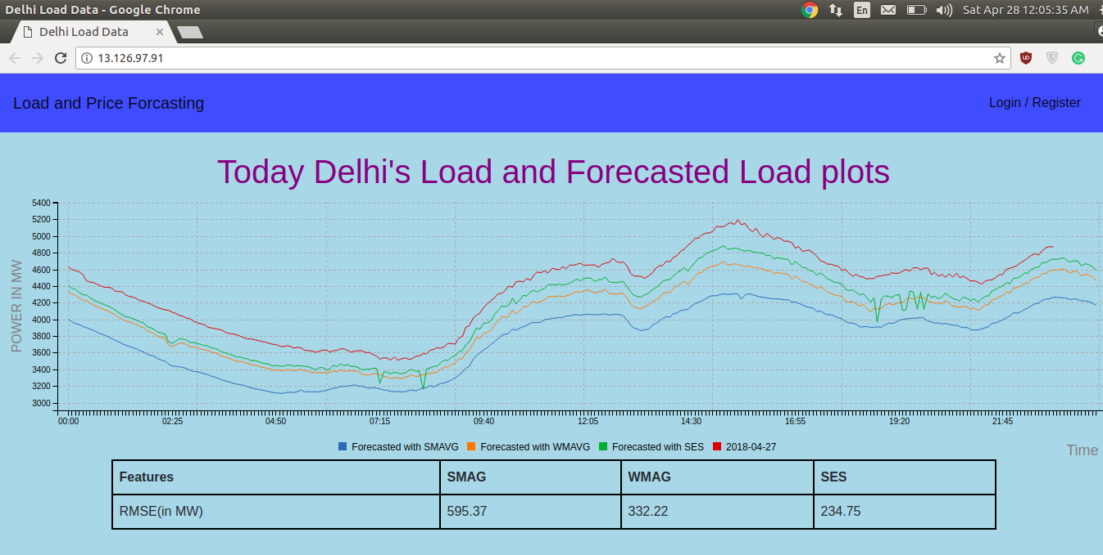
Comparison of Forecasts using SMAG, WMA and SES
Notes:
<number>

