Slide 1

AI-SDLC FRAMEWORK
Migration Walkthrough Comic Tutorial
An enterprise architect walkthrough: how teams move from legacy pressure to governed AI-assisted delivery.
Govern
Architect
Agents
Scale
Presenter stance: framework first, agents second, evidence always.

Slide 2
ARCHITECT SETUP
The story starts with tension, not a tool demo
G0 -> project-manifest.yml
How to present it
Maya: This is now a delivery risk.
Omar: Then audit cannot be optional.
Rina: No agent before governance.
Maya
Product owner
Rina
AI architecture lead
Dev
Engineering lead
Omar
Risk stakeholder
As the enterprise architect, narrate the operating model: the team can disagree, but the artifact settles the next gate.
Decision: enter the AI SDLC path before selecting any coding agent.
Core line: The framework is not an abstraction layer. The manifest is the control plane.

Slide 3

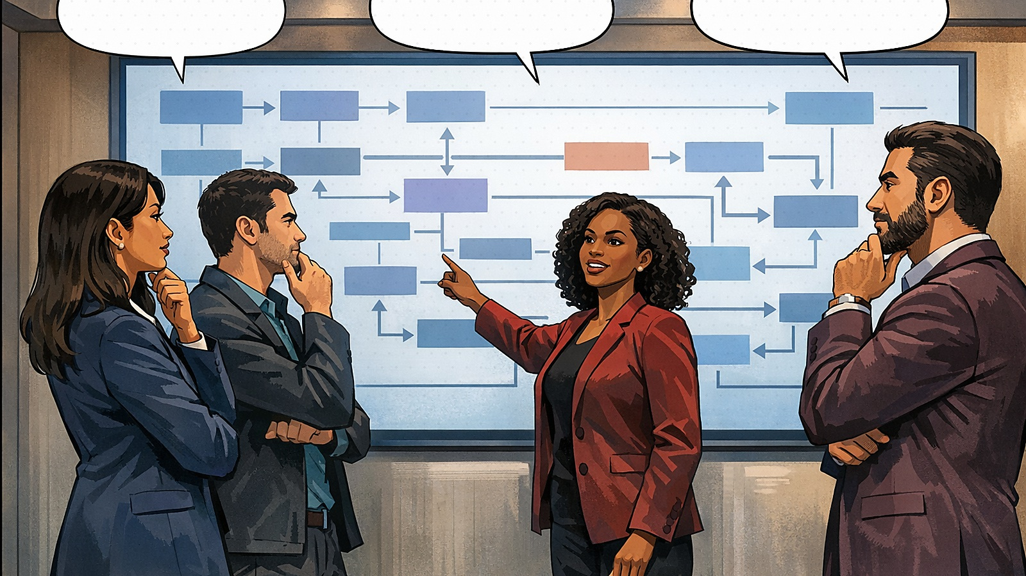

ACT 1
Controlled intake before agent adoption
G0 -> intake
G2 -> risk
Maya: Six months per feature is the problem.
Dev: Every change still touches the monolith.
Dev: Can Copilot clear the backlog?
Omar: Not without audit trails.
Decision: treat migration delay as an enterprise risk.
Decision: block agent usage until controls exist.
G0/G2 -> manifest
G3 -> architecture
Rina: We classify risk first.
Maya: So the artifact decides next.
Rina: Map capabilities and data flows.
Dev: Then pilot one thin slice.
Decision: let the manifest determine the next gate.
Decision: migrate by domain slice, not big bang.

Slide 4




ACT 2
Guardrails, subagents, and evidence gates
G3 -> ADR links
G4 -> agent model
Omar: Who owns traceability?
Rina: The manifest links every decision.
Dev: Codex here, Claude there?
Maya: Same gates, different assistants.
Decision: guardrails travel with every agent task.
Decision: agents vary, SDLC contract stays fixed.
G5 -> evidence
G7 -> scale
Rina: Tests and risk notes first.
Omar: The team approves, not the tool.
Maya: Now value is visible each sprint.
Dev: And reuse is safe.
Decision: no merge without evidence.
Decision: scale only what becomes measurable.

Slide 5
MANIFEST GATE
Make the framework tangible at every decision
control plane
project-manifest.yml
Rina: This is not abstraction.
Omar: Show me the control record.
project: scenario: migration owner: product-platform criticality: high ai_sdlc: onboarding_mode: onboard-lite current_gate: G2-risk risk: classification: high human_approval_required: true architecture: decision_records: - adr/001-domain-slice.md agents: allowed: [codex, claude, copilot] evidence: required: [tests, risk_notes, arch_review]
Decision: the team does not move gates until the manifest is updated.
Presenter cue: point to the YAML, not the process name. The manifest is how governance becomes executable.

Slide 6
ARCHITECT WALKTHROUGH
Use the comic as a guided decision conversation
For each panel, ask: What decision is being made? Which artifact enforces it? What proof unlocks the next gate?
Problem
Decision
Artifact
Gate
Outcome
Legacy delay and unclear ownership
Classify risk and choose the migration slice
Manifest, knowledge, ADRs, subagents
Evidence before merge and release
Measured modernization
The story lands when the audience sees one thing clearly: the framework turns tool usage into governed SDLC decisions.
Claude
Codex
GitHub Copilot
Future agents

Slide 7
OPERATING MODEL
When teams should engage the AI SDLC framework POC
Use this closing slide to position ownership operationally, not personally: you are the entry point for consistent framework enablement.
POC handoff contract
Use-case and risk class
before teams start: engage: ai-sdlc-framework-poc bring: - problem statement - target system - data sensitivity - intended agents - release path framework_owner_provides: - onboarding path - manifest readiness - governance alignment - artifact templates - evidence gate review
Classify
Onboard
Manifest + knowledge setup
Architect
ADRs, boundaries, data flows
Enable
Prompts, commands, subagents
Evidence
Tests, reviews, release proof
Suggested close: 'The comic is the onboarding layer. The asset is the operating model behind it.'

