Slide 1

AI-SDLC FRAMEWORK
Migration Walkthrough Comic Tutorial
A decision-driven enterprise story for moving legacy delivery into governed AI-assisted SDLC.
Govern
Architect
Agents
Scale
Agent-agnostic: Claude, Codex, GitHub Copilot, and future assistants.

Slide 2
PREMISE
Start with the business problem, then enforce the path
Enterprise cast
The monolith is now a delivery risk, not just technical debt.
Then the first artifact is intake and risk classification.
No agent before governance.
Maya
Product owner
Rina
AI architecture lead
Dev
Engineering lead
Omar
Risk stakeholder
Walkthrough rule: every panel shows a decision and the AI-SDLC artifact that makes it repeatable.
Situation: migration pressure is real, but tool-first adoption would create unmanaged risk.

Slide 3

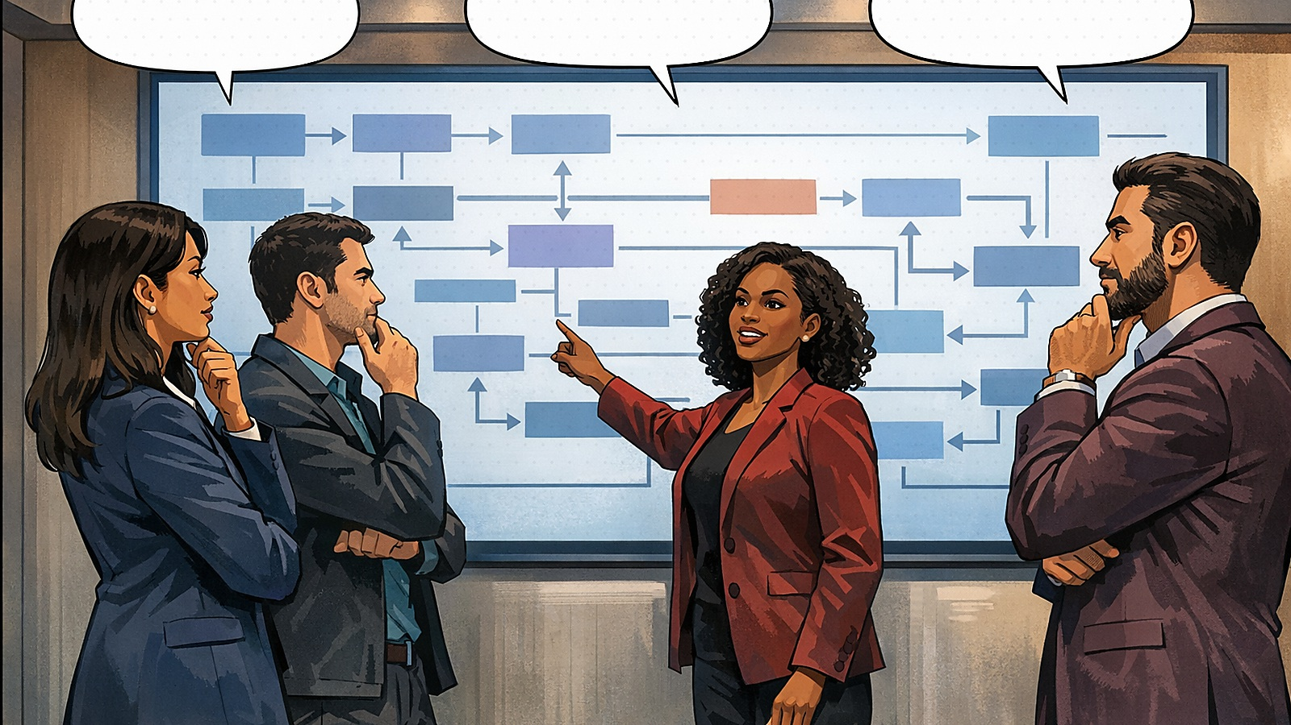
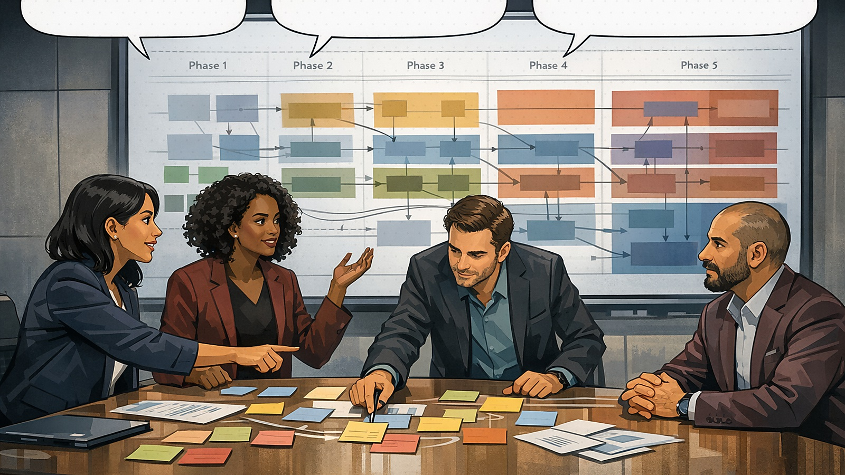
ACT 1
Controlled intake before agent adoption
Six months per feature is no longer acceptable.
Every change carries unknown blast radius.
Should we just let the assistants attack the backlog?
Only after access, audit, and approval paths exist.
Trigger: legacy pain becomes a business constraint.
Conflict: agent-first thinking creates governance risk.
We start with the SDLC map, not a vendor choice.
Good. The artifact should decide the next step.
Map capabilities, dependencies, data, and owners.
Pilot one thin slice before scaling.
Framework step: intake, risk class, and decision record.
Decision: migrate by domain slice with explicit ownership.

Slide 4
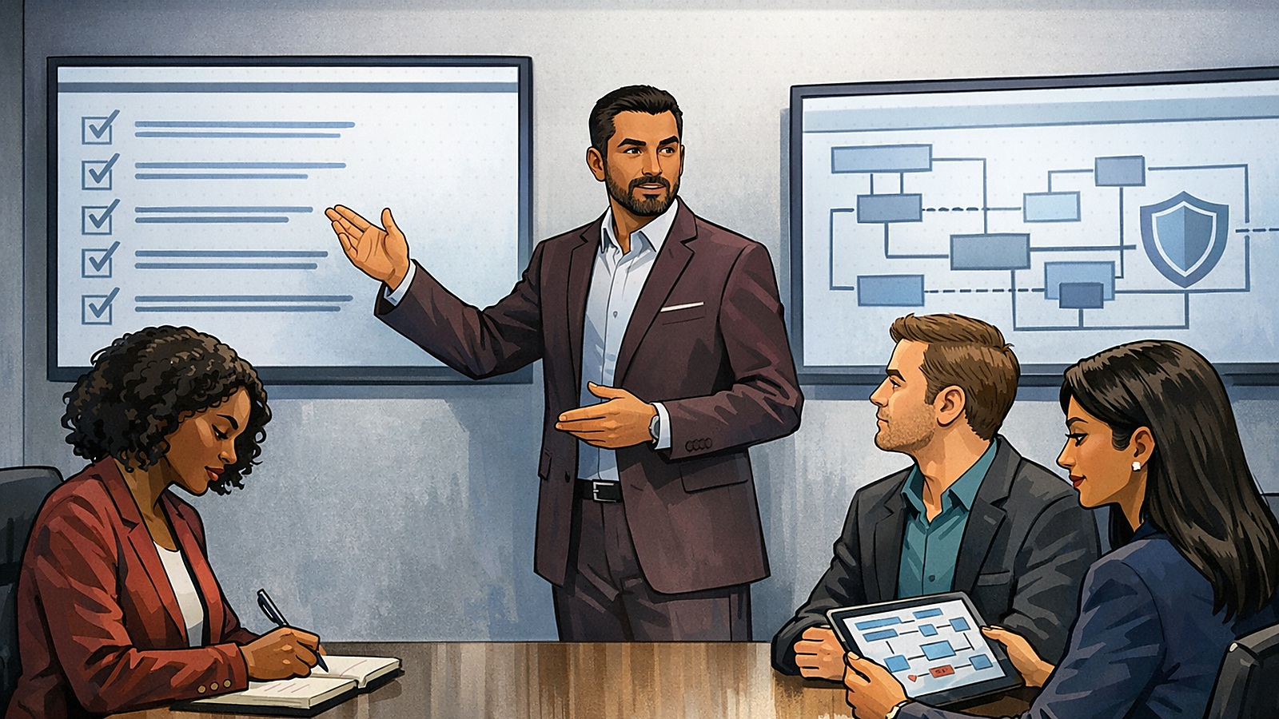
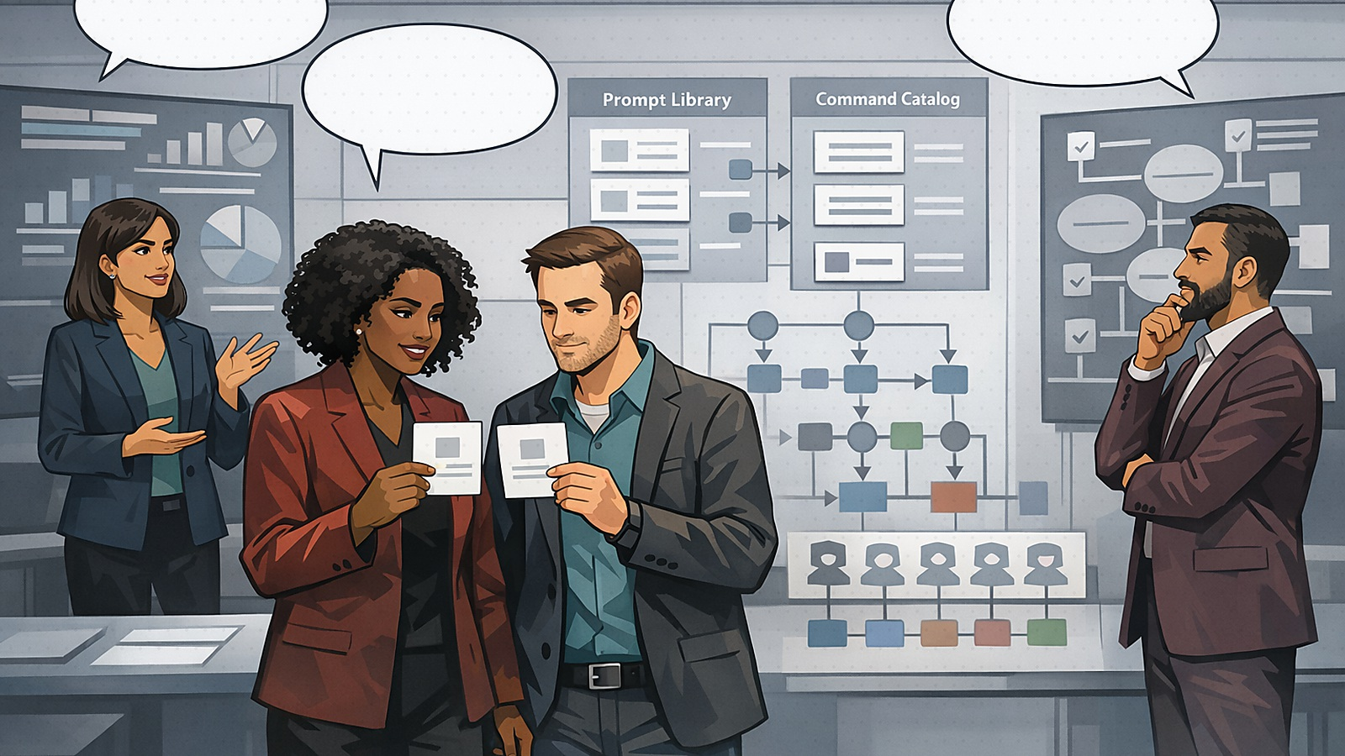

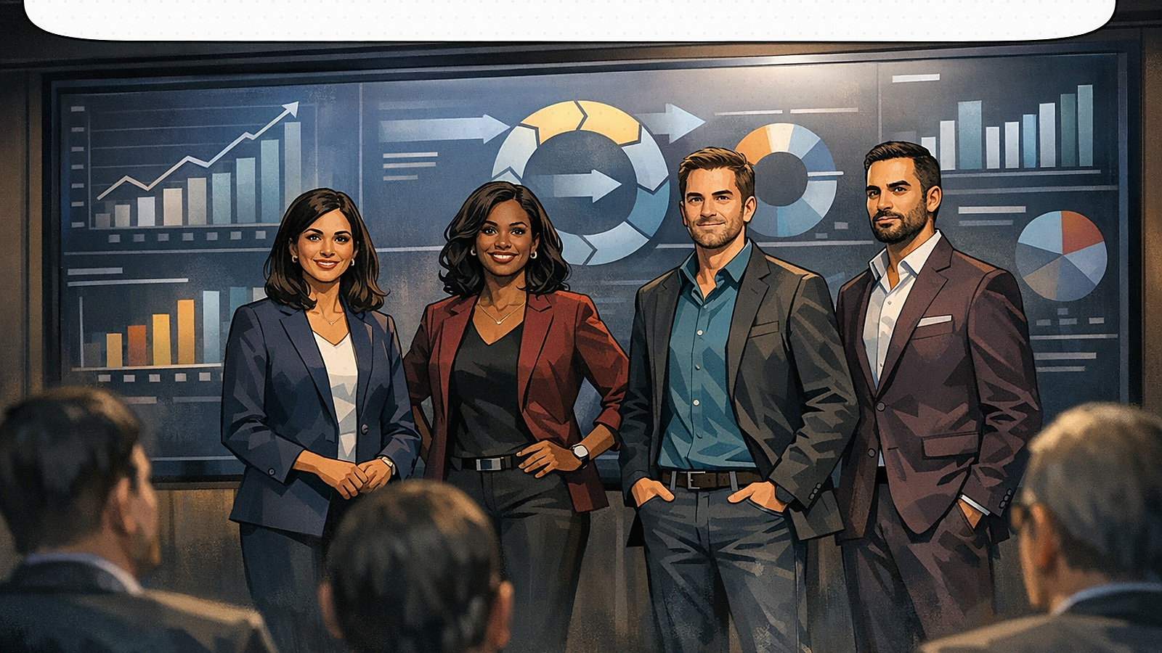
ACT 2
Guardrails, subagents, and evidence gates
Every agent action needs traceability.
The reference architecture sets the boundary.
Codex here, Claude there, Copilot in the IDE.
The framework stays the same.
Architecture guardrails: controls travel with the work.
Agent-agnostic execution: same artifacts, different assistants.
No merge without tests, risk notes, and architecture checks.
The assistant prepares evidence; the team decides.
Now stakeholders see scope, risk, and value each sprint.
Governance is part of delivery, not a separate ceremony.
Decision enforcement: evidence before merge or release.
Outcome: modernization becomes measurable.

Slide 5
WALKTHROUGH SPINE
Use the comic as a guided decision conversation
For each panel, ask: What is the decision? Which artifact enforces it? What outcome becomes safer or faster?
Problem
Decision
Artifact
Gate
Outcome
Legacy delay and unclear ownership
Classify risk and choose the migration slice
Governance, architecture, subagents, prompts
Evidence before merge and release
Measured modernization
The story lands because it is not about commands. It is about enterprise decisions made repeatable across agents.
Claude
Codex
GitHub Copilot
Future agents

