Slide 1
Business Problem
Knowledge fragmentation, operational search overhead, incident troubleshooting delays.

Slide 2
ROI Opportunity
25–35% reduction in documentation search effort and operational overhead.

Slide 3
Solution Overview
Enterprise RAG + Fine-tuned OSS models + Governance + Agentic workflows.

Slide 4
Knowledge Separation Strategy
Behavior in model weights. Dynamic enterprise knowledge in RAG.

Slide 5
Architecture
See architecture diagram.

Slide 6
GPU Ask
Phase 1: 1–2 H100s. Phase 2: 4–8 H100s based on measurable outcomes.

Slide 7
Governance & Security
RBAC, audit logging, PII filtering, internal-only endpoints.

Slide 8
Success Metrics
>85% retrieval precision, reduced MTTR, reduced repetitive escalations.

Slide 9
Final Ask
Approve Phase 1 pilot and initial H100 allocation.

Slide 10
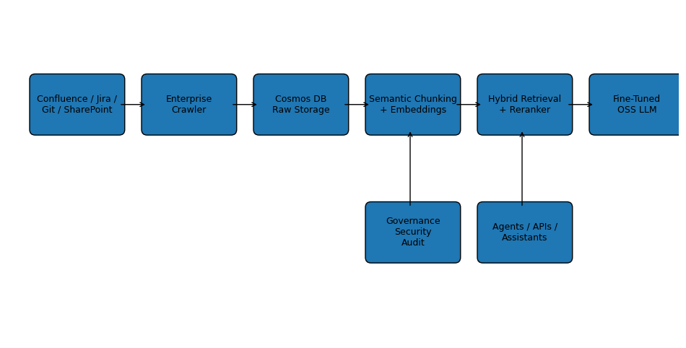
Enterprise AI Architecture

