Slide 1
MASTERCORP · HOUSEKEEPING
User guide
How to report the status of the vacuums
You don't need a username or a password.
You don't need to install any app.
Housekeeping staff · Quick guide

Slide 2
GETTING STARTED
There are two QR codes, and each one is for something different
The vacuum's QR code
The QR code on the wall
It's stuck on each unit. Use it to say how that vacuum is doing: whether it works fine, works with faults, or doesn't work at all.
It's in the housekeeping room. Use it to report that there are no vacuums left available to work with.
Both open the same way: point your phone's camera at the code and tap the banner that appears.

Slide 3
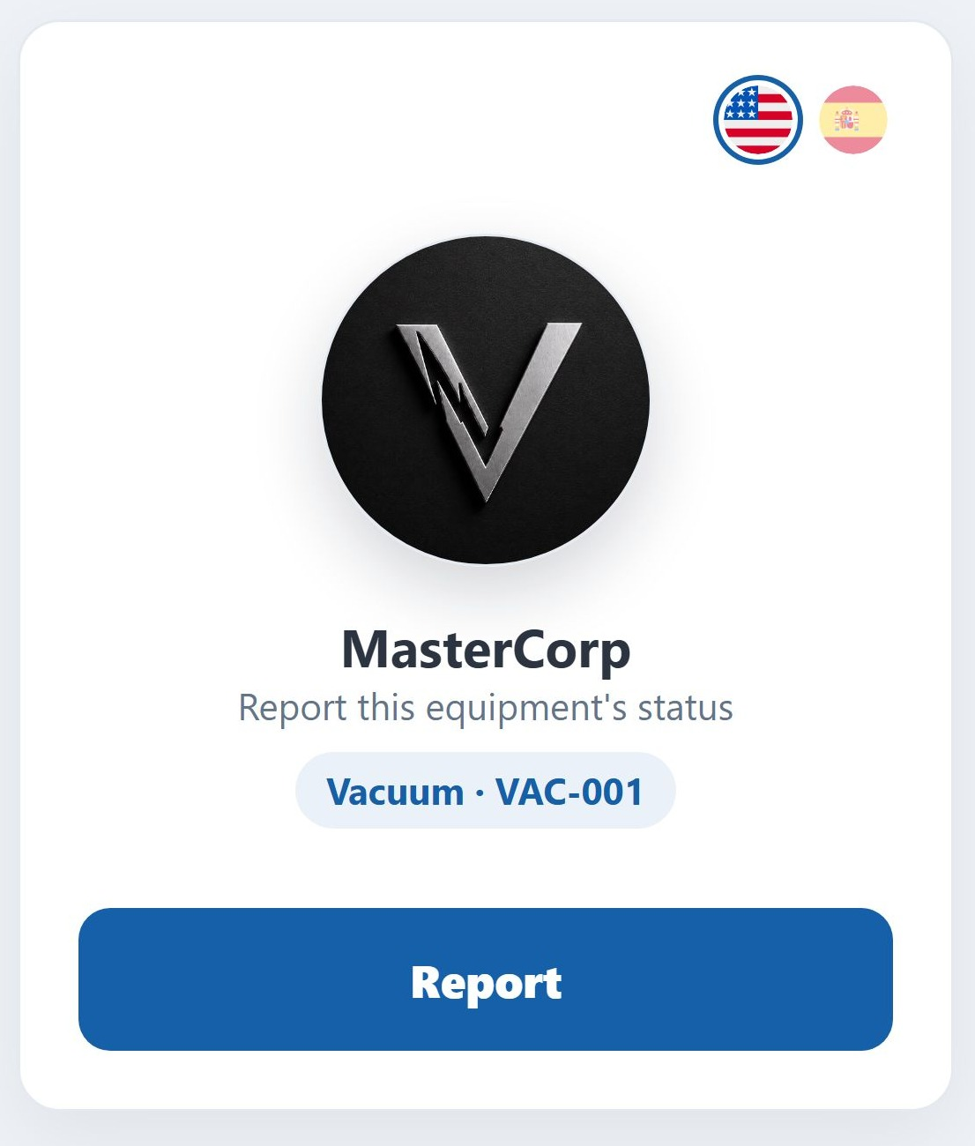
STEP 1
Scan the vacuum's QR code
1
Open your phone's camera and point it at the code stuck on the vacuum.
2
Tap the banner that appears on screen. It opens on its own, nothing to install.
3
You'll see the unit's code, for example VAC-001. Check it matches the sticker.
4
Tap the blue button to continue.
To read in Spanish: tap the Spanish flag at the top right. It's remembered for next time.

Slide 4
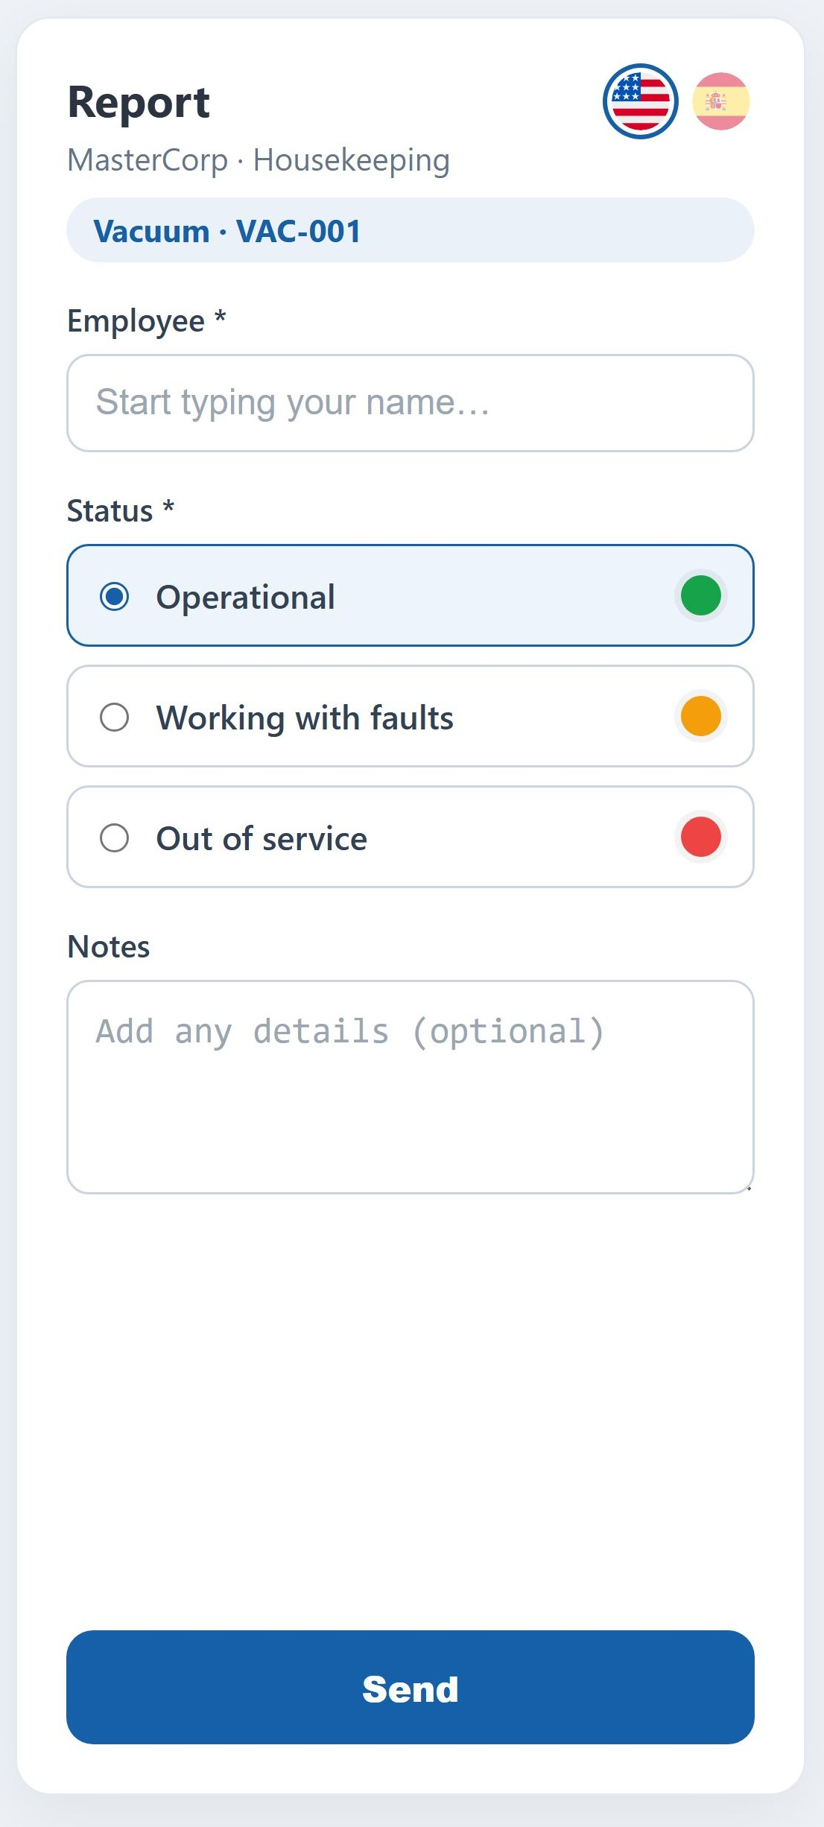
STEP 2
Tell us how the vacuum is doing
1
Type your name. Suggestions appear as you type: pick yours from the list.
2
Choose the unit's status from the three options.
3
If something is wrong, describe it. The clearer you are, the faster it gets fixed.
4
You can take photos of the problem if that helps explain it.
5
Tap Send. That's it — it takes less than a minute.
Operational
With faults
Out of service
works fine
usable, but something's wrong
cannot be used

Slide 5
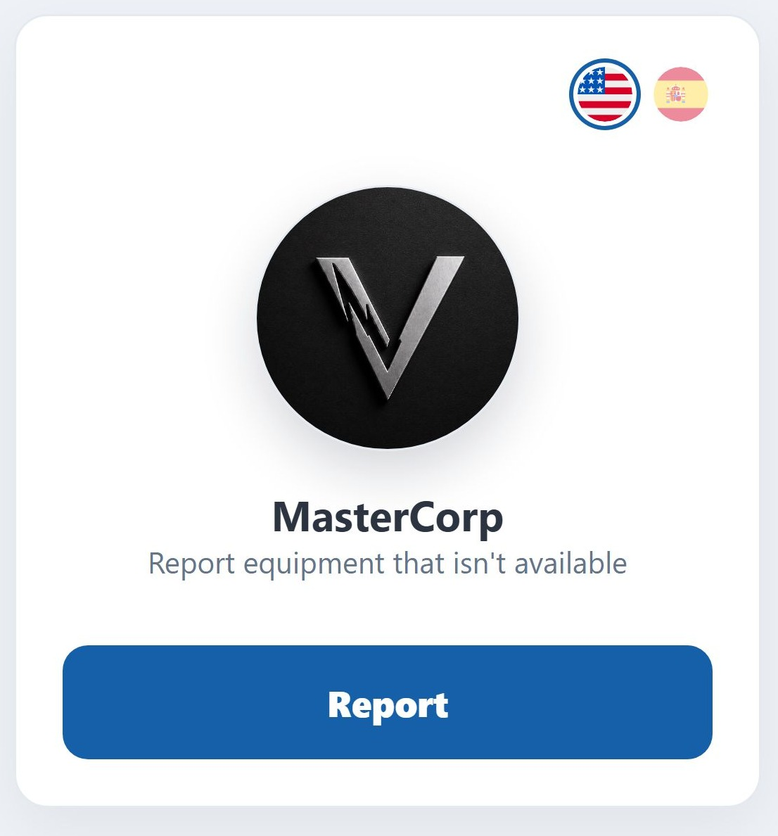
THE OTHER QR
When there are no vacuums left available
1
Go to the fixed QR code on the housekeeping room wall.
2
Scan it just like a vacuum's code.
3
Tap the button to continue to the form.
Careful: this report means there is NO equipment available. If one particular vacuum is faulty, use the QR code stuck on that vacuum instead.

Slide 6
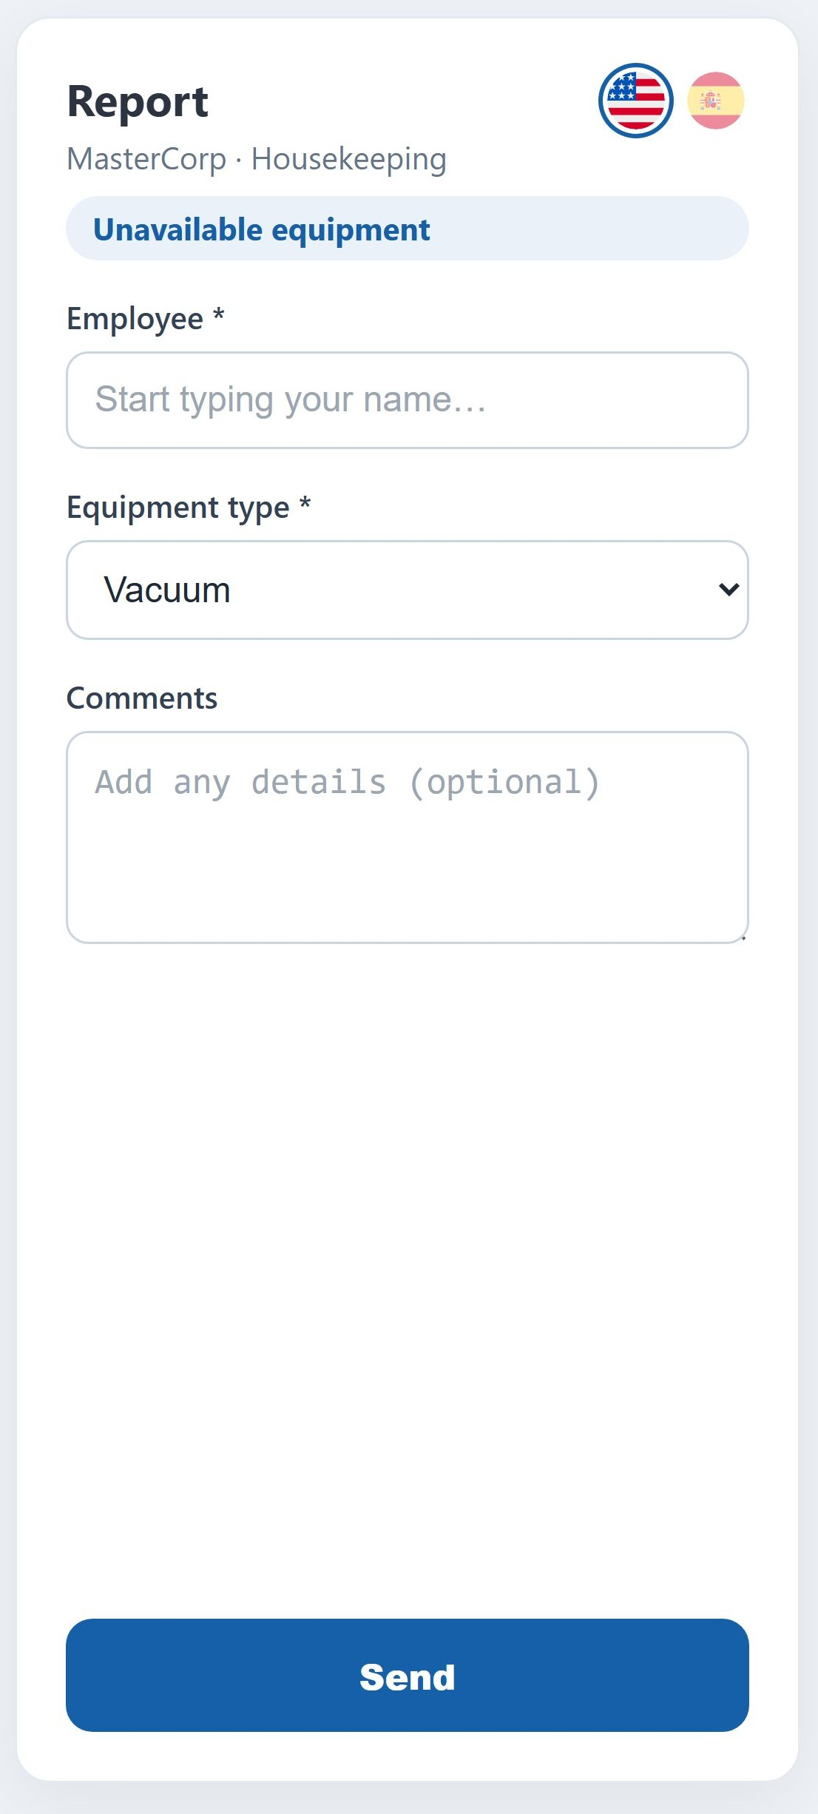
STEP 2
Fill in the report
1
Type your name and pick it from the suggestions.
2
Leave the equipment type as Vacuum.
3
In comments, give the detail: for example, that no vacuums are left for the night shift.
4
Tap Send.
Comments matter: they're what lets your supervisor understand what happened without having to ask you.

Slide 7
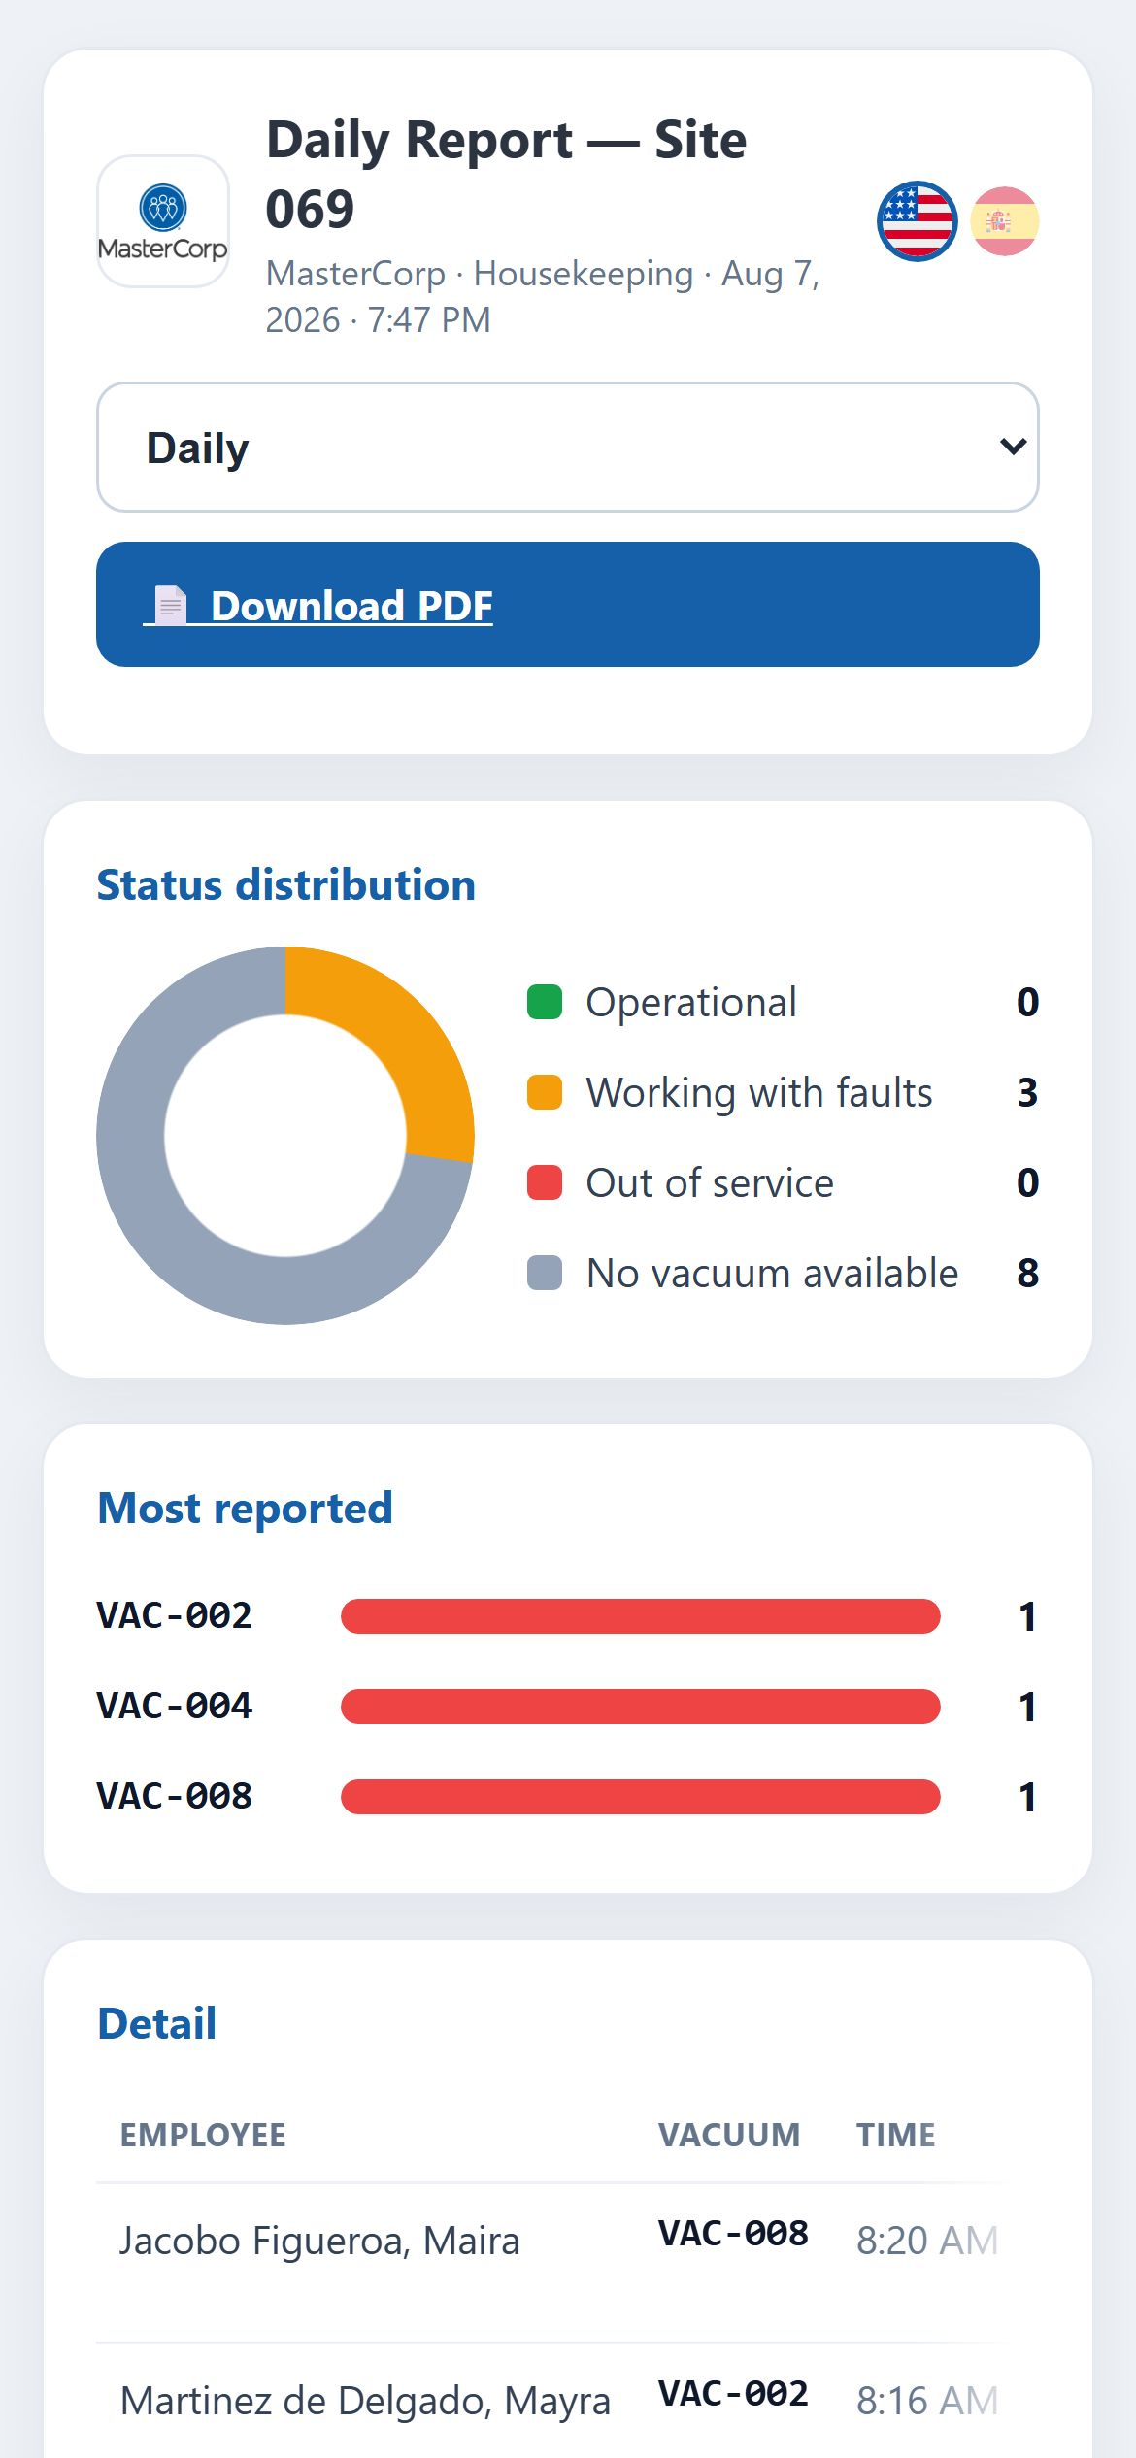
WHAT HAPPENS NEXT
Everything you report shows up on the results screen
The day's summary: how many units are fine, how many have faults, how many are out of service.
The most reported vacuums, so you know which ones give the most trouble.
The detail of every report, with who filed it and at what time.
The selector at the top switches between today, the last 7 days and the last 30 days.
It can be downloaded as a PDF to print or share.
On top of that, every day at 10:00 in the morning an automatic email goes out with this same summary for the managers.

Slide 8
COMMON QUESTIONS
Questions we get often
Do I need a username and password?
Do I have to install an app?
No. You scan the code and report. That's all.
No. It opens in your phone's browser, like any web page.
What if the code won't scan or has come off?
Can I report the same vacuum twice in one day?
Tell your supervisor so a new one gets printed. Don't report that unit using another one's QR code.
Yes. Every report is saved with its own time, so nothing is lost.
Is it available in Spanish?
I sent it by mistake — what now?
Yes. Tap the Spanish flag at the top right and the whole screen changes.
Scan again and send the correct report. Let your supervisor know which one counts.
If anything doesn't work the way this guide says, tell your supervisor.

