Slide 1
VALENTISOFT · SaaS PLATFORM
Vacuum Control
QR-based housekeeping equipment control
Housekeepers report the status of every vacuum by scanning a QR code —
no apps, no logins. Admins get automatic KPIs and reports.
Client: MasterCorp · mastercorp.valentisoft.com

Slide 2
CONTEXT
The challenge: reporting and tracking equipment is scattered and manual
Manual reporting
No visibility
Reports by hand
The housekeeper reports verbally or on paper when a vacuum fails. It gets lost, forgotten, or reaches maintenance late.
The supervisor has no real-time view of which equipment is operational, faulty, or out of service at each site.
Consolidating the day's status and putting together the email for management is time-consuming and error-prone.
The result: equipment down longer, decisions made blind, and man-hours wasted on repetitive administrative tasks.

Slide 3
THE SOLUTION
A simple flow: scan → report → visualize
1
2
3
4
QR on every unit
The housekeeper scans
Logged instantly
The admin decides
Each vacuum carries a QR sticker with its code (VAC-001…). Generated and printed from the panel.
Opens a web page (no app, no login), picks their name and the equipment status. 30 seconds.
The report is saved with time, employee and site. It feeds the KPIs automatically.
Dashboard with status distribution, most-reported units and an automatic daily email to management.
Multi-site and multi-client: each company gets its own subdomain (mastercorp.valentisoft.com) and each site its own equipment, QRs and KPIs.

Slide 4
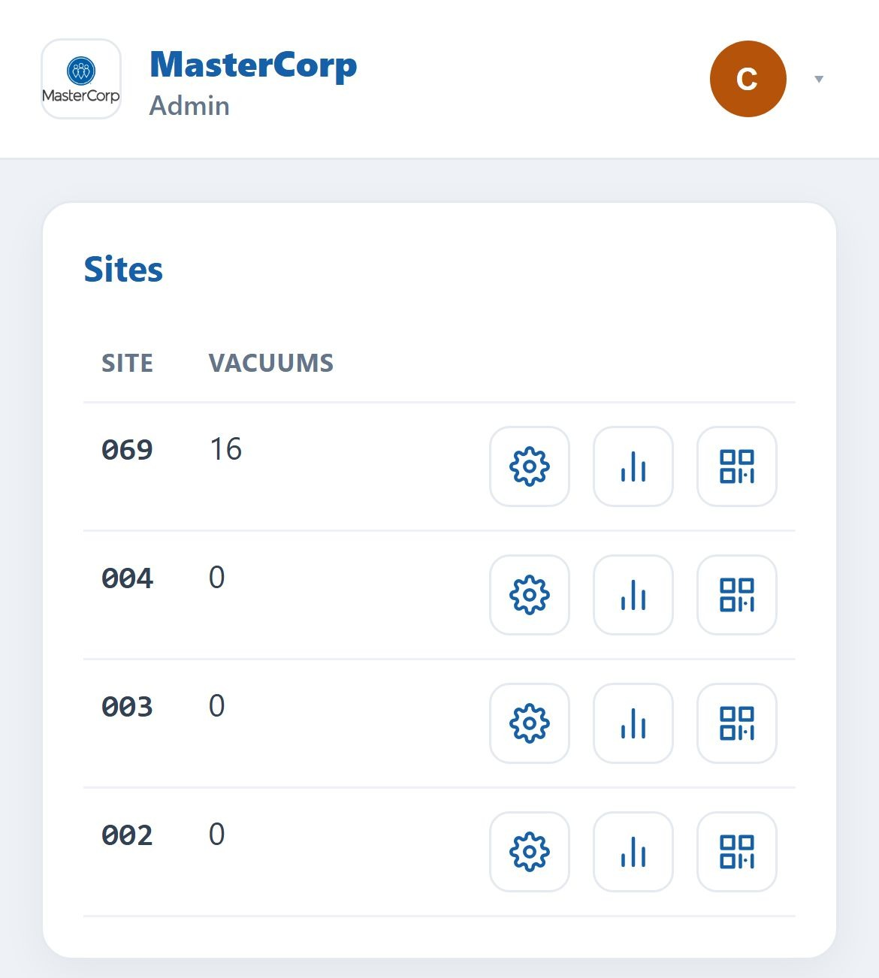
ADMIN
Sites panel
The central view of all the client's sites, each with its equipment count and its recipients.
• List of sites with their code, number of vacuums and report recipients.
• 3 shortcuts per row: ⚙ configure · 📊 KPIs · ▦ QR codes.
• Each site has a unique slug used in the public URLs (/XjUS3/…).
• Responsive: adapts to mobile by hiding secondary columns.

Slide 5
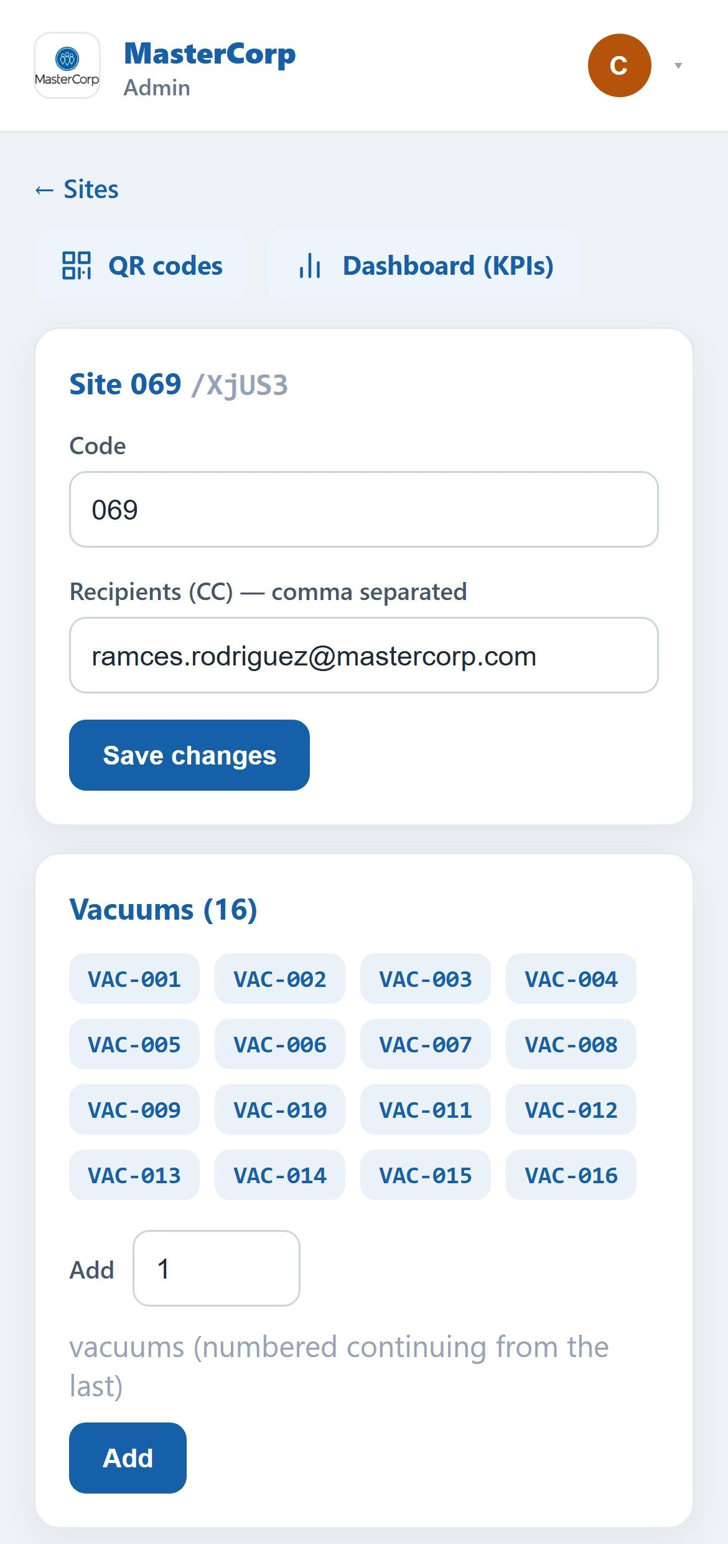
ADMIN
Configure a site and its equipment
This is where you set the site code, the recipients' emails (CC) and its vacuums.
• Edit code and recipients (email validation with an example if wrong).
• Add vacuums: numbered automatically (VAC-001, 002…).
• Confirmation before creating equipment to avoid mistakes.
• Shortcuts to the site's QR codes and Dashboard.

Slide 6
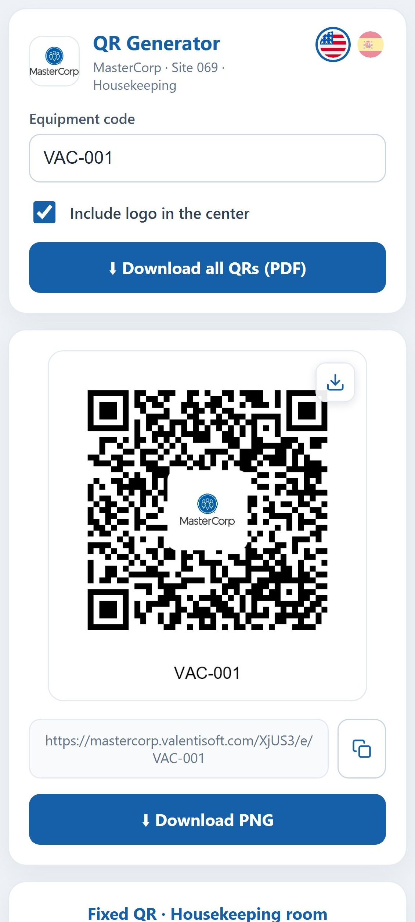
ADMIN
QR code generator
Generates each unit's QR with the client's logo in the center, ready to print and stick.
• One QR per unit with the public URL ready to scan.
• Download one QR (PNG) or ALL of the site's in a printable PDF sheet.
• Fixed housekeeping-room QR to report 'equipment unavailable'.
• Copy-URL button and bilingual interface (EN/ES).

Slide 7
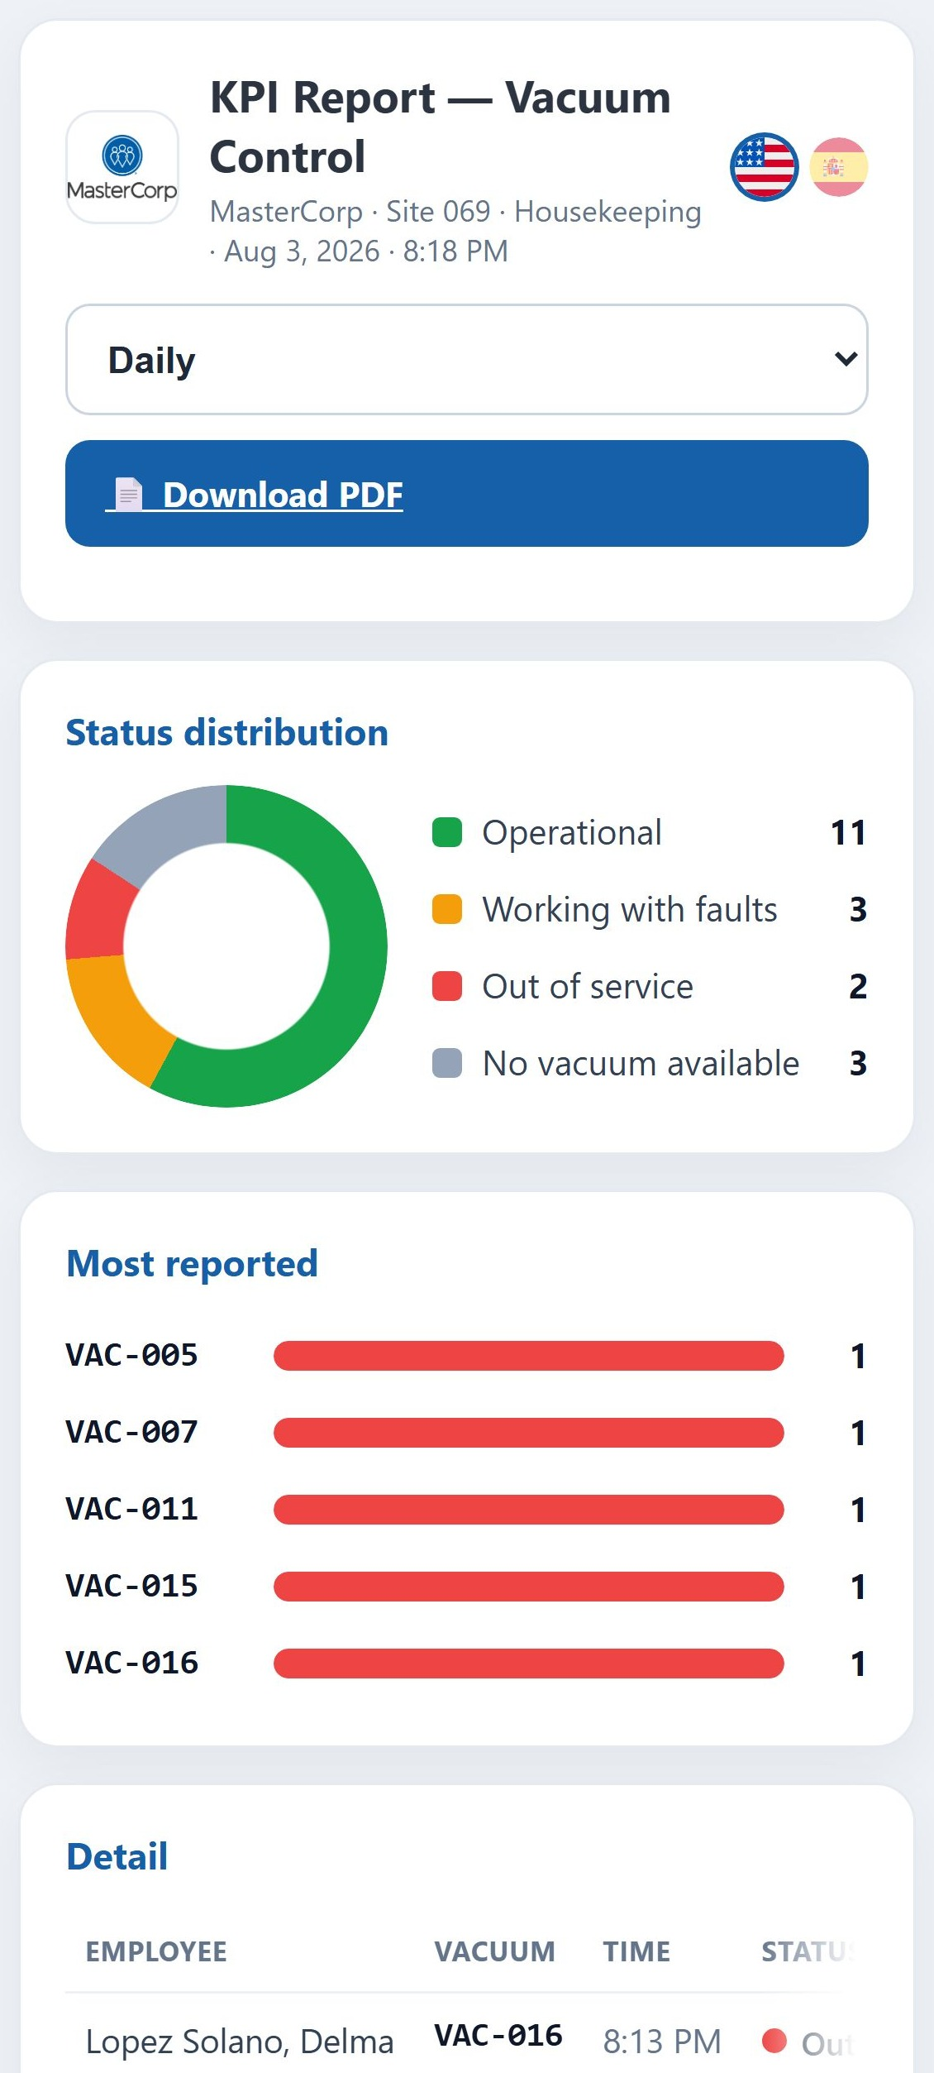
ADMIN
Per-site KPI dashboard
Real-time indicators: status distribution, most-reported units and availability.
• Status donut: Operational / With faults / Out of service / Unavailable.
• Ranking of most-reported units and availability %.
• Daily / Weekly / Monthly selector with a trend chart.
• Button to download the report as PDF.

Slide 8
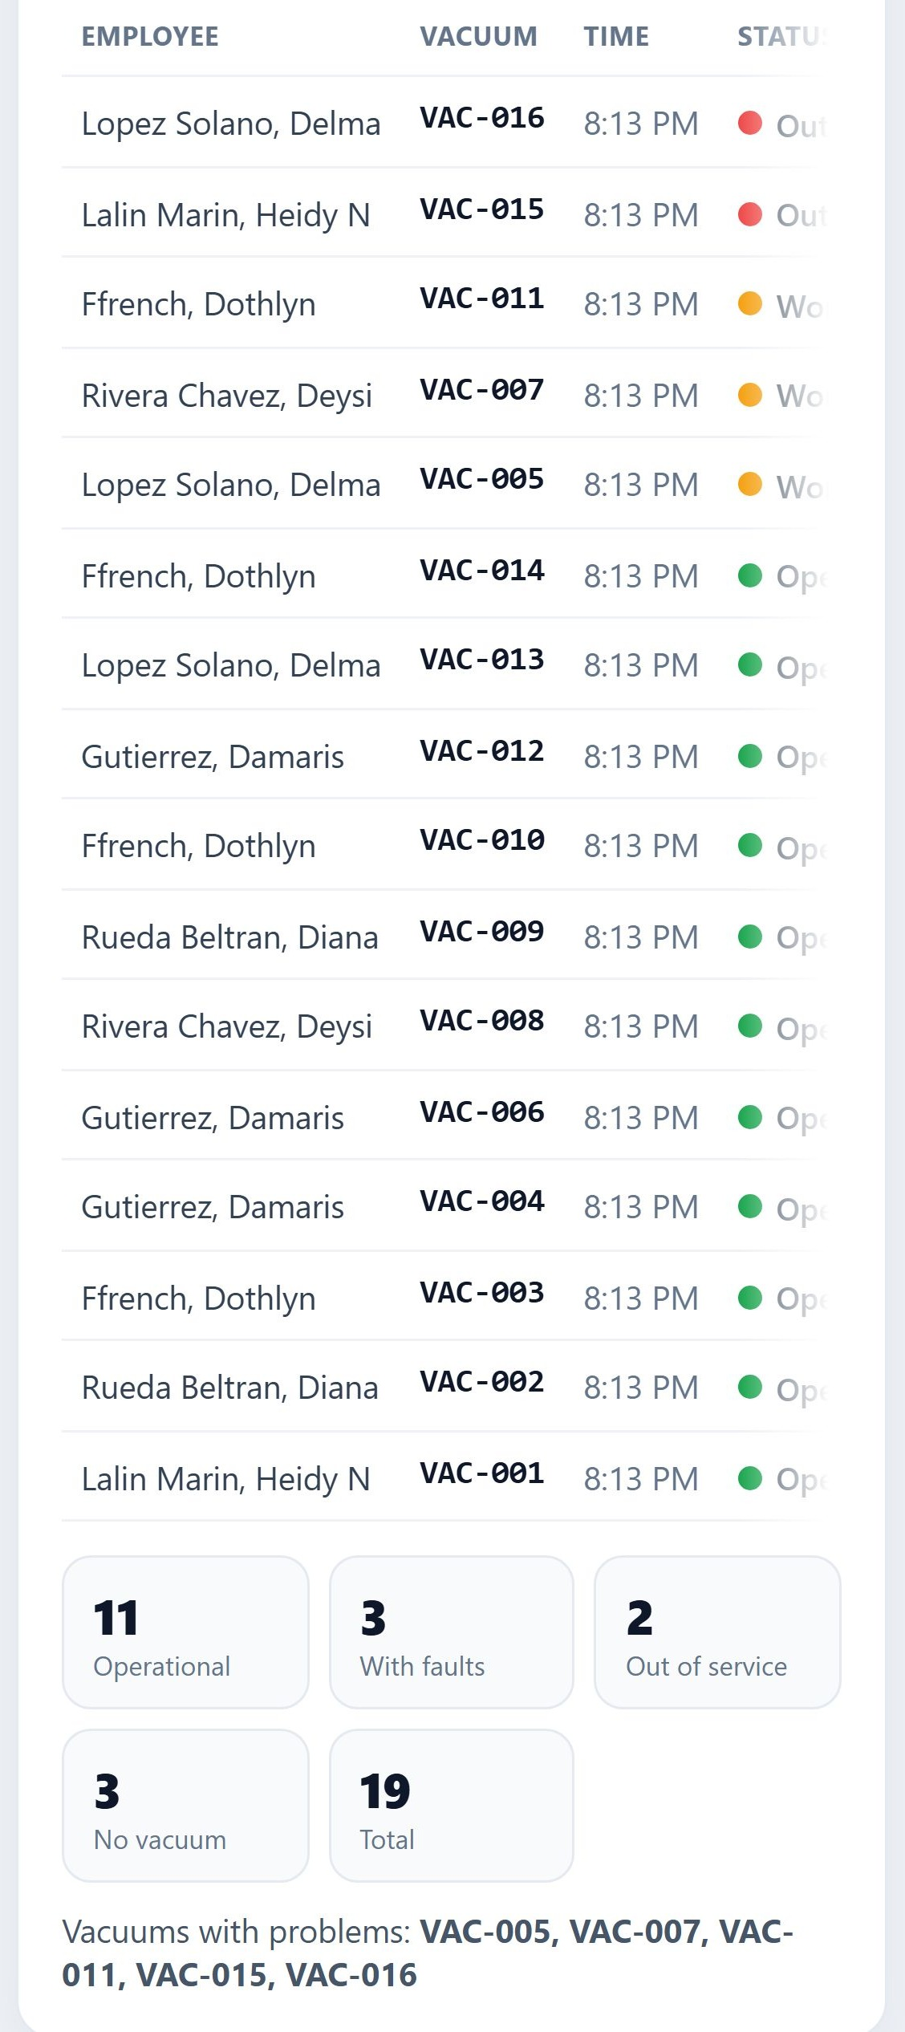
ADMIN
Report detail
Every check-in with employee, unit, time/date, status and note. Full traceability.
• Detail table with the record of every report in the period.
• Daily shows the time; weekly/monthly, the date.
• Separate 'equipment unavailable' section.
• Everything feeds the automatic daily email to recipients.

Slide 9
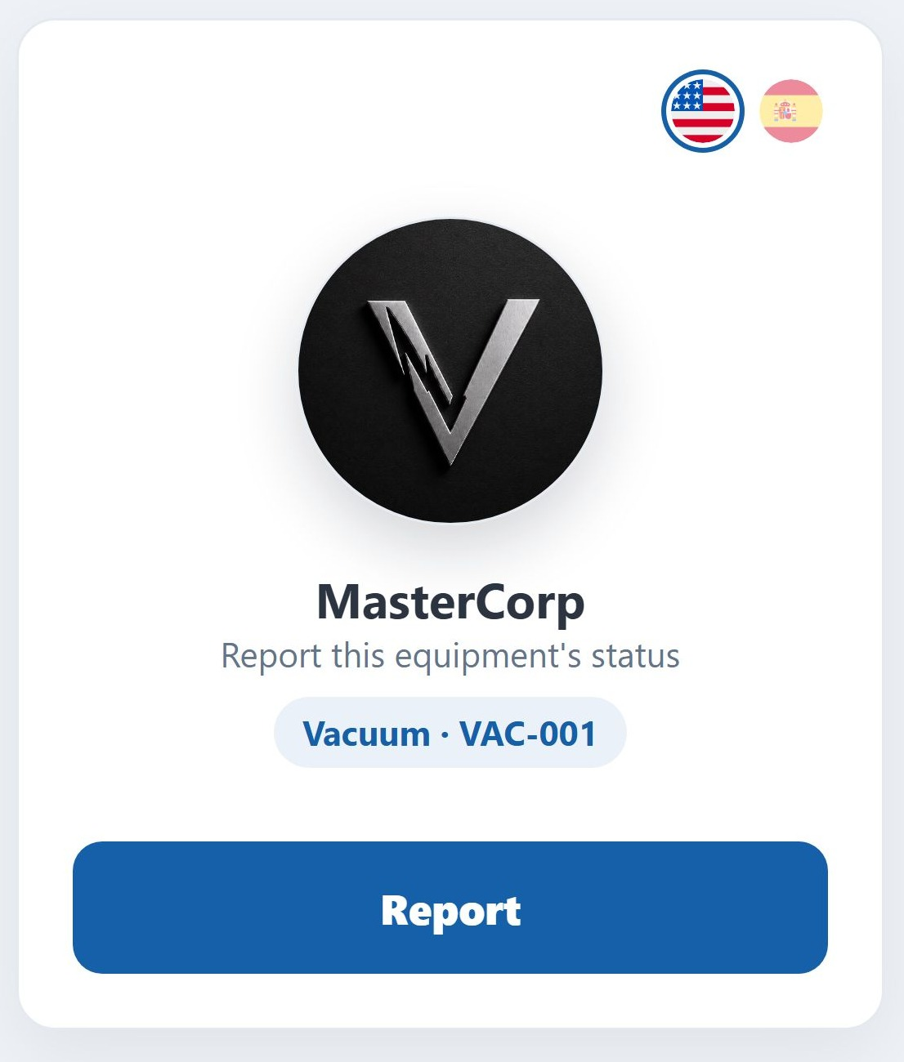
HOUSEKEEPER
Scan a unit (no login)
What the housekeeper sees when scanning a vacuum's QR. Simple, in their language, nothing to install.
• Scan with the phone camera (iPhone or Android).
• See the client's branding and the unit (Vacuum · VAC-001).
• One button: 'Report'. EN/ES language switch.
• Works in any mobile browser.

Slide 10
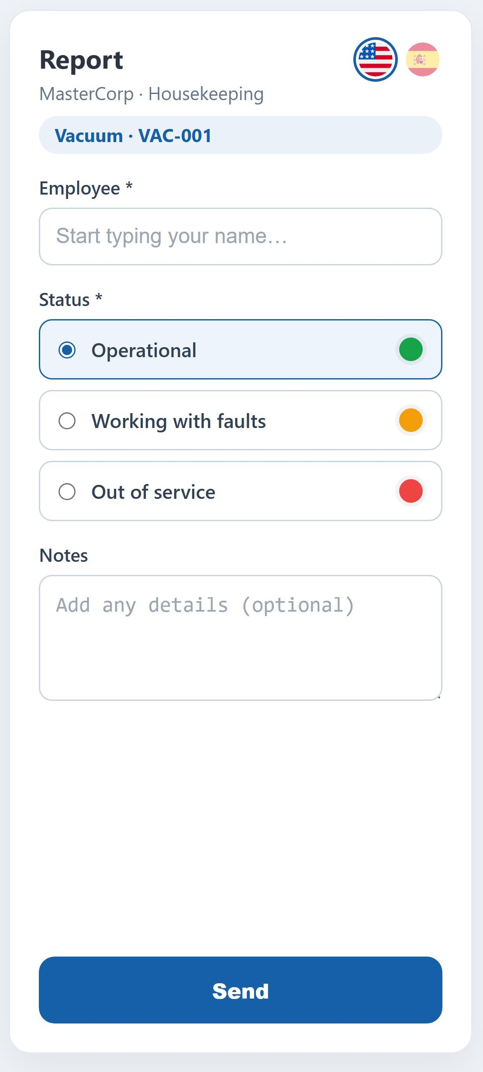
HOUSEKEEPER
Report equipment status
A 30-second form: who is reporting, what state the unit is in, and an optional note.
• Employee autocomplete (pick your name from the list).
• 3 color-coded states: Operational · With faults · Out of service.
• Optional note and photos when there is a problem.
• On submit, the record feeds the KPIs instantly.

Slide 11
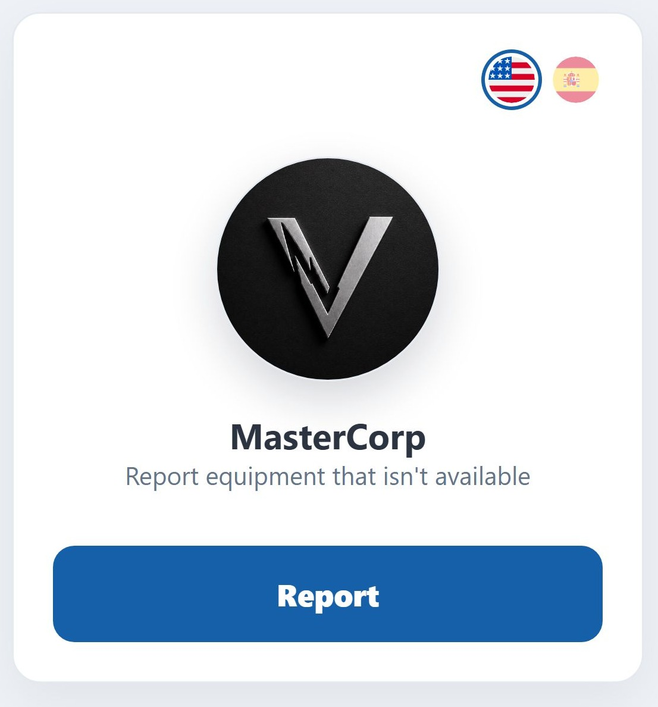
HOUSEKEEPER
Report 'equipment unavailable'
A fixed QR in the housekeeping room to flag when NO vacuum is available.
• Fixed QR posted in the room (not tied to a unit).
• The housekeeper scans and reports the shortage.
• Useful to detect equipment shortages per shift/floor.
• Counted separately in the dashboard.

Slide 12
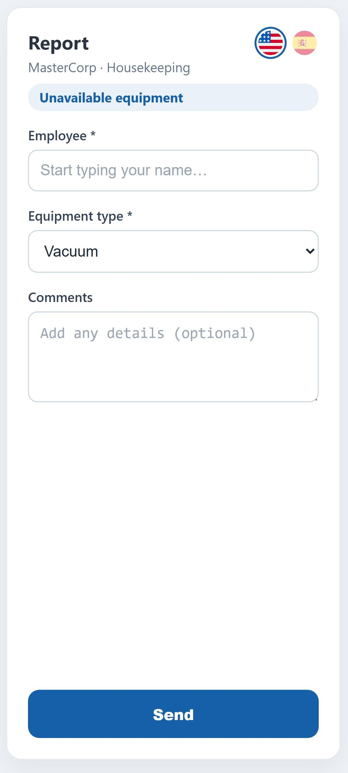
HOUSEKEEPER
Equipment-unavailable form
Employee, equipment type and comment. As simple as the status report.
• Employee autocomplete.
• Equipment type (Vacuum) pre-selected.
• Optional comment (e.g. 'no vacuums on floor 3').
• Recorded with time and site.

Slide 13
THE VALUE
Man-hour savings and faster tasks
~90%
~40 min
~48 h
less time per report
per site per day
saved per site per month
From ~7 min (paper + manual entry)
to ~30 sec scanning a QR.
The daily report is no longer built by hand:
it is generated and sent on its own at 10 am.
Adding up reports + consolidation.
With 5 sites: ~240 h/month (~30 man-days).
Plus value that is hard to measure in hours:
• Faster maintenance: faulty equipment is detected instantly, not at the end of the shift.
• Data-driven decisions: real-time visibility of availability per site.
• Fewer errors: no lost paper and no manual transcription.
• Scales with no extra management cost: adding sites or equipment is immediate.
Illustrative estimates based on a typical manual process; they vary with volume and operation.

Slide 14
SUMMARY
Why Vacuum Control
Zero friction for the operator
Real-time visibility
No apps, no logins: scan and report in seconds, in their language.
Per-site KPIs, an automatic daily email and full traceability.
Multi-site and multi-client
Secure and self-service
One subdomain per company, unlimited sites, each with its own equipment.
Encrypted passwords, code-based recovery, admin roles.
Print-ready
Measurable savings
QRs with the client's branding, PDF sheets and a fixed housekeeping QR.
Fewer man-hours on reporting and consolidation; faster maintenance.

Slide 15
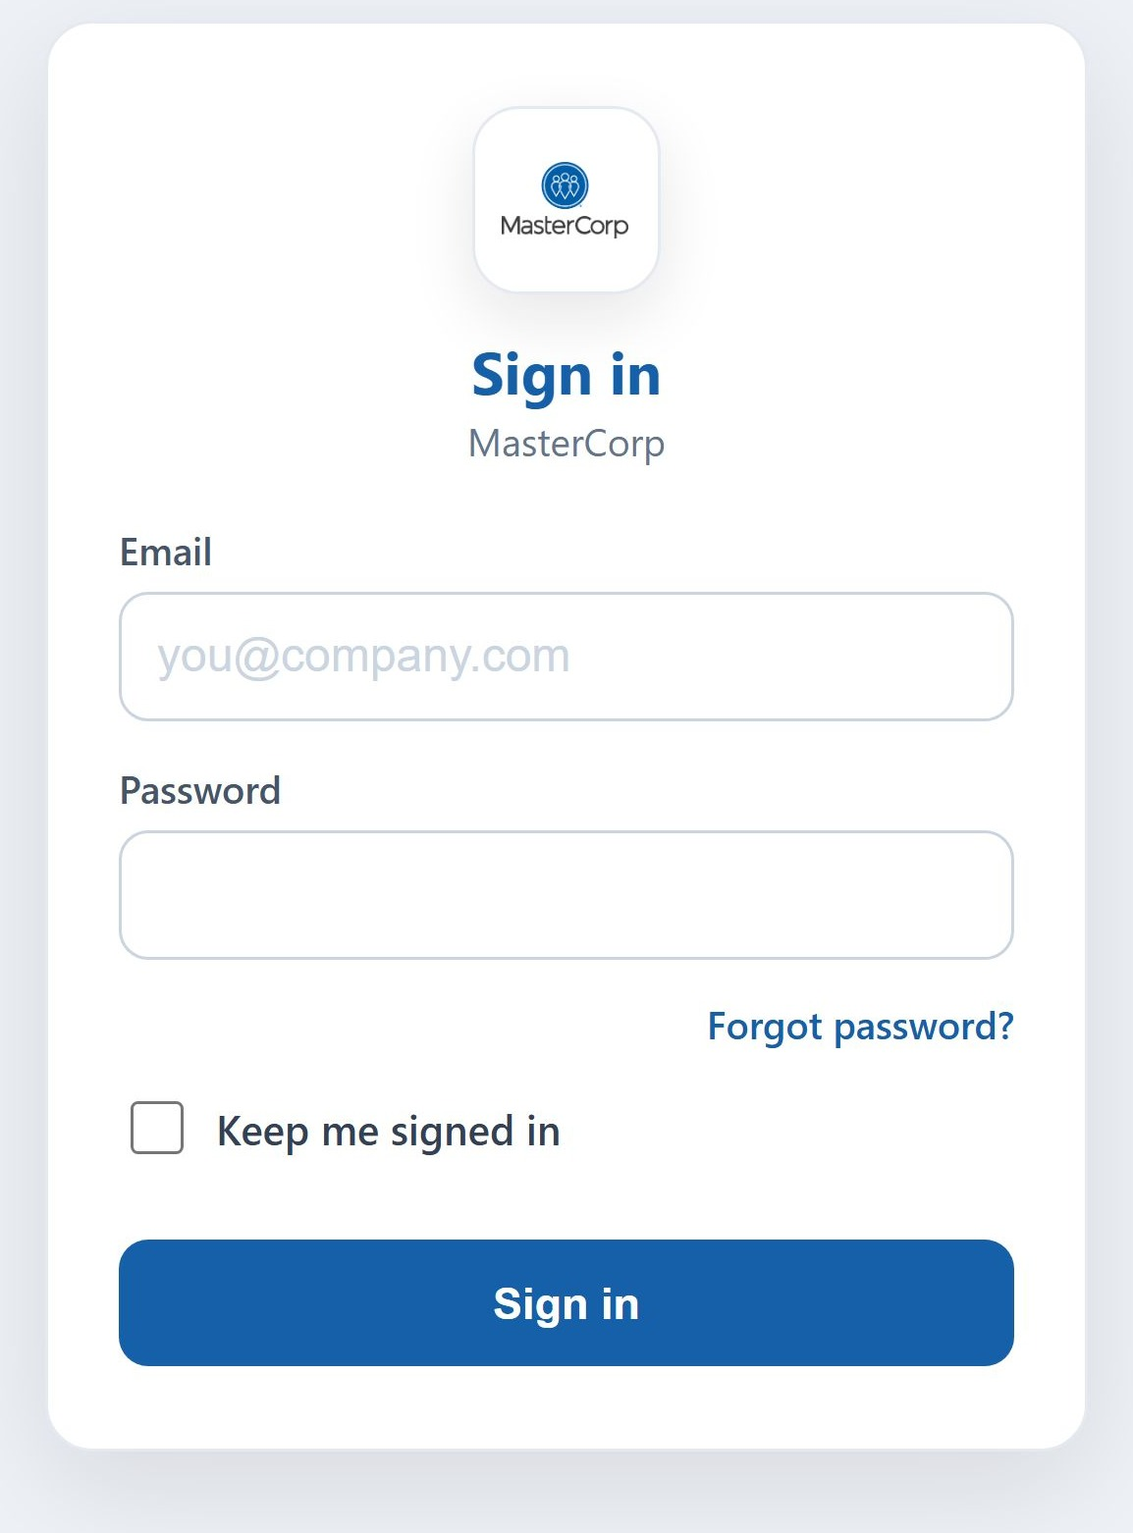
ACCESS & SECURITY
Secure per-client sign-in
Each client signs in through its subdomain with its own branding. Encrypted passwords (PBKDF2) and a persistent session.
• The admin opens mastercorp.valentisoft.com and sees the login with their company logo.
• Enters email and password; long session (does not expire in normal use).
• Admin roles at the tenant level (e.g. Chris David, Ramces Rodriguez).
• Session invalidated when the password changes (account protection).

Slide 16
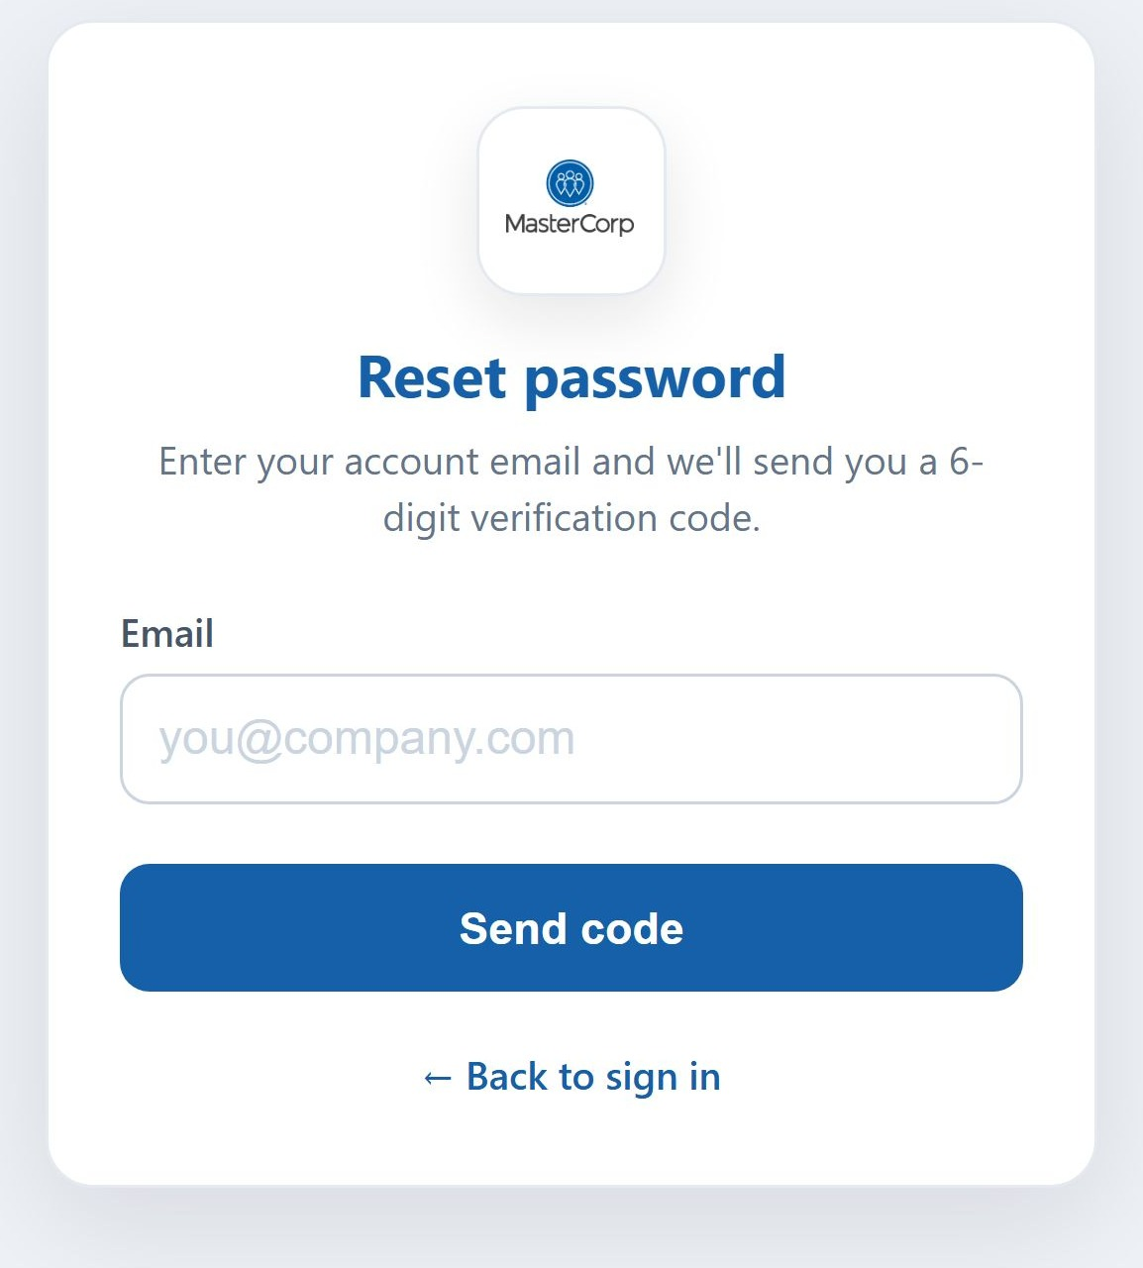
ACCESS & SECURITY
Password recovery
If an admin forgets their password, they recover it on their own, without relying on support.
• 'Forgot password?' → enter your email.
• Receive a 6-digit code by email (expires in 15 min).
• Enter the code and set the new password.
• Per-IP rate limiting against brute force; does not reveal whether the email exists.

