Slide 1
Keras
The Python Deep Learning library

Slide 2
Why Keras
You need to make deep learning models (fancy neural networks with hidden layers)
You work in Python (either 2.7 and 3.x)
You don’t have time to understand TensorFlow
You still want to use TensorFlow (indirectly through Keras)

Slide 3
What is Keras
Keras is a high-level neural networks API, written in Python and capable of running on top of TensorFlow, CNTK, or Theano.
With Keras you can:
train regular (fully connected), convolutional and other more exotic neural nets
parallelize on GPUs
not know TensorFlow

Slide 4
Install Keras
just use pip
sudo pip install tensorflow
sudo pip install keras
One of the scripts will need to download data, so have an internet connection

Slide 5
Make a model
from keras.models import Sequential
model = Sequential()
A Sequential model is made of stacked layers
The simplest type of layer is Dense, a fully connected layer
from keras.layers import Dense
model.add(Dense(units=64, activation='relu', input_dim=100))
model.add(Dense(units=10, activation='softmax'))
I’ll show hands on

Slide 6
Neural net
x_{i} are the variables (features)
w_{i} are weights
b is a constant (AKA bias)
A is a non-linear function (activation)
e.g. arctg
x₁
x₂
w₁
w₂
w₀x₀ + w₁x₁ +
w₂x₂ + w₃x₃
A(w₀x₀ + w₁x₁ + w₂x₂ + w₃x₃)
x₃
w₃
w₁’
w₀
b

Slide 7
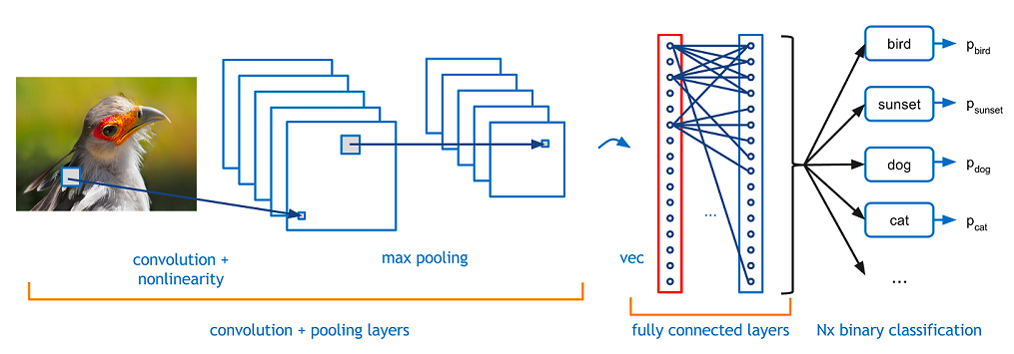
Convolutional neural net
https://adeshpande3.github.io/A-Beginner%27s-Guide-To-Understanding-Convolutional-Neural-Networks/

Slide 8
Decide how to train it
Configure model learning process with .compile():
model.compile(loss='categorical_crossentropy’, optimizer='sgd’, metrics=['accuracy'])
Loss = the “error” function to minimize (e.g. residual mean squares)
Optimizer = the algorithm used for minimization (e.g. stochastic gradient descent)
Metrics = the function that measures performance (e.g. misclassification rate)

Slide 9
Actually train it
model.fit(x_train, y_train, epochs=5, batch_size=32)
note that training data x_train, labels y_train are supplied as numpy arrays
batch_size = size of the mini batch over which to train
epochs = how many times to show the dataset to the neural net during training

Slide 10
Make predictions
classes = model.predict(x_test)

Slide 11
Evaluate performance
loss_and_metrics = model.evaluate(x_test, y_test, batch_size=128)

Slide 12
useful diagnostics
model.layers
model.summary()

Slide 13
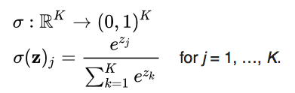

Activation functions
Softmax
relu

Slide 14
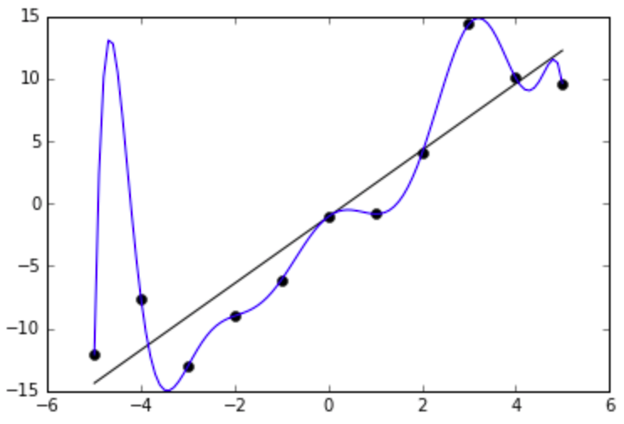
Regularization
Many weights = too many degrees of freedom
performance in training is too
good to be true, performance
in testing is not good
Penalize the weights, use early stopping, dropout...

