Slide 1
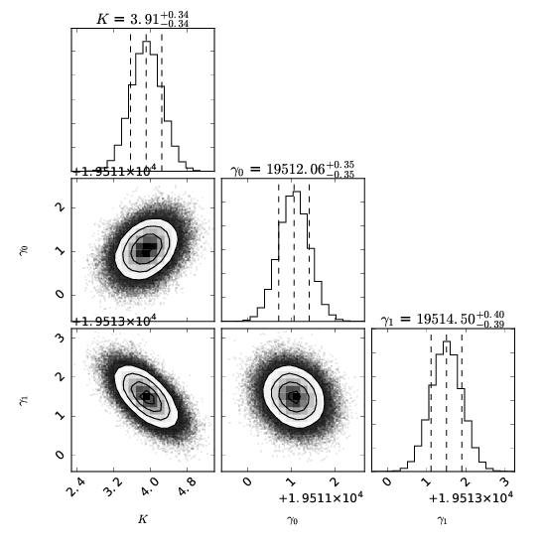

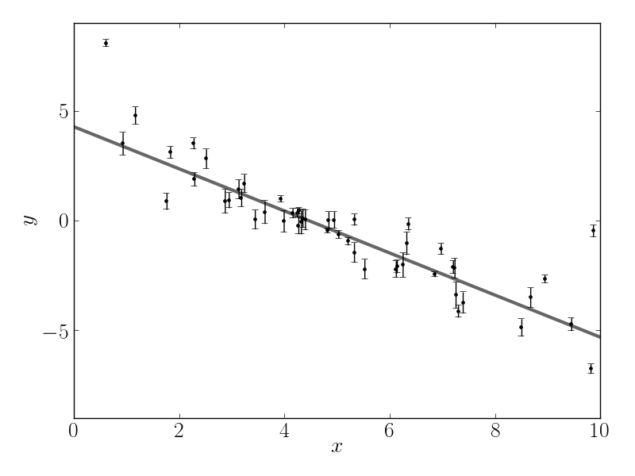
Bayesian Model Fitting with emcee
Giuliano Antoniciello
Py@STRO
April 24th, 2018

Slide 2
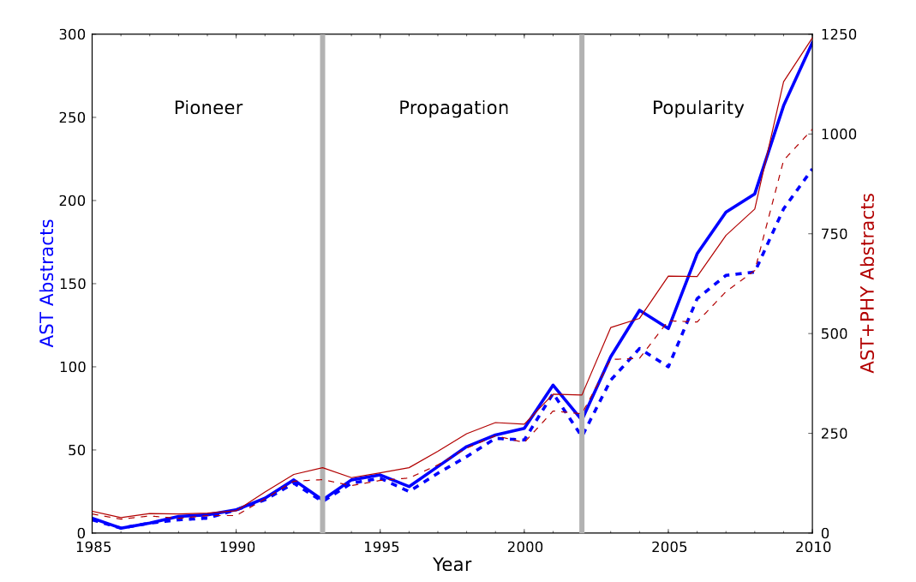
A growing though recent popularity
“Bayesian”
Loredo, 2012

Slide 3
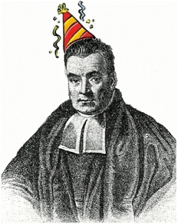
Bayes who?
Bayesian = Frequentist (likelihood) + Priors?

Slide 4

Bayes who?
Bayesian = Frequentist (likelihood) + Priors?

Slide 5
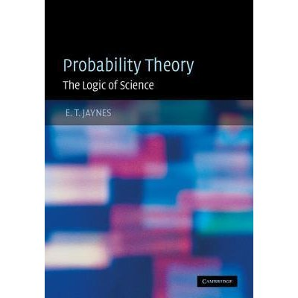
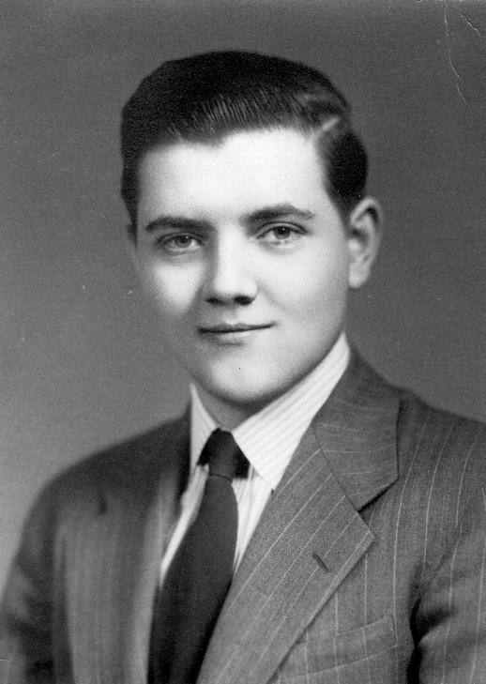
Theoretical framework
Edwin Thompson Jaynes
(1922 – 1998)
Probability is a property of a logical implication between two events, not of a single event!
A ⇒ B

Slide 6
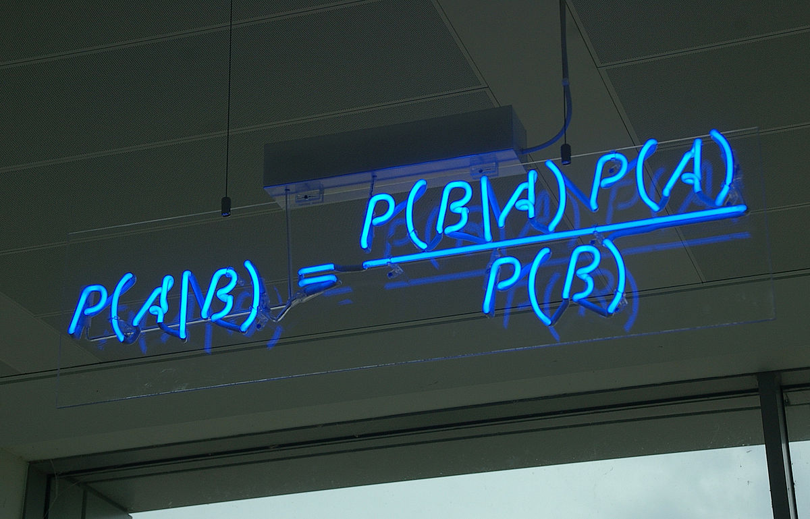
The logic of Science
Science does not deal with strong syllogisms...
If A is true, then B is true
A is true
----------------------------------
Therefore, B is true
...but rather with a weak version of syllogisms:
If A is true, then B become more plausible
B is true
----------------------------------
Therefore, A becomes more plausible
A ⇒ B

Slide 7
A theory of states of knowledge
Bayesian probability theory
=
theory of degrees of plausibility of logical implication relationships
Bayesian inference is based on our state of knowledge, not on any physical property of the objects of our reasoning!
Different states of knowledge → Different conclusions!

Slide 8
Bayesian foundations
Bayesian probability theory can be deduced from three desiderata (Jaynes, 2003):
Degrees of plausibility are represented by real numbers.
Reasoning must have a qualitative correspondence with common sense.
Reasoning must be self consistent.

Slide 9
Bayesian foundations
Notice that, so far, we do not need concepts like:
1. Repeated experiments
2. Favorable cases
3. Relative frequencies
4. “Large” numbers
5. Any physical property of our world (!!!)
In fact, Bayesian probability theory is “just” a theory of reasoning!

Slide 10
The role of prior information
How do we estimate the degree of plausibility of a logical implication relationship?
A ⇒ B
It depends on what we know about A, B, and the context...
We call such knowledge the prior information we have about the problem!

Slide 11
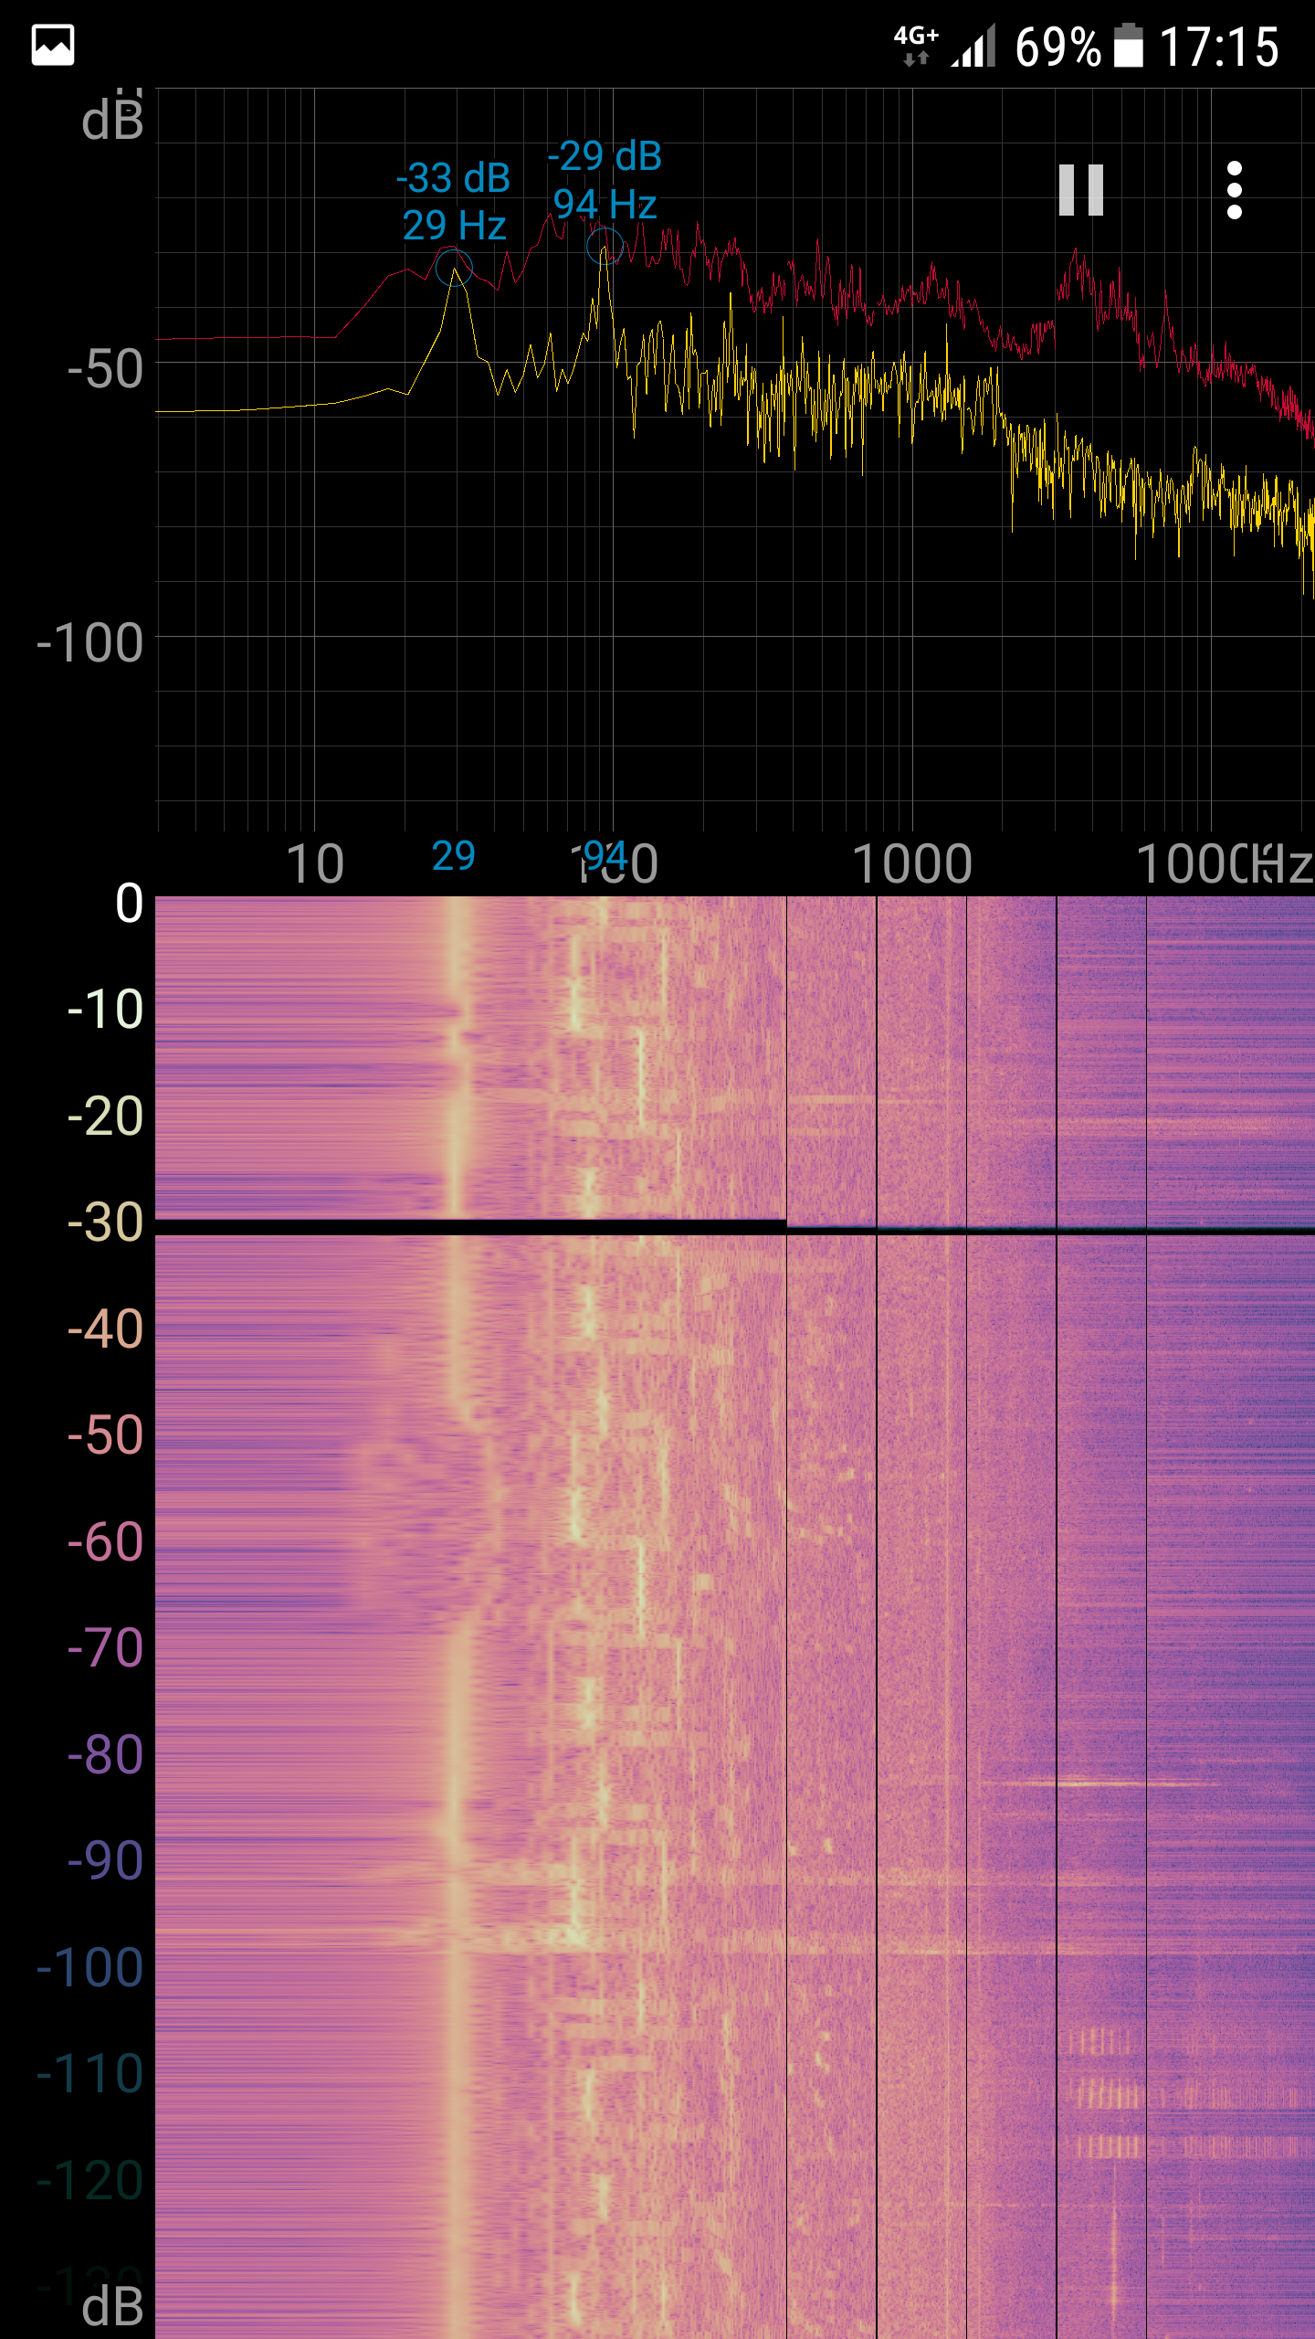

Priors: the elephant in the room
~30 Hz constant sound
~80-120 Hz short and repeated sounds
High frequency short sounds

Slide 12

A plausible explanation
~30 Hz constant sound

Slide 13
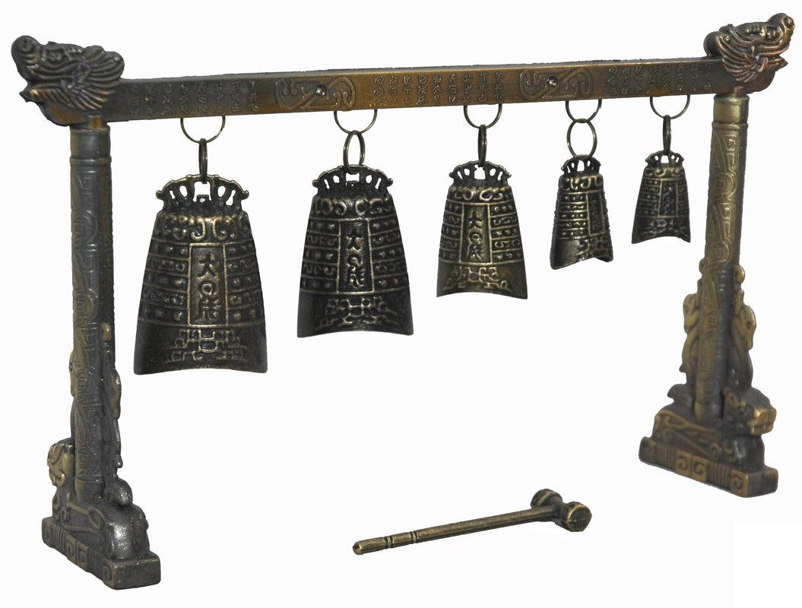
A plausible explanation
~80 -120 Hz short and repeated sounds

Slide 14

A plausible explanation
High frequency short sounds

Slide 15


Conclusions...

Slide 16
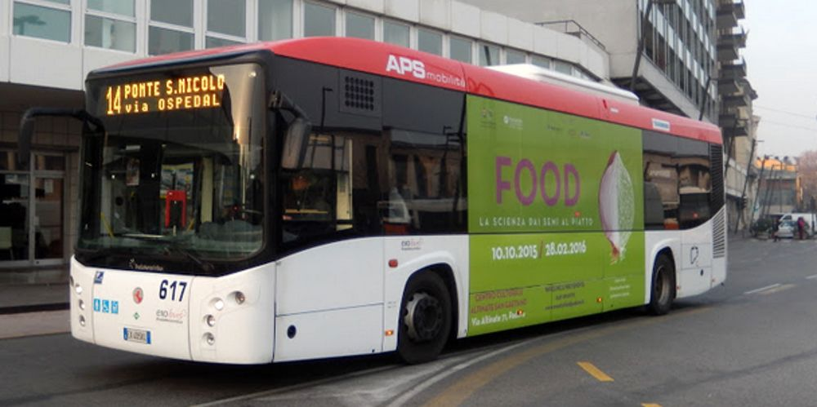
A more plausible explanation
~30 Hz constant sound
30 Hz
=
1800 min⁻¹
=
900 cycles/min of a four-cylinder
diesel engine

Slide 17
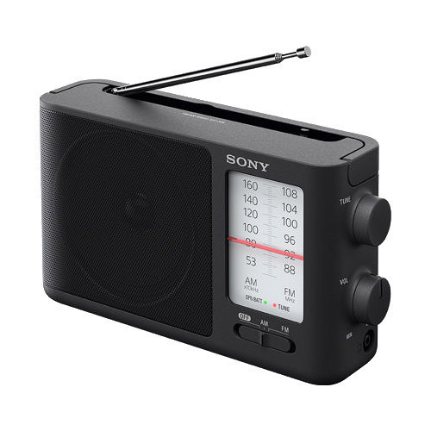
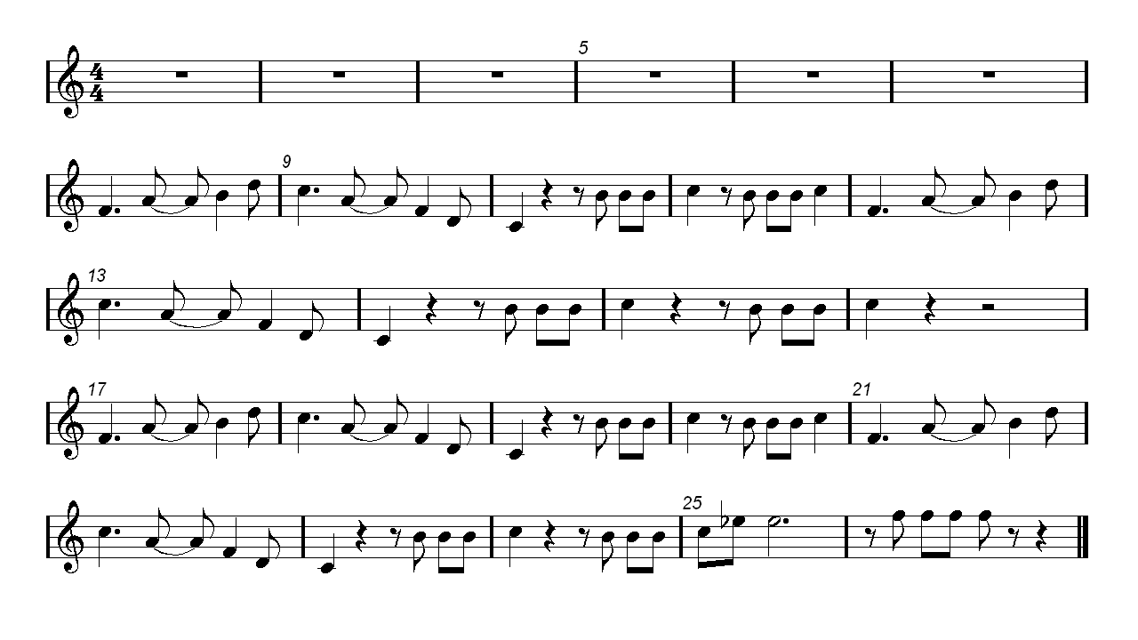
A more plausible explanation
~80 -120 Hz short and repeated sounds

Slide 18

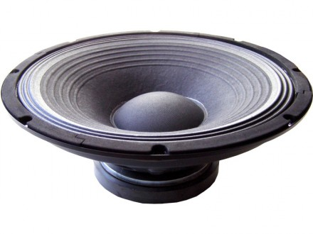
A more plausible explanation
High frequency short sounds

Slide 19
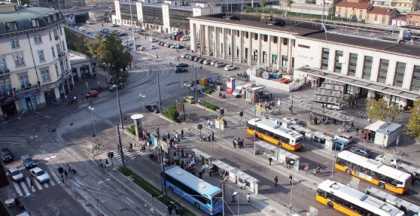
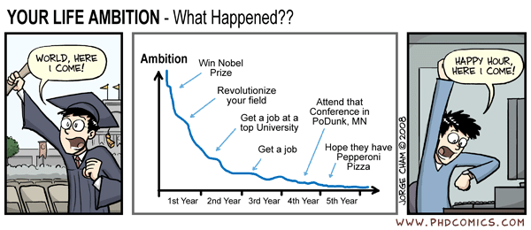
Again, conclusions...

Slide 20
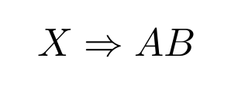

From “common” sense to formalism
What's the probability of this logical implication relationship?
Everything I know about the problem
My hypothesis for an explanation is true
Data
Boolean algebra:
AB means “A and B are true”

Slide 21
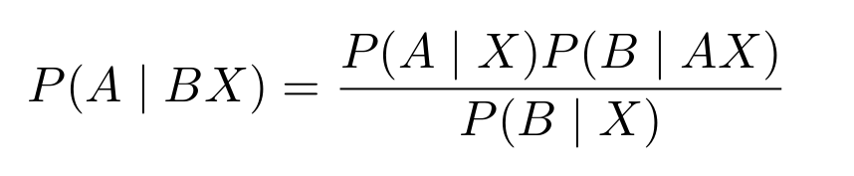

Bayes theorem for logical statements
B = “He recorded these (weird looking) sounds”
A = “He's on a bus waiting for it to leave Padova train station while someone listen to music”
X = “Everything I know about this guy (mostly, a poor PhD student from somewhere far from Padova)”
Prior information!

Slide 22


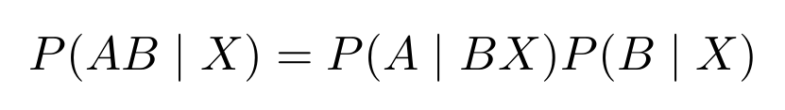
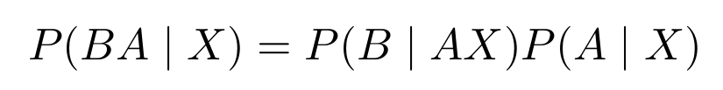
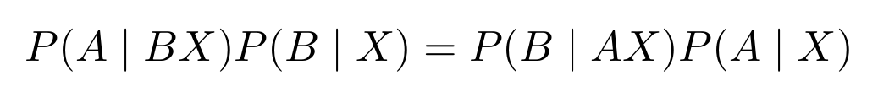
Bayes theorem for logical statements
How to compute this probability?
The logical product (AND) is commutative!

Slide 23
Bayes theorem for logical statements
“Posterior probability”:
Probability that those sounds have been recorded because he was on a bus waiting for it to leave Padova train station while someone listen to music
“Likelihood”:
Probability that those sounds where recorded on a bus, given what I know about him
“Prior probability”:
Probability that he actually was on a bus in front of Padova train station, given what I know about him
“Evidence”:
Probability that he recorded those sounds, given what I know about him

Slide 24
Bayes theorem for logical statements
Let's consider these particular logical statements:
M = “Our model M is true”
D = “We observed the data D”
X = “Everything we know about
the problem (instruments, physics)”

Slide 25
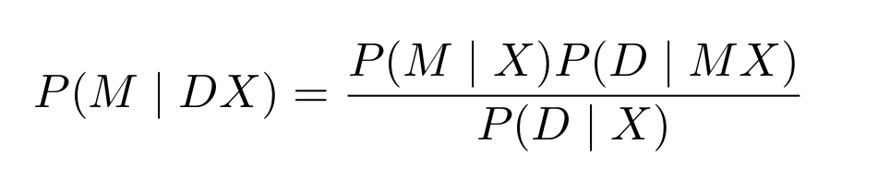
Bayes theorem for logical statements
“Posterior probability”:
Probability that our model M is true given that we observed the data D and we know X about the problem
“Likelihood”:
Probability of observing the data D assuming that M is true
“Prior probability”:
Probability that our model M is true given our prior information X
“Evidence”:
Probability of observing the data D, whatever the true model is

Slide 26
Bayes theorem for parametric models
Let's introduce a slightly different notation for logical statements:
ϑ = “The model defined by the set of parameter values ϑ is true”
D = “We observed the data D”
X = “Everything we know about
the problem (instruments, physics)”
P (probability of a logical statement → p (probability density function of some real valued parameter)

Slide 27
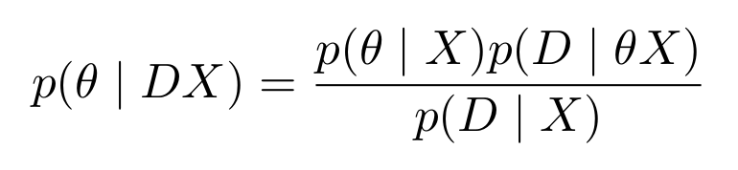
Bayes theorem for parametric models
“Posterior probability”:
Probability that the parameter values ϑ are the true ones given that we observed data D and that we know X
“Likelihood”:
Probability of observing the data D assuming that the parameter values ϑ are the true ones and that we know X
“Prior probability”:
Probability that the parameter values ϑ are the true ones just given X
“Evidence”:
Probability of observing the data D, whatever the true parameter values are

Slide 28
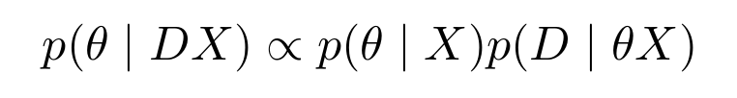
Bayesian Model Selection (BMF)
Aim of BMF:
finding the most probable set of parameter values ϑ, given D and X
=
finding the set of parameter values ϑ that maximize the posterior probability

Slide 29
Bayesian Model Selection (BMF)
In typical real world problems, we cannot maximize the posteriors analytically!
We need numerical methods to sample from the posterior probability density distribution (pdf)
emcee is a Python implementation of a Markov Chain Monte Carlo Method (MCMC)

Slide 30
MCMC algorithms
Cool! But how does MCMC algorithm work?
Some walkers are initialized with random positions in the parameter space
Every walker is asked to draw a new position according to some “jump rule”
Such jump proposals must be accepted :) or rejected :(
Proposals are more likely to be accepted if to the new positions in the parameter space correspond higher values of posterior probability
If everything works fine (typically not the real world case), walkers will converge to the region of parameter space that maximize the posterior probability
The distribution of walkers' positions approximates the pdf of our model parameters!
Posterior probability
distribution sampled!

Slide 31
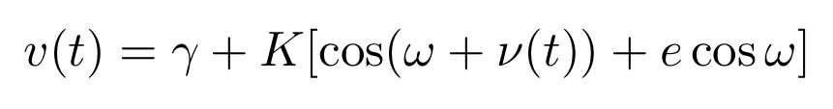
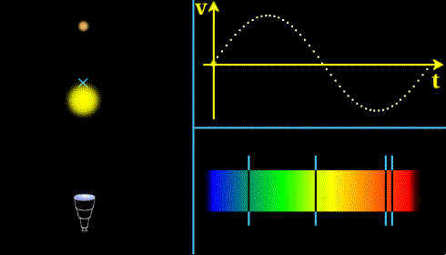
A case study
Radial Velocity method for exoplanets' masses

Slide 32
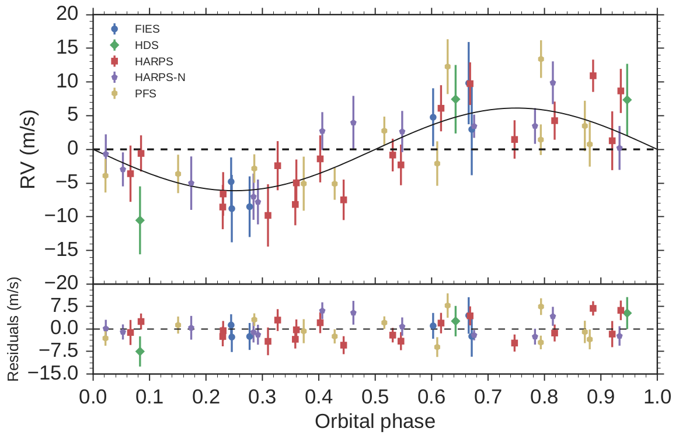
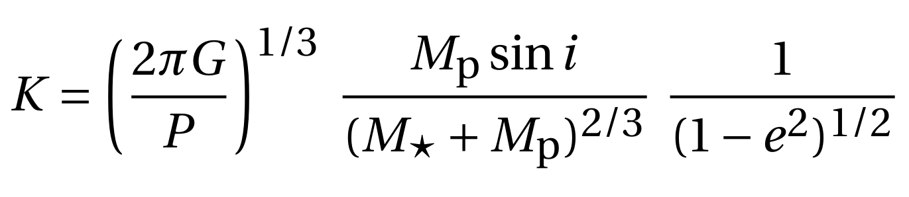
A case study
Radial Velocity method for exoplanets' masses
Mass function
From RV semi-amplitude (~1 – 10 m/s) we get the planet's mass.
State-of-the-art instruments (e. g. HARPS) allow us to pin masses of Earth-like planets down to ~10 – 20 % uncertainties!

Slide 33
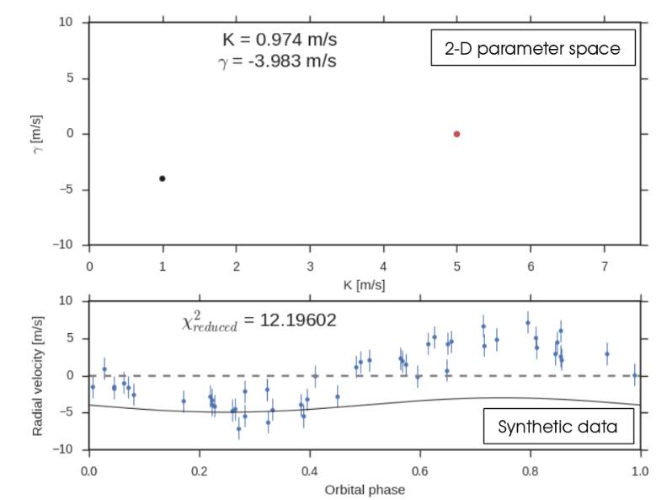
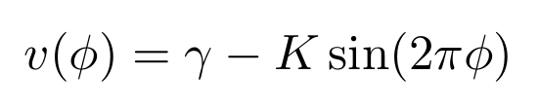
emcee at work!
Keplerian model with two parameters:
- RV semi-amplitude K
- Systemic velocity γ
Initial guess
Real values
What's the result?
Samples of the posterior pdf in a D-dimensional parameter space...

Slide 34
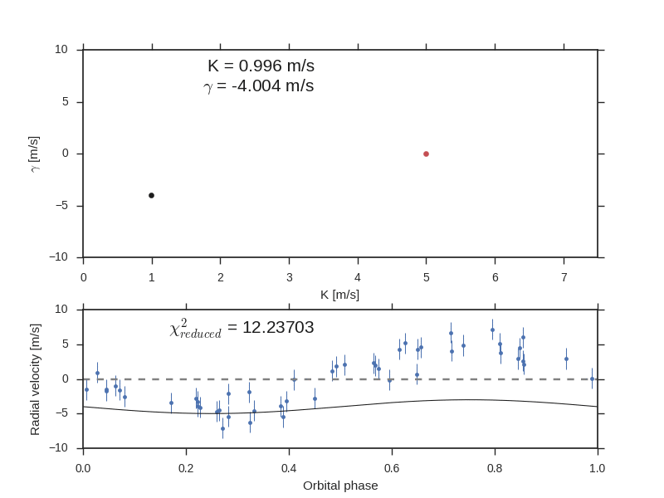
emcee at work!
Keplerian model with two parameters:
- RV semi-amplitude K
- Systemic velocity γ
2-D parameter space
Initial guess
Real values
What's the result?
Samples of the posterior pdf in a D-dimensional parameter space...
Synthetic data

Slide 35
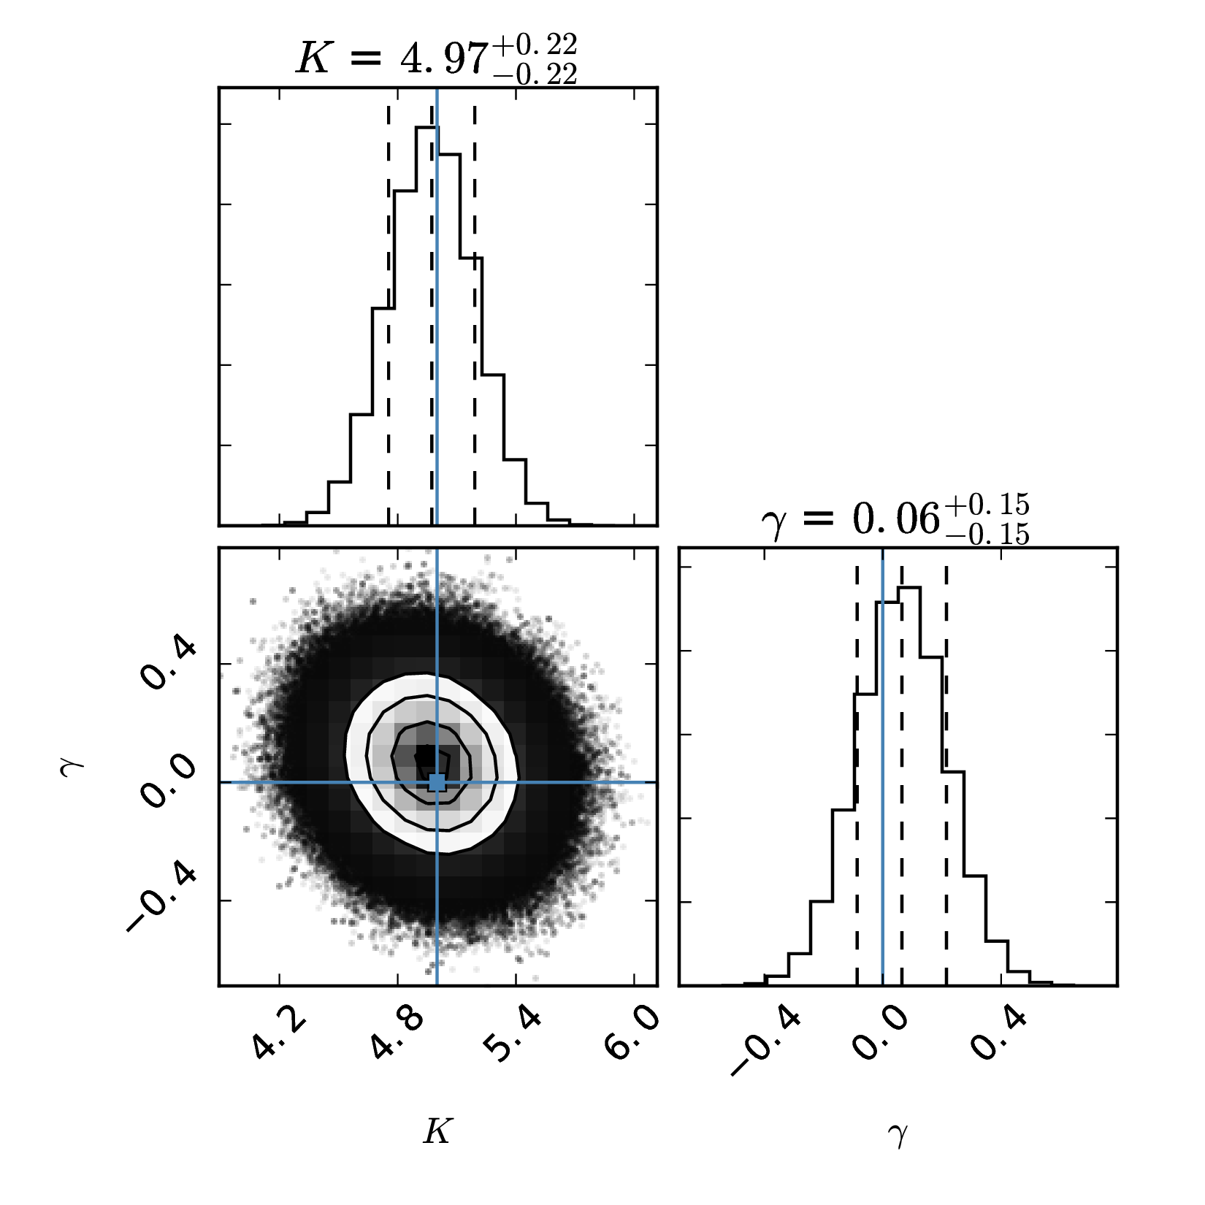
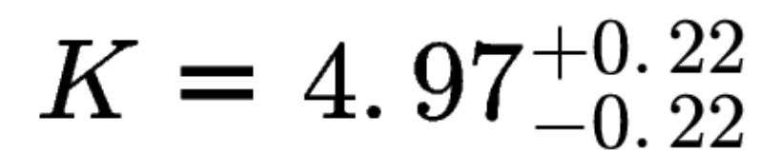
MCMC results with corner.py
We usually express results with a median value and a 1-sigma confidence interval centered on the median:
What is the probabilistic interpretation of such result in a Bayesian framework?

Slide 36
How to interpret MCMC results?
Frequentist interpretation:
“The interval 4.97± 0.22 m/s has a 68% probability of containing the true value of K”
Bayesian interpretation:
“The value of K has a 68% probability of being in the interval 4.97± 0.22 m/s”
There is a true, fixed (yet unknow) value of K
Probability is referred to the interval!
We assign to K a value according to our state of knowledge
Probability is referred to the parameter!
Same name (“probability”), but different meaning!

Slide 37
Let's see a practical example...
We now switch to the Jupyter notebook!

