Slide 1
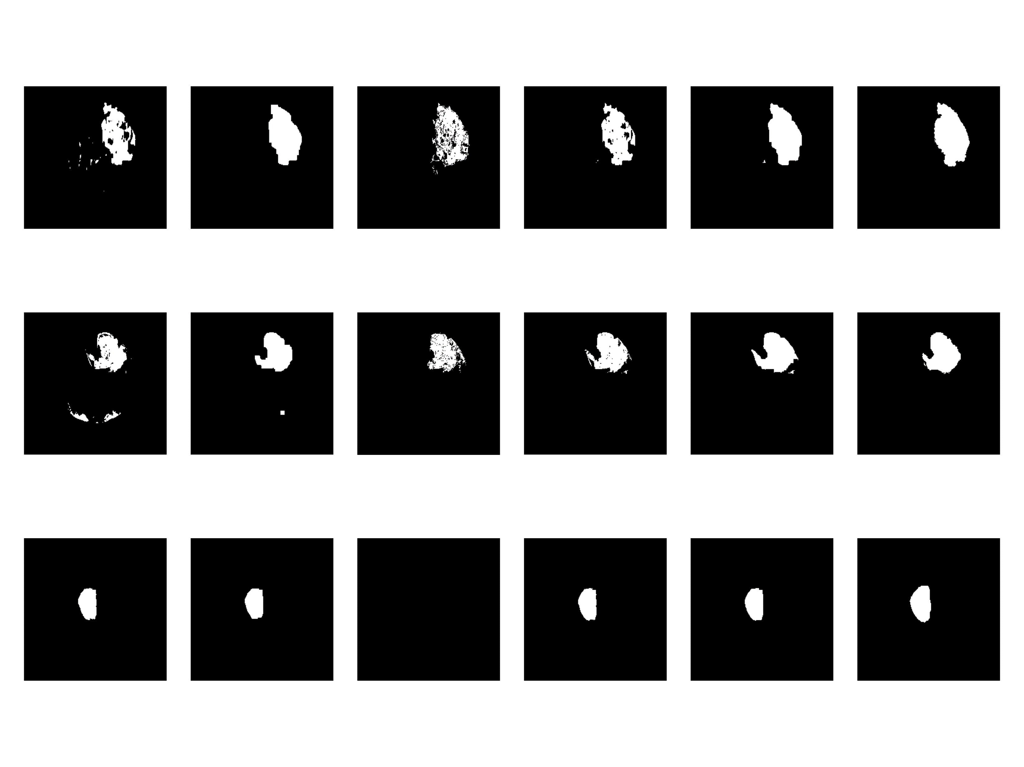
Visualized result with different method
BRATS_008
(show z=60)
BRATS_033
(show z=70)
BRATS_259
(show z=110)
Multi-thres
-hold Otsu
Otsu with
opening
closing
Traditional
region
growing
new region
growing
new region
growing
with closing
label

