Slide 1
PyBaMM submodels

Slide 2
Getting started with PyBaMM
Many resources and links available at pybamm.org
Installation instructions and tutorials: pybamm.org/getting-started
How to run a model and change settings: https://github.com/pybamm-team/PyBaMM/tree/develop/examples/notebooks/Getting%20Started
How models are built (examples from scratch) – useful to understand lithium-ion models: https://github.com/pybamm-team/PyBaMM/tree/develop/examples/notebooks/Creating%20Models

Slide 3
Submodel structure
Models are implemented as a combination of submodels (plug-and-play physics)
Relies heavily on object-oriented programming (classes and inheritance): https://realpython.com/python3-object-oriented-programming/
Model files: read these to see which submodels are used when using different options
pybamm/models/full_battery_models/lithium_ion/spm.py
pybamm/models/full_battery_models/lithium_ion/dfn.py
Print `model.submodels` to see which submodels a particular model uses
Submodel files: located in pybamm/models/submodels

Slide 4
Submodels
Each submodel folder contains
A base submodel (e.g. electrolyte_diffusion/base_electrolyte_diffusion.py)
At least one specific submodel, e.g.
electrolyte_diffusion/full_diffusion.py: nonlinear diffusion equation for electrolyte concentration
electrolyte_diffusion/constant_concentration.py: sets the electrolyte concentration to constant
Base submodels assign all the different variables that can be plotted, shared by all specific submodels
Specific submodels set the equations, initial conditions and boundary conditions specific to that submodel

Slide 5
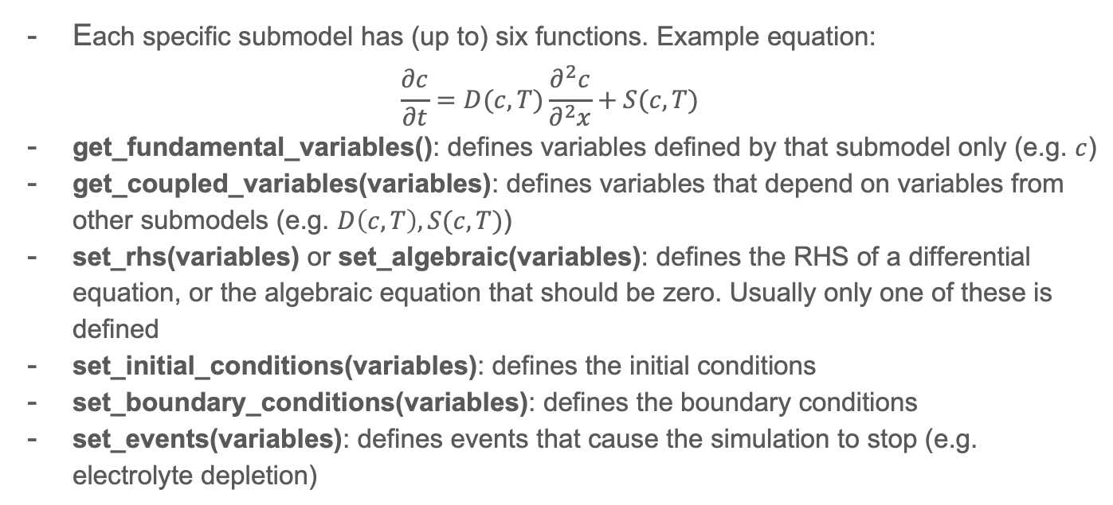
Specific submodels
Each specific submodel has (up to) six functions. Example equation:
$$\frac{∂c}{∂t}=D(c,T)\frac{∂^{2}c}{∂^{2}x}+S(c,T)$$
get_fundamental_variables(): defines variables defined by that submodel only (e.g. $c$)
get_coupled_variables(variables): defines variables that depend on variables from other submodels (e.g. $D\left(c,T\right), S(c,T)$)
set_rhs(variables) or set_algebraic(variables): defines the RHS of a differential equation, or the algebraic equation that should be zero. Usually only one of these is defined
set_initial_conditions(variables): defines the initial conditions
set_boundary_conditions(variables): defines the boundary conditions
set_events(variables): defines events that cause the simulation to stop (e.g. electrolyte depletion)

