Slide 1
Pack modeling with liionpack
Valentin Sulzer

Slide 2
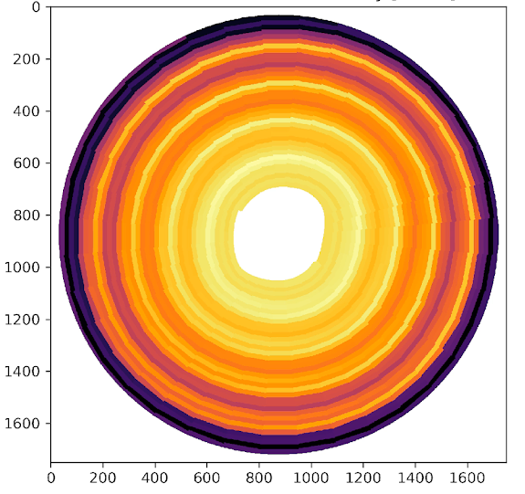
Introduction
Understanding, optimizing, and managing large packs is crucial to achieve battery cost and efficiency targets
Liionpack: A Python package for simulating packs of batteries with PyBaMM
Open-source at https://github.com/pybamm-team/liionpack
Works with any PyBaMM model
Different parameter sets
Thermal models
Degradation models
…
Inspired by Tom Tranter’s work on jellyroll modeling

Slide 3
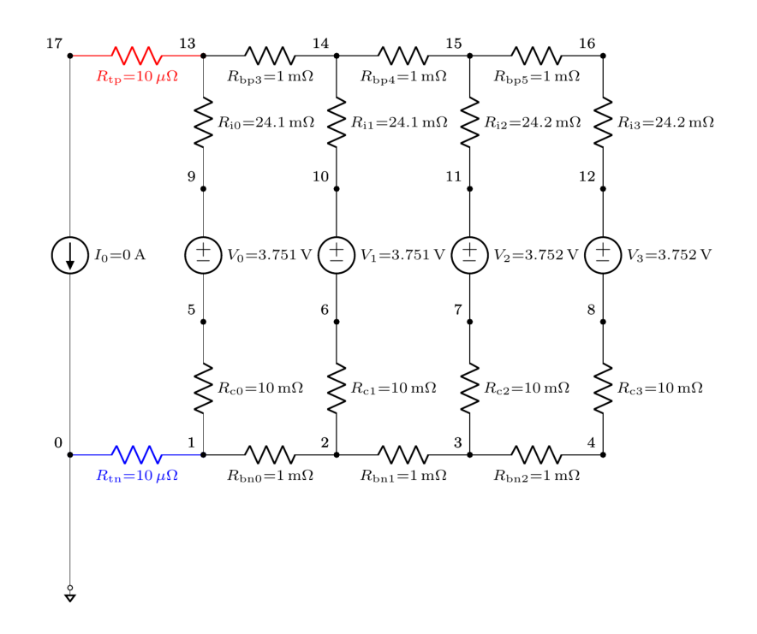
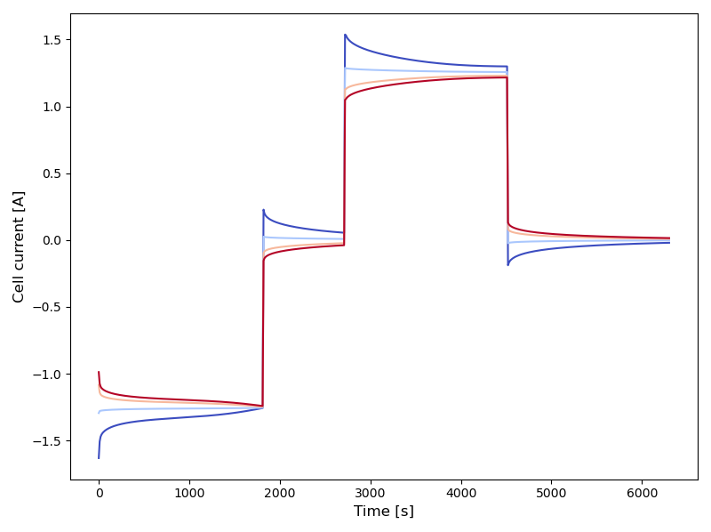
Basic example
Simulated current through each cell
(CC charge / rest / CC discharge / rest)
Four cells in parallel
1 cell
(PyBaMM)

Slide 4
How does it work?

Slide 5
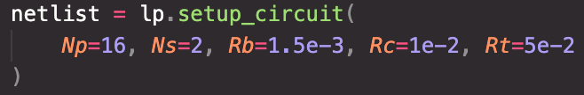
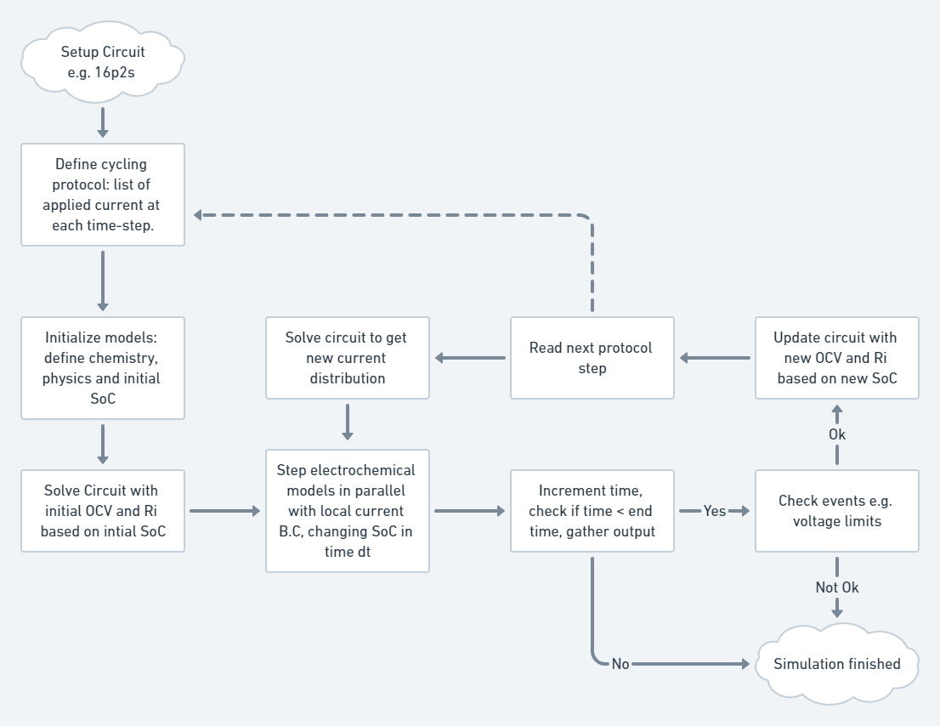
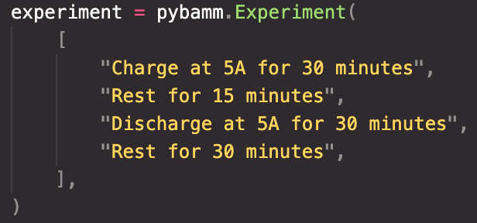
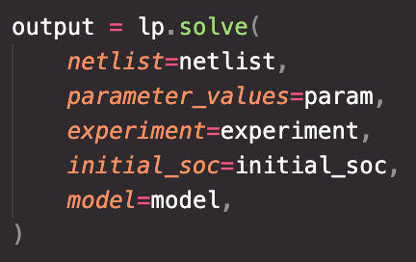
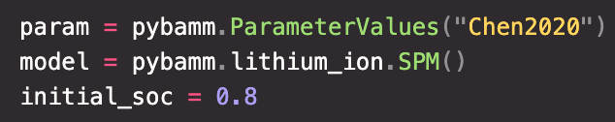
Solution overview

Slide 6
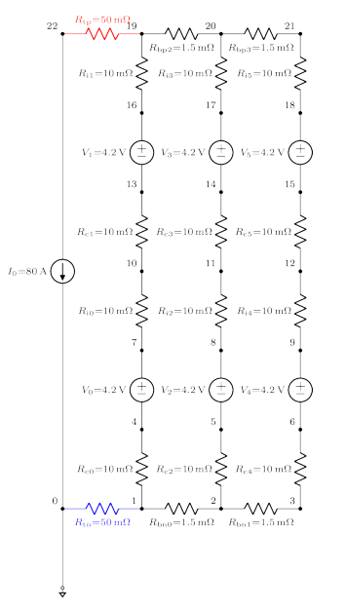
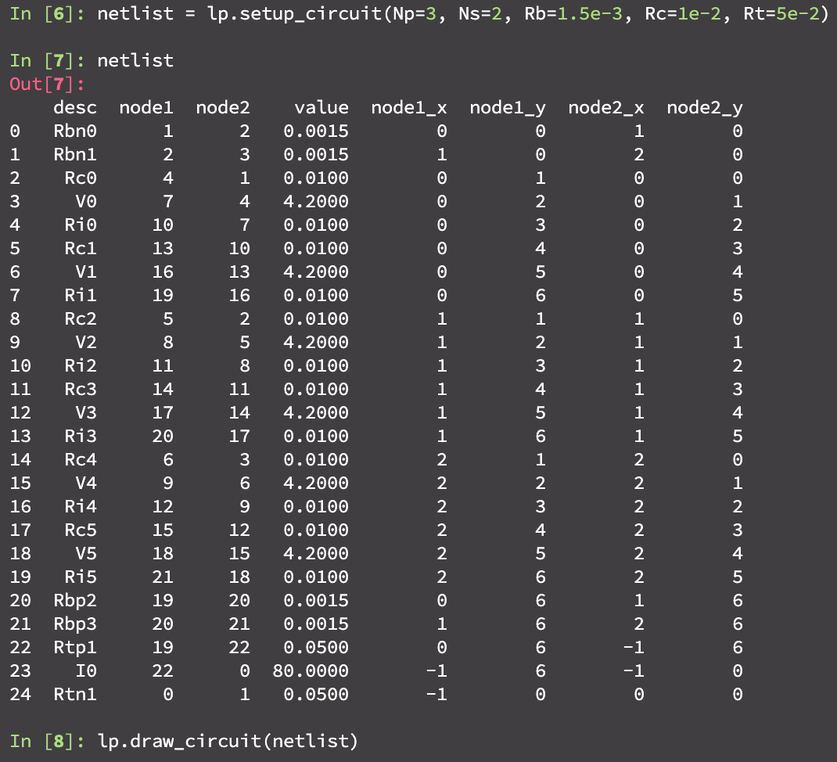
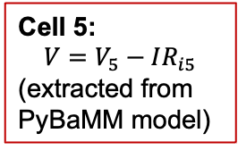
Circuit representation
Cell 5:
$$V=V_{5}−IR_{i5}$$
(extracted from
PyBaMM model)

Slide 7
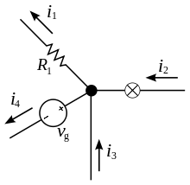
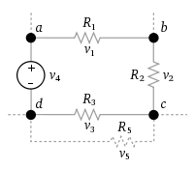


Modified Nodal Analysis
“Kirchhoff’s circuit laws for algorithms”
Modified Nodal Analysis: write these in the form Ax=b (solve for x)
Kirchhoff’s current law
Kirchhoff’s voltage law
Total current in = Total current out
$$i_{2}+i_{3}=i_{1}+i_{4}$$
Sum of voltages around a loop is zero
$$v_{1}+v_{2}+v_{3}+v_{4}=0$$
https://en.wikipedia.org/wiki/Kirchhoff%27s_circuit_laws

Slide 8
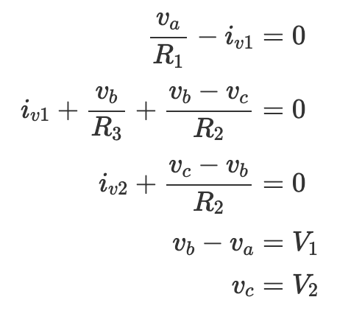
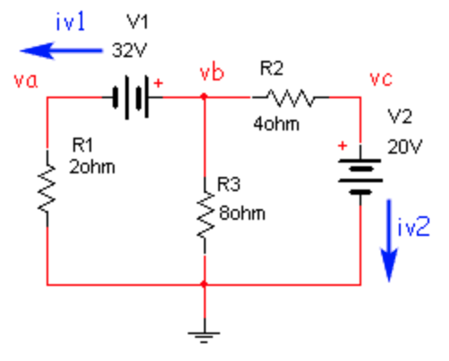
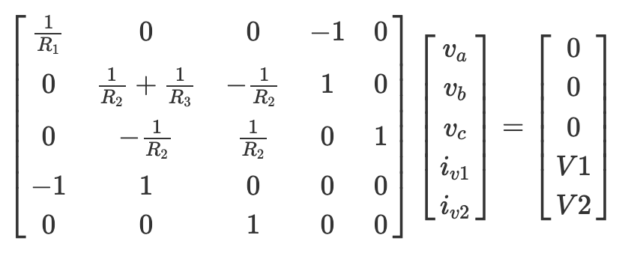
Modified Nodal Analysis
KC1
Example circuit
KC2
KC2
KC3
KC3
KV1
KV2
KC1
KV1
KV2
0 V
A
x
b
https://lpsa.swarthmore.edu/Systems/Electrical/mna/MNA2.html

Slide 9
Iterative solution
MNA (Ax=b)
PyBaMM solver step

Slide 10
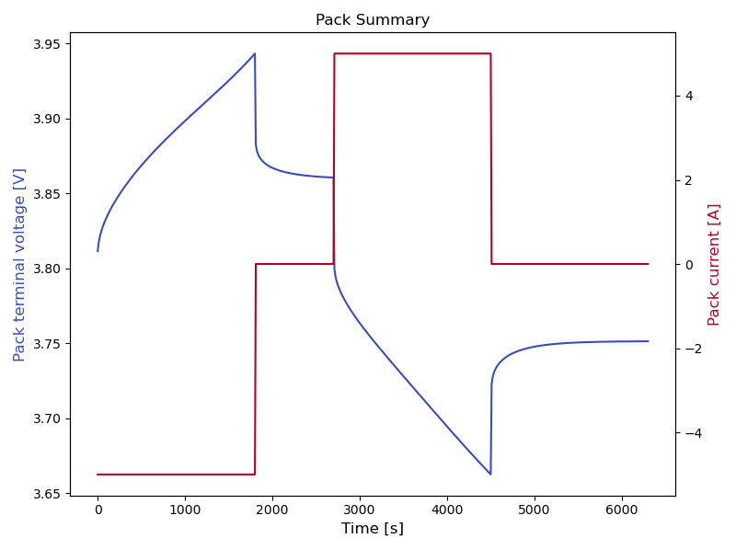
Results (4p1s)

Slide 11
Advanced Examples

Slide 12
Thermal model

Slide 13
Different initial SOCs

Slide 14
Drive cycles

Slide 15
Larger packs

Slide 16
Degradation model

Slide 17
Terminal locations

Slide 18
Multiprocessing
Use dask or ray for solving PyBaMM cell models in parallel on clusters
32 parallel, 20 series (~1.6 kWh simulated)
400 parallel, 125 series (~250 kWh simulated)
MacBook Pro laptop
CADES cloud 80 vCPU

Slide 19
Conclusions

Slide 20








Acknowledgements
Tom Tranter,
Robert Timms,
Ferran Brosa-Planella,
Gavin Wiggins,
Srikanth Allu,
Vikrant Karra,
Priyanshu Agarwal, Saransh Chopra,
Dan Brett,
Paul Shearing

