Slide 1




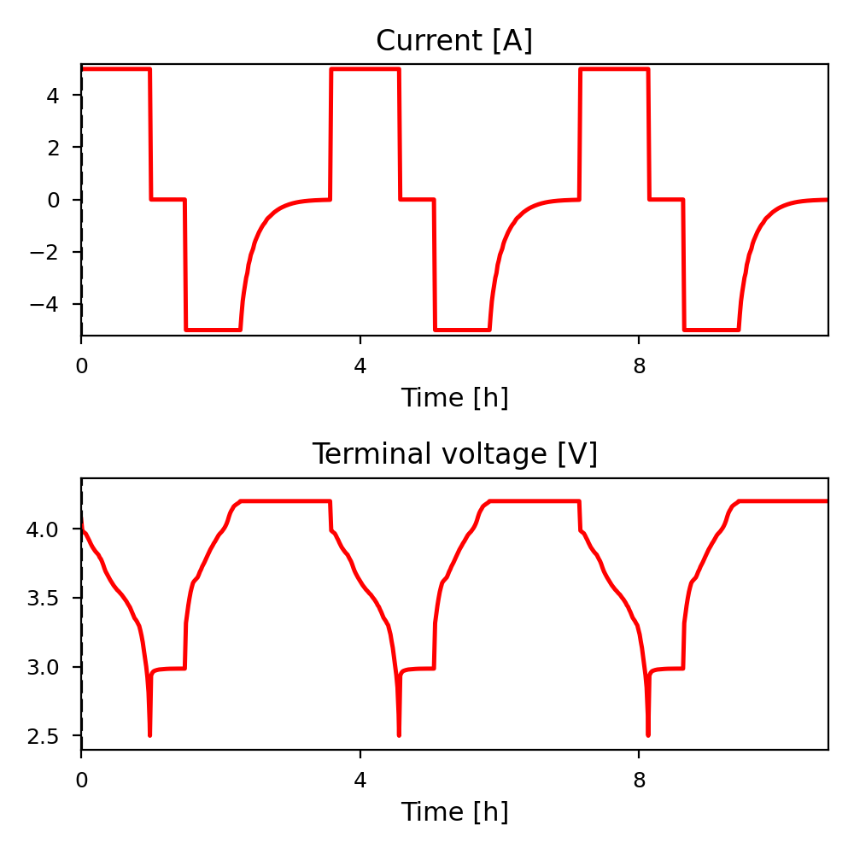
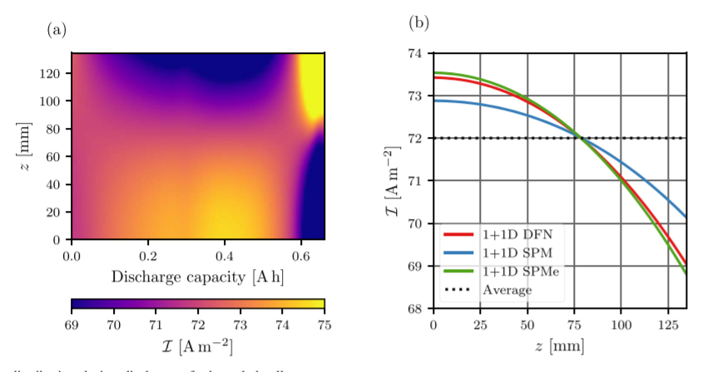

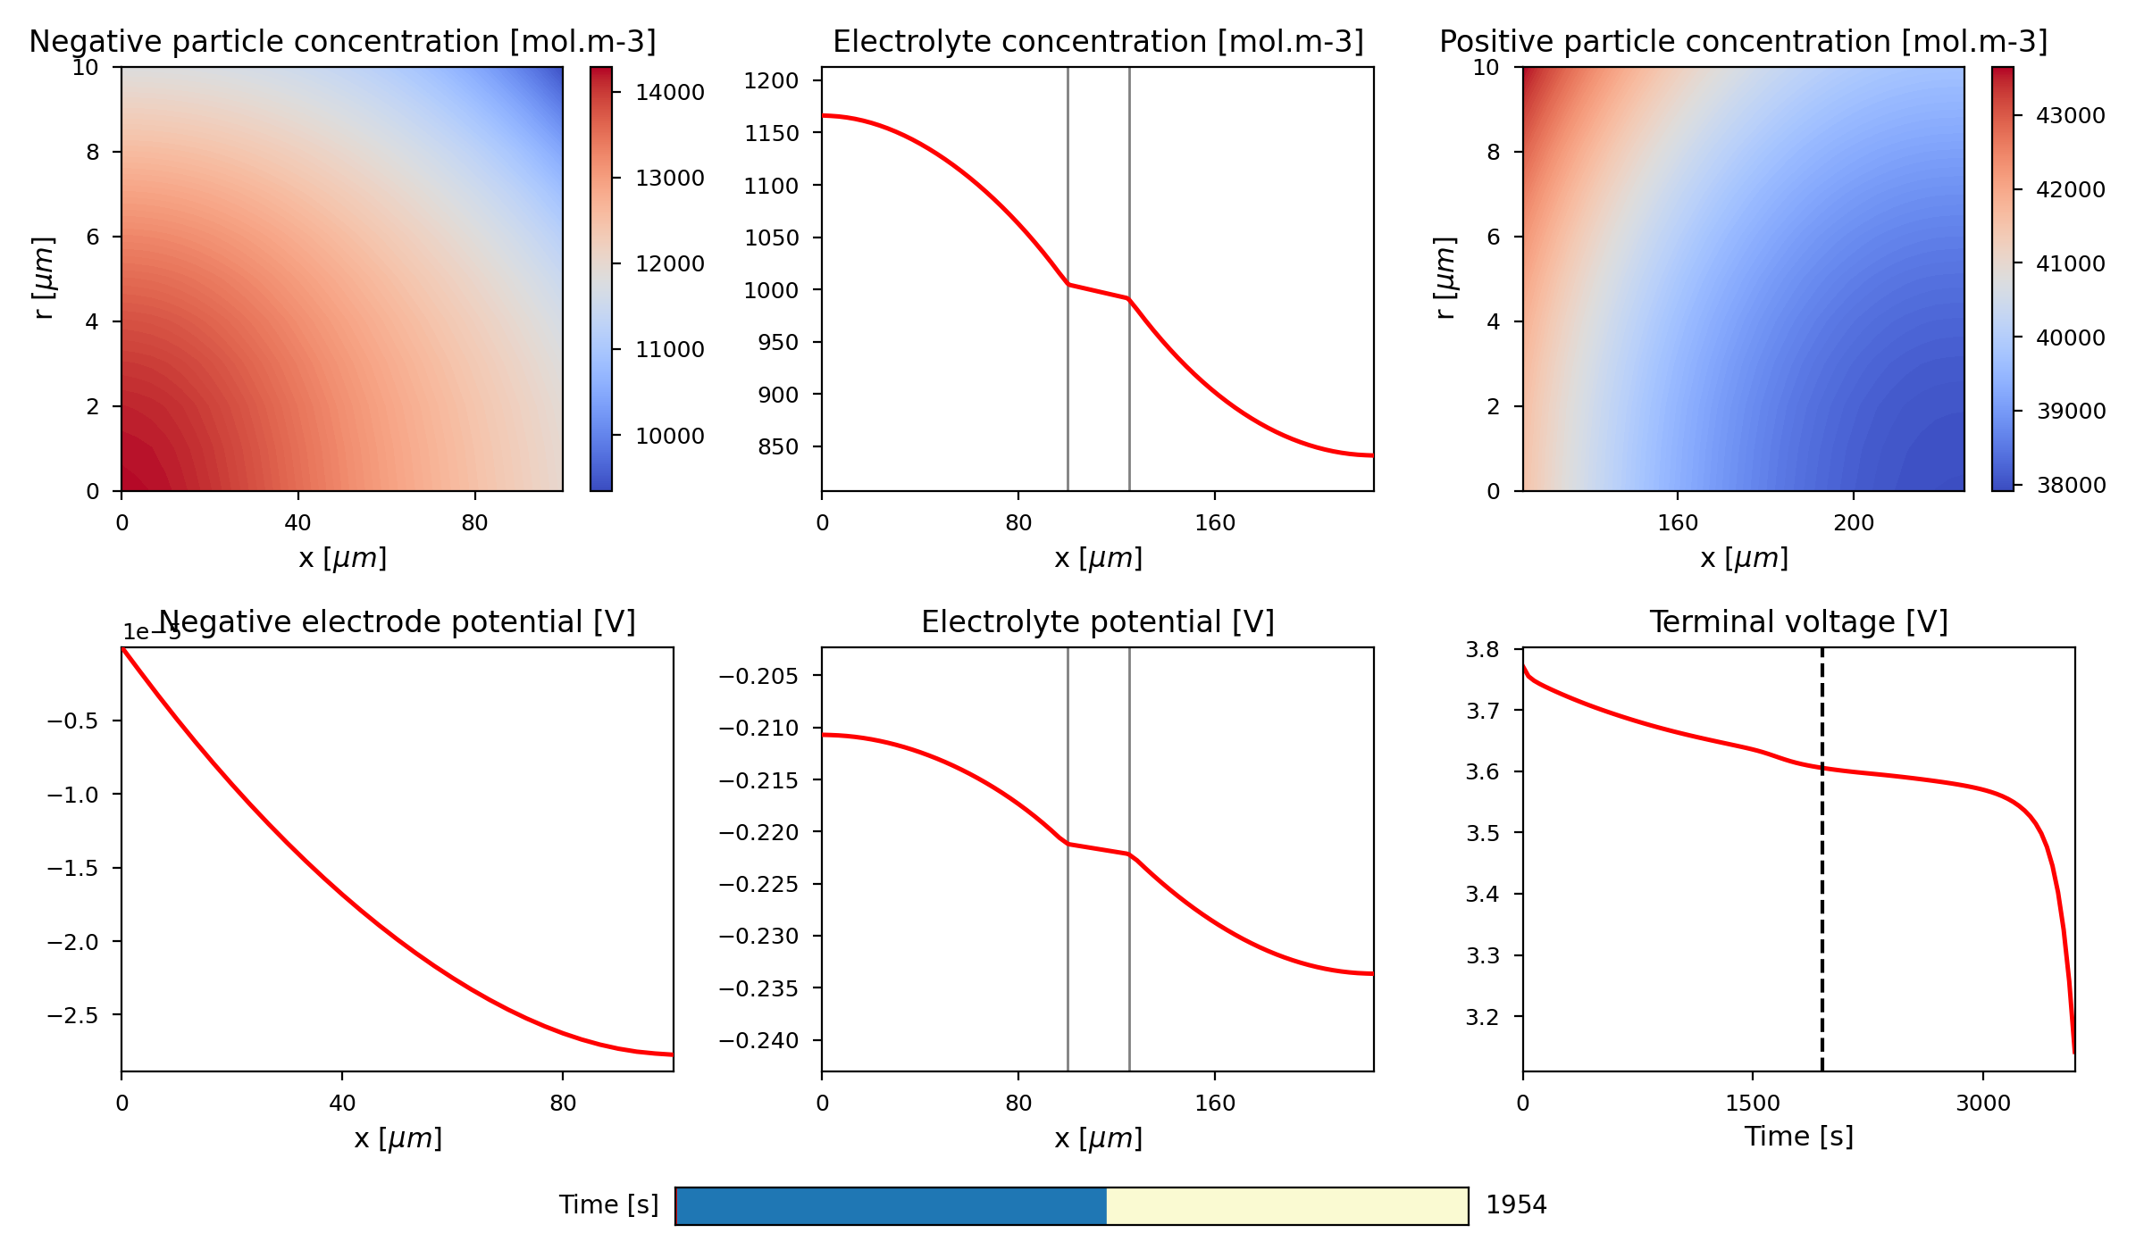
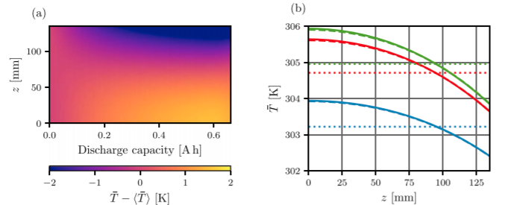
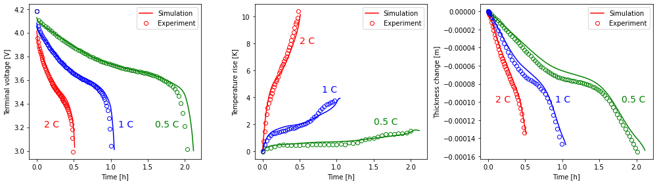
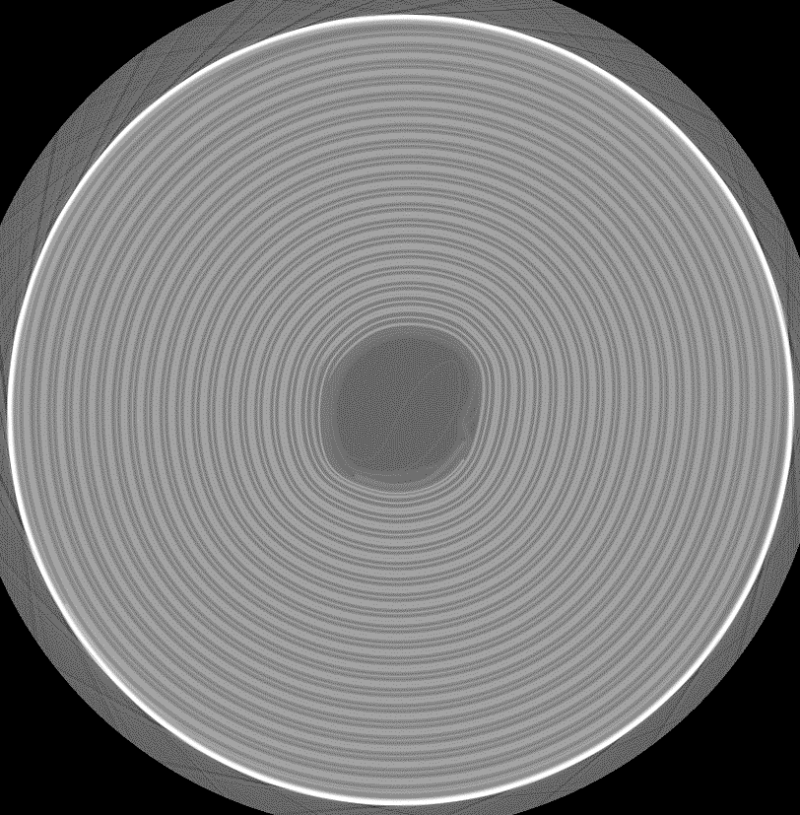
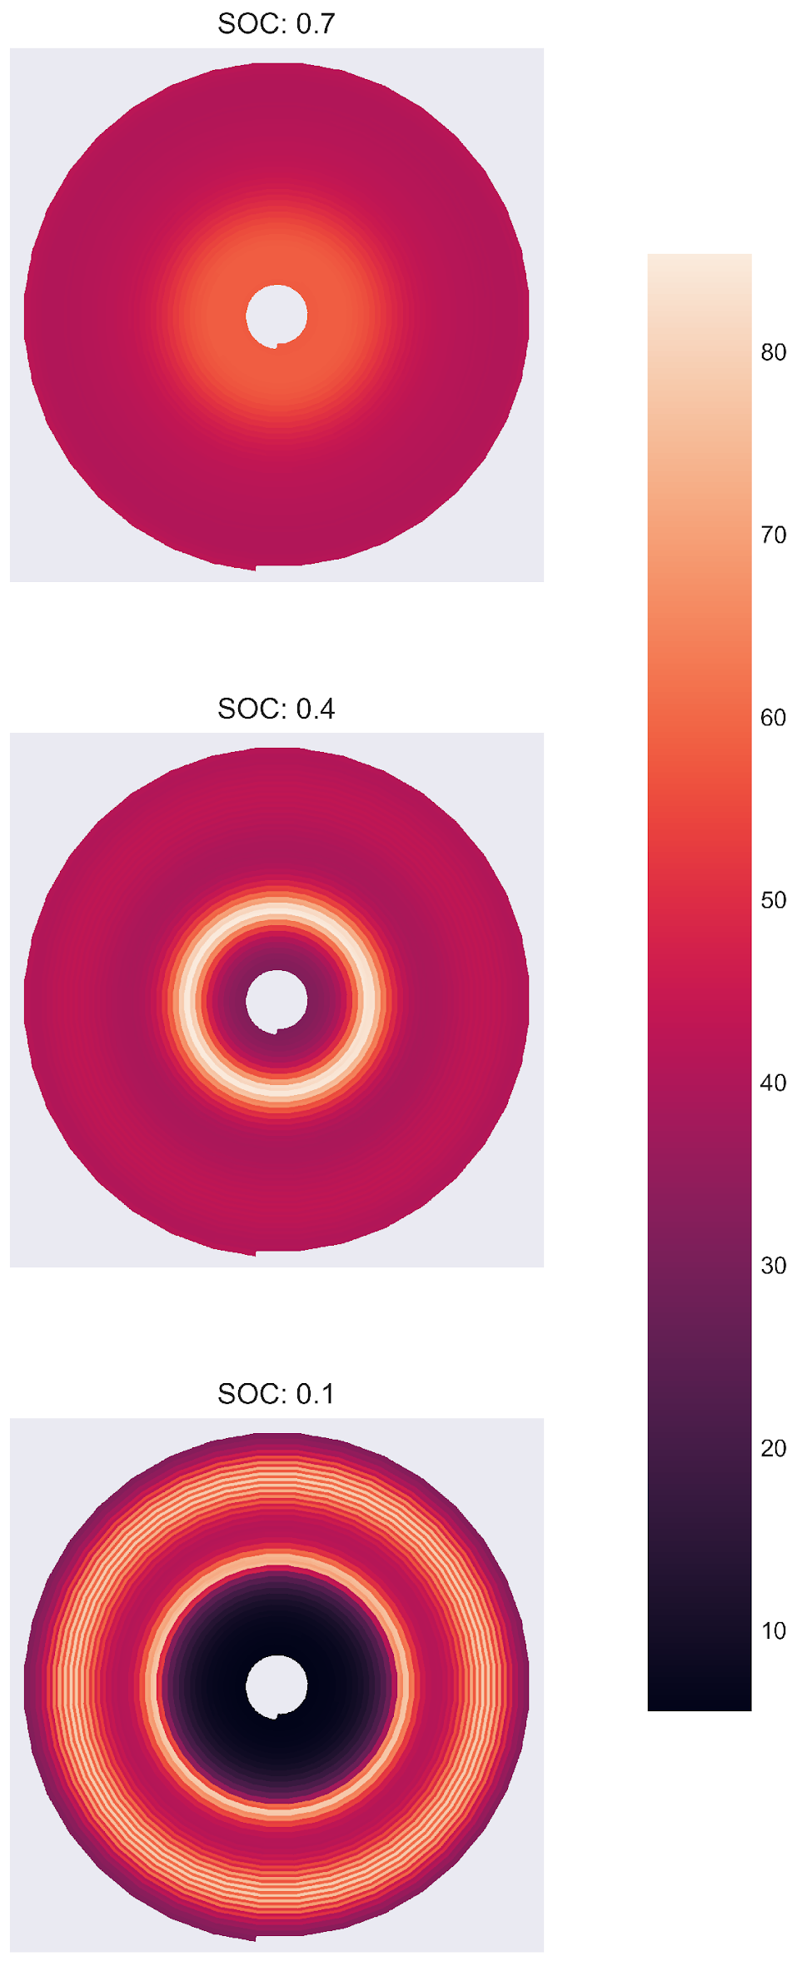
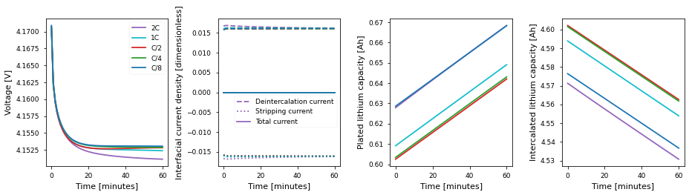
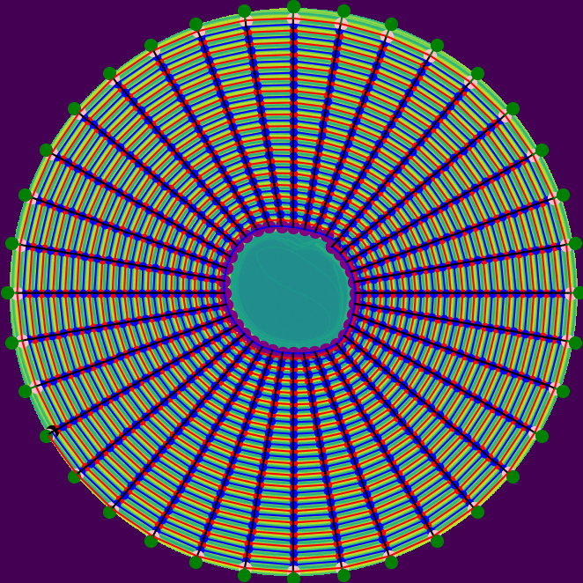
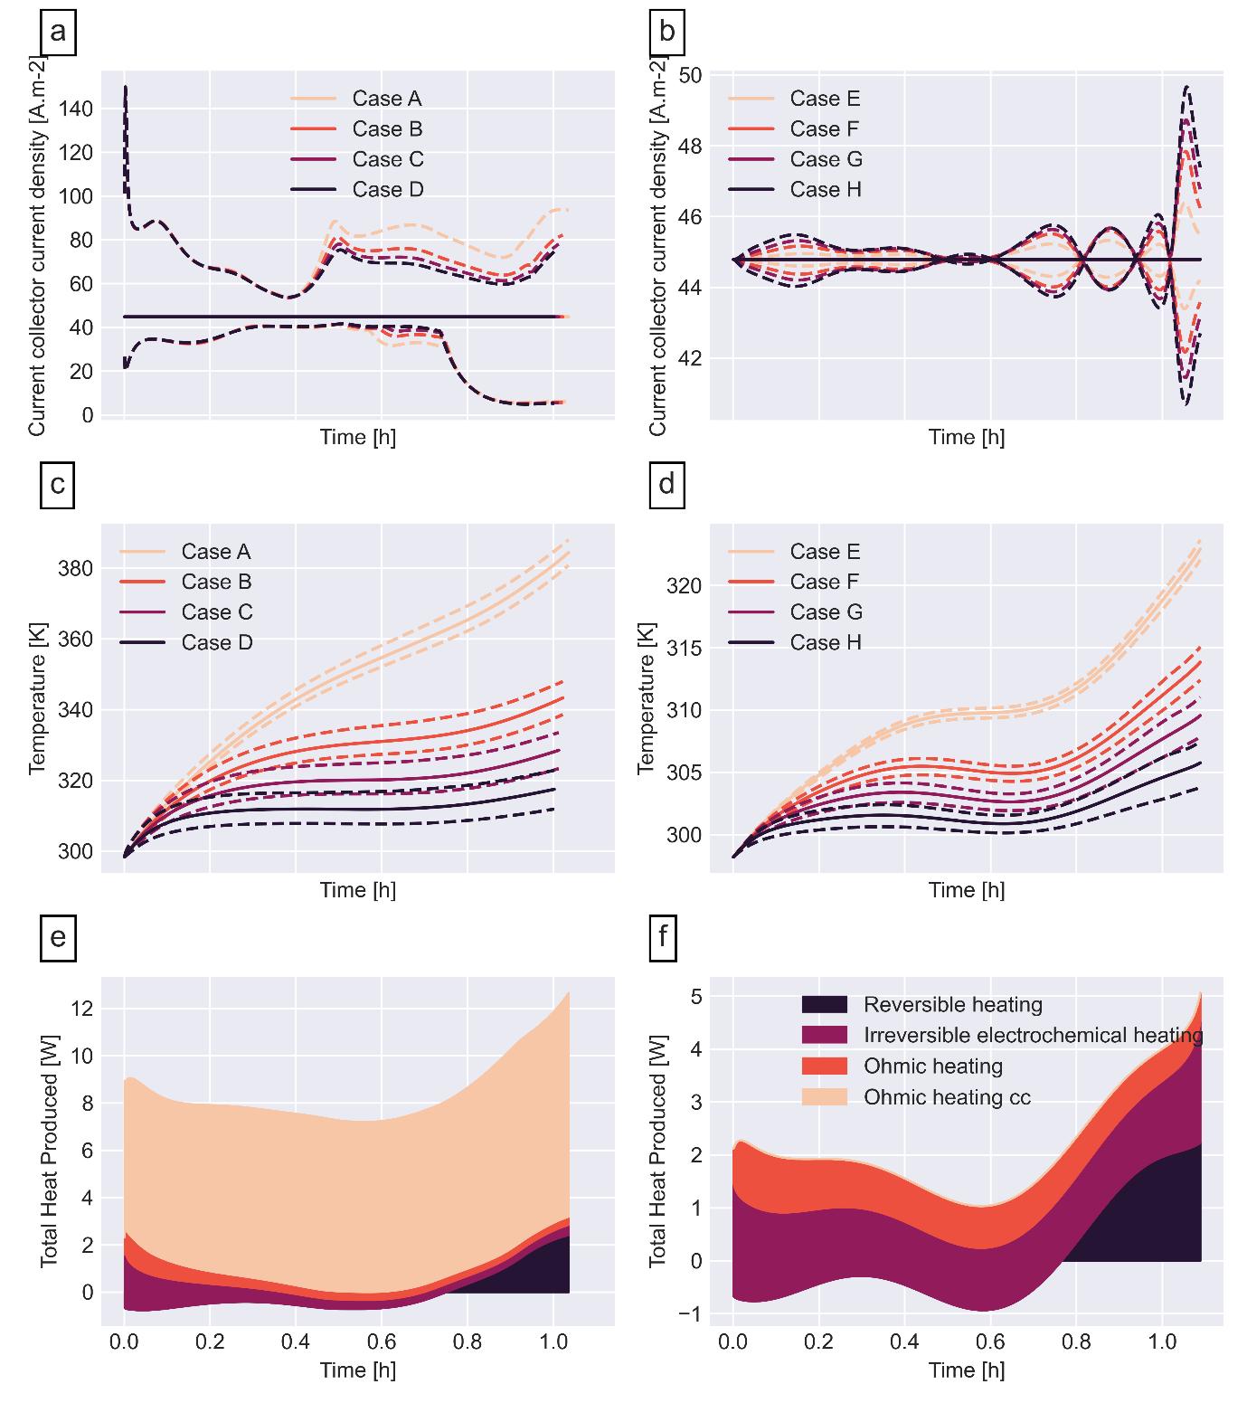
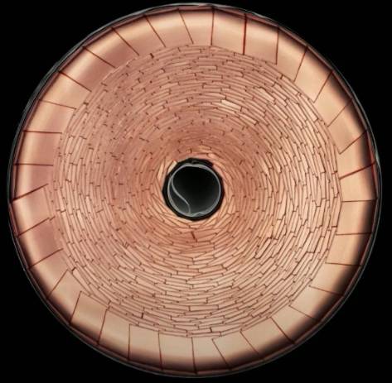
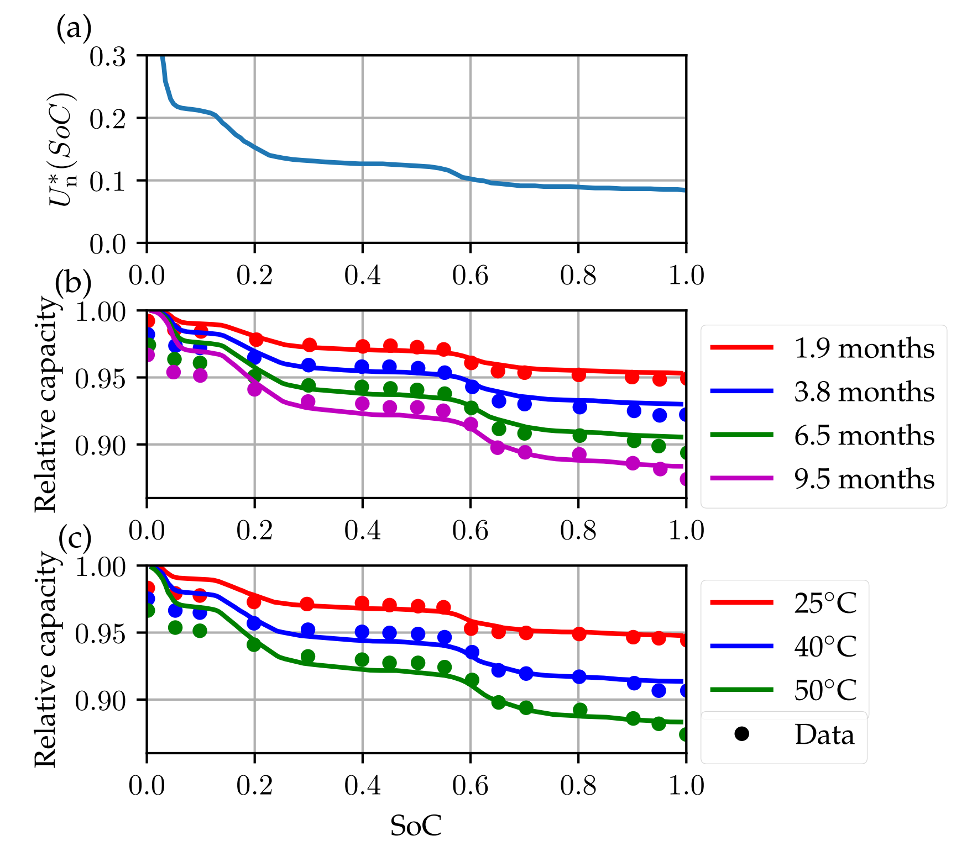






PyBaMM - Python Battery Mathematical Modelling
A flexible, open-source python package for development, comparison, and fast solutions of physics-based battery models.
The PyBaMM Team
@pybamm_
join Slack
www.pybamm.org
As the worldwide battery modelling community grows, there is a clear need for software that uses modern software engineering techniques to facilitate cross-institutional collaboration on battery research. The Python package PyBaMM addresses this need by being
Open-source and freely available
Flexible with a modular design
Well-tested by employing test-driven software development practices
PyBaMM allows users to easily:
Change model parameters
Run drive cycles/standard experimental routines (CCCV, GITT, etc)
Simulate degradation mechanisms such as SEI formation, lithium plating, and particle cracking, including coupling between mechanisms
Add additional physics (model equations entered symbolically)
Achieve fast simulation times (Doyle-Fuller-Newman model with ~3000 states solved in under 200ms for a 1C constant current discharge)
ABSTRACT
CUSTOM EXPERIMENTAL PROCEDURES [code]
PyBaMM allows users to enter custom experimental procedures in text form using the Experiment object, e.g.:
pybamm.Experiment(
[
("Discharge at 1C until 2.5V",
"Rest for 30 minutes",
"Charge at 5A until 4.2V"
"Hold at 4.2V until 10mA")
] * 3
)
PyBaMM includes:
fully-coupled full-order (e.g. Doyle-Fuller-Newman) and reduced-order (e.g. Single Particle Model) lithium-ion battery models
available in 1D, 2D and 3D
available in 1D, 2D, and 3D
THERMAL MODELLING OF LITHIUM-ION POUCH CELLS [paper|code]
SIMPLE INSTALLATION
Just like other python packages, PyBaMM can be easily installed on Windows, Mac, and Linux with just one command:
pip install pybamm
Then run a 1C discharge of the
Doyle-Fuller-Newman Model:
import pybamm
model = pybamm.lithium_ion.DFN()
sim = pybamm.Simulation(model)
sim.solve([0,3600])
sim.plot()
Thermal results for a selection of single-layer pouch cell models
MODELLING STRESS RESPONSE IN ELECTRODE PARTICLES [paper|code]
Mechanically coupled diffusion physics from Ai et al. 2019
Voltage, temperature and thickness change for a lithium cobalt oxide-graphite pouch cell agree well with experimental results
FAST SOLUTIONS
Millisecond solve times for a 1C discharge using the CasADi solver (n grid points per domain)
Single particle model (SPM)
Doyle-Fuller-Newman (DFN)
Grid points | States | Time (ms)
10 | 21 | 1.8
40 | 81 | 1.9
80 | 321 | 3.6
Grid points | States | Time (ms)
10 | 281 | 35
40 | 3521 | 190
80 | 13441 | 870
PyBaMM can be used in circuits forming cells or packs. Jellyroll models are constructed from tomography or from geometric spirals with resistor networks representing current collector foils and 1000s of DFN models are computed in parallel representing electrochemistry in each section
Tab locations and ohmic losses in cc’s play major role in cell heating and current heterogeneity
Standard tabs (a) are compared to Tesla’s new ‘tab-less’ (b) design showing large differences
A/m²
MODELLING LITHIUM PLATING [paper|code]
MODELLING OF JELLYROLL CELLS [paper 1|paper 2]
Reversible and irreversible lithium plating models from O’Kane et al. 2020.
PyBaMM’s framework allows easy coupling with other degradation mechanisms.
(a)
(b)
MODELLING SEI LAYER GROWTH
Current density
heterogeneity in
standard tabbed cells
Several models for SEI layer growth are available, including:
reaction limited
diffusion limited
electron-migration limited
SEI layer resistance and pore clogging included
Simulates calendar aging and cycle aging
Can be coupled with other degradation mechanisms
V. Sulzer, S.G. Marquis, R. Timms, M. Robinson and S.J. Chapman (2020). “Python Battery Mathematical Modelling (PyBaMM)”. ECS ArXiv. February, 7. [pdf]
REFERENCE

