Slide 1


Python Battery Mathematical Modelling

Slide 2

Why PyBaMM?
PyBaMM's mission is to accelerate battery modelling research
by providing an open-source framework for multi-institutional,
interdisciplinary collaboration.
Fostering a Sustainable Community in Batteries, J.A. Baker, M. Beuse, S.C. DeCaluwe, L.W. Jing, E. Khoo, S. Sripad, U. Ulissi, A. Verma, A.A. Wang, Y.T. Yeh, N. Yiu, D.A. Howey, and V Viswanathan, ACS Energy Letters, 2020

Slide 3
Who is PyBaMM?
Development timeline
Fall 2018 | Need for a Common Modeling Framework identified by the Faraday Institution
Winter/Spring 2019 | PyBaMM developed by Oxford Maths / RSE to provide a CMF
Summer 2019 | First workshop for Faraday Institution
Fall 2019 | PyBaMM 0.1.0 released; core development team expanded to Imperial, Warwick, UCL, Michigan
Winter 2020 | First paper submitted; presented at OBMS20
Spring 2020 | PyBaMM 0.2.0 released; second workshop for Faraday Institution; publicizing beyond UK academia (website, Twitter)

Slide 4
Who is PyBaMM?
Current Collaborators
Faraday MSM
Oxford
Birmingham
Maths
Computer science
Energy materials group
Michigan
Imperial
PyBaMM
Mechanical Engineering
Engineering
UCL
Warwick
Elec. Innovation Lab
WMG

Slide 5
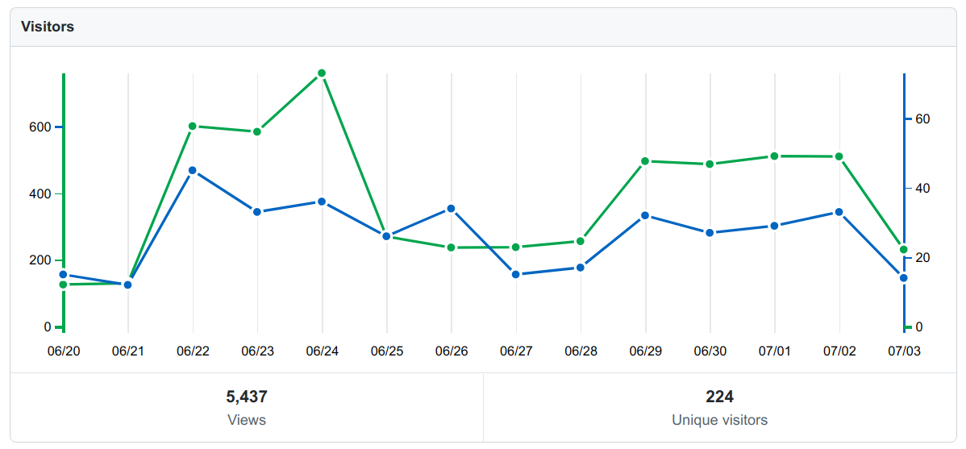
Who is PyBaMM?
Active and growing community
PyBaMM benefits from an active community of developers and users
224 Unique visitors to GitHub repository over the last 2 weeks

Slide 6
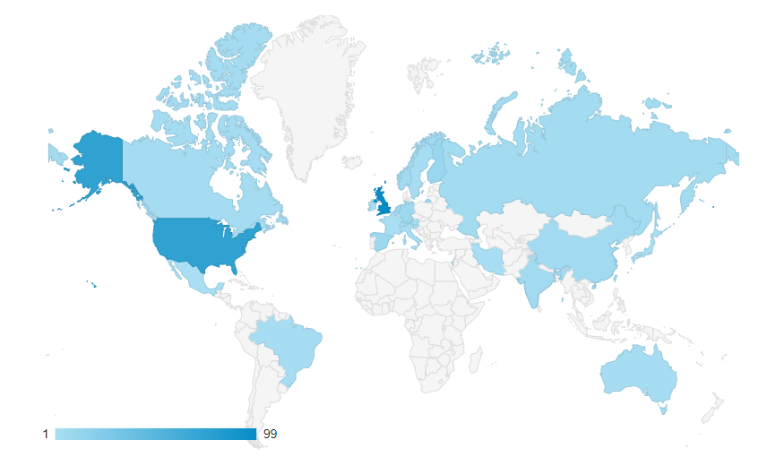
Who is PyBaMM?
Active and growing community
Number of website hits

Slide 7
What is PyBaMM?
PyBaMM is a framework for building and solving battery models
FAST
FLEXIBLE
MODULAR
Models
Lithium-ion models:
ODE, SPM, SPMe, DFN
Lead-acid models
Fully coupled thermal models
Degradation mechanisms (SEI)
Experimental suite
Any voltage, current or power control, for example:
GITT, PITT, CCCV, drive cycle
Easy interface to define custom protocols
Library of Chemistries / Parameters
LCO, LiNiCo02, NCA, NMC
Graphite
LiPF6 ​
Easy to add your own parameter sets
Functionality
Nonlinear parameters provided as functional form or as data
Choice of cell geometries: 1D, 2+1D single layer pouch cells
Interface with external software

Slide 8
Flexible Submodel Structure
r
x
Battery models are constructed from submodels
Use or adapt pre-built models
Create custom models
r
x
PyBaMM includes popular battery model such as the Doyle-Fuller-Newman model (P2D) and the Single Particle Model
Stefan
Maxwell
Fickian Diffusion
Lumped Thermal
Custom Model
Users can build custom models from submodels

Slide 9
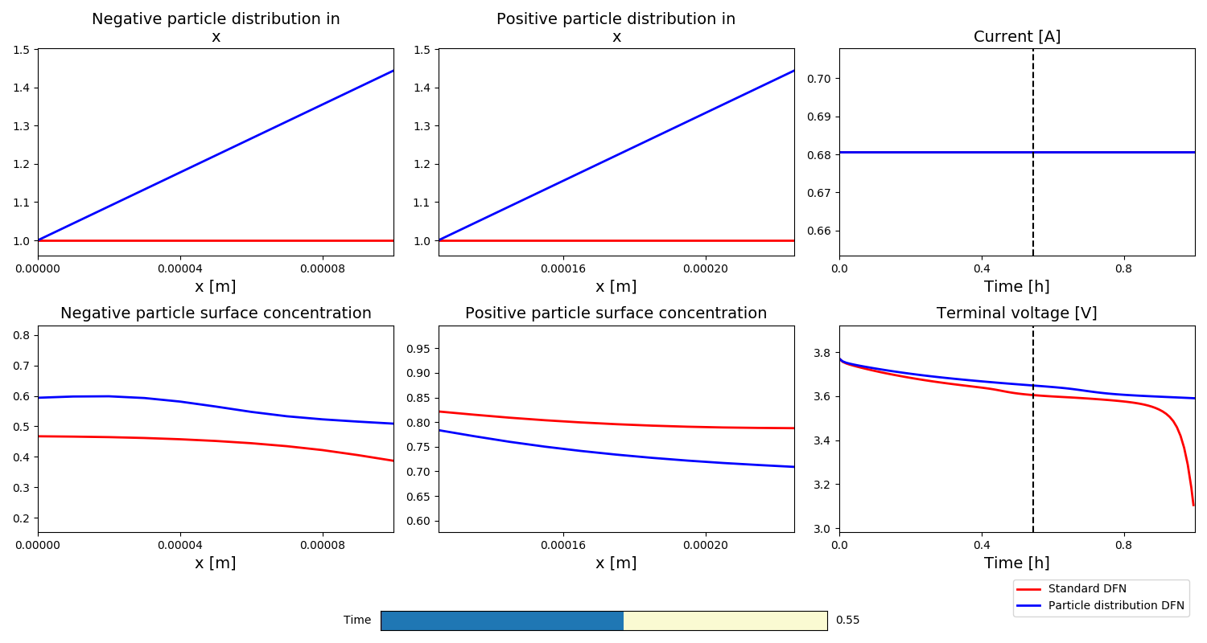
Flexible Submodel Structure
Structure allows for
“plug and play” physics
New physics can be quickly implemented in an independent fashion
Different physical mechanisms are readily included in both full and reduced-order models
Using PyBaMM it is easy to compare how different physics affects the model solution. Here we investigate the influence of graded electrodes (particle distribution in the through-cell direction x).

Slide 10
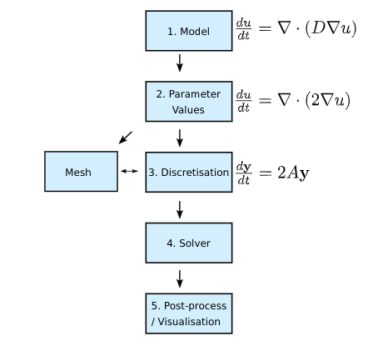
Numerical Methods
Choice of spatial discretisation
Finite Volume Method (macroscopic and particles)
Finite Element Method in 2D direction (current collectors in pouch cell models)
Calculation of the analytic Jacobian from expression tree via automatic differentiation (using CasADi)
Multiple ODE and DAE solvers (e.g. scipy, sundials CVODE and IDA)
Ability to set up, solve and perform forward and adjoint sensitivity analysis
By employing a pipeline process PyBaMM separates the statement of model equations from the inputted parameters, choice of spatial discretization and choice of time stepping algorithm.

Slide 11
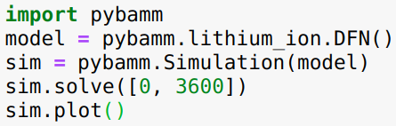
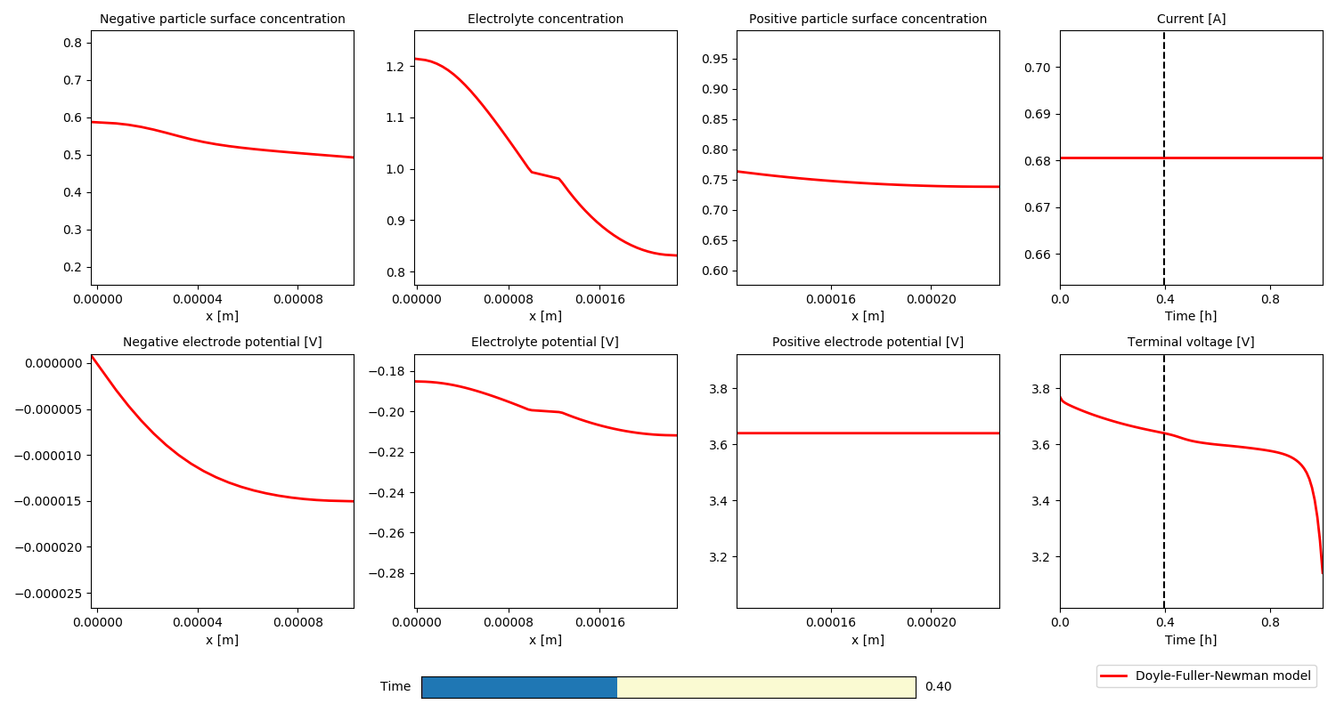
Simple Interface: CC Discharge
Easy interface for running simulations
Both model and simulation can be customised

Slide 12
Fast Solve Times
A comparison of typical solve times for different models and disrectisations for a 1C constant current discharge.
Grid points per domain | Single Particle Model |  | Doyle-Fuller-Newman Model
 | States | Time (milliseconds) | States | Time (milliseconds)
10 | 21 | 3 | 281 | 72
20 | 41 | 3 | 961 | 149
40 | 81 | 4 | 3251 | 384
80 | 161 | 5 | 13441 | 1293
160 | 321 | 9 | 52481 | 7689
All simulation performed on a laptop computer (i5, 2.1 GHz, 16 Gb of RAM) using the CasADi solver with both absolute and relative tolerances of 10⁻⁶ . The parameters are from the reference:
An asymptotic derivation of a single particle model with electrolyte, S.G. Marquis, V.Sulzer, R. Timms, C.P. Please and S.J. Chapman, Journal of The Electrochemical Society 2019

Slide 13
Fast Solve Times
A comparison of typical solve times for different models and disrectisations for the US06 drive cycle
Grid points per domain | Single Particle Model |  | Doyle-Fuller-Newman Model
 | States | Time (seconds) | States | Time (seconds)
10 | 21 | 0.03 | 281 | 4.01
20 | 41 | 0.03 | 961 | 7.53
40 | 81 | 0.04 | 3251 | 20.30
80 | 161 | 0.07 | 13441 | 66.19
160 | 321 | 0.10 | 52481 | 247.15
All simulation performed on a laptop computer (i5, 2.1 GHz, 16 Gb of RAM) using the CasADi solver with both absolute and relative tolerances of 10⁻⁶ . The parameters are from the reference:
An asymptotic derivation of a single particle model with electrolyte, S.G. Marquis, V.Sulzer, R. Timms, C.P. Please and S.J. Chapman, Journal of The Electrochemical Society 2019

Slide 14
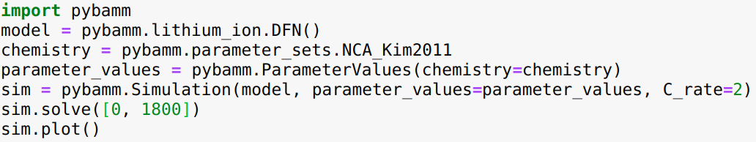
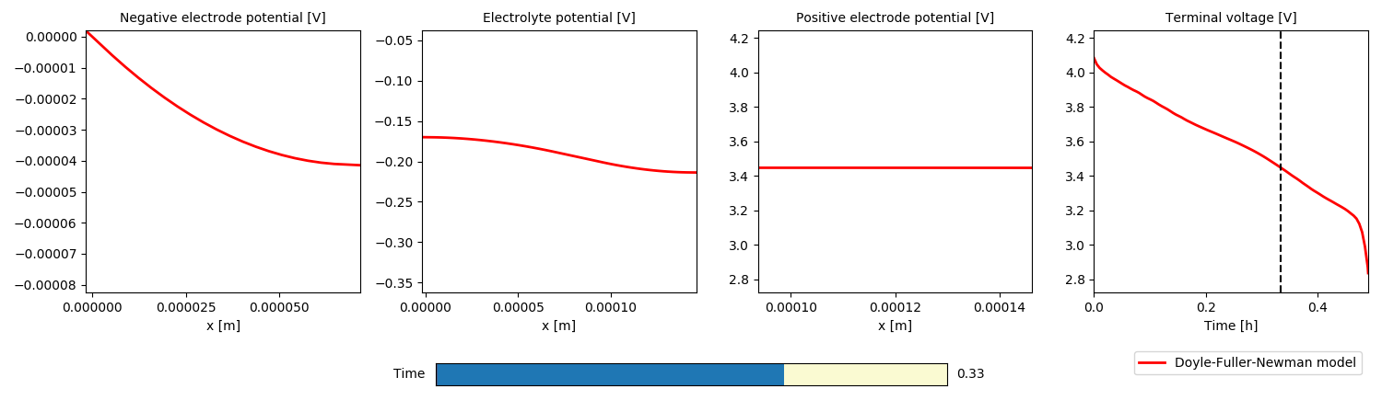
Simple Interface: Change parameters
Easy to change parameters and model options

Slide 15
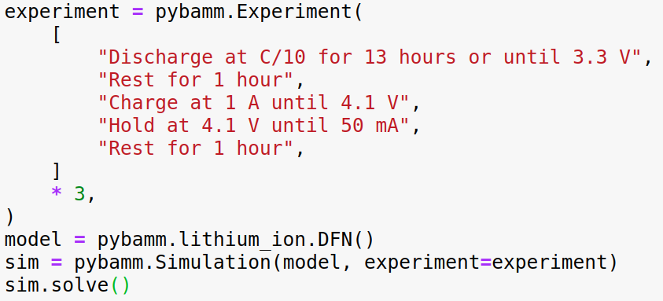
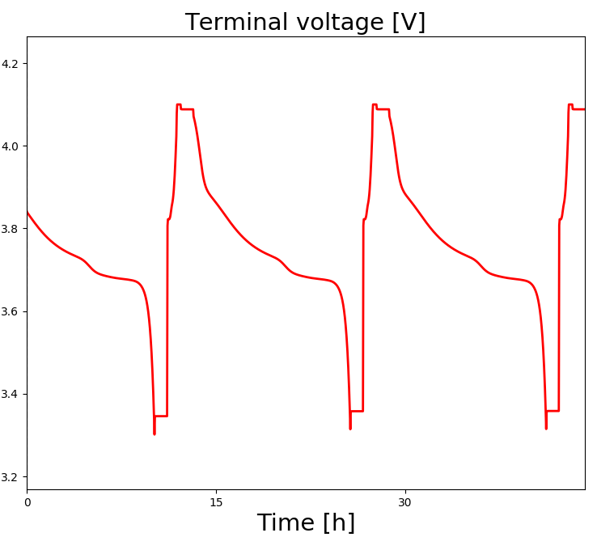
Simple Interface: Experimental protocol
PyBaMM allows users to specify experimental protocols using keyword strings
Can easily define custom protocols
Specify current, power or voltage

Slide 16
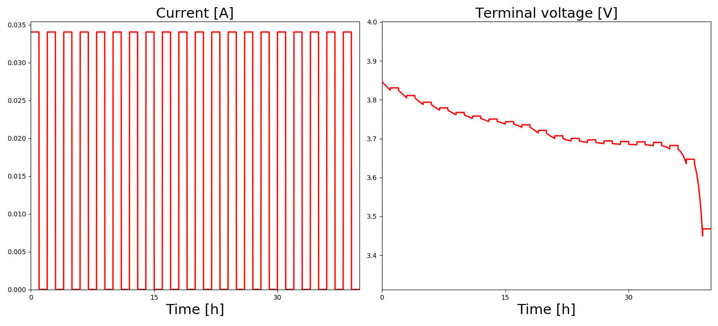
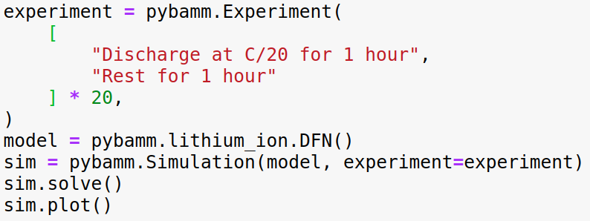
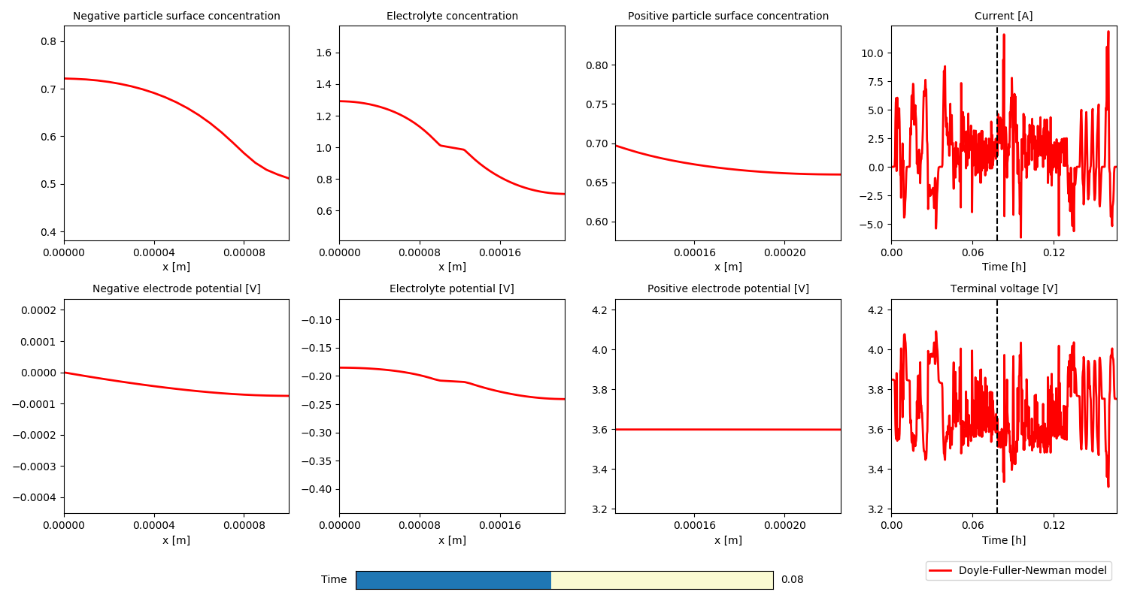
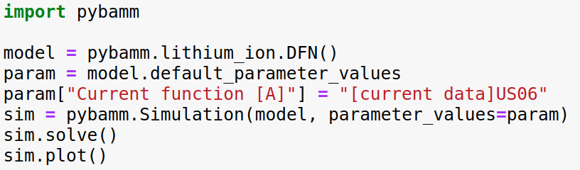
Simple Interface: Experimental protocols & drive cycles

Slide 17
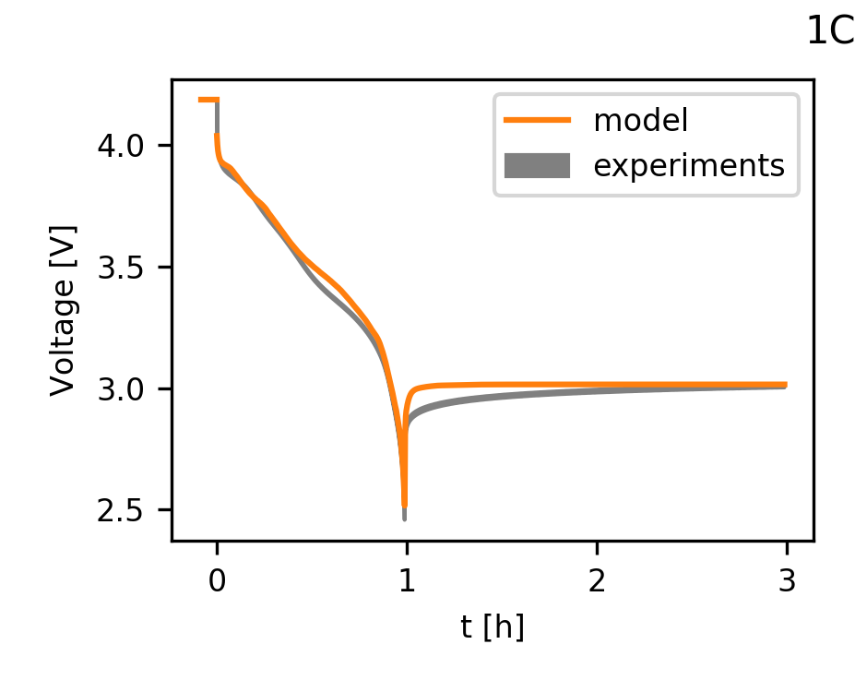
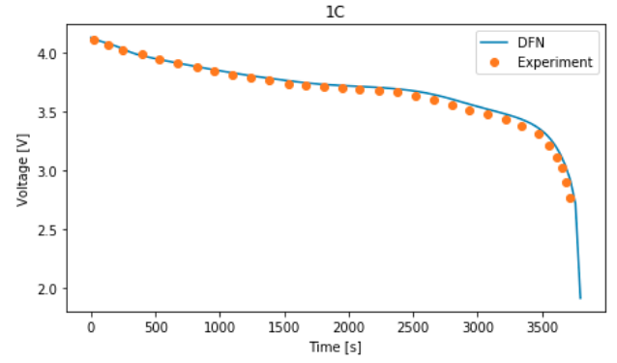
Parameter Library
Library of parameter values including popular chemistries such as LiNiCo02, NMC, Graphite, LiPF6
Choose by component (anode, cathode, etc.) or pick a complete parametrization from ​a given reference
Easy to “tweak” existing parameter sets or add your own from scratch
Development of Experimental Techniques for Parameterization of Multiscale Lithium-ion Battery Models, Chang-Hui Chen, Ferran Brosa Planella, Kieran O’Regan, Dominika Gastol, W. Dhammika Widanage and Emma Kendrick, Journal of The Electrochemical Society, 2020
Parameterization of a physico-chemical model of a lithium-ion battery II. Model validation, Madeleine Ecker, et al, Journal of The Electrochemical Society, 2015

Slide 18
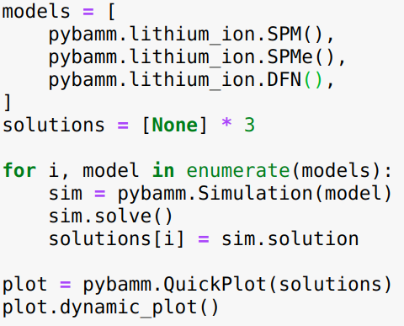
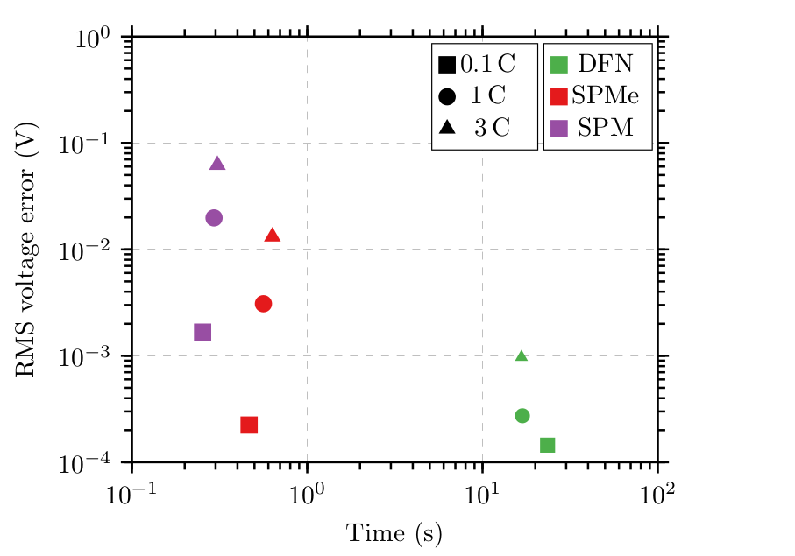
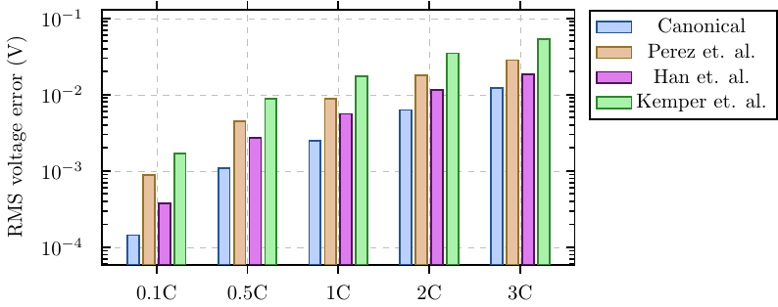
Case Study: Single Particle Model with electrolyte (SPMe)
Systematic derivation of SPMe using asymptotic methods
Electrolyte diffusion time << discharge time
Large electrode and electrolyte conductivity
Outperforms other (ad hoc) models in literature of similar complexity
Achieves order of magnitude reduction in computation cost at small loss of accuracy
Extends the validity of SPM to higher C-rates.
An asymptotic derivation of a single particle model with electrolyte, S.G. Marquis, V.Sulzer, R. Timms, C.P. Please and S.J. Chapman, Journal of The Electrochemical Society 2019

Slide 19
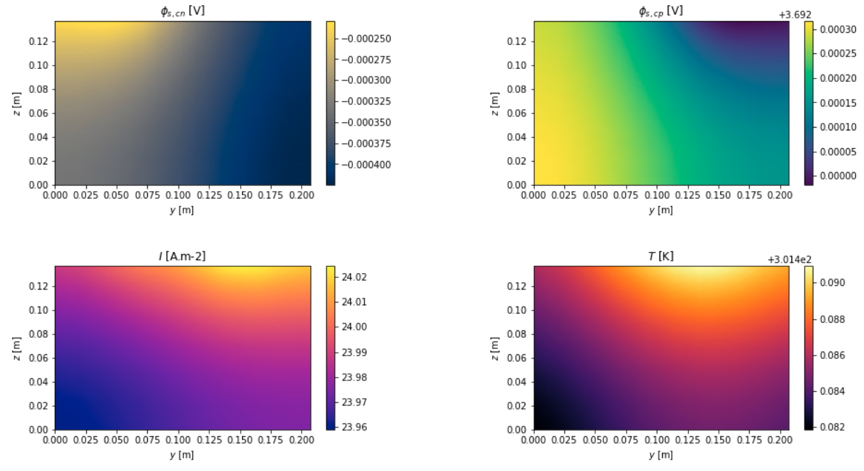
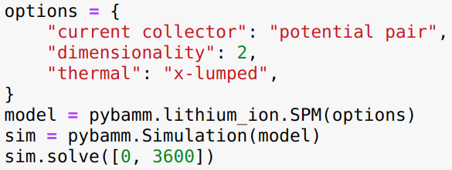
Case Study: Reduced order pouch cell modelling
Example result: 10x10 grid of Single Particle Models with fully coupled thermal effects. Approximate solve time: 9s
Asymptotic Reduction of a Lithium-ion Pouch Cell Model, R. Timms, S.G. Marquis, V.Sulzer, C.P. Please and S.J. Chapman, Submitted to SIAM Journal on Applied Mathematics
A Suite of Reduced-Order Models of a Single-Layer Lithium-ion Pouch Cell, S.G. Marquis, R. Timms, V.Sulzer, C.P. Please and
S.J. Chapman, In Preparation

Slide 20
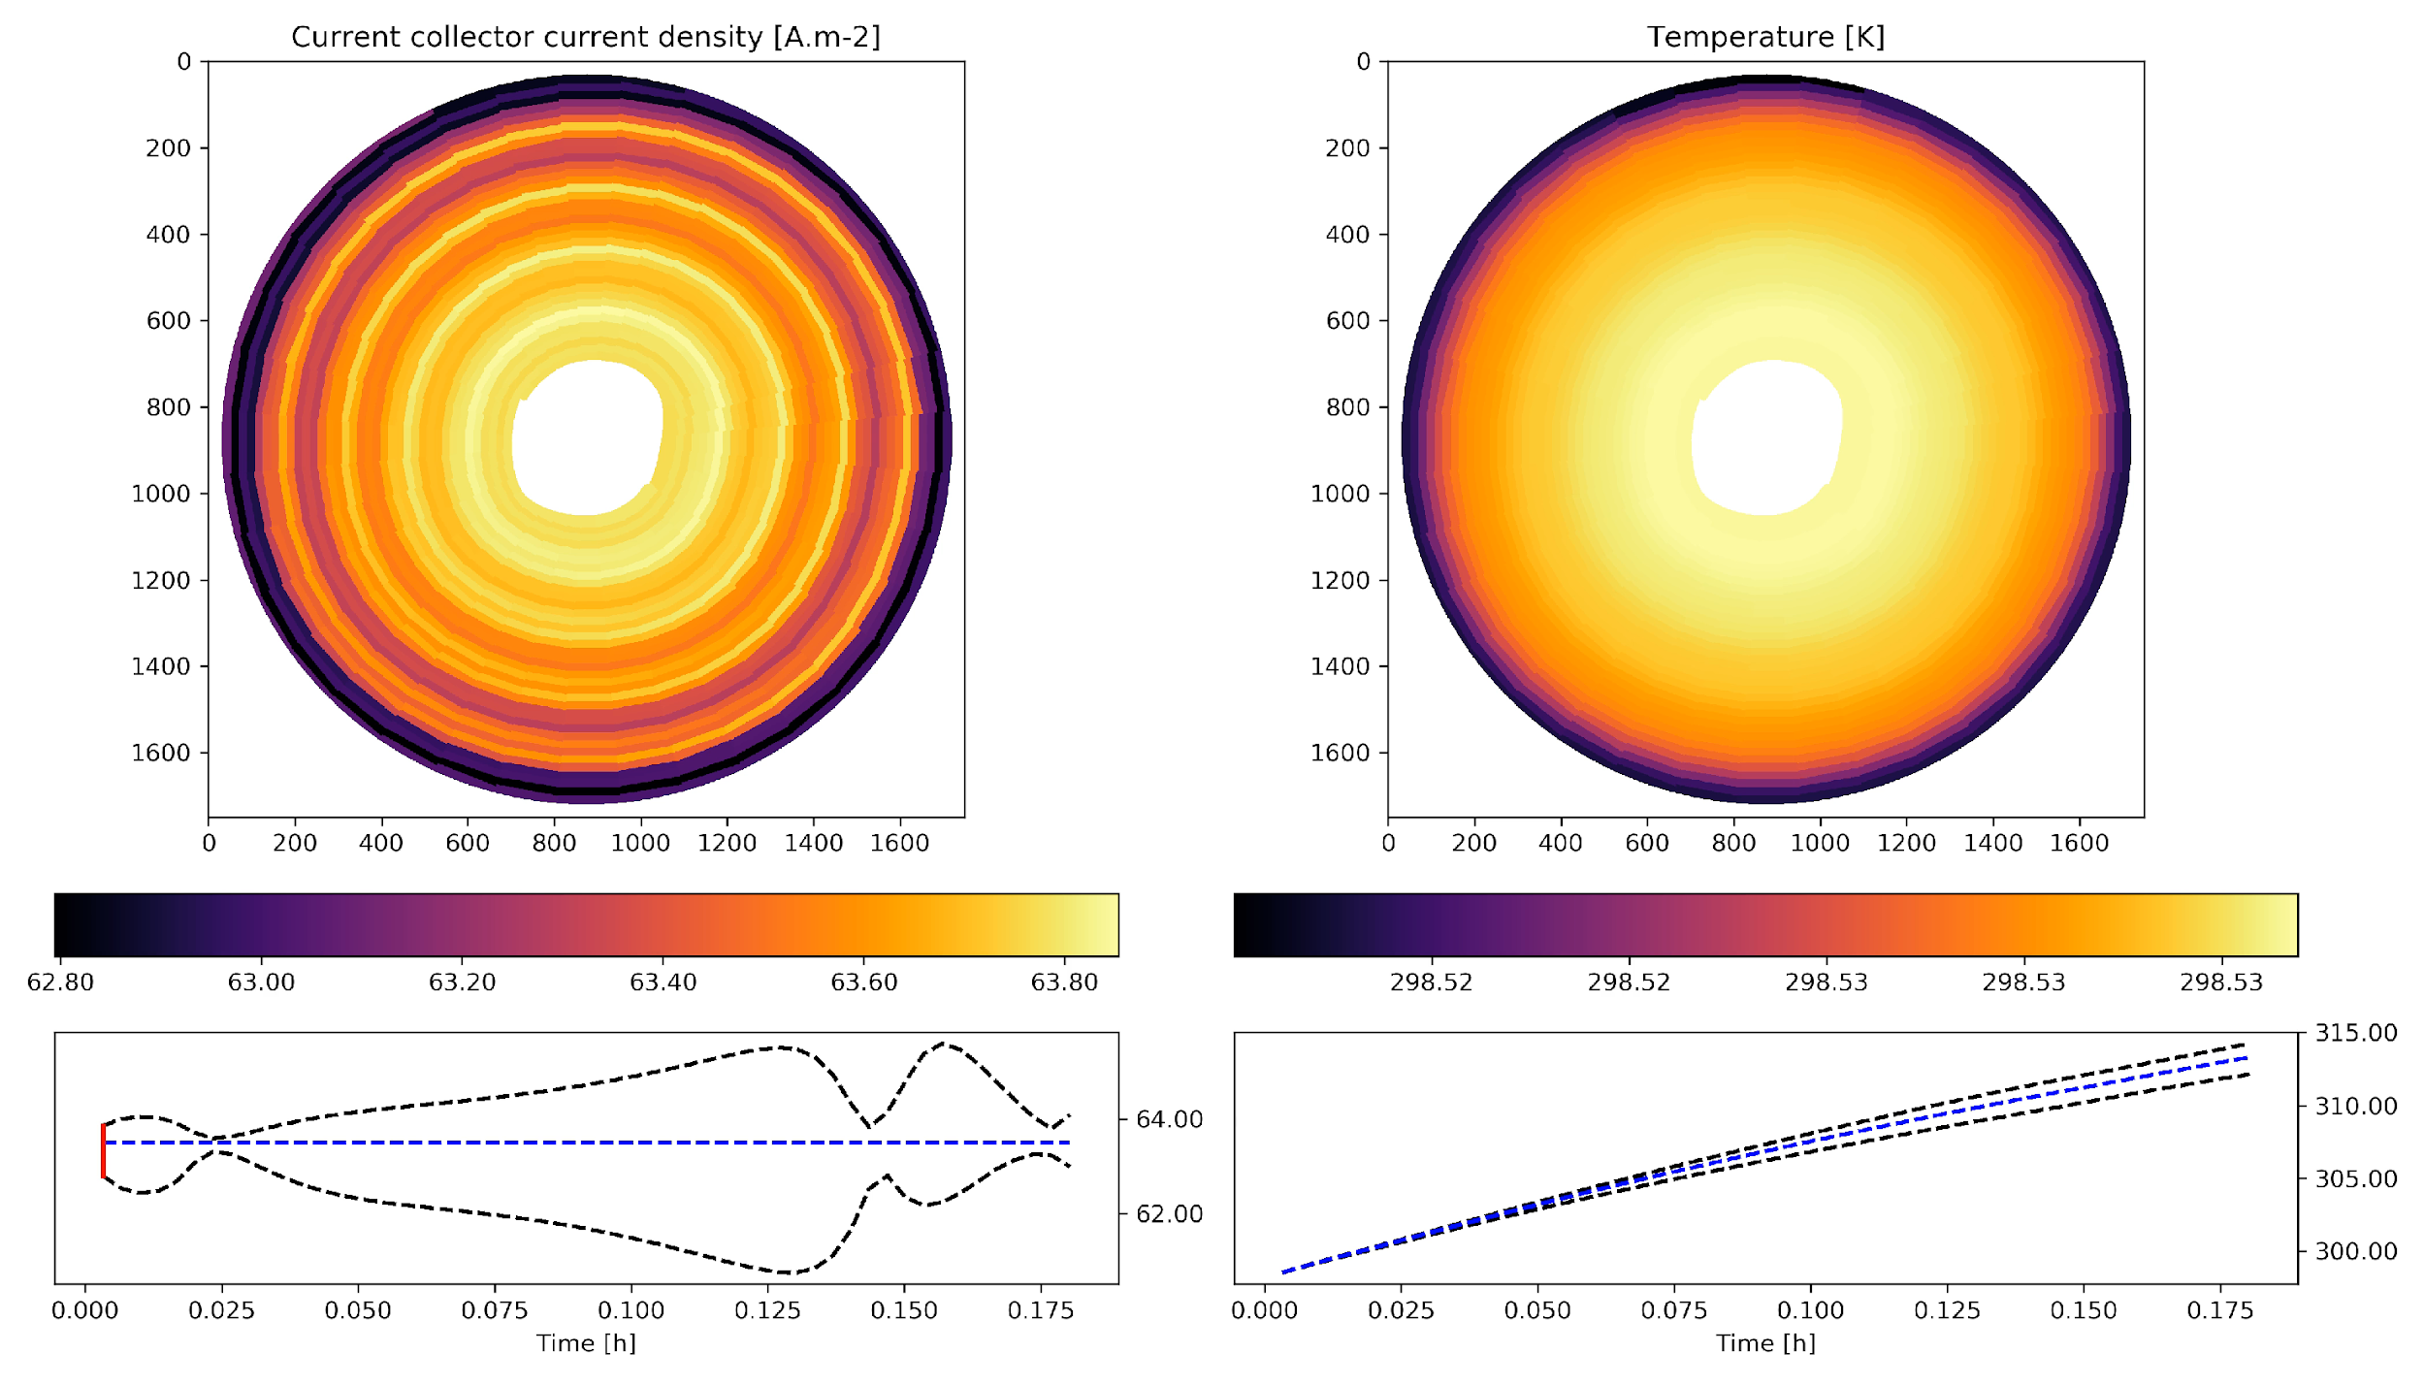
Case Study: A coupled multiscale model of electrochemistry
and thermal transport for Li-ion cells
HTC = 5 [W.m-2]
σ = 3e7 [S.m-1]
#tabs = 5
Current = 5 [A]
Probing heterogeneity in Li-ion batteries with coupled multiscale models of electrochemistry and thermal transport using tomographic domains, T.G. Tranter, R. Timms, T.M.M. Heenan, S.G. Marquis, V. Sulzer, A. Jnawali, M.D.R. Kok, C.P. Please, S.J. Chapman, P.R. Shearing, D.J. L. Brett, Submitted to Journal of The Electrochemical Society, 2020

Slide 21
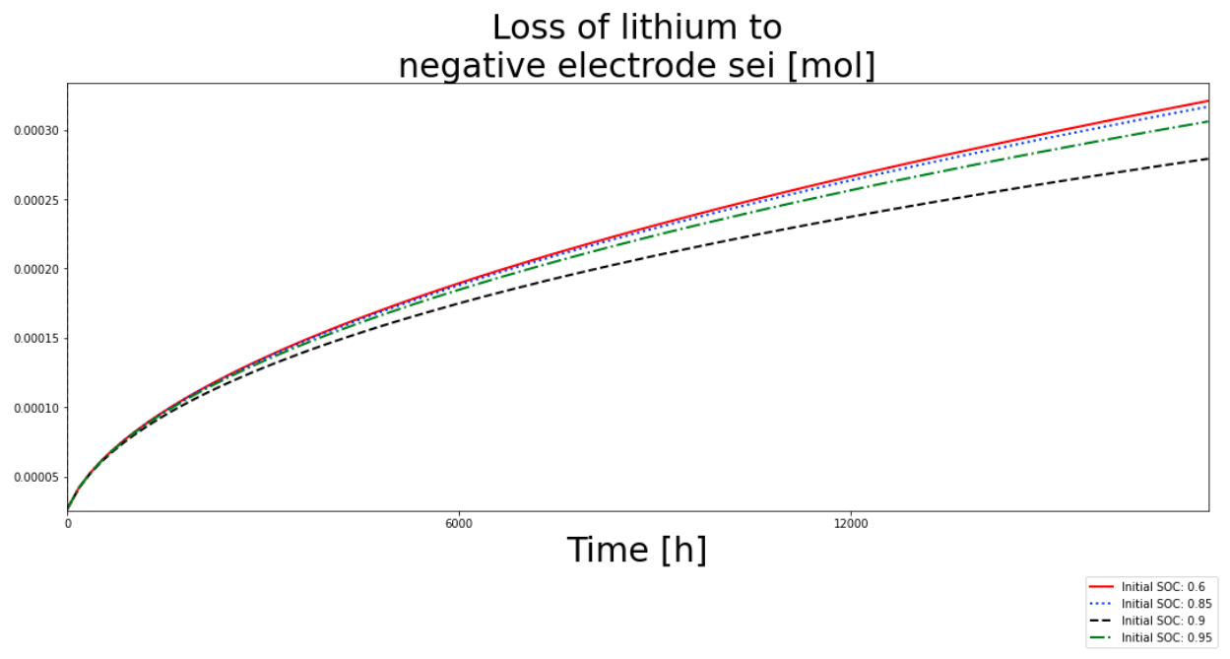
Highlighted new feature: SEI models
SEI models for:
constant SEI thickness
reaction limited
solvent-diffusion limited
electron-migration limited
interstitial-diffusion limited
Example: loss of lithium to negative electrode SEI using the interstitial-diffusion limited model with different initial SOCs

Slide 22
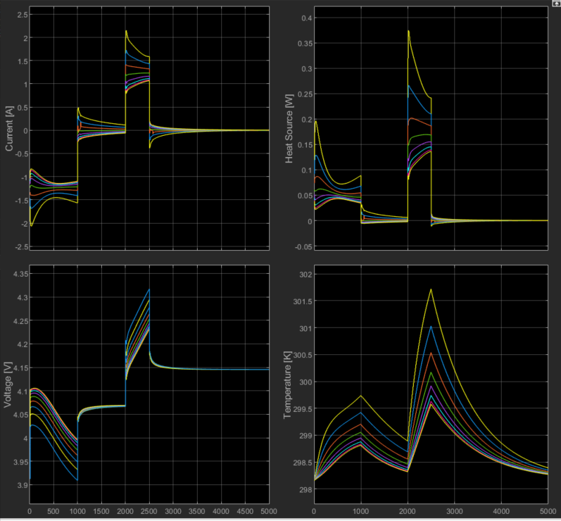
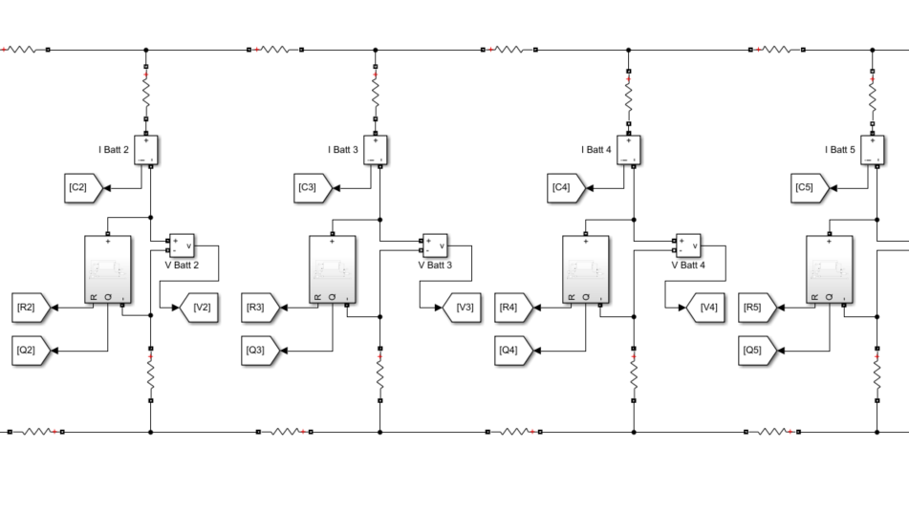
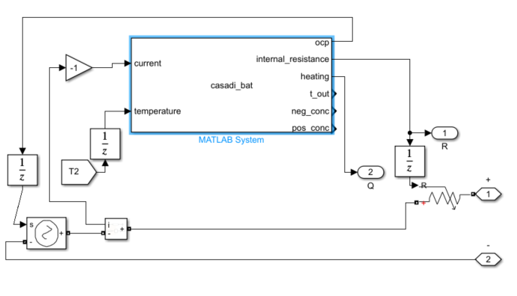
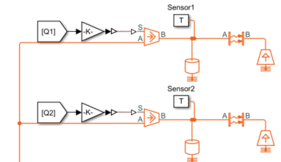
Highlighted upcoming feature: pack modelling using PyBaMM and Simulink
Black box PyBaMM model put in Matlab system
Linked in circuit with busbar and connection resistances
Pack level electrical and thermal problem solved in Simulink
Casadi solver used to efficiently call battery functions
Input currents and temperatures
Output heat and voltage sources and internal resistance calculated with physics based models
For more information contact Dr T Tranter, UCL Electrochemical Innovation Lab

Slide 23
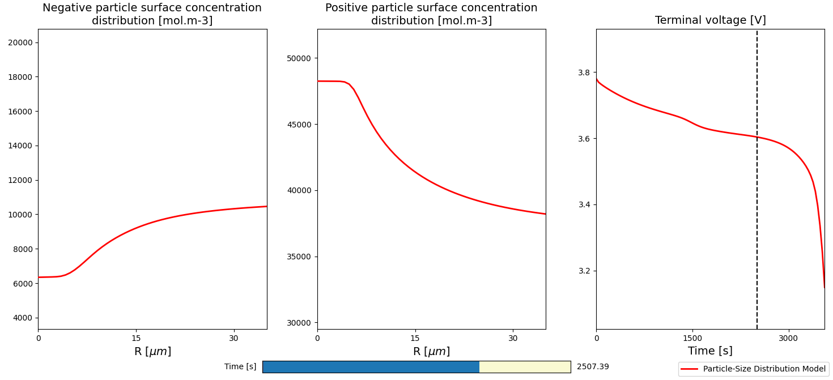
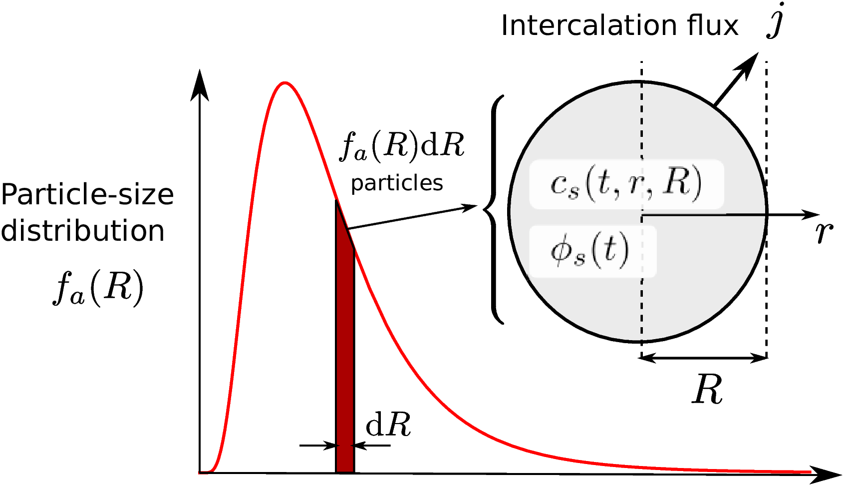
Highlighted upcoming feature: particle size distribution
Particle-Size Distribution (PSD) model: extension of the SPM to include size distribution, introducing "particle-size dimension"
Asymptotic reduced model for narrow distributions
Input size-distribution as a function parameter, e.g. log-normal
PSD submodel, allowing e.g. DFN with a PSD at every macroscale location
Modelling electrode heterogeneity in lithium-ion batteries: unimodal and bimodal particle-size distributions, T. Kirk, J. Evans, C.P. Please, S.J. Chapman, Submitted to SIAM Journal on Applied Mathematics

Slide 24
Upcoming features
Sensitivity analysis & parameter estimation
Simulink interface
Particle size distribution
Other chemistries (LiS)
Fuel cells
Half-cell configuration
Different particle shapes
Lithium plating
Mechanics coupled to temperature and lithiation
Solid-state battery models
Improvements to framework
Other geometries (jelly rolls, multiple layer cells, etc.)
Integration with open battery database, parameter database
Work commenced
Planned work
Future work

Slide 25
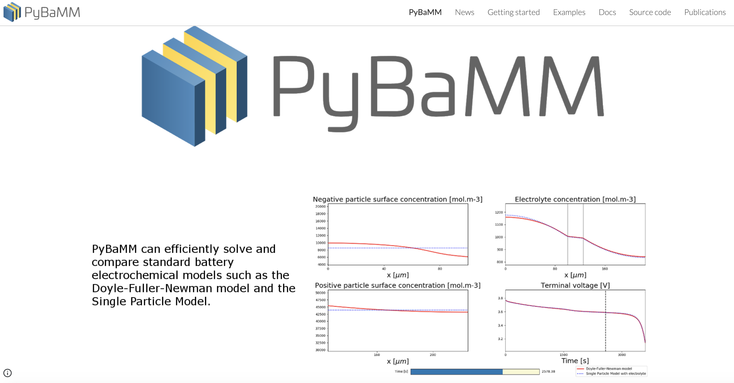
Further information

