Slide 1


Reproducibility Spectrum
Publication only
Full replication
Code
Code and data
Linked and executable code and data
Not reproducible
Gold standard
From R.D. Peng, Science 334, 1226 (2011)

Slide 2
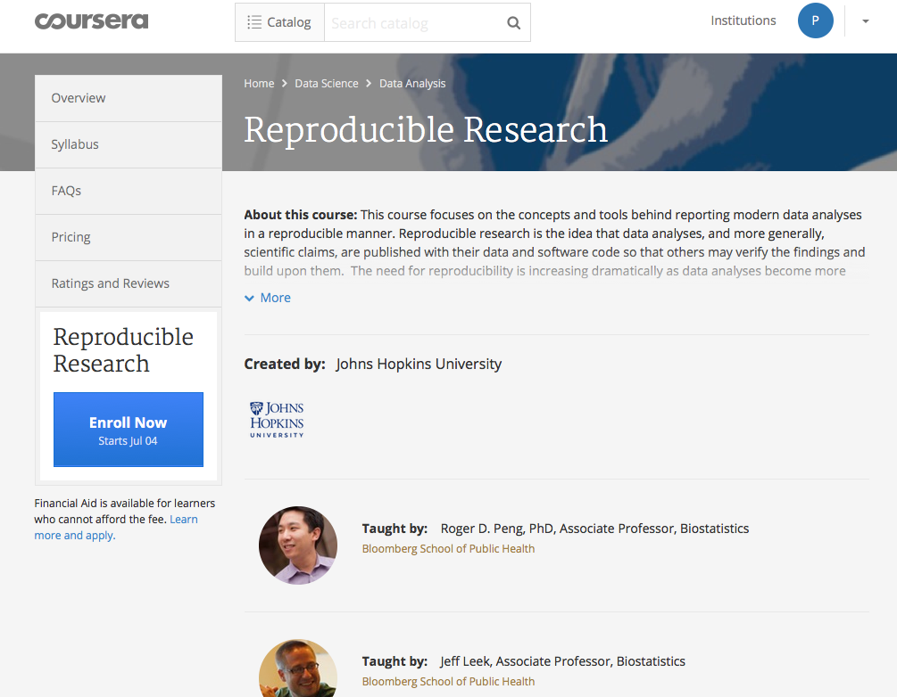

Slide 3
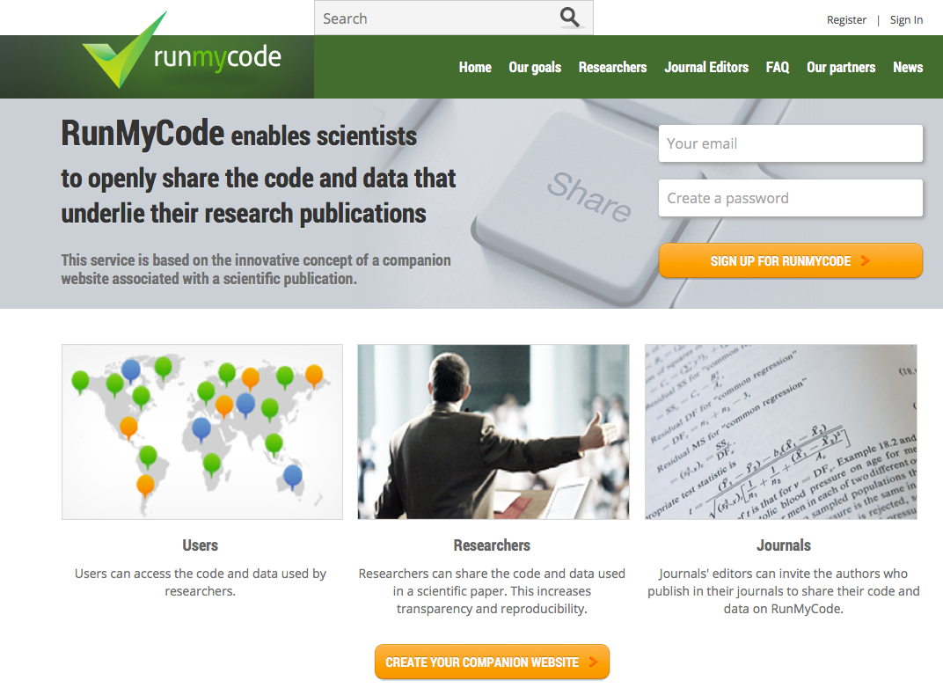

Slide 4









Can reproduce in principle
Software not available
Can reproduce with some discrepancies
Methods unclear
Cannot reproduce
Data not available
Can reproduce from processed data
with some discrepancies
Different result
Can reproduce partially with some discrepancies
From Ioannidis et al., Nature Genetics, 41, 149 (2009)
N=18 (articles published in Nature Genetics 2005/2006)

Slide 5
DMP
Creating data
Re-using data
Raw data
Processing data
GIT/GITHUB
(data, code, method, etc.)
DOI
SIP
Giving access to data
...
V_{n+1}
Analyzing data
V_{n}
Preserving data
DIP
SIP
AIP

Slide 6
test

