Slide 1

Big Data Storage & Processing
Traffic Accident Analysis
Final Presentation
Phan Công Anh – 20210078
Nguyễn Việt Dũng - 20214883
Lê Quang Hiếu – 20210335
Bùi Anh Nhật – 20210657
Nhữ Minh Hà – 20212784
Vũ Nhật Minh - 20214919

Slide 2
Architecture
Content
Problem Definition
Architecture
System components
Difficulties and solutions

Slide 3

Data Storage
Storage Layer
Stores raw accident data coming from Kafka Consumer
Has one Name Node to manages and serves request
Distributed across 3 Data Nodes
Each file blocks is replicated 3 times for fault tolerance
Splits data into 128 MB HDFS blocks
Provides reliable storage before batch & real-time processing
Structure
HDFS Cluster – distributed file system
1 NameNode – manages metadata, status and serves requests
3 DataNodes – store actual data blocks

Slide 4
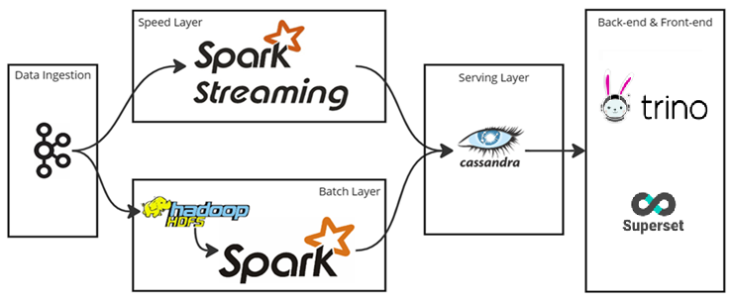
Architecture
Lambda Architecture

Slide 5
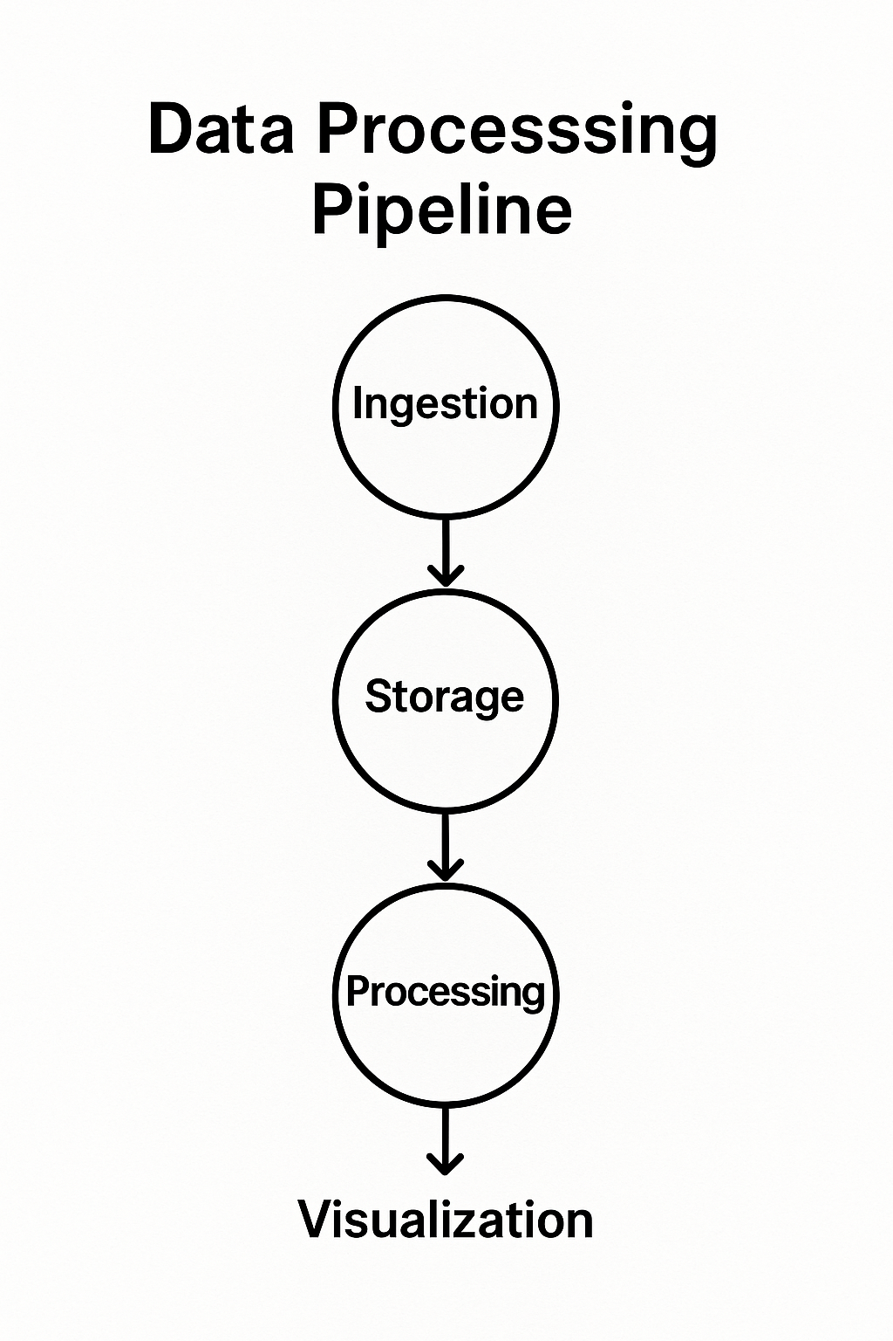
System Components
Main components of our data pipeline:
Real-time data ingestion
Distributed raw data storage
Streaming and batch processing
Storing processed results for fast queries
Visualization through dashboards

Slide 6
Data Storage
Storage Layer
Stores raw accident data coming from Kafka Consumer
Has one Name Node to manages and serves request
Distributed across 3 Data Nodes
Each file blocks is replicated 3 times for fault tolerance
Splits data into 128 MB HDFS blocks
Provides reliable storage before batch & real-time processing
Structure
HDFS Cluster – distributed file system
1 NameNode – manages metadata, status and serves requests
3 DataNodes – store actual data blocks

Slide 7

Data Ingestion
Ingestion Layer
Receives continuous accident data
Simulated stream adds 1 new article every 0.5 seconds
Article is in JSON format
Acts as the entry point of the entire pipeline
Structure
3 Kafka brokers
1 Zookeeper
1 Kafka Topic (traffic_accident)

Slide 8

Data Processing
Processing Layer
Handles streaming + batch workloads
Performs cleaning, transformation, and aggregation
Extracts key metrics (severity, trends, weather)
Real-Time Processing (Streaming)
Spark Streaming processes incoming Kafka records
Lightweight transformations
Writes results to Cassandra
Batch Processing
Spark reads all data from HDFS
Performs heavy transformations
Prevents duplicate processing mechanism
Stores aggregated batch results in Cassandra

Slide 9
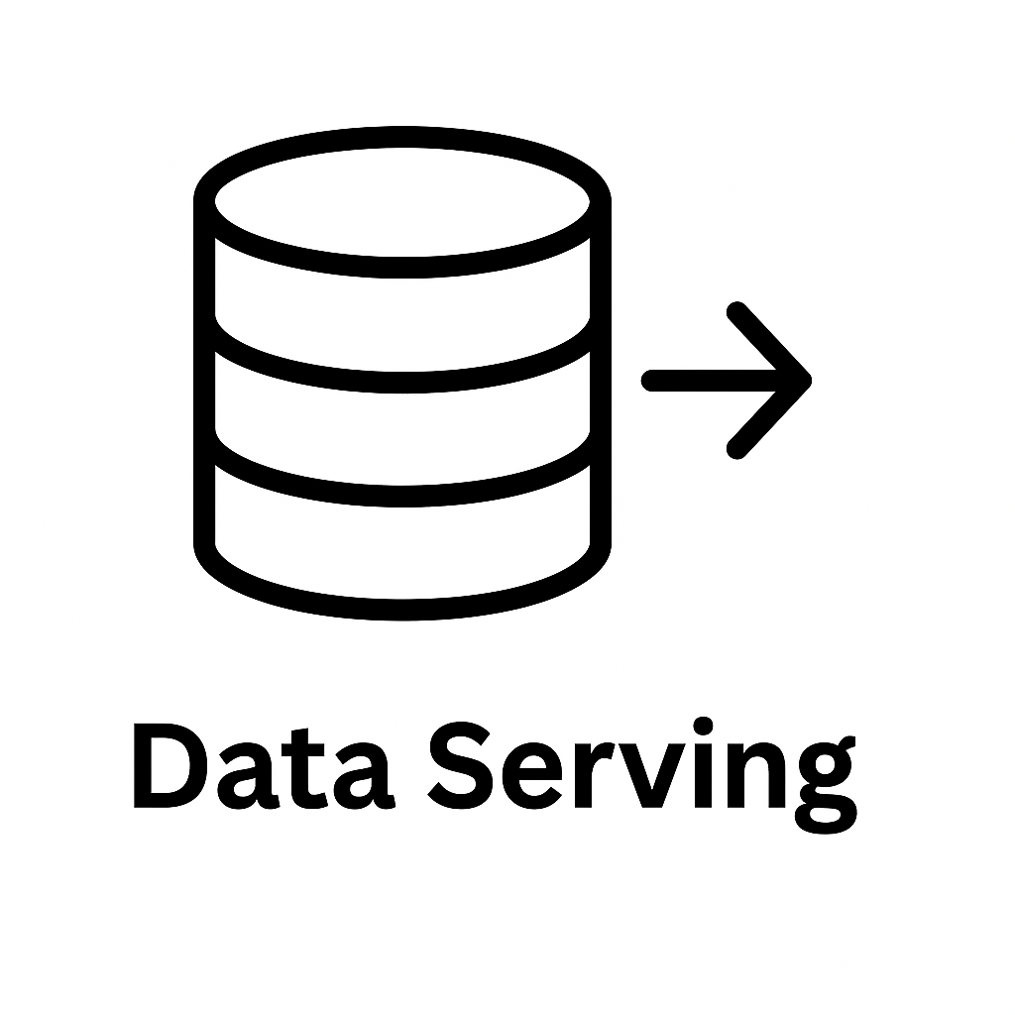
Data Serving
Serving Layer
Stores processed streaming + batch outputs
Provides fast, fault-tolerant access to results
Main data source for dashboards
Cassandra Storage
3-node Cassandra cluster (RF=3)
High availability + distributed writes
Stores severity counts, trends, weather metrics
Tools
Cassandra
Spark → Cassandra connector
Trino (for queries)

Slide 10

Data Visualization
Visualization Layer
Dashboards for real-time + historical statistics
Displays trends, severity levels, weather impact
Helps fast decision-making
How It Works
Trino translates NoSQL to SQL queries for Cassandra
Superset builds interactive dashboards
Supports multiple chart types
Visualizes
Total accidents
Accidents by hour
Accidents by weather
Accidents by severity, ...

Slide 11
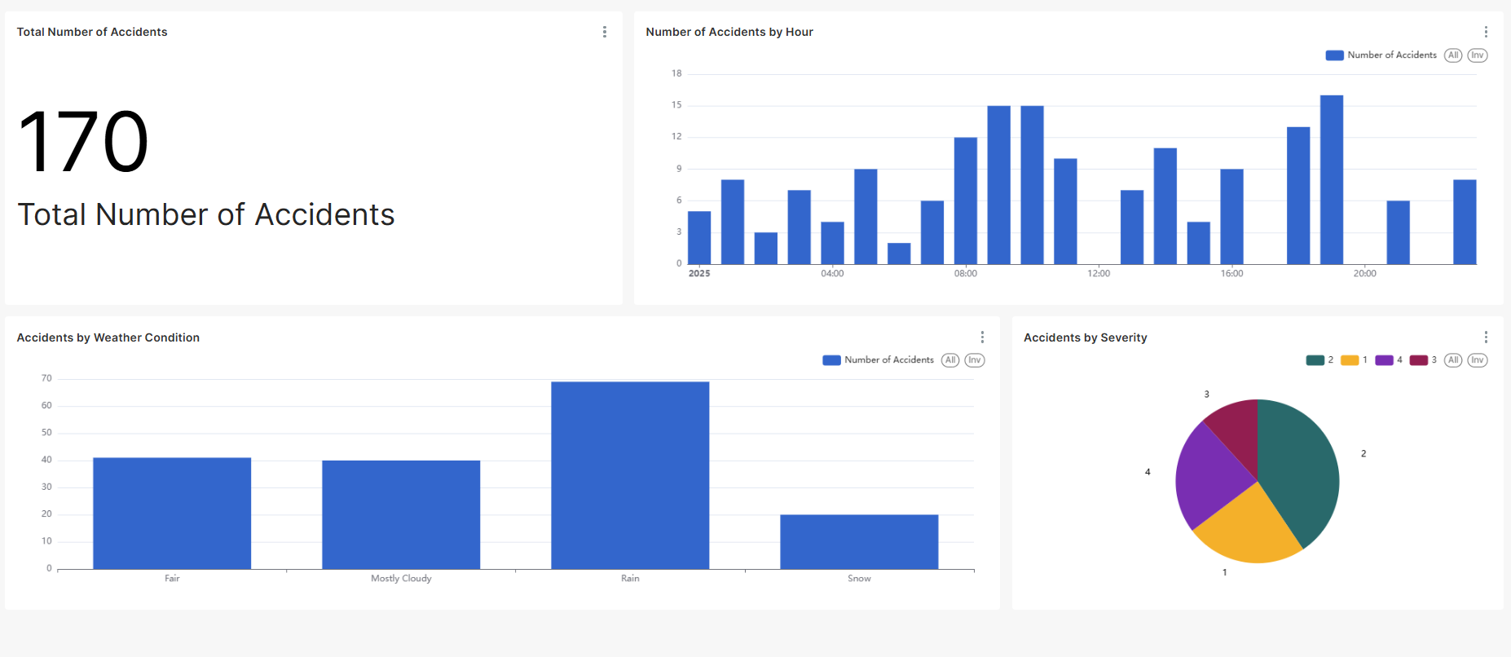
Data Visualization

Slide 12
Difficulties and solutions
Problem 1: HDFS Datanode Corruption and Manual Recovery
- The HDFS cluster frequently experienced Datanode corruption, which required manual intervention to restart the affected services
=> System downtime.
Solution:
- Redeployed the Datanodes using a Kubernetes StatefulSet configuration with a replica count of 3.
- The Kubernetes scheduler automatically terminates it and provides a fresh replica to replace it.
=> Eliminates the need for manual restarts and maintains the required replication factor for data reliability.

Slide 13
Difficulties and solutions
Problem 2: Resource Exhaustion from Individual Record Processing
- The pipeline suffered from frequent crashes and memory exhaustion because the Kafka consumer was writing every incoming record to HDFS individually
=> Generated an excessive number of small files and high I/O overhead, overwhelming the storage system and the consumer pod's computing resources.
Solution: Batch processing mechanism based on time windows and message counts.
Instead of immediate writes, incoming records are buffered in memory and written to HDFS in consolidated batches.
Each batch will have a fixed size and a time windows. The batchs will be sent when they exceed the time windows or reached its maximum size.
=> This optimization significantly reduced the frequency of file creation operations, lowered memory pressure, and prevented the pod from crashing due to resource starvation.

Slide 14
THANK YOU !

