Slide 1



Slide 2
Circus is a Python program which can be used to monitor and control processes and sockets.

Slide 3
Installation
Prerequisites
# apt-get install libzmq-dev libevent-dev python-dev
Pip
# pip install circus
Git
# git clone https://github.com/circus-tent/circus.git
# cd circus
# python setup.py

Slide 4
Ecosystem
Circus-web
# pip install circus-web
Chaussette
# pip install chaussette

Slide 5
circusd
root@circus:~# circusd --help
usage: circusd [-h]
[--log-level {info,debug,critical,warning,error}]
[--log-output LOGOUTPUT] [--logger-config LOGGERCONFIG]
[--daemon] [--pidfile PIDFILE] [--version]
[config]
Run some watchers.

Slide 6
Configuration ini
[circus]
Section is responsible for defining the circus control endpoints.
[watcher:NAME]
Section defines the program to be run, and attributes to use.
[socket:NAME]
Defines the socket and its properties
[env:NAME]
This section is resposible for delivering environment variables to running processes.

Slide 7
Interfaces
Browser
Terminal

Slide 8
Terminal tools
circusctl
circusctl is a command line interface to control running Circus daemon
circus-top
circus-top is a command line tool to see circus daemon stats

Slide 9
Other tools
circusd-stats
root@circus:~/circus-breath# circusd-stats --help
usage: circusd-stats [-h] [--endpoint ENDPOINT] [--pubsub PUBSUB]
[--statspoint STATSPOINT] [--log-level LOGLEVEL]
[--log-output LOGOUTPUT] [--version] [--ssh SSH]
Runs the stats aggregator for Circus
circushttpd
circushttpd --help
usage: circushttpd [-h] [--fd FD] [--host HOST] [--port PORT]
[--endpoint ENDPOINT] [--version]
[--log-level {info,debug,critical,warning,error}]
[--log-output LOGOUTPUT] [--ssh SSH]
[--multicast MULTICAST]
Run the Web Console

Slide 10
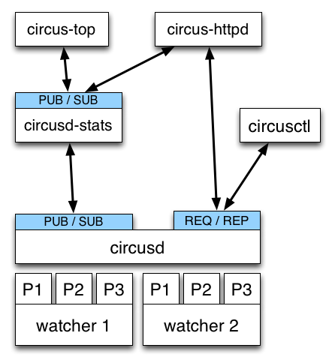
Architecture
REQ/REP – a socket used to control circusd using json-based commands.
PUB/SUB – a socket where circusd publishes events, like when a process is started or stopped.

Slide 11
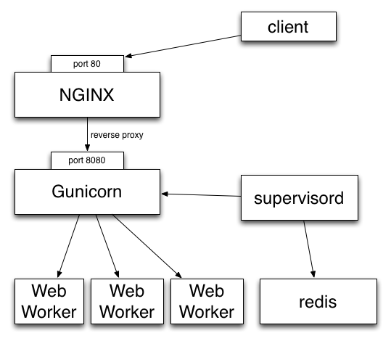
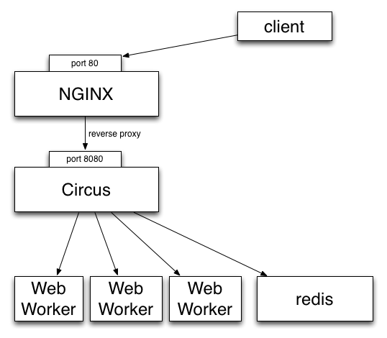
vs Supervisord
Supervisor
Circus

Slide 12
Demo time
[circus]
statsd = 1
httpd = 1
[watcher:webapp]
cmd = bin/chaussette --fd $(circus.sockets.web)
numprocesses = 3
use_sockets = True
[socket:web]
host = 127.0.0.1
port = 9999

