Slide 1
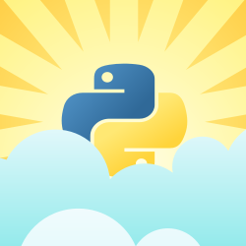
PYCH
PROCESS

Slide 2
PYCH
DEFINITION
A running instance of a program is called
a process.

Slide 3
PYCH
THE FORK
fork() creates a new process by duplicating the calling process. The new process, referred to as the child, is an exact duplicate of the calling process, referred to as the parent, except for the following points . . .

Slide 4
PYCH
TASK_RUNNING
(ready but not
running)
Dispatch
to run
THE LIFE
Task Preempted
TASK_RUNNING
(running)
Task forks
fork()
Event Occurs
Task Exits
TASK_INTERRUPTIBLE
Or
TASK_UNINTERRUPTIBLE
(running)
TASK_ZOMBIE
(running)
Task Waits on an Event

Slide 5
PYCH
THE PIECES
Memory
The program code, heap, stack, global variables.
Signal Handlers
Software interrupts, SIG*, signal handlers, SIGKILL, SIGSTOP.
File Descriptor Table
stdin, stdout, stderr, open files
Environment Variables
Getenv, setenv, parent environment

Slide 6
PYCH
THE RELATION
The init process

Slide 7
PYCH
THE DAEMON
The init process
Always attached to the init process...
… yeah mostly!
Always runs in the background

Slide 8
PYCH
THE PYCH
To learn about the Python way of Creating Processes, Daemons, and Managing them.

