Slide 1
Knowledge Distillation
Transferring the knowledge of a cumbersome model to a small model
Based on G. Hinton, O. Vinyals, and J. Dean (2015),
Distilling the Knowledge in a Neural Network, arXiv:1503.02531
© 2026 Maritime AI Lab. All rights reserved.

Slide 2
Outline
Based on Hinton, Vinyals, and Dean (2015), Distilling the Knowledge in a Neural Network
Part | Key points | Slides
1 Introduction | Training and deployment have different requirements; the relative probabilities of incorrect answers | 3–4
2 Soft targets | Softmax with a temperature, computed in four steps; T = 1 compared with T = 4 | 5–8
3 Distillation | L = α T² C_soft + (1 − α) C_hard step by step; the gradient; why we multiply by T² | 9–13
4 Experiments on MNIST | Fewer test errors; intermediate temperatures for a very small net; a mythical digit 3 | 14–18
Summary and exercises | Three main points and three exercises | 19
After working through this module, you should be able to:
1. compute a softmax with a temperature by hand and explain what soft targets convey that hard targets do not;
2. write down the distillation objective and compute its value and gradient step by step;
3. train a cumbersome model and a distilled model in Colab and interpret the effect of the temperature.
Accompanied by the Colab notebook knowledge_distillation_en.ipynb and the data file kd_mnist.npz.
Every number in Part 3 can be recomputed in Sections 2 and 3 of the notebook; Part 4 is the output of the same notebook.

Slide 3
1. Introduction
Training and deployment have very different requirements
 | Training stage | Deployment stage
Data | very large, highly redundant | one case at a time
Time | need not run in real time | stringent latency
Computation | a huge amount | limited resources
Model | cumbersome model | small model
Cumbersome model
ensemble or large regularized net
soft targets
Distillation: a different kind of training that transfers
the knowledge from the cumbersome model to a small model
Distilled model
small, suitable for deployment
We tend to identify the knowledge in a trained model with the learned parameter values, which makes it hard to see how we can change the form of the model but keep the same knowledge.
A more abstract view of the knowledge, which frees it from any particular instantiation, is that it is a learned mapping from input vectors to output vectors.

Slide 4
1. The relative probabilities of incorrect answers
Examples from Section 1 of the paper
A side-effect of learning is that the trained model assigns probabilities to all of the incorrect answers. Even when these are very small, some of them are much larger than others, and they tell us a lot about how the model tends to generalize.
An image of a BMW | mistaken for | chance
 | a garbage truck | very small
 | a carrot | many times smaller
This defines a rich similarity
structure over the data: it says
which 2's look like 3's and
which look like 7's.
A version of a 2 | probability of a 3 | probability of a 7
one version | 10⁻⁶ | 10⁻⁹
another version | 10⁻⁹ | 10⁻⁶
Problem: such probabilities have very little influence on the cross-entropy cost function during the transfer stage, because they are so close to zero.
Our solution: raise the temperature of the final softmax until the cumbersome model produces a suitably soft set of targets (Part 2).

Slide 5
A worked example: a handwritten 2
Used from this slide to slide 13
The logits are the inputs to the final softmax. To allow calculation by hand, we consider only the three classes 2, 3, and 7.
Class | Cumbersome v | Distilled z | Correct label y
2 | 8 | 4 | 1
3 | 4 | 2 | 0
7 | 0 | 2 | 0
The cumbersome model is confident that
this is a 2 and rates a 3 above a 7
The distilled model, not yet trained,
identifies the 2 but rates 3 and 7 equally
These logits are chosen for hand calculation; they are not produced by a trained model.
The temperature T and the weight α are introduced where they are first used.

Slide 6
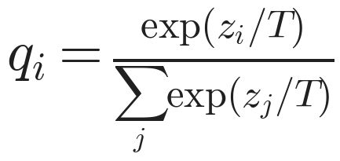
2. Softmax with a temperature: T = 1
Eq. 1 of the paper; T is normally set to 1
The softmax converts the logit z_i computed for each class into a probability q_i by comparing z_i with the other logits; T is a temperature.
Class
2
3
7
v
8
4
0
Step 1: ÷ T
8.0000
4.0000
0.0000
Step 2: exp
2980.9580
54.5982
1.0000
Step 3: sum
3036.5561
Step 4: p
0.9817
0.0180
0.0003
The probabilities of 3 and 7 are 0.0180 and 0.0003. The information that this 2 resembles a 3 more than a 7
is present, but it has very little influence on the cross-entropy cost function.
Check: exp(8) = 2980.9580, exp(4) = 54.5982, and exp(0) = 1, which sum to 3036.5561.

Slide 7
2. Softmax with a temperature: T = 4
The same logits of the cumbersome model at a higher temperature
Using a higher value for T produces a softer probability distribution over classes: Step 1 reduces the differences between the logits by a factor of 4.
Class
2
3
7
v
8
4
0
Step 1: ÷ T
2.0000
1.0000
0.0000
Step 2: exp
7.3891
2.7183
1.0000
Step 3: sum
11.1073
Step 4: p
0.6652
0.2447
0.0900
The probabilities of 3 and 7 become 0.2447 and 0.0900.
At this temperature, the relative probabilities of the incorrect classes are large enough to influence learning.
Check: exp(2) = 7.3891, exp(1) = 2.7183, and exp(0) = 1, which sum to 11.1073.

Slide 8
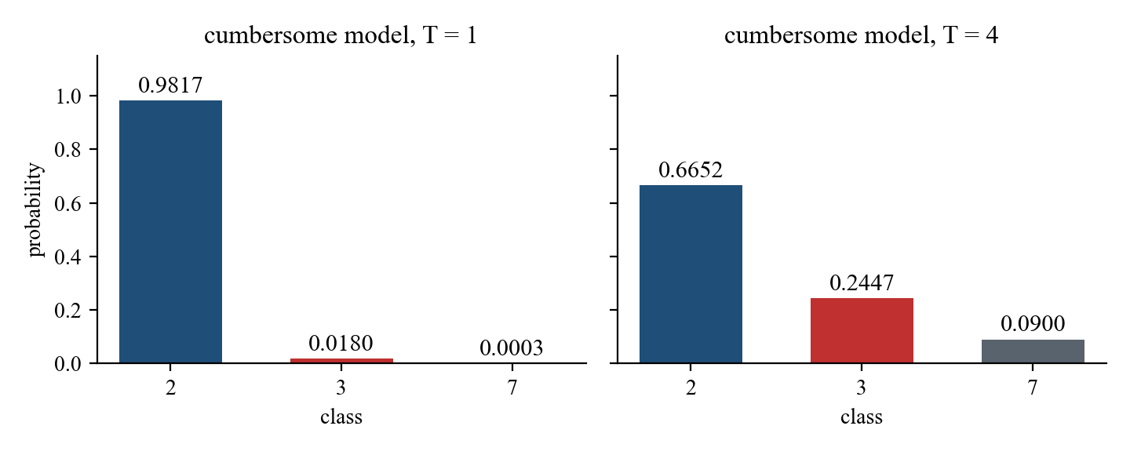
2. Soft targets and hard targets
The same 2 at two temperatures
 | T = 1 | T = 4
P(3) | 0.0180 | 0.2447
P(7) | 0.0003 | 0.0900
P(3) / P(7) | 54.60 | 2.72
The ratio equals exp((4 − 0)/T):
e⁴ = 54.60 at T = 1 and e¹ = 2.72 at T = 4.
Soft targets: class probabilities of the cumbersome model at a high temperature, e.g. (0.6652, 0.2447, 0.0900)
Hard targets: the correct labels, here (1, 0, 0)
When the soft targets have high entropy, they provide much more information per training case than hard targets and much less variance in the gradient between training cases, so the small model can often be trained on much less data and using a much higher learning rate.

Slide 9
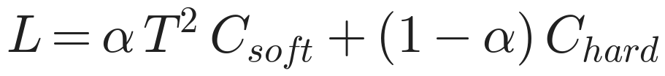
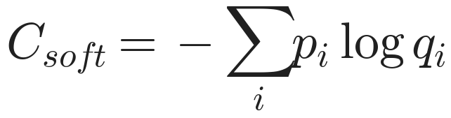
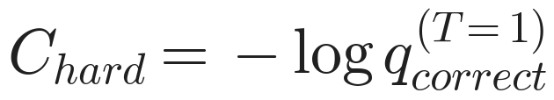
3. Distillation
Section 2 of the paper: a weighted average of two different objective functions
The cross entropy with the soft targets, computed using the same high temperature in the softmax of the distilled model as was used for generating the soft targets
The cross entropy with the correct labels, computed using exactly the same logits in the softmax of the distilled model but at a temperature of 1
α: we found that the best results were
generally obtained by using a considerably
lower weight on the second objective; α = 0.9
T²: the magnitudes of the gradients produced by
the soft targets scale as 1/T², so we multiply
them by T² (checked on slide 13)
After it has been trained, the distilled model uses a temperature of 1.

Slide 10
3. Computing C_soft step by step: T = 4
The softmax of the distilled logits z = (4, 2, 2), then the cross entropy with the soft targets p
Class
2
3
7
z
4
2
2
z / 4
1.0000
0.5000
0.5000
exp
2.7183
1.6487
1.6487
sum
6.0157
q
0.4519
0.2741
0.2741
At T = 4 the distilled
model gives 3 and 7
the same probability
Class
2
3
7
p
0.6652
0.2447
0.0900
log q
-0.7944
-1.2944
-1.2944
p × log q
-0.5285
-0.3168
-0.1165
Sum of the three rows = -0.9618
C_soft = −(sum) = 0.9618
Here log denotes the natural logarithm. Entries are rounded to four decimal places; the sum is computed from unrounded values.
C_soft is smallest when q equals p and grows as they differ.

Slide 11
3. Computing C_hard and the total objective L
C_hard is computed at a temperature of 1; α = 0.9 and T = 4
Class
2
3
7
z
4
2
2
exp(z)
54.5982
7.3891
7.3891
sum
69.3763
q at T = 1
0.7870
0.1065
0.1065
The correct label is 2
C_hard = −log 0.7870
= 0.2395
Term | Expression | Value
Soft targets | 0.9 × 4² × 0.9618 | 13.8493
Hard targets | 0.1 × 0.2395 | 0.0240
Total L | sum of the two terms | 13.8732
Because it is multiplied by T² = 16, the soft-target term is much larger than the hard-target term; the contribution of each term to the gradient is shown on the next slide.

Slide 12
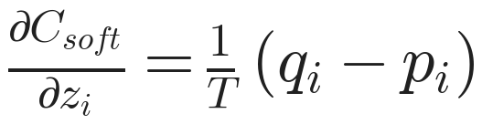
3. The gradient, step by step
Eq. 2: the cross-entropy gradient with respect to each logit of the distilled model
The gradient of the hard-target term is that of the ordinary cross entropy, q(T=1) − y.
Class
2
3
7
q − p
-0.2134
0.0293
0.1840
÷ T (Eq. 2)
-0.0533
0.0073
0.0460
× α T² = 14.4
-0.7682
0.1056
0.6625
q(T=1) − y
-0.2130
0.1065
0.1065
× (1 − α) = 0.1
-0.0213
0.0107
0.0107
Total gradient
-0.7895
0.1163
0.6732
Gradient descent moves the logit of 2 up, the logit of 7 down the most, and the logit of 3 down only slightly,
so the distilled model moves toward the view of the cumbersome model: 2 first, 3 second, 7 last.
Section 3 of the notebook recomputes these values with automatic differentiation (TensorFlow GradientTape)
and obtains the same objective, 13.8732, and the same gradient.

Slide 13
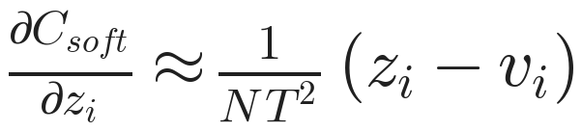
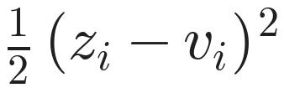
3. Why multiply by T², and matching logits
Eqs. 2 to 4 of the paper
T | largest |gradient|, Eq. 2 | multiplied by T²
1 | 0.194704 | 0.1947
4 | 0.053345 | 0.8535
20 | 0.002637 | 1.0547
If T is high compared with the logits and the logits
are zero-meaned (N classes), distillation minimizes
From T = 4 to T = 20 the gradient shrinks by a factor
of about 20, close to (20/4)² = 25; multiplied by T²,
the values 0.85 and 1.05 are of similar size. The 1/T²
scaling holds in the high-temperature limit; T = 1 is
outside it.
Class | Eq. 2, exact | Eq. 4, approx.
2 | -0.00229 | -0.00222
3 | -0.00034 | -0.00056
7 | 0.00264 | 0.00278
T = 20; zero-meaned z = (1.33, −0.67, −0.67), v = (4, 0, −4)
Matching logits is a special case of distillation. At lower temperatures, distillation pays much less attention
to matching logits that are much more negative than the average.

Slide 14
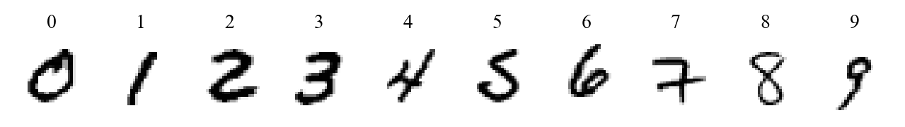
Preliminary experiments on MNIST
From this slide on, all results come from the notebook knowledge_distillation_en.ipynb
 | Section 3 of the paper | Notebook of this module
Training cases | 60,000 | 10,000 (1000 of each digit)
Test cases | 10,000 | 10,000 (the same test set)
Cumbersome model | 1200-1200, dropout, jitter of 2 pixels | 1200-1200, dropout, jitter of 2 pixels
Small net | 800-800, no regularization; also 30-30 | 100-100, no regularization; also 30-30
Temperature | 20 (and others) | 1, 2, 4, 8, 20; α = 0.9
1200-1200 denotes two hidden layers of 1200 rectified linear hidden units.
The training set and the nets are smaller than in the paper, so the numbers of test errors differ; what matters is whether the three effects are reproduced.

Slide 15
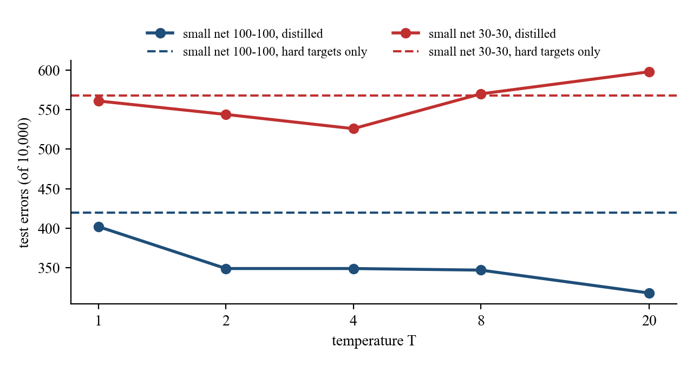
4. Distillation gives fewer test errors
Number of errors on the 10,000 test cases
Model | Paper | This module
Cumbersome model | 67 | 203
Small net, hard targets only | 146 | 420
Small net, distilled | 74 (T = 20) | 318 (T = 20)
This module: distillation reduces the gap between the
small net and the cumbersome model from 217 to 115 errors
In the paper, soft targets transfer a great deal of knowledge
to the distilled model, including the knowledge about how
to generalize that is learned from translated training data,
even though the transfer set does not contain any translations.
Blue: small net 100-100. At every temperature, distillation gives fewer test errors than training on hard targets only (dashed line).

Slide 16
4. Intermediate temperatures for a very small net
The small net is reduced to 30-30
T | Small net 100-100 | Small net 30-30
hard targets only | 420 | 568
1 | 402 | 561
2 | 349 | 544
4 | 349 | 526
8 | 347 | 570
20 | 318 | 598
Paper: with 300 or more units per layer, all temperatures above 8 gave fairly similar results; with 30 units per layer,
temperatures in the range 2.5 to 4 worked significantly better than higher or lower temperatures
This module: the 30-30 net is best at T = 4 (526 errors); at T = 20 it is worse than with hard targets only
When the distilled model is much too small to capture all of the knowledge, ignoring the large negative logits can be helpful.

Slide 17
4. A mythical digit 3
All examples of 3 omitted from the transfer set (9000 cases here); the test set contains 1010 threes
Model | Test errors | Errors on 3s | Test 3s correct
This module: hard targets only | 1372 | 1010 of 1010 | 0.0%
This module: distilled, T = 8 | 646 | 378 of 1010 | 62.6%
This module: distilled, bias for 3 increased by 3.0 | 430 | 84 of 1010 | 91.7%
Paper: distilled | 206 | 133 of 1010 | 86.8%
Paper: distilled, bias for 3 increased by 3.5 | 109 | 14 of 1010 | 98.6%
Hard targets only: no training case has the
label 3, so the net never outputs a 3
Distillation: the soft targets for other digits
say how much each of them resembles a 3,
from which the distilled model learns about 3s
Most of the errors are caused by the fact that the learned bias for the 3 class is much too low.
As in the paper, the increase in the bias is chosen to optimize overall performance on the test set, so the corrected figures are optimistic.

Slide 18
Other results of the paper
Section 4: speech recognition. Section 5: specialist models. Section 6: soft targets as regularizers
System | Test frame acc. | WER
Baseline | 58.9% | 10.9%
10xEnsemble | 61.1% | 10.7%
Distilled single model | 60.8% | 10.7%
System | Training set | Test frame acc.
Baseline | 100% | 58.9%
Baseline | 3% | 44.5%
Soft targets | 3% | 57.0%
Acoustic model of Android voice search: more than 80%
of the improvement in frame accuracy achieved by the
ensemble is transferred to the distilled model.
Soft targets allow a new model to generalize well from
only 3% of the training set; with hard targets the model
overfits severely and needs early stopping.
Specialist models: on JFT (100 million labeled images, 15,000 labels), 61 specialist models, each trained on a
confusable subset of the classes, are added to the generalist model; test accuracy rises from 25.0% to 26.1%.
Figures from Tables 1, 3, and 5 of the paper; these experiments are not repeated in this module.

Slide 19
Summary and exercises
1 A higher temperature produces a softer distribution and exposes the relative probabilities of incorrect classes
2 L = α T² × cross entropy with soft targets + (1 − α) × cross entropy with hard targets; T² offsets the 1/T²
3 Matching logits is the high-temperature limit; a very small net works best at intermediate temperatures
Exercise 1 At T = 2, what are the soft targets for v = (8, 4, 0)? Use the four steps of slide 6
Exercise 2 Set the distilled logits to z = (8, 4, 0), equal to v. What is the gradient in Eq. 2, and why?
Exercise 3 In Section 7 of the notebook, omit the digit 7 instead and record the fraction of test 7s correct
Exercise 1 can be checked in Section 2 of the notebook with T = 2; Exercise 2 in Section 3.

