Slide 1
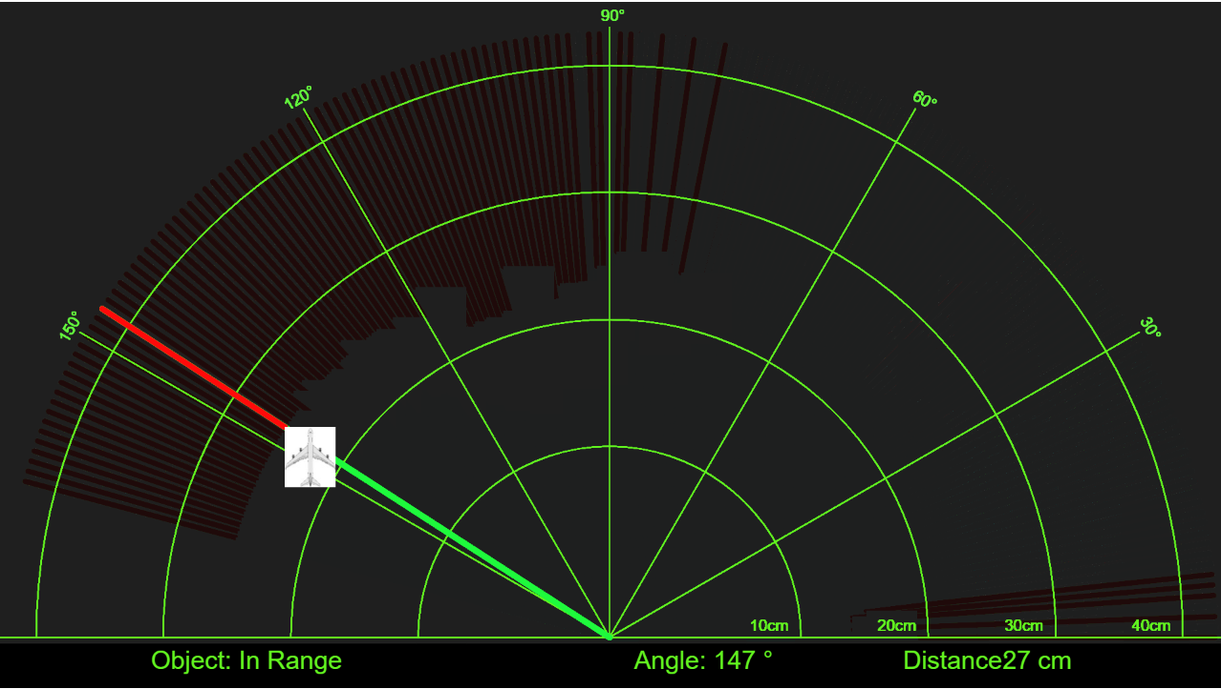
Home-made ultrasonic radar

Slide 2
Let’s show how it works!!

Slide 3
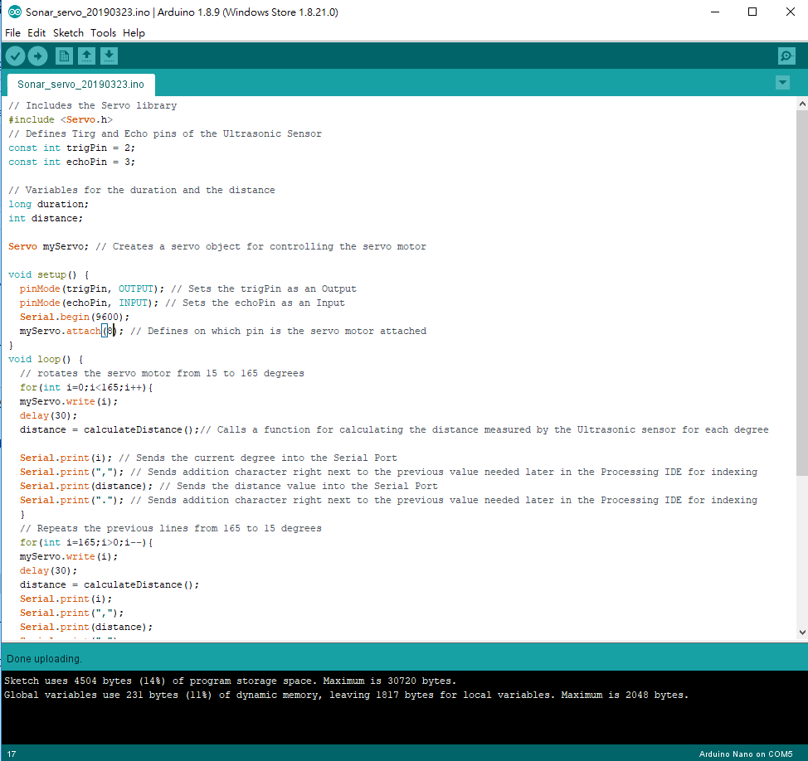
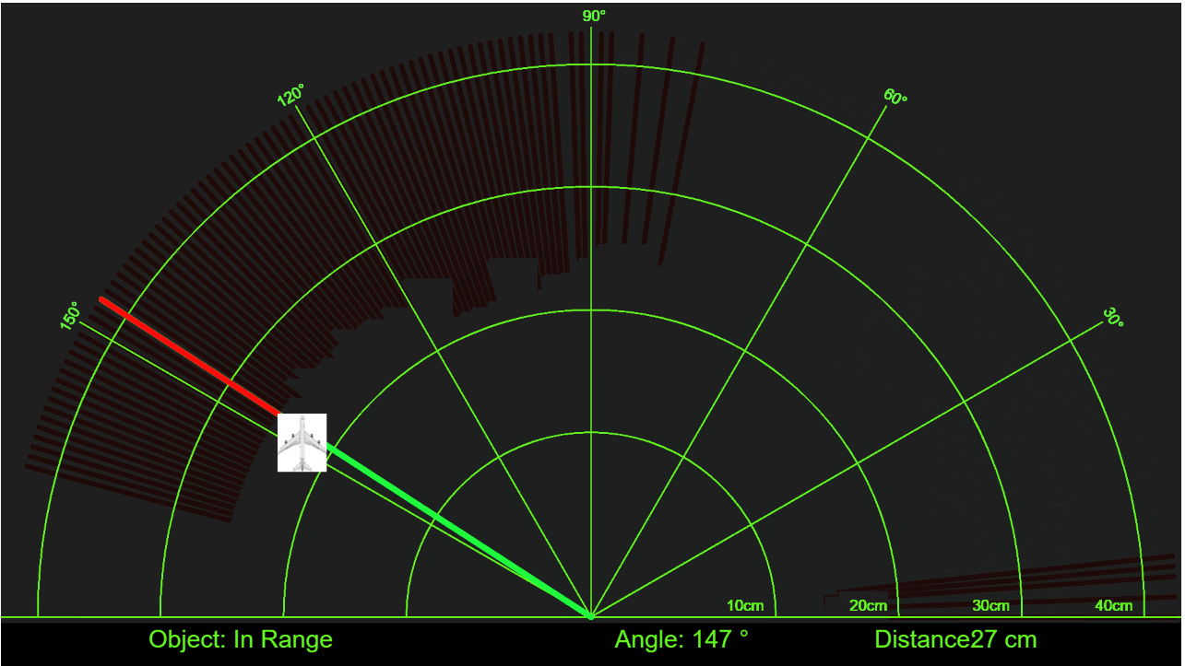
Software preparation
For communication with Arduino board and Google Chrome, we need to start a p5.serialport server by Node.JS.
A p5.js library that enables communication between your p5 sketch and Arduino (or another serial enabled device).
Arduino IDE
P5.serial Port
Google Chrome
With p5.js framework
>node startserver.js

Slide 4
Software preparation
Please refer to Github
https://github.com/pycilin/Arduino_sonar_Radar/blob/master/Ultrasonic_radar_release_github.zip

