Slide 1
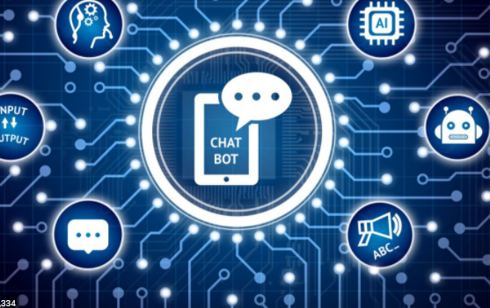
CHATBOT
Presented By:
1. Mujawar Simran Gulabhusen. - 20UET305
2. Pol Shradhha Deepak. - 20UET310
3. Rajoba Rushikesh Mahavir. – 20UET311

Slide 2
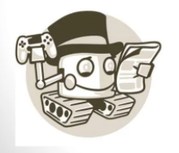
content
Introduction
Need of chatbot
Goods/bads
Simple chatbot using python
conclusion
reference

Slide 3
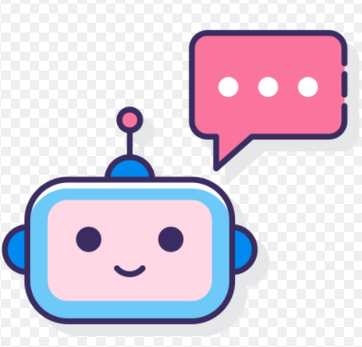
Introduction What is chatbot ?
Chat robot, a computer program that simulates human conversation, or chat through artificial intelligence.
Typically, a chat bot will communicate with a real person.

Slide 4
Goods bads
Message platforms are everywhere.
Simple, known interface.
Applicable to many situations.
63% of the people are willing to
communicate through chatbots.
73% won’t use the chatbot again after a bad experience.
75% want to know it is a bot.
50% are disturbed when a bot pretends to be human.
Not all languages are equally supported.

Slide 5
Chatbot
Tkinter
Chatterbot.trainer
Chatterbot
Photoimage

Slide 6
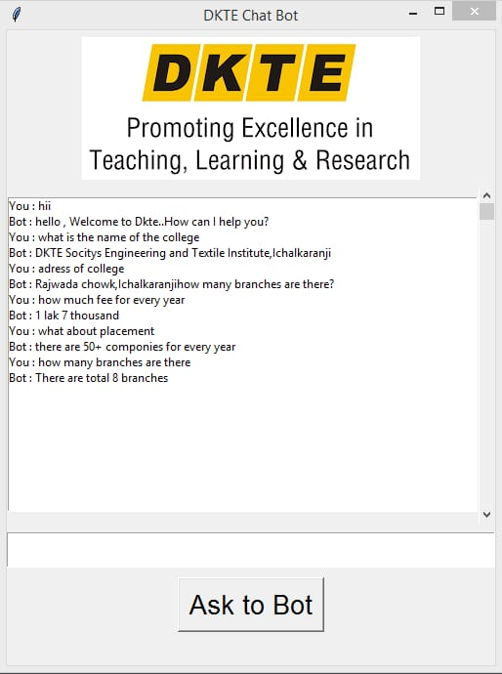
Result

Slide 7
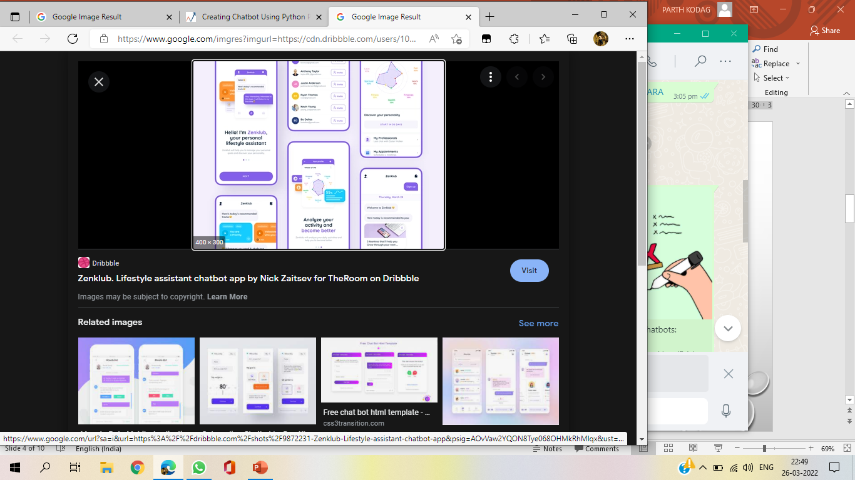

Slide 8
Conclusion
chatbot is important in business.
how we can build a simple chatbot by using Python and Library Chatterbot.

Slide 9
reference
https://www.slideshare.net/GeffThomas/chatbot-ppt
https://www.analyticsvidhya.com/blog/2021/12/creating-chatbot-building-using-python
https://www.techtarget.com/searchenterpriseai/feature
https://www.aivo.co/blog/advantages-and-disadvantages-of-chatbots

Slide 10
THANK YOU

