Slide 1
Python power electronics
Open Source Circuit Simulator in Python
Shivkumar Iyer

Slide 2
Background
A need to simulate large electrical systems with power electronic converters (example a wind farm with 25 turbines).
Project homepage: http://sourceforge.net/projects/pythonpowerelec/
Project blog:
http://pythonpowerelectronics.blogspot.ca/
Project status: Released 8 versions so far – basic electrical library available.

Slide 3
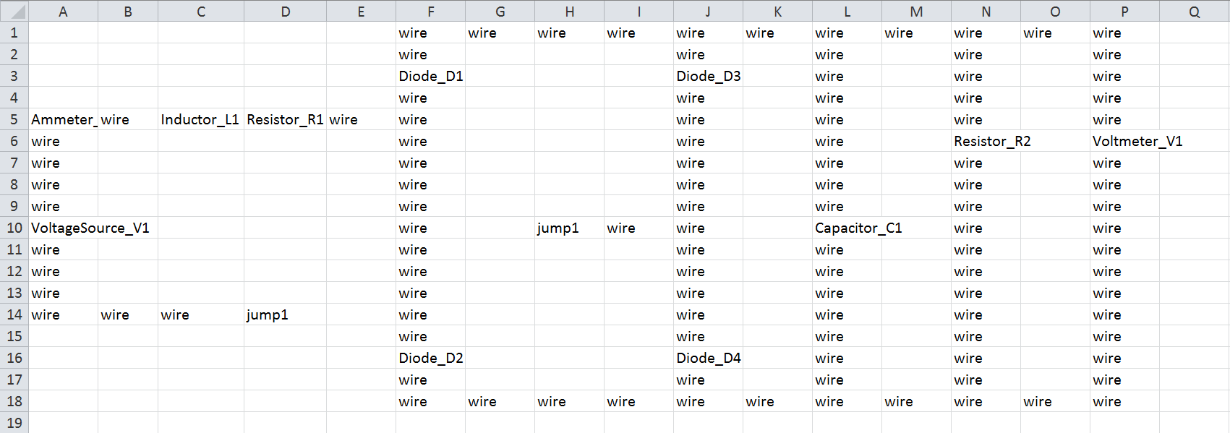
User Interface
All user interface is through spreadsheets (save as .csv).
Resistor_R1 → Resistor (type) + _ + R1 (name)
Available library → Resistor, Inductor, Capacitor, VoltageSource, CurrentSource, Ammeter, Voltmeter, Diode

Slide 4
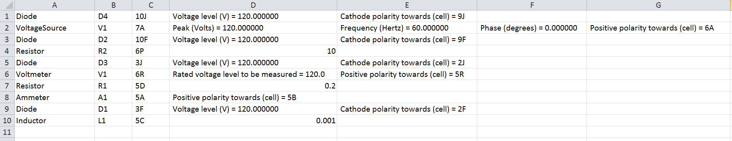
User interface (contd)
User asked to enter parameters in another spreadsheet (this is generated automatically from the circuit).
Final results stored in a .dat file with “time” as the first column. Can be plotted using any plotting software (example Gnuplot).

Slide 5
Future work
Power electronics library
Machines library
Renewable sources library
Integrate with other scientific projects in Python.
THANK YOU!

