Slide 1

Campaign Automation
& Abusing Celery Properly
PyCon SK 2017 Peter Dolák

Slide 2






Who's the guy talking
Fastest growing SaaS company in Europe
Peter Dolák
Senior SE engineer
Python & C++ & Go
Notes:
Working for Exponea for over 3 years
Exponea is relatively young Slovak company that has become a global player in analytics & marketing automation
0:30

Slide 3
Content
What's Celery
Campaign automation using Celery
How Exponea abused Celery
Notes:
What is this “Celery”
When and how to use it in your project
How Exponea uses Celery to implement campaign automation – best in the world :)
How we abused Celery in the process and what we learned
1:30

Slide 4




About Celery
Celery – Distributed task queue
Deferring and distributing work
Planned and periodic tasks
Most common setup uses:
  RabbitMQ – message broker
  Redis – result backend
Notes:
What is Celery?
Distributed task queue – you put some tasks to its queue and it will execute them when you want
Similar projects - Redis Queue, Dramatiq – Celery most popular.
I found the Celery logo boring, so I will be using my own.
There is a bit prerequisite:
RabbitMQ – message broker.
A bit similar to Kafka, but a different approach.
RabbitMQ logo less boring, but I'll be using my own anyway
3:30

Slide 5
Advantages of Celery
Delaying work that can be done asynchronously
ETA tasks – execute at a precise time in future
Celery beat – CRON-like periodic jobs
Simple to set up for a developer (less fun for ops)
Easily scalable distributed worker pool
Fast – thousands of tasks/s, few ms latency
Management GUI – Celery Flower
Notes:
When you might even consider using Celery?
Delaying work – stuff you don't want to do while processing a request.
ETA tasks – execute at a precise time in future or with a countdown.
When you want to execute periodic tasks and are too fancy to just use CRON.
Advantages
:) Celery is user-friendly, it's just a bit picky about who can be its friend.
Lots of functionality, easy to extend.
5:30

Slide 6
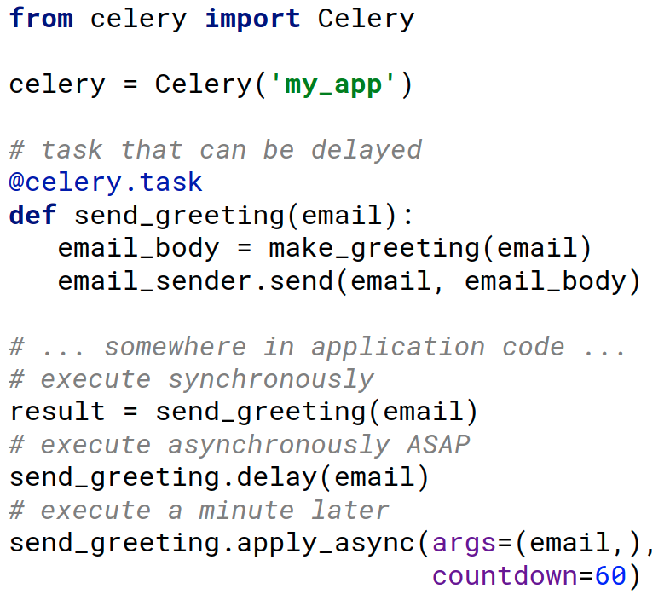
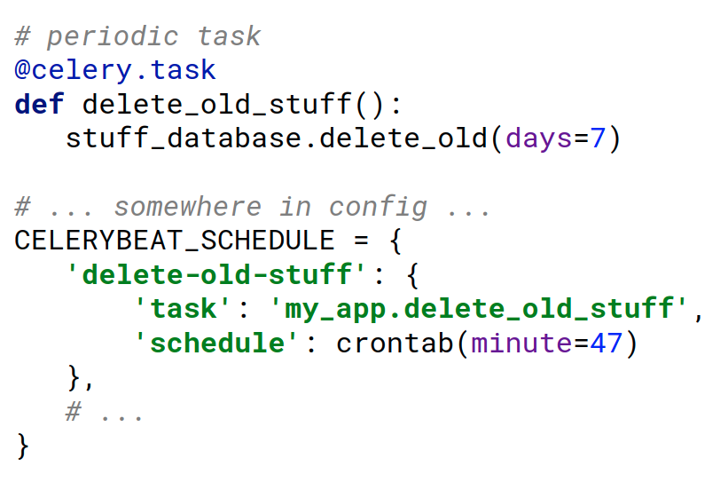
Example with Celery
Run for example with supervisor:
celery -A my_app worker
celery -A my_app beat
Notes:
I once heard it's a bad idea to put code to tech presentation slides.
I did it anyway, to show you don't need a lot of code to get Celery running.
Comment on running task sync, async and ETA
Scheduling periodic tasks
7:30

Slide 7




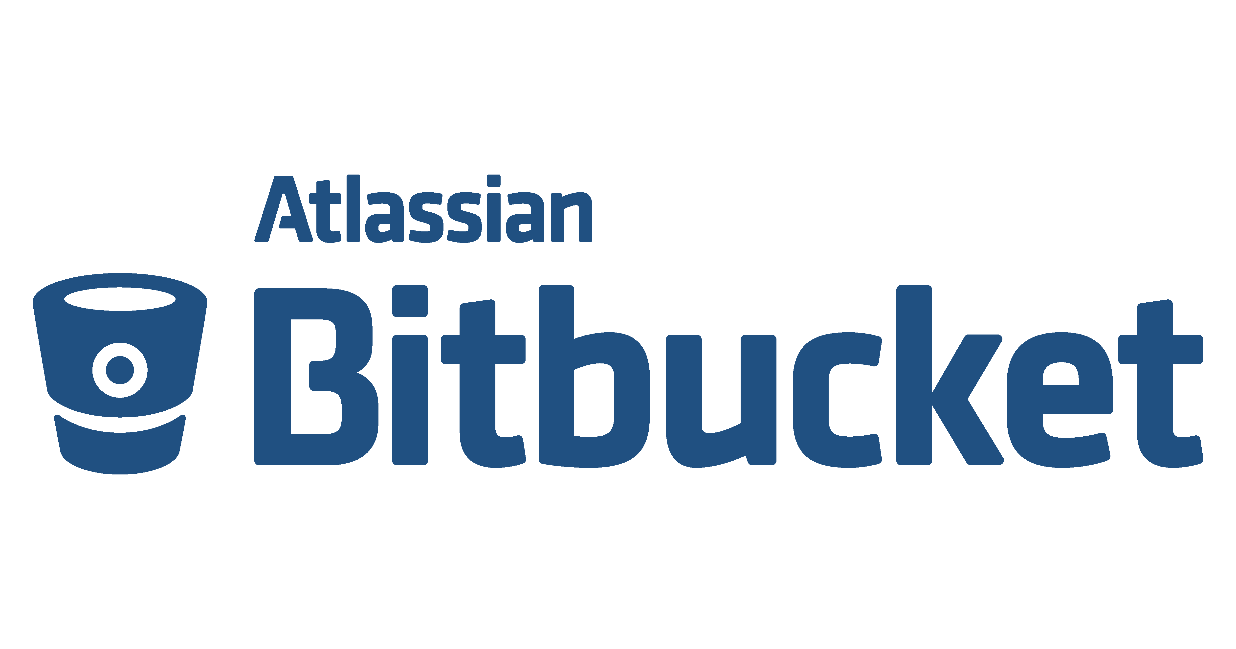



Companies using Celery
Notes:
Some of the companies that reportedly use Celery
8:00

Slide 8
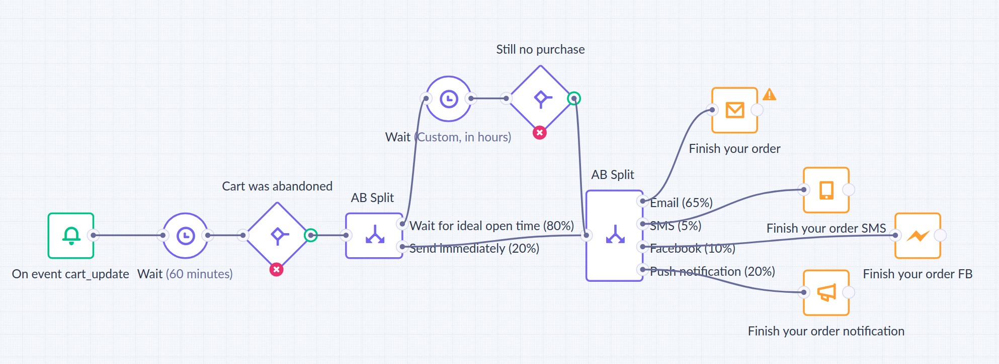
Exponea's campaign automation
Emails in hundreds of millions a month
SMS, push notifications, FB messages, ad retargeting,
AB testing, webhooks allowing other integrations
Highly personalized using Jinja templating language
Notes:
This is what a campaign definition may look like in Exponea.
Nodes can be arranged to a directed acyclic graph – we call it scenario – executed for each customer.
Many clients choose similar best time to send a weekly newsletter, so the load is often very concentrated.
Jinja templating language, can be used to query our in memory database for customer data, also get AI recommendations and more
10:00

Slide 9
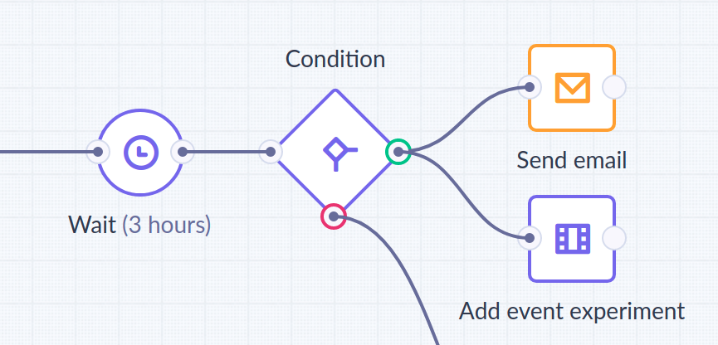
Exponea's campaign automation
1 celery task = process a subtree of campaign DAG
with a chunk of hundreds/thousands of customers
Tasks schedule next tasks to implement the DAG
Enter & prepare
Execute for a chunk
ETA
Leave & schedule
Notes:
How does Celery fall into this?
It's most efficient for us to process the same action for many (hundreds/thousands) customers at once.
Processing each node in the graph has a few potential places where Celery tasks are used.
Celery tasks scheduling other Celery tasks.
11:30

Slide 10


Exponea's journey with Celery
We pushed Celery (3.1.25) to its limits, sometimes using obscure functionality in unintended ways
So how did we get from this...
... to this?
THINK I KNOW
Notes:
Sounds simple on paper, but to execute very diverse campaigns for all kinds of clients in shared cloud environment, we had to do a lot of hacks and we …
Full disclaimer: even in this moment, we still use Celery 3.1.25, which is not the newest version of Celery. Some of the issues I will point out today may possibly be addressed in Celery 4, but I didn't see anything in change log suggesting so.
So now I would like to mention some issues we have found while using Celery like this and how we got from this….
To this. Yeah, I still don't consider myself an expert, but the things we learned might be very useful for anyone dealing with Celery.
13:30

Slide 11
Large task data
Few years ago we would push tons of ids of customers & their context data as task arguments
Problems:
  Celery eating up tons of memory
  Tens of tasks may occupy memory of one worker – Celery Flower, synchronization – chord, chain
Ideally celery task data should be the definition of the job, not the entire input data – use another DB
Notes:
I'll start with a beginner's mistake
What we noticed:
Because
If enough time! Chord (read kórt) and chain – synchronization mechanisms
Large RabbitMQ load – it doesn't behave well when under too much load
15:00

Slide 12
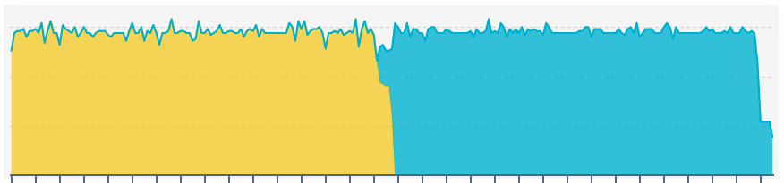
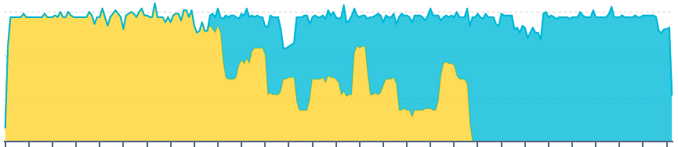
Dynamic queues & exchanges
Tasks by one campaign shouldn't completely block another campaign (possibly by another client)
Solution:
  Queue for each campaign + high priority queues
  Dynamically created when campaign is started
  Celery does round-robin by default – fair allocation
A started
B started
A done
A started
B started
A done
Notes:
Most of our clients are on a cloud instance, using the same worker pool for all their campaigns.
If you use a single queue for all your tasks, Celery will process tasks in the same order as you inserted them into the queue, a large campaign will insert thousands of tasks at once
Pictures: customers processed by two concurrent campaign per second.
Very well balanced over time, works best if tasks have short execution times or are using a special fair scheduler (default in Celery 4)
17:00

Slide 13
Dynamic queues & exchanges
Our clients use most campaign definitions just once
Problem #2: increasing number of queues (>10k)
Solution: delete queues for stopped campaigns
Problem #3: re-creating deleted queues confuses Celery workers until they are restarted
Solution: versioning queues to avoid re-creating
Notes:
But that would too easy, right?
When I implemented the dynamic queue creation initially, I didn't worry about increasing number of queues, because that's not a problem that will bother me, but “me” a month later.
So how do you solve this? Find queues that are no longer being used and delete them, simple right?
That would still be too easy. Any campaign definition can be stopped and later resumed whenever the client desires, so a queue for a campaign needs to be re-created.
As we found out, Celery (3.1.25 at least) would experience quite annoying problems if a worker still has some meta-information in cache for a deleted queue and you re-create the queue without restarting them – so don't do that, we fixed that by versioning them.

Slide 14
Long ETA tasks
Campaigns allow wait nodes and planned triggers that can wait with an action even for months
Problem: RabbitMQ broker backend implements ETA tasks by keeping them in worker memory until ready
Solution: Storing tasks with ETA larger than few minutes in a database and scheduling them ahead
Notes:
...
But how Celery using RabbitMQ as broker implements ETA tasks?
…
Memory usage keeps growing again…
Solution – pretty obvious thing to do
Still has the great precision of Celery ETA tasks
Kinda starts to stink – isn't that the library's job?
19:30

Slide 15
Disappearing tasks
Losing a single task may mean not sending a campaign to hundreds or even tens of thousands of customers
Problem: at times, task loss of even few % occurred
Seems to coincide with high load on RabbitMQ
No idea whether it's in Celery or RabbitMQ
No logged errors
Hard to replicate
Tasks not idempotent
Notes:
It's important the Celery tasks we use for campaign execution have an exactly once guarantee. It usually works that way but it's not a guarantee. If you use late task acknowledgment, you may have easier at least once guarantee, but your task needs to be idempotent.
So at times, Celery was losing even up to few % of scheduled tasks. The loss was usually connected with high load on servers where our RabbitMQ cluster was running, but were never quite able to identify where our tasks are lost. It's easier to debug why something happened that shouldn't have happened, than the opposite.
[Run animation] So we had no idea why this loss was occurring, whether we should have blamed our application code, Celery library or even RabbitMQ. There was nothing logged by any of those things, so the tasks never started executing.
[Finish animation] And whenever we actually tried to look at what's wrong, the issue stopped occurring.
Couldn't use late acknowledgment as our tasks were not idempotent.
23:00

Slide 16
Disappearing tasks
“Q1 Goal: Less than one lost campaign task in March”
Solution: library(-ish) built on top of Celery
  Ensures every task is persisted, now using MongoDB
  Uses Celery to actually execute tasks
  Automatically reschedules/reports missed tasks
  Handles ETA, re-implements synchronization
  Measures important stuff that Celery doesn't
Notes:
So as this was quite serious, our CEO told me there should be not one lost campaign task during March.
:) After laughing at this joke for a bit, I realized it was a work assigment.
So what should you do when a library doesn't do what you want it to? Well I don't know, but I can tell you what I did instead :)
I wrote my own library… -ish. It's not rewritten Celery, instead it uses Celery for the stuff Celery does well and addresses some issues with it that I mentioned.
A possible question: Is this library open-source? No, as I said, it's only a library-ish, it needs a lot of polishing to be usable in general and we would also like to properly test in.. in production ;)
24:30

Slide 17
So should I use Celery?
So… Should I use Celery or not?
Can be a great tool for standard usage
Be careful when doing something fishy
Don't rely on Celery working perfectly from day one
Make sure your devops have enough coffee
Notes:
So did I just tell you to use Celery, or not to use Celery?
Neither, I just wanted to bring across a few points:
…
25:00

Slide 18



Exponea at PyConSK 2018
More info about our activities: www.exponea.com/python
Other Activities
Peter Dolák
Senior Software Developer
Happy Hour with CTO & team leads
Python Challenge
Devops Challenge
Competitions
Gifts
and more
Saturday 13:00-17:30
Exponea Booth
Let’s talk more!
Exponea Booth
Notes:
Now before we get to your questions, a word from our sponsor :)
Be sure to visit our yellow Exponea booth. We are hiring a lot and are looking for talented people. You can meet me and talk more, also our CTO and some of our team leads.
Also you can grab free stickers, pop corn and if you complete a survey, our Python or DevOps challenge, you can even win stuff like free T-shirts, conference ticket, newest i-Phone, Samsung or free lunches for a month.
26:00

Slide 19


THANK YOU
more info: www.exponea.com/python
Twitter: @Exponea_Society

