Slide 1
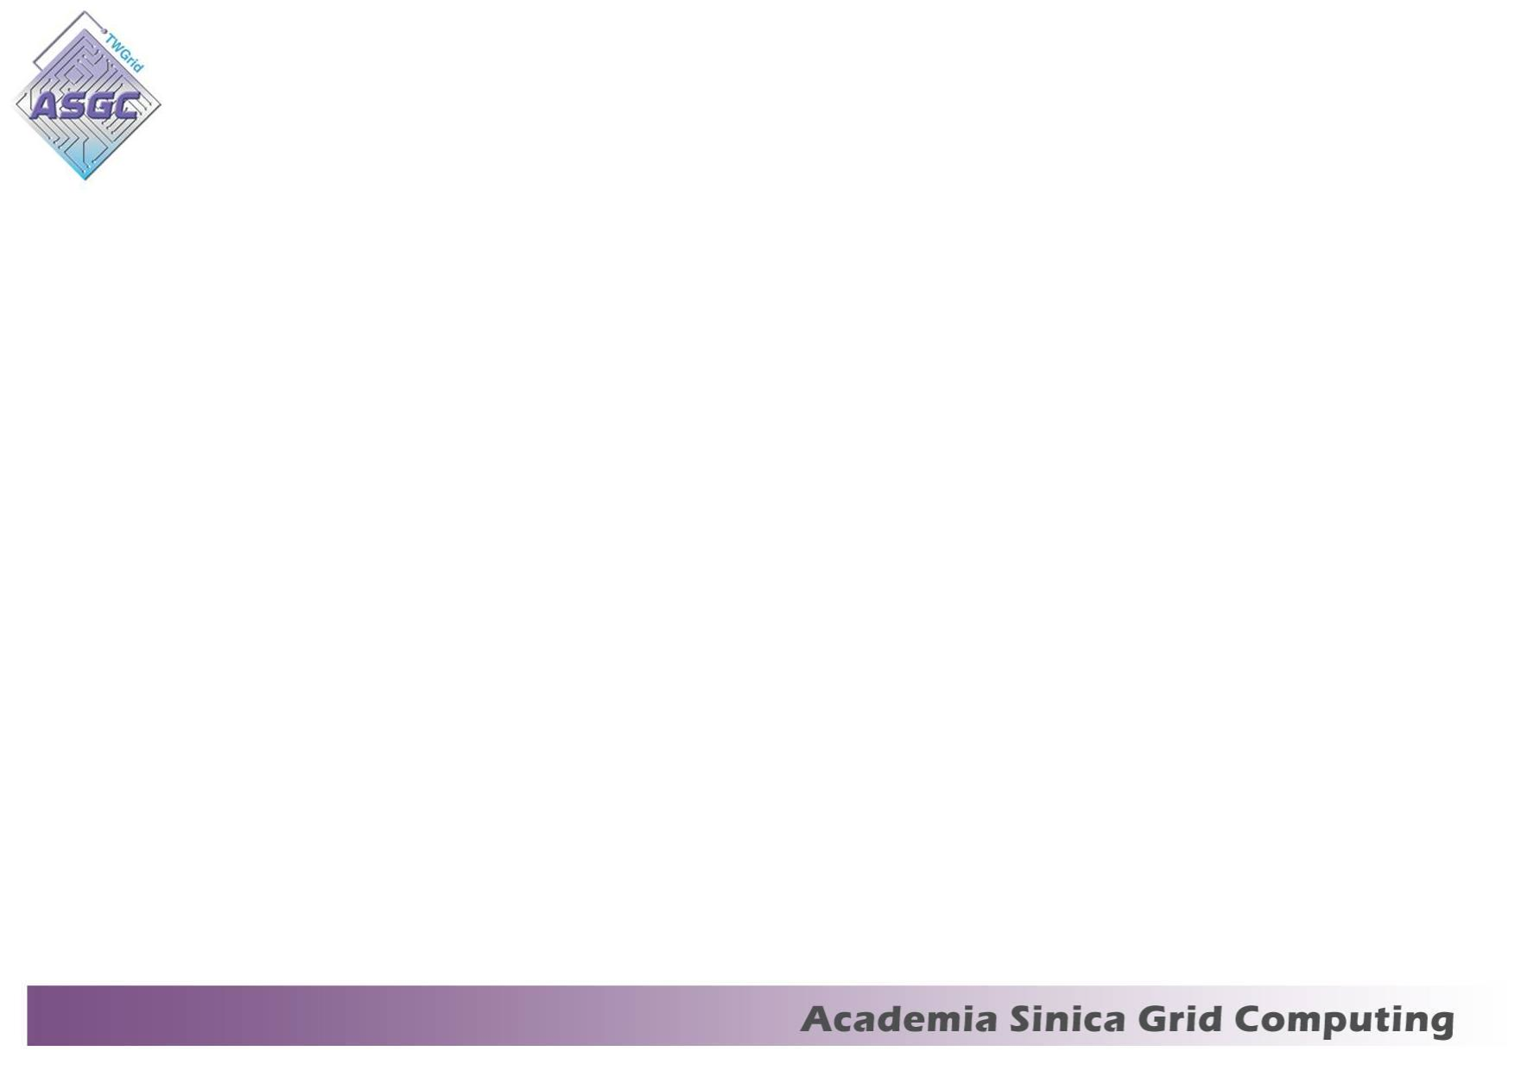
PyCon 2012
Grid Job management
Felix Lee, ASGC

Slide 2
About ASGC
Academia Sinica Grid & Cloud

Slide 3
Something we might need to know..
LHC
WLCG
Grid Computing

Slide 4
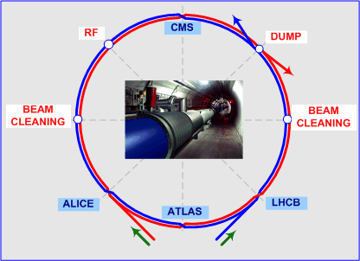
LHC experiment
LHC – The Large Hadron Collider.
  It was built by European Organization for Nuclear Research (CERN)
  27KM tunnel in circumference, as deep as 175M

Slide 5
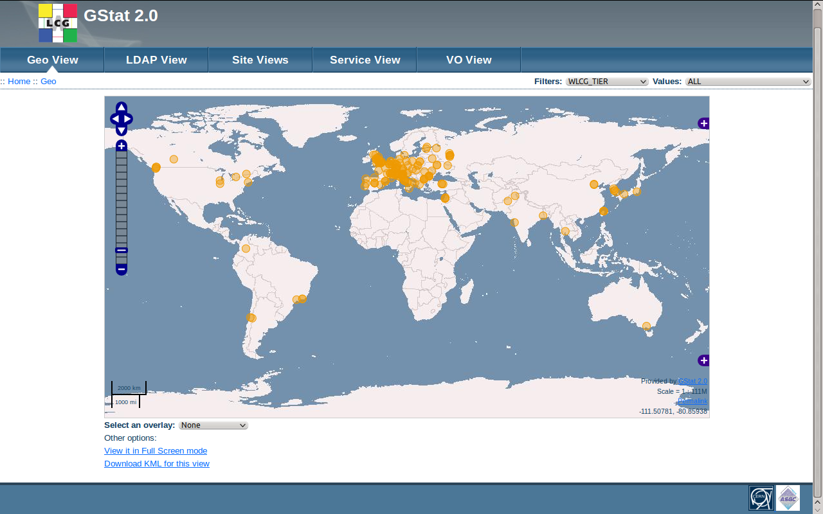
WLCG
World-wide LHC Computing Grid
It's a distributed computing infrastructure to provide the production and analysis environment for LHC experiment.
Currently, there are 11 tier1, 140 tier2 and several small tier3 in the world.
There are 269299 CPU cores, 183PB storage capacity in the world.

Slide 6
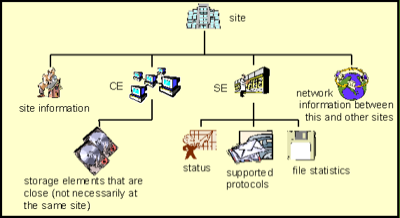
Grid Computing
It's one of distributed computing
Base on federal resources.
It connects loosely-coupled computers by the Internet to be super virtual computer.

Slide 7
What we do
ASGC is WLCG(World-wide LHC Computing Grid) Tier 1 operation center since 2005
ASGC is also conducting Asia Pacific regional e-Science collaborations, development and infrastructure operation.
Developing new generation distributed computing infrastructure and technologies.

Slide 8
Python in WLCG & Grid
It's widely used for high level integration.
Clear code, strict syntax...
Fast and flexible implementing
  It's script.
  No need to be complied.
  Plenty of mathematic and science modules.

Slide 9
Python in WLCG & Grid
Work flow & Job Management.
Data Management.
Information system.
Monitoring.
HEP applications
  Data processing.
  Data analysis.

Slide 10
Python in ASGC
Work flow & Job Management
  GAP 1.0
  PanDA, collaborating with Atlas
Monitoring and information
  GSTAT 2.0, Nagios plugin.
Integration of Grid & Cloud.
  Virtual worker node on demand.
  Virtual machine catalog service.
Deployment and automation.

Slide 11
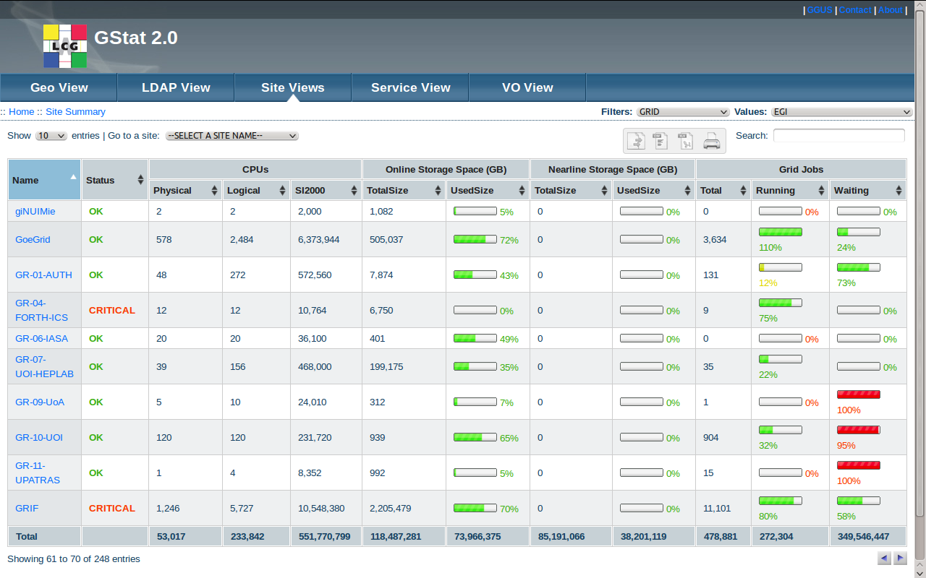
GStat 2.0

Slide 12
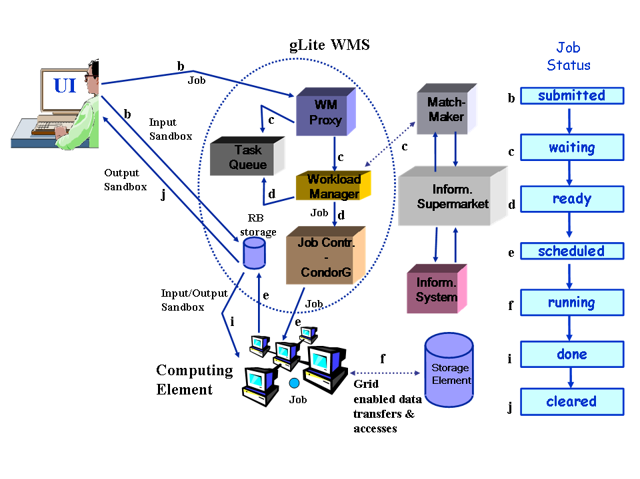
Work flow & Job management
A typical Grid workflow

Slide 13
PanDA
PanDA
  Production and Distributed Analysis system.
  Designed and developed by Atlas experiment.
  It's data driven and pull model computing.
  Including workflow, resource matchmaking and job management.
  We are now working with Atlas to improve and deploy it for eScience users.

Slide 14
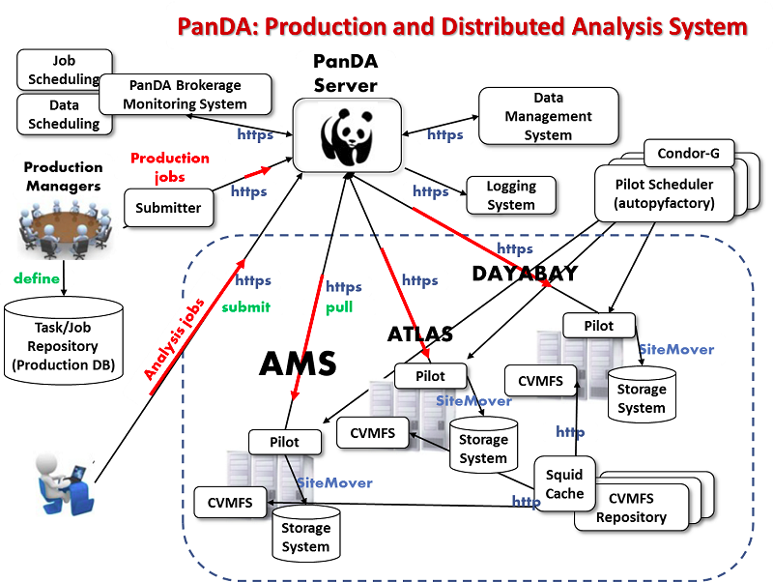
PanDA diagram

Slide 15
PanDA Server
PanDA server design
  Apache-based
  Communication via HTTP/HTTPs
  Multi-process
  Global info in the memory resident database
Apache
Child process
DB
MySQL API
Client
HTTP/HTTPS
Python interpreter
Python interpreter
DQ2

Slide 16
PanDA Client
PanDA client
  Pickle module of python and native curl.
  Client require python 2.3 or higher, curl and grid-proxy
  Simple, light-weight.
PanDA
UserIF
Client
Request
(HTTPS)
Pyhon
Obj
Serialize
(cPlckle)
mod_python
Pyhon
Obj
deserialize
(cPlckle)
mod_deflate
Pyhon
Obj
Response
(HTTPS)

Slide 17
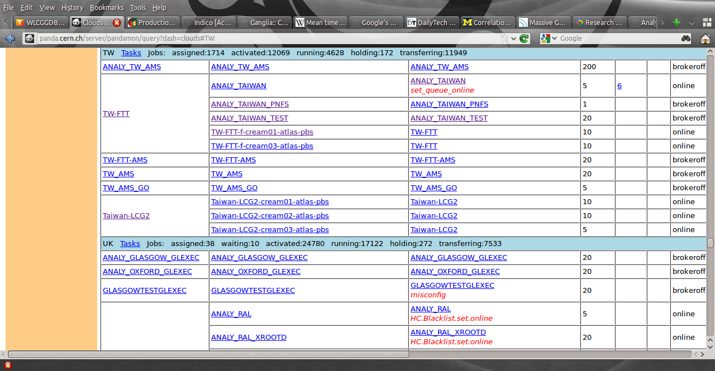
PanDA screen shot

