Slide 1
Scientific Data Analysis Pipelines -
Push, Pull, React, Or Schedule?
Ami Tavory
Final, Israel
SciPy.in 2012 PyConTW 2013

Slide 2
Outline
Introduction
Usage Consideration
Available Language Constructs
Push, Pull, React, Or Schedule?
DagPype – A Push-Based Solution
Conclusions

Slide 3
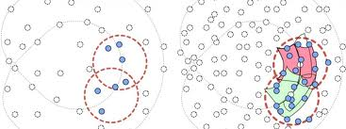
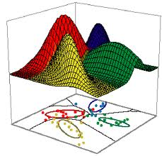
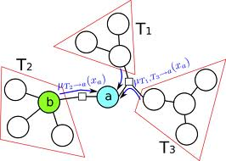
Complementing
Existing Python Scientific Libraries
Once data is assembled, existing Python Scientific libraries are great
  numpy/scipy, pandas, scikit-learn, mayavi, many more
Data-analysis processes include several complementary tasks:
  Data assembly (ugly-format files, outliers, etc.)
  Extremely quick preliminary analysis
  Huge-data aggregation (from simple correlation to complex stream algs)

Slide 4
Complementary Tasks:
Examples And Attributes
Examples of common tasks:
  Find the correlation of the (transformed) content of two files, excluding outliers
wind.dat
rain.dat
10.2
11.2
9.1
8.3
840.88
12
13.4
...
0.2
0.14
11.4
0
0.23
1.2
0.01
...
correlation: 0.23

Slide 5
Complementary Tasks:
Examples And Attributes
Examples of common tasks:
  Find the correlation of the contents of two files, excluding outliers
  Aggregate similar-row CSV columns
meteo.csv
day,wind,rain,snow
1,10.2,3.8.4.7
1, 12.2,4.8
1,10.7,6.7
1,9.7,5.2
2,10.4,8.77
2,9,6.2
...
[9.97,10,...]

Slide 6
Complementary Tasks:
Examples And Attributes
Examples of common tasks:
  Find the correlation of the contents of two files, excluding outliers
  Aggregate similar-row CSV columns
Common attributes:
  Complex & flexible combination of relatively simple steps
  (Existing libraries focus on complex steps)

Slide 7
Pipes
Pipes are natural for expressing multiple stage connections.
  This is how we use the shell:
$ cat | grep | wc

Slide 8
Pipes
Pipes are natural for expressing multiple stage connections.
Previous two examples, using extended pipeline syntax:
Valid Python expressions – can be used in scripts or even a(n IronPython) prompt.
>> wind_rain_corr = stream_vals('wind.txt') + stream_vals('rain.txt') | \
... filt(pre = lambda (wind, rain) : wind < 10 and rain < 10) | \
... corr()
>> day_wind = stream_vals('meteo.csv', ('day, 'wind')) | \
... group( \
... key = lambda (day, wind, rain, snow) : day,
... pipe = lambda day : ave_()) | \
... to_array()

Slide 9
Plenty Of Reusable Stages
IO
stream_lines (text), stream_vals (csv),
parse_xml (xml),
to_stream (text), vals_to_stream (csv),
np.chunk_stream_vals (csv, numpy), ...
Control
filt, skip, nth, cast, count,
to_list, to_dict, np.to_array,
size_rand_sample, prob_rand_sample
select_inds, grep, trace
Aggregates
min_,max_, sum, count,mean,
stddev, corr, kurtosis
Signal Processing
window_simple_ave, cum_ave, exp_ave,
window_min, window_max, window_quantile
...
Econometrics
...
Plotting
...

Slide 10
Underlying Mechanism?
Which underlying mechanism should drive the pipes?
  David Beazly (Pycon 08, 09)
Focus of this talk
We will:
  Look at usage considerations
  Review available language constructs
  See, using these points, why a coroutine push-based solution is necessary

Slide 11
Outline
Introduction
Usage Consideration
Available Language Constructs
Push, Pull, React, Or Schedule?
DAGPype – A Push-Based Solution
Conclusions

Slide 12
Footprint
Typical data sets can be huge.
Each stage should be able to process the data in chunks, not necessarily its entirely.
Memory use should be proportional to the size of the chunks, not the size of the original dataset.
  First example (correlation): constant

Slide 13
Footprint
Typical data sets can be huge.
Each stage should be able to process the data in chunks, not necessarily its entirely.
Memory use should be proportional to the size of the chunks, not the size of the original dataset.
  First example (correlation): constant
  Second example (grouping): proportional to the number of days.

Slide 14
Topolgy -
DAGs (Directed Acyclic Graphs)
Traditional pipelining is linear:
  Each stage is fed by at most one stage, and feeds at most one stage.
Data-processing pipelines need more expressiveness.
  Fanning in, fanning out
In general, a DAG (directed acyclic graph) topology is needed.
cat
grep
wc
stream_vals
stream_vals
stream_vals
mean
corr
stream_vals
corr
stream_vals
stddev
source0() + (source1() | filt0()) | \
filt1() | \
sink0() + sink1() + (filt2() | sink2())

Slide 15
Python Interoperability
Pipelines are natural for expressing some things, not all
  Loops, conditionals, functions, classes
Pipes should work with the rest of the language
means = [ stream_vals('%d_data.dat' %i) | mean() for i in xrange(10)]

Slide 16
Relay / Processing Ratio
Python pipelines used for many tasks, e.g., web servers
  Typically have low relay / processing ratio
Conversely, stages here typically take a few floats, do some operations, send them on.
Relay should be direct & efficient
accept_conn
accept_request
authenticate
assemble
reply
IO
stream_lines (text), stream_vals (csv),
parse_xml,
to_stream (text), vals_to_stream (csv),
np.chunk_stream_vals (csv, numpy), ...
Control
filt, skip, nth, cast, count,
to_list, to_dict, np.to_array,
size_rand_sample, prob_rand_sample
select_inds, grep, trace
Aggregates
min_,max_, sum, count,mean,
stddev, corr, kurtosis
Signal Processing
window_simple_ave, cum_ave, exp_ave,
window_min, window_max, window_quantile
Econometrics
...

Slide 17
Stage State And Synchronization
In general, we must assume that processing stages are stateful...
and unsyncrhonized
wind_rain_corr = stream_vals('meteo.csv', ('wind', 'rain')) | corr()
(x, y)
corr
{n, sum_xtx, sum_xty, sum_yty}
stream_vals('meteo.csv', 'rain') | relay() + skip(5) | corr()

Slide 18
Outline
Introduction
Usage Consideration
Available Language Constructs
Push, Pull, React, Or Schedule?
DagPype – A Push-Based Solution
Conclusions

Slide 19
Starting Point - Statefulness
As we saw, when stages process elements, they change state
Which stateful mechanisms does Python offer?

Slide 20
Class Objects - React
Classic OO:
  State stored in objects
  Objects react through methods
1 class Klass(object):
2 def __init__(self, …):
3 ... [Store initial state] ...
4
5 def method(self, ...):
6 ... [Update state] ...
7
8 def another_method(self, ...):
9 ... [Update state] ...

Slide 21
Generators - Pull
Writing style sequential, but execution not
Example: transform a sequence of numbers to a their cumulative sum.
  [1, 2, 3, 4] → [1, 3, 6, 10]
1 def gen(some_sequence, ...):
2 ... [set initial state] ...
3 for e in some_sequence:
4 ... [update state ...]
5 yield .. [something depending on s] ...
like calling a function
like returning a value … but not quite
1 def cum_sum(seq):
2 sum_ = 0
3 for e in seq:
4 sum_ += e
5 yield sum

Slide 22
Coroutines - Push
Again, writing style sequential, but execution not
Same example:
1 def co(target, ...):
2 ... [set initial state] ...
3 try:
4 while True:
5 e = (yield)
6 target.send(...[something]...)
7 except GeneratorExit:
8 ... [send something] ...
9 target.close()
like being called … but not quite
like calling a function
1 def cum_sum(target):
2 sum = 0
3 try:
4 while True:
5 e = (yield)
6 sum_ += e
7 target.send(sum_)
8 except GeneratorExit:
9 target.close()

Slide 23
Trampoline-Function Coroutines - Schedule
Using coroutines yielding functions, it's possible to build a full-blown scheduler.
Won't go into it.

Slide 24
Outline
Introduction
Usage Consideration
Available Language Constructs
Push, Pull, React, Or Schedule?
DagPype – A Push-Based Solution
Conclusions

Slide 25
React-Style Stages
A simple absolute-value stage:
  [1, -2, -3, 4] → [1, 2, 3, 4]
needs to be set somewhere
1 class Abs(object):
2 def __init__(self):
3 self._has_val = False
4
5 def push(self, e):
6 self._has_val = True
7 self._val = abs(e)
8
9 def close(self):
10 pass
11
12 def has_value(self):
13 return self._has_val
14
15 def value(self):
16 assert self._has_val
17 self._has_val = False
18 return self._val
push a value, update one exists
some stages perform after-close ops
stages can be unsynchronized
get a value (assuming one exists)

Slide 26
React-Style Stages
A simple absolute-value stage:
Tremendous overhead:
  Code SNR, Runtime
1 class Abs(object):
2 def __init__(self):
3 self._has_val = False
4
5 def push(self, e):
6 self._has_val = True
7 self._val = abs(e)
8
9 def close(self):
10 pass
11
12 def has_value(self):
13 return self._has_val
14
15 def value(self):
16 assert self._has_val
17 self._has_val = False
18 return self._val

Slide 27
Pull-Style Stages
A simple absolute-value stage:
1 @pipe
2 def abs(seq):
3 for e in seq:
4 yield abs(e)

Slide 28
Advantages Of Pull-Style Stages
Simplicity, low overhead
@pipe
def abs(seq):
for e in seq:
yield abs(e)

Slide 29
Advantages Of Pull-Style Stages
Simplicity, low overhead
“Free” left associativity
stream_vals('foo.dat') | abs_() | mean()
1 @pipe
2 def abs_(seq):
3 for e in seq:
4 yield abs(e)

Slide 30
Major Disadvantages Of
Pull-Style Stages
No efficient fan-out
  Requires memory loading entire stream
Implication – no composable aggregates
Inherent nature of generators
mean
stream_vals
stddev
for e in seq:
... [do something] ...
stage1
stage0
stage2
stage1
stage0
make copies
stage2

Slide 31
Push-Style Stages
A simple absolute-value stage:
1 @filter
2 def abs(target):
3 try:
4 while True:
5 target.send(abs((yield)))
6 except GeneratorExit:
7 target.close()

Slide 32
Assessment Of Push-Style Stages
Clarity and overhead slightly less than pull, but much better than react
Natural associativity is right, not left
stream_vals('foo.dat') | abs_() | mean()
1 @filter
2 def abs(target):
3 try:
4 while True:
5 target.send(abs((yield)))
6 except GeneratorExit:
7 target.close()

Slide 33
Assessment Of Push-Style Stages
Clarity and overhead slightly less than pull, but much better than react
Natural associativity is right, not left
Slightly unnatural fan-in
stream_vals
stream_vals
stage0
stage2
stage1
1 def stage2(target)
2 try:
3 while True:
4 x, y = (yield)
5 ...
6 except GeneratorExit:
7 ...
8 target.close()

Slide 34
Outline
Introduction
Usage Consideration
Available Language Constructs
Push, Pull, React, Or Schedule?
DAGPype – A Push-Based Solution
  Some Design Points
  Examples & Performance
Conclusions

Slide 35
Lazy Construction
LTR / RTL discrepancy solution
During pipeline construction, objects store pipes and fans recursively as lists and tuples.
source0() + (source1() | filt0()) | \
Filt1() | \
sink0() + sink1() + (filt2() | sink2())
[source0]
[source1]
[filt0]

Slide 36
Lazy Construction
LTR / RTL discrepancy solution
During pipeline construction, objects store pipes and fans recursively as lists and tuples.
source0() + (source1() | filt0()) | \
Filt1() | \
sink0() + sink1() + (filt2() | sink2())
[source0]
[source1]
[source1, filt0]

Slide 37
Lazy Construction
LTR / RTL discrepancy solution
During pipeline construction, objects store pipes and fans recursively as lists and tuples.
source0() + (source1() | filt0()) | \
Filt1() | \
sink0() + sink1() + (filt2() | sink2())
[(source0, [source1, filt0])]

Slide 38
Lazy Construction
LTR / RTL discrepancy solution
During pipeline construction, object store pipes and fans recursively as lists and tuples.
Source->sink connections trigger actual calculations.
source0() + (source1() | filt0()) | \
Filt1() | \
sink0() + sink1() + (filt2() | sink2())
[source0]
[(source0, [source1, filt0]]), filt1, (sink0, sink1, [filt2, sink2])]

Slide 39
Fanning Out And In
Fanning out:
stage1
stage0
stage2
stage0 | stage1 + stage2
1 def stage0(target):
2 while True:
3 e = (yield)
4 target.send( fn(e) )

Slide 40
Fanning Out And In
Fanning out:
stage1
stage0
stage2
stage1
stage0
demultiplexer
stage2
1 def _demux(*targets):
2 …
3 while True:
4 e = (yield)
5 for t in *targets:
6 t.send(e)

Slide 41
Fanning Out And In
Fanning out:
Fanning in:
stage1
stage0
stage2
stage0
stage2
stage1
1 def stage2(target):
2 …
3 while True:
4 x, y = (yield)

Slide 42
Fanning Out And In
Fanning out:
Fanning in:
stage1
stage0
stage2
stream_vals
stream_vals
stage0
id0
queuer
stage2
stage1
id1
1 def _id(target, id):
2 …
3 while True:
4 target.send( (id, (yield)) )

Slide 43
Fanning Out And In
Fanning out:
Fanning in:
stage1
stage0
stage2
stream_vals
stream_vals
stage0
id0
queuer
stage2
stage1
id1
queue0
e
(0, e)
queue1
(e0, e1)

Slide 44
Outline
Introduction
Usage Consideration
Available Language Constructs
Push, Pull, React, Or Schedule?
DagPype – A Push-Based Solution
  Some Design Points
  Examples & Performance
Conclusions

Slide 45
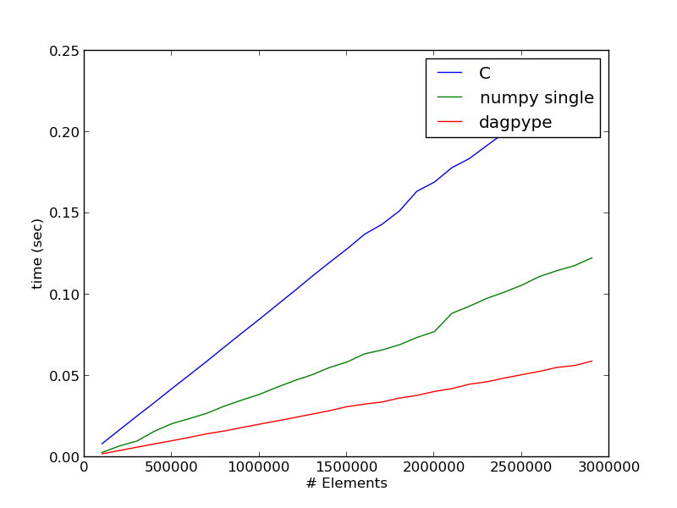
Performance -
Binary File Correlation
c = np.chunk_stream_bytes('foo.dat', num_cols = 2) | np.corr()

Slide 46
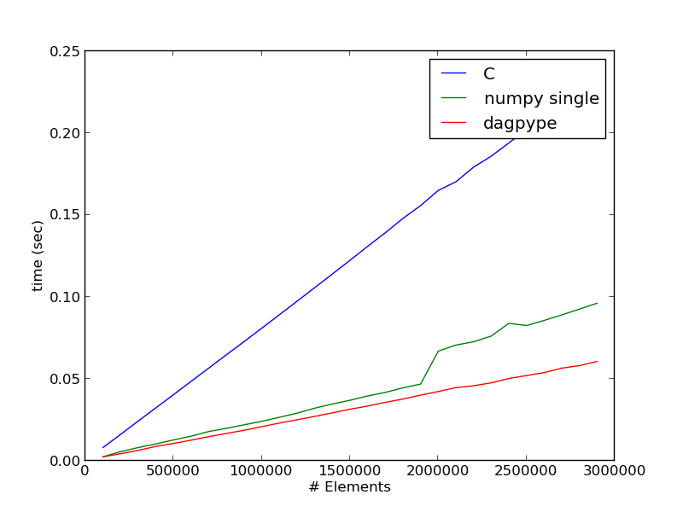
Performance -
Pruned Binary File Correlation
c = np.chunk_stream_bytes('foo.csv', num_cols = 2) | \
filt(lambda a : a[numpy.logical_and(a[:, 0] < 0.25, a[:, 1] < 0.25), :]) | \
np.corr()

Slide 47
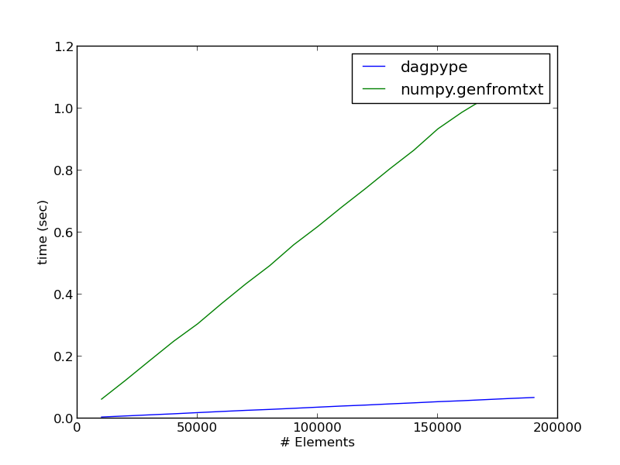
Performance -
CSV File Mean
np.chunk_stream_vals('foo.csv', '0') | np.mean()

Slide 48
Outline
Introduction
Usage Consideration
Available Language Constructs
Push, Pull, React, Or Schedule?
DagPype – A Push-Based Solution
Conclusions

Slide 49
Main Points Covered
(Python) pipelines can complement existing great Python libraries and tools
  A large fraction of (at least my) time is spent
    trying to figure out what to learn ...
    out of horrible (noisy) data ...
    in terrible formats

Slide 50
Main Points Covered
(Python) pipelines can complement existing great Python libraries and tools
Push-based coroutines are the way to implement them in Python
https://pypi.python.org/pypi/DAGPype/

Slide 51
Points Not Covered
Chunk granularity
Parallelism
Operations beyond DAG-pipelines' expressiveness

Slide 52

Thanks!
Thank you for your time!

