Slide 1
Getting Python To Learn From
Only Parts Of Your Data
Ami Tavory
Final, Israel
PyConTW 2013

Slide 2
Outline
Introduction
Model Selection And Cross Validation
Model Assessment And The Bootstrap
Conclusions

Slide 3


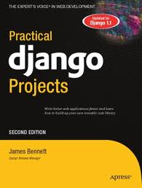
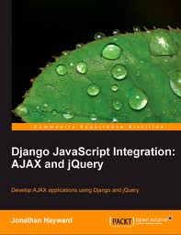
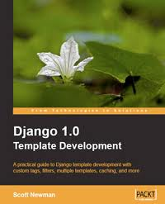
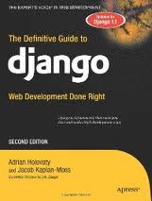
Prevalence Of Computing & Python -
Two Implications
General computing:
  Tasks & calculations unlimited by human limitations
Python (& high-level languages):
  Low bar for new-area experimentation
In the context of scientific Python: a challenge and an opportunity
As time goes by...

Slide 4
Low Bar For Experimentation &
Model Selection
Web developer exa\mple
Site revenues:
Revenues seem inverse to clicks-to-purchase & page load time.
Can we quantify using SciPy?
  Polyfit? linear regression (unconstrained, ridge, lasso, elastic net, total),
  random forests? etc.
Clicks To Purchase | Page Load Time (secs.) | Daily Revenue (K $)
3 | 1 | 20
2 | 0.2 | 400
3 | 0.4 | 40
2 | 0.1 | 500
10 | 2 | 2

Slide 5

Computing Power &
Model Assessment
(Another web developer example)
“The XYZ framework processes requests in under 2.5 msec”
Transaction processing time (msecs.):
Without computers, we have classical statistics:
  With high probability, the mean is between 1.89 and 4.63.
No need for low-computation statistics.
  We can, e.g., assess the median and its confidence.
1.71 | 2.55 | 12.23 | 3.42 | 2.58 | 0.03 | 2.46 | 0.01
2.56 | 1.17 | 1.46 | 1.22 | 1.51 | 3.6 | 1.9 | 23.99
1.12 | 2.73 | 2.21 | 1.81 | 2.22 | 2.73 | 2.63 | 8.13
2.23 | 0.00 | 2.0 | 2.34 | 3.2 | 1.9 | 3.4

Slide 6
This Talk
Two problems, common solution:
  Getting Python To Learn From
  Only Parts Of Your Data
Talk will use:
  no math
  short NumPy / SciPy / SciKits snippets

Slide 7
Outline
Introduction
Model Selection And Cross Validation
Model Assessment And The Bootstrap
Conclusions

Slide 8
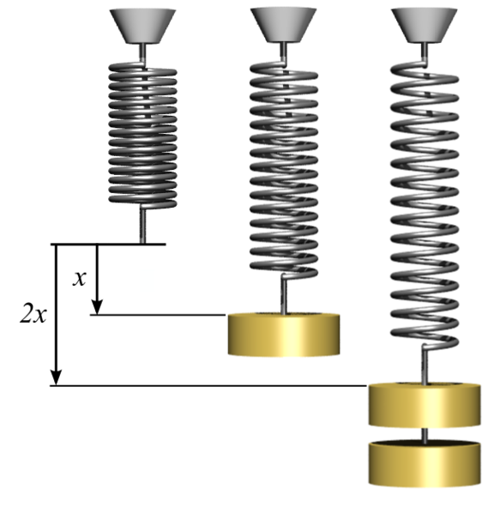
Example Domain – Hooke's Law
Basic experiment with springs.
Hooke's Law (Force proportional to displacement)
  F ~ x (F = force, x = displacement)
>>> from numpy import *
>>> from scipy import *
>>> from matplotlib.pyplot import *
>>>
>>> # measure 8 displacements
>>> x = arange(1, 8)
>>> # note measurement errors
>>> F = x + 3 * random.randn(8)
>>>
>>> plot(x, F, 'bo', label = 'Experimental')
[<matplotlib.lines.Line2D object at 0x31c5f90>]
>>> show()

Slide 9
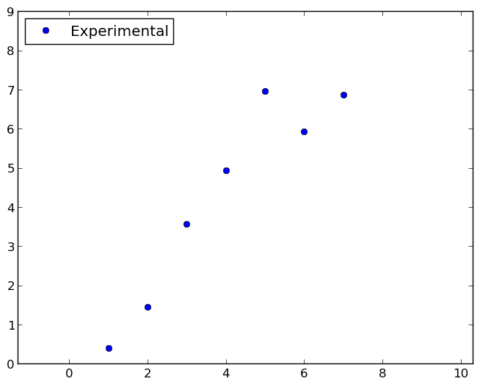
Example Domain – Hooke's Law –
Experiment Results
F
x

Slide 10
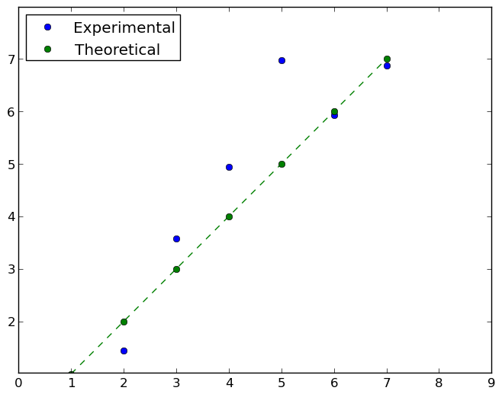
Example Domain – Hooke's Law –
Experiment & Theoretical Results
F
F = x
x

Slide 11
Example Predictor – Polynomial Fitting
Polynomial fit (scipy.polyfit)
>>> help(polyfit)
polyfit(x, y, deg)
Least squares polynomial fit.
Fit a polynomial ``p(x) = p[0] * x**deg + ... + p[deg]`` of degree `deg`
to points `(x, y)`. Returns a vector of coefficients `p` that minimises
the squared error.

Slide 12
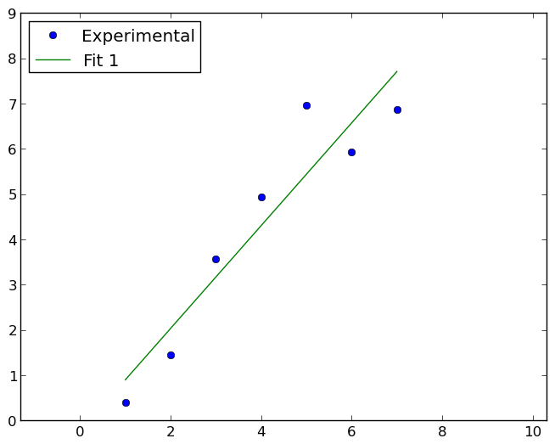
Example Predictor – Polynomial Fitting Applied
Polynomial fit (scipy.polyfit)
>>> x = arange(1, 8)
>>> F = x + 3 * random.randn(8)
>>> # Fit the data to a straight line.
>>> print polyfit(x, F, 1)
>>> [ 1.13 -0.23]
>>> # F ~ 1.13 * x – 0.23

Slide 13
The Problem – Which Model?
Polynomial fit (scipy.polyfit)
>>> x = arange(1, 8)
>>> F = x + 3 * random.randn(8)
>>> # Fit the data to a straight line.
>>> print polyfit(x, F, 1)
>>> [ 1.13 -0.23]
>>> # F ~ 1.13 * x – 0.23
Cheating!
What Types Of Problems Are We Considering?
Find model relating # clicks + load time / revenue

Slide 14
The Problem – Alternatives?
Polynomial fit (scipy.polyfit)
>>> x = arange(1, 8)
>>> F = x + 3 * random.randn(8)
>>> # Fit the data to a straight line.
>>> print polyfit(x, F, 1)
>>> [ 1.13 -0.23]
>>> # F ~ 1.13 * x – 0.23
>>> x = arange(1, 8)
>>> F = x + 3 * random.randn(8)
>>> # Fit the data to a parabola.
>>> print polyfit(x, F, 2)
>>> [-0.18 2.56 -2.38]
>>> # F ~ -0.18 * x^2 + 2.56 * x – 2.38 * x

Slide 15
The Problem – Alternatives In Depth – Straight Line
F
x

Slide 16
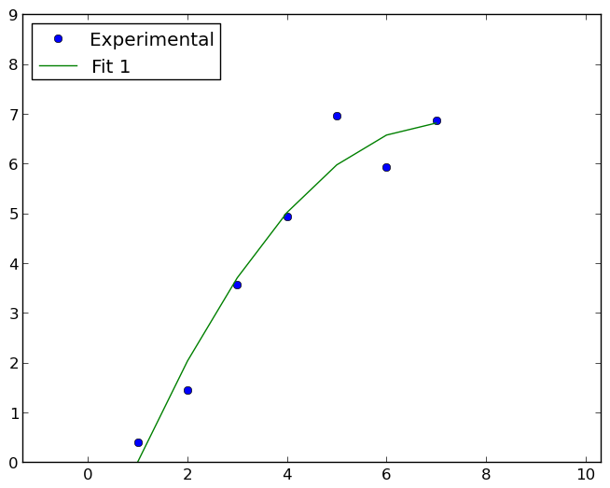
The Problem – Alternatives In Depth – Parabola
F
x

Slide 17
The Problem – Alternatives Comparison

Slide 18
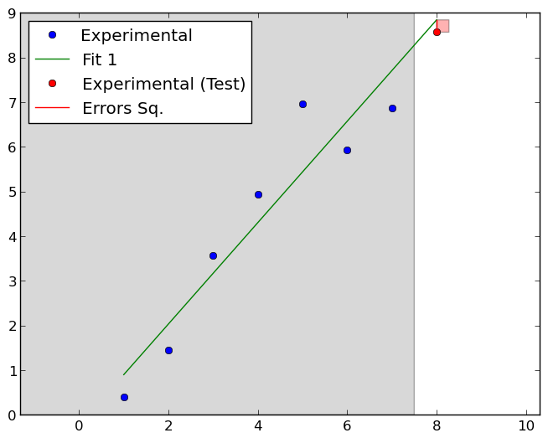
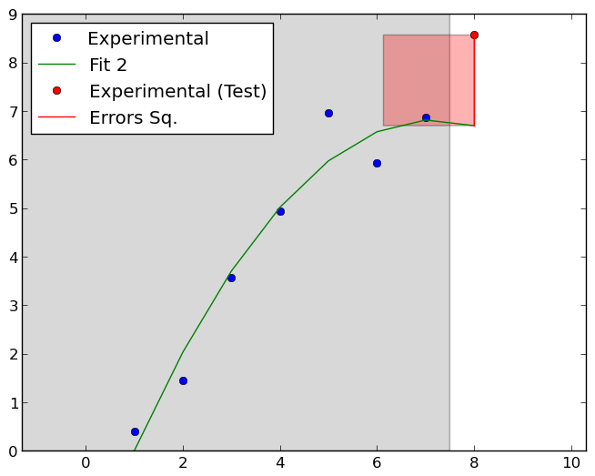
The Problem – Alternatives Comparison

Slide 19
The Problem – Alternatives Comparison

Slide 20

The Solution – Observation
Getting Python To Learn Fron
Only Parts Of Your Data
To assess models,
treat some of the train data as test data

Slide 21
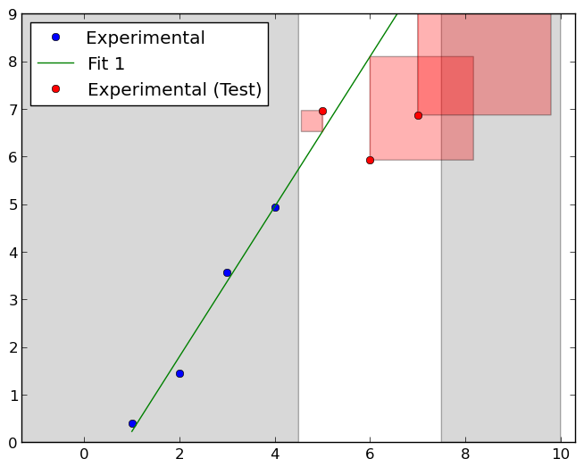
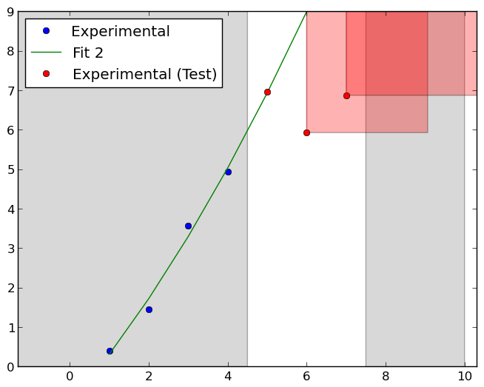
The Solution – Cross Validation

Slide 22
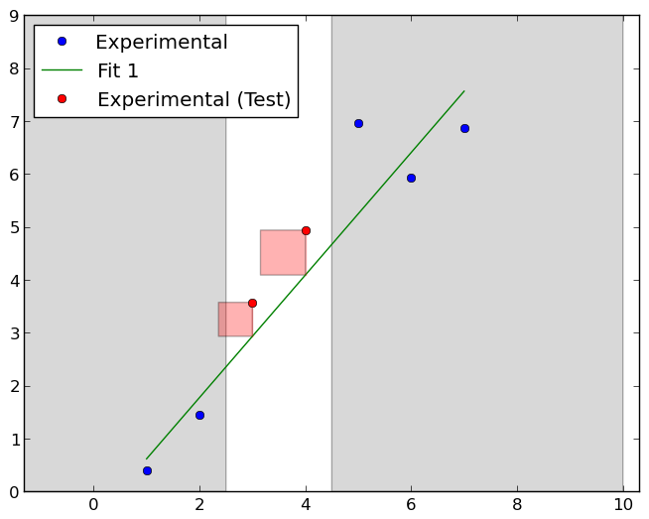
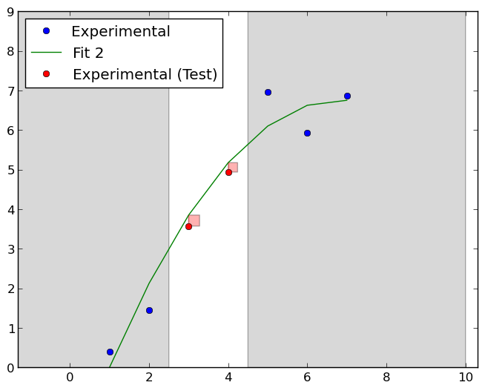
The Solution – Cross Validation

Slide 23
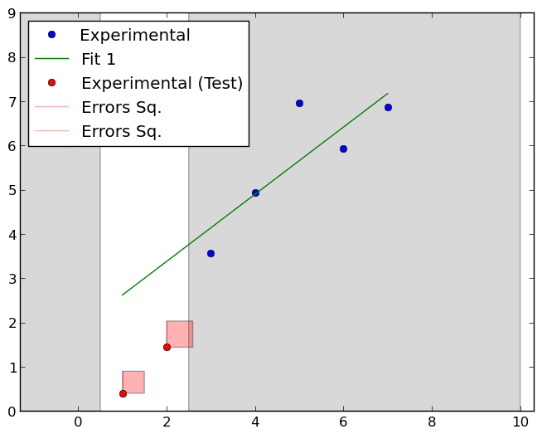
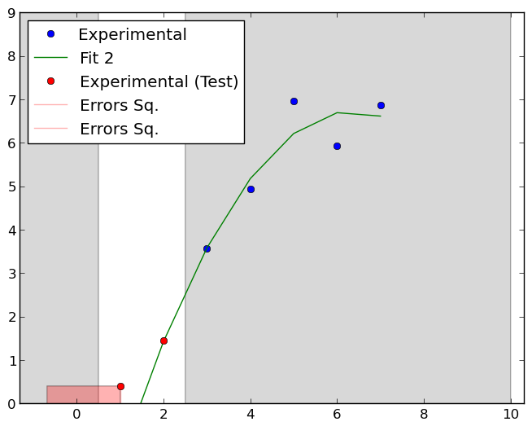
The Solution – Cross Validation

Slide 24
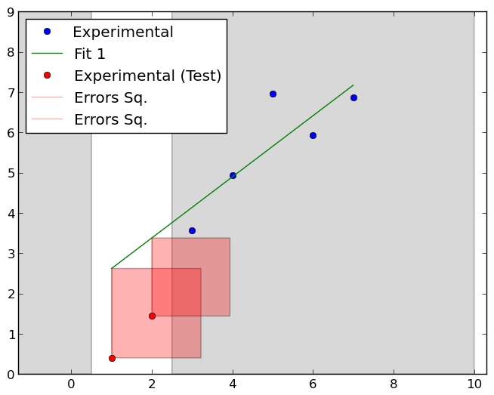
The Solution – Cross Validation
On average,
the linear model has lower error than the parabolic model

Slide 25
Let's See It In Code...
>>> from sklearn.cross_validation import *
>>>
>>> for tr, te in KFold(8):
... print tr, te
...
[0 1 2 3 4] [5 6 7]
[0 1 4 5 6 7] [2 3]
[2 3 4 5 6 7] [0 1]
>>>
>>> Assume:
>>> # build_model(train_x, train_F) builds a model from train_x, train_F
>>> # find_err(model, test_x, test_F) evaluates model on test_x, test_F
>>>
>>> err = 0
>>> for tr, te in KFold(8):
... m = build_model(x[tr], F[tr])
... err += find_err(m, x[te], F[te])

Slide 26
Outline
Introduction
Model Selection And Cross Validation
Model Assessment And The Bootstrap
Conclusions

Slide 27
Example Domain – Processing Time
Transaction processing time (msecs.) of XYZ:
What is the “typical” processing time?
>>> t = [1.71, 2.55, 12.23, 3.42, 2.58, 0.03, 2.46, 0.01, 2.56, 1.17, 1.46, 1.22, 1.51, 3.6, 1.9, 23.99, 1.12, 2.73, 2.21, 1.81, 2.22, 2.73, 2.63, 8.13, 2.23, 0.00, 2.0, 2.34, 3.2, 1.9, 3.4]

Slide 28
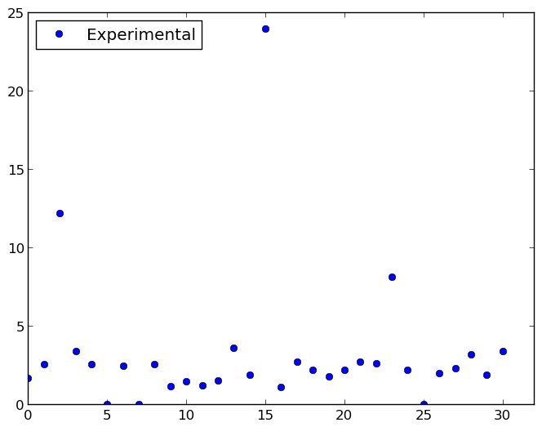
Example Domain – Processing Time

Slide 29
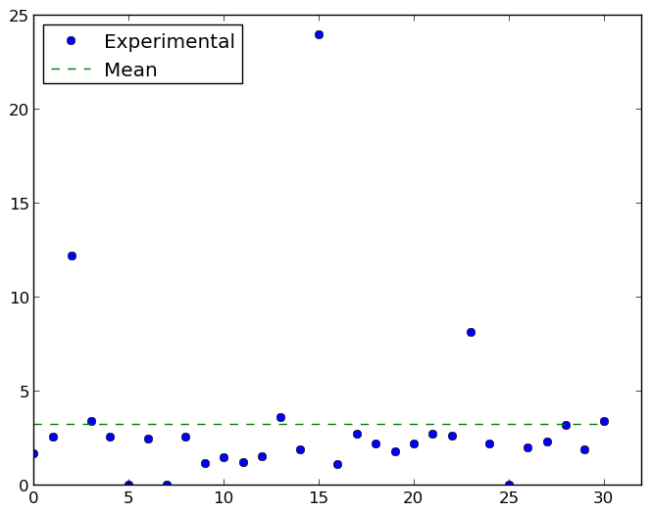
Example Domain And Model - Mean
The mean is 3.25 with confidence interval 0.7
But what about outliers?

Slide 30
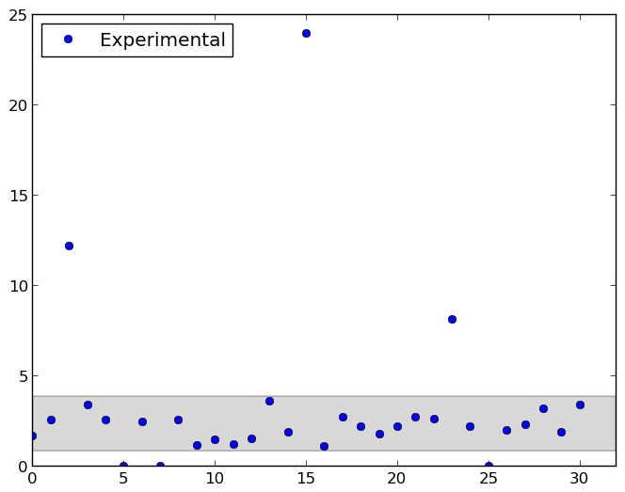
Example Domain And Model – Trimmed Mean

Slide 31
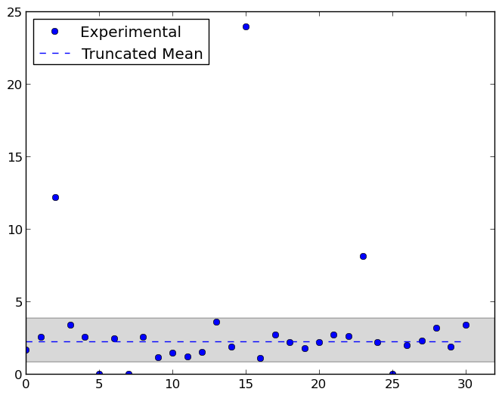
Example Domain And Model – Trimmed Mean

Slide 32
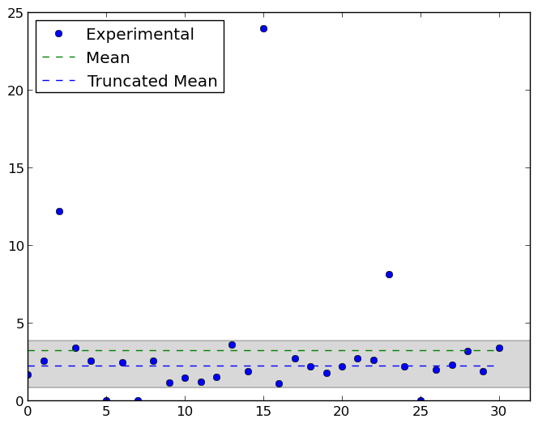
The Problem – Model Assessment
The trimmed mean is 2.27
But what is the confidence interval?

Slide 33
The Problem – Model Assessment
12.23
2.21
2.27
1.71
2.56
1.46
3.42
2.22
8.13
2.73
2.55
1.17
1.22
2.58
0.03
3.6
1.51
0.00
23.99
2.46
3.2
0.01
1.9
1.9
2.63
2.46
2.23
2.73
3.4
2.0
1.12
2.34
1.81

Slide 34
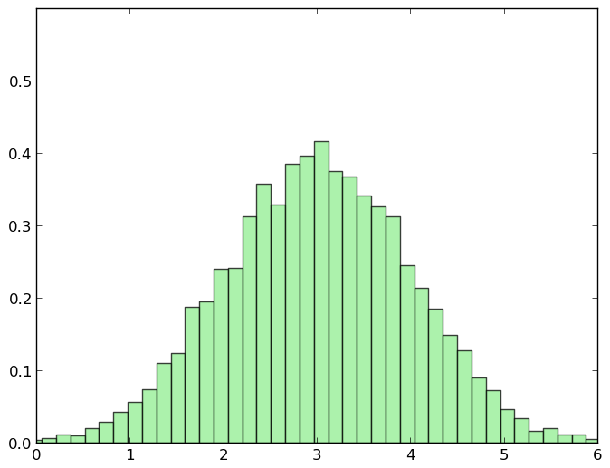
The Problem – Model Assessment
2.27

Slide 35
The Solution – Observation
12.23
2.21
2.27
1.71
2.56
1.46
3.42
Getting Python To Learn Fron
Only Parts Of Your Data
Create new datasets by random
Sampling (with replacement)
2.22
8.13
2.73
2.55
1.17
1.22
2.58
0.03
3.6
1.51
0.00
23.99
2.46
3.2
0.01
1.9
1.9
2.63
2.46
2.23
2.73
3.4
2.0
1.12
2.34
1.81

Slide 36
The Solution – Bootstrapping
12.23
2.21
2.27
1.71
2.56
1.46
3.42
2.22
8.13
2.73
2.55
1.17
1.22
2.58
0.03
3.6
1.51
0.00
23.99
23.99
2.46
3.2
0.01
1.9
1.9
2.63
2.46
2.34
2.23
3.4
2.58
2.73
3.4
2.0
1.12
2.58
2.34
1.81
2.73
2.56
1.51
2.46
1.81
1.51
1.12
12.23
1.9
12.23
1.51
3.6
23.99
1.51
2.56
2.56
2.58
3.2
3.6

Slide 37
The Solution – Bootstrapping
12.23
2.21
2.27
1.71
2.56
1.46
3.42
2.22
8.13
2.73
2.55
1.17
1.22
2.58
0.03
3.6
1.51
0.00
23.99
2.46
3.2
0.01
1.9
1.9
2.63
2.46
2.23
2.73
3.4
2.0
1.12
2.34
1.81

Slide 38
The Solution – Bootstrapping
2.27

Slide 39
Let's See It In Code...
>>> from scipy.stats.mstats import *
>>> from scikits.bootstrap.bootstrap import *
>>>
>>> t = [1.71, 2.55, 12.23, 3.42, 2.58, 0.03, 2.46, 0.01, 2.56, 1.17, 1.46, 1.22, 1.51, 3.6, 1.9, 23.99, 1.12, 2.73, 2.21, 1.81, 2.22, 2.73, 2.63, 8.13, 2.23, 0.00, 2.0, 2.34, 3.2, 1.9, 3.4]
>>>
>>> print mean(t), trimmed_mean(t)
3.25967741935 2.2664
>>>
>>> print ci(t, trimmed_mean)
[ 1.7604 3.2816]

Slide 40
Outline
Introduction
Model Selection And Cross Validation
Model Assessment And The Bootstrap
Conclusions

Slide 41
Conclusions
Computers & Python availability implies that:
  We are faced with varied, configurable prediction techniques
  We are unconstrained by pen-and-paper-only statistical methods
We can use Python's scientific libraries to address this:
  Cross validation
  Bootstrapping

Slide 42

Thanks!
Thank you for your time!

