Slide 1
The Life of an Ubuntu Developer
A Brief Introduction of Launchpad
Shawn Wang <shawn111@gmail.com>
PyCon TW 2013

Slide 2
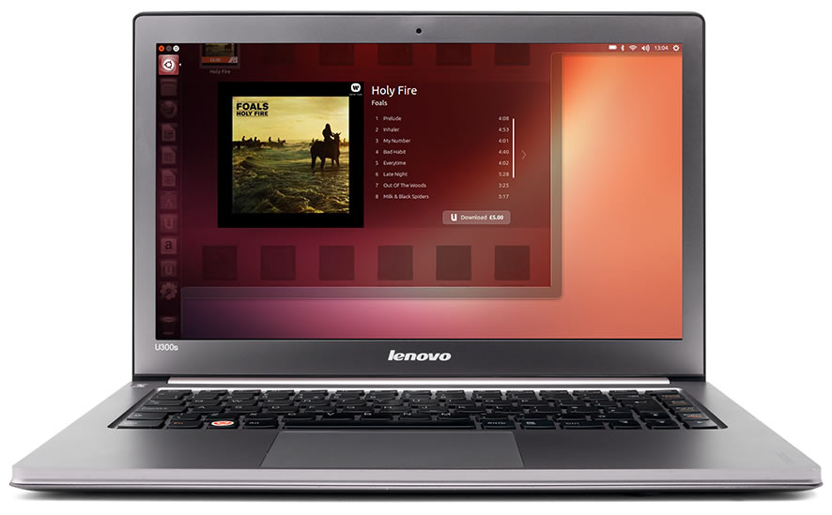
About me
Join Canonical on July 2012
Major Tasks
  Hardware Enablement
  Package Maintain
KaLUG/H4/TOSSUG

Slide 3
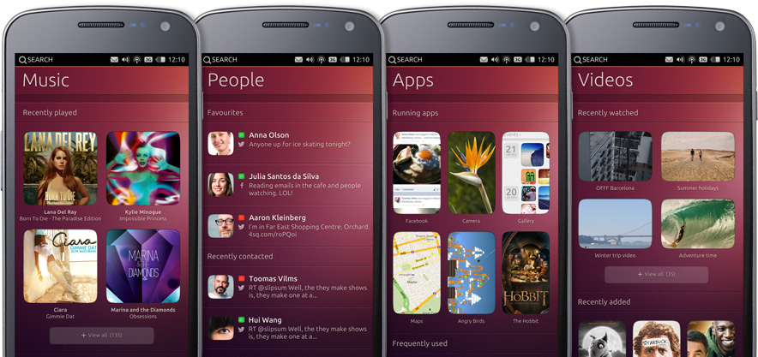
What is Next Ubuntu
Next LTS 14.04
  only Python 3(plan)
New Display Server- MIR
  Replace X
  Ubuntu Touch (13.04) is based on Android SurfaceFlinger
Next Unity- Switch to Qt/QML
  Support platforms
    PC/ phone /table

Slide 4
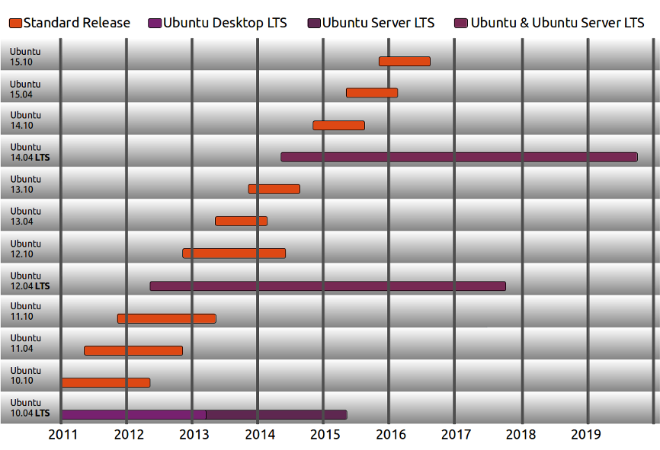
Ubuntu Release Schedule
6 months → new release
2 years → LTS release (backports)

Slide 5
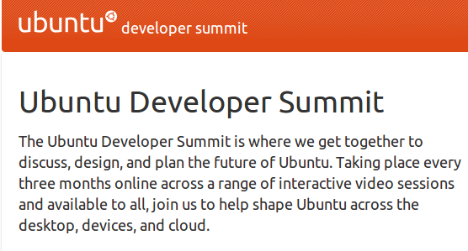
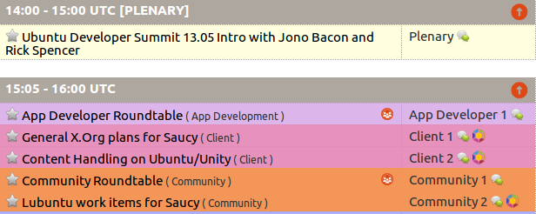
ubuntu developer summit
http://uds.ubuntu.com/
virtual UDS
  Google hangout/ youtube
  Blueprint on launchpad
    https://blueprints.launchpad.net/ubuntu/saucy/+specs

Slide 6
Why use bzr/lp? Why not git/github?
All are made by Canonical
Workflow
  Code/Package/Issue/Project
ppa (Personal Package Archive)
Apport
bzr / lp are based on python

Slide 7
Launchpad
a set of Web services to help software developers collaborate.https://launchpad.net
  Source control services
  Translation services
  Bug tracking
  Task management
  Answers/FAQ functionality
Launchpad Help- https://help.launchpad.net/
License: Affero GPL

Slide 8
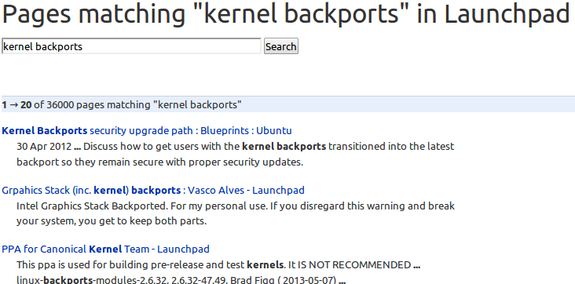
Install some package from ppa
Search package name from lp s-lts-backport
$ sudo add-apt-repository ppa:ubuntu-x-swat/s-lts-backport

Slide 9
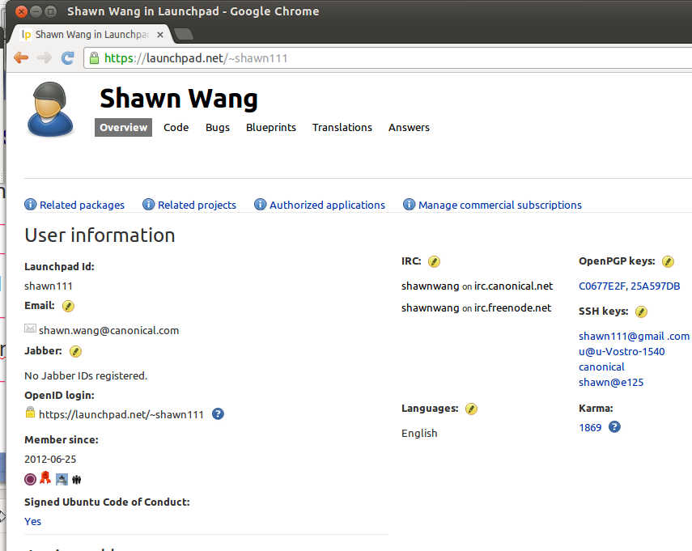
Personal launchpad home page
Launchpad Id
  Launchpad Login Service utilizing OpenID
  login.ubuntu.com
SSH public keys
  Upload/bzr
OpenPGP keys
  package

Slide 10
Importing Your PGP Key
Creating your OpenPGP keys with gpg
  $ gpg –gen-key
List your OpenPGP keys
  gpg --list- keys
  gpg --fingerprint
export your public key to a key server
  $ gpg --keyserver keyserver.ubuntu.com --send-keys 12345678
Upload fingerprint to lp OpenPGP keys page

Slide 11
Shell Variable
export NAME="Shawn Wang <shawn.wang@canonical.com>"
export DEBFULLNAME="Shawn Wang"
export DEBEMAIL="shawn.wang@canonical.com"
export GPGKEY=25A597DB
export QUILT_PATCHES=debian/patches

Slide 12
Personal Code Branch
Get this branch:
  bzr branch lp:~shawn111/+junk/xxx
Update this branch:
  bzr branch lp:~shawn111/+junk/xxx
Branch from other project:
  lp:~shawn111/libchewing/ibus-chewing

Slide 13
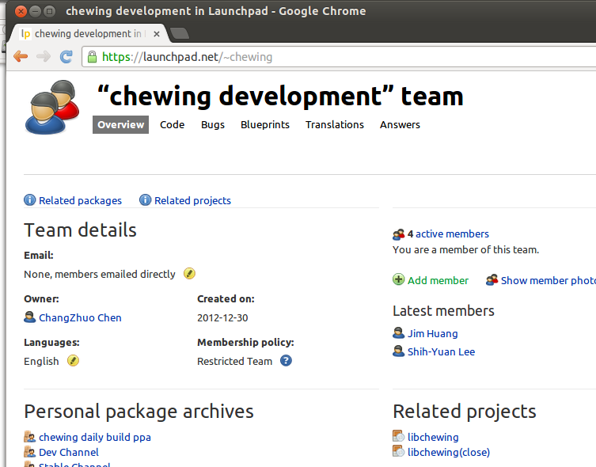
Team Page
Mailing list
Team members
Projects

Slide 14
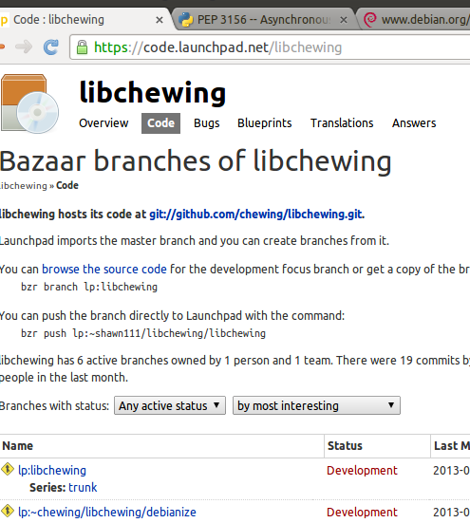
Project Page
Blueprints+spec/client-1303-mir-galaxynexus
Series and milestones
Answers +question/227499
Code
No PPA

Slide 15
Personal Package Archives
Advantage
  Multi-platform- arch(i386/amd64/..) & series(Precise/Raring/..)
  daily build & unit test
Activating a PPA
Uploading packages to PPA
  dput ppa:shawn111/test <source.changes>
Adding this PPA to your system
  sudo add-apt-repository ppa:shawn111/test

Slide 16
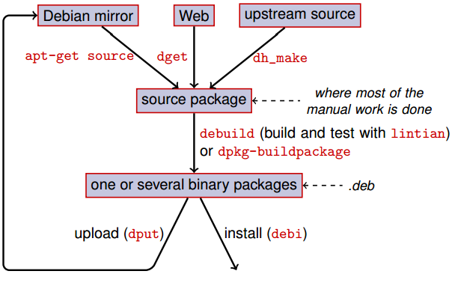
General packaging workﬂow

Slide 17
Debian package
Debian New Maintainers' Guide / packaging-tutorial.en.pdf
Source
  ./ - original source code (upstream)
  ./debian - debianize dir
Binary
  .deb
Source
  .dsc
  .diff
  .orig.tar.gz

Slide 18
Important file
changelog
control
  Build-Depends/Depends
rules (based on Makefile) devhelper
python-webdavlib (0.4.1-ubuntu1) precise; urgency=low
* Initial release.
-- Shawn Wang <shawn.wang@canonical.com> Tue, 09 Apr 2013 18:04:37 +0800
#!/usr/bin/make -f
export DH_VERBOSE=1
%:
dh $@

Slide 19
How to build you own package
Get Source code
  $ apt-get source wget
Modify code
  $ quilt new test.patch
  $ quilt edit xxx / quilt add xxx
  $ quilt refresh
create src package
  $ dch -i # modify changelog
  $ debuild -S # create src package
Upload to PPA
  $ dput ppa:shawn111/pycontw2013 wget_1.13.4-2ubuntu2_source.changes

Slide 20
Bzr with launchpad
bug tracking –fixes
  bzr --fixes lp:xxx , others bzr help bzr
builddeb
  bzr db (skip .bzr)

Slide 21
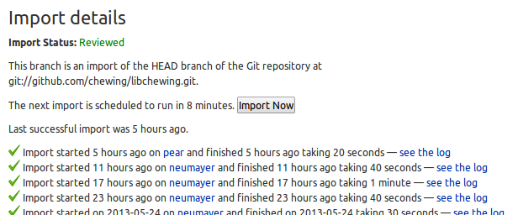
github import
use git:// rather than http://
https://code.launchpad.net/libchewing/+new-import
  Import a branch from bzr/git/svn/cvs
Bug #1072461 Code import from github does not take latest commits

Slide 22
Launchpad API
launchpadlib – a python client for accessing to Launchpad's web service.
https://api.launchpad.net/
lp-cli – tools for measure bugs

Slide 23
recipes - Daily build
recipe is a simple description to construct a package
  which branch to use (source/debianize)
  which version to give
# bzr-builder format 0.3 deb-version {debupstream}-2~{revno}
lp:libchewing
nest-part packaging lp:~chewing/libchewing/debianize debian debian

Slide 24
Code review
merge proposal
  push the branch directly to Launchpad with the command:
    bzr push lp:~user/project/project
  Branch merges on your code page
    Propose for merging
https://help.launchpad.net/Code/Review

Slide 25
Combine lp & git
git-lp https://github.com/zyga/git-lp
  InfoSession
  $ git lp init checkbox && cd checkbox
  $ git lp fetch
  $ git lp branch feature-foo
  $ git lp push
Need bzr.patch & no ppa yet

Slide 26

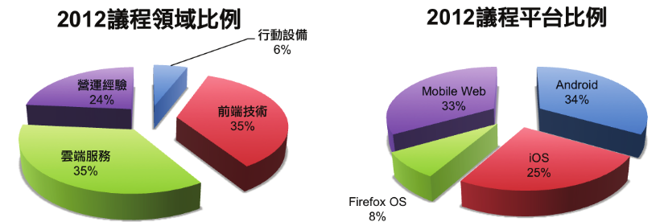
Mobile Open Platform Conference
http://mopcon.org/
2013 10 26~27 高雄國際會議中心(ICCK)
“堅持” 濁水溪以南舉辦的研討會

