Slide 1
Pysx: A Psx emulator written in python
Should be: “why you should not write a psx emulator in python”
But you already know why.
So let’s talk about why I wrote it.

Slide 2
My plan is writing a javascript/webgl psx emulator.
Sounds like a cool project.
But I know nothing about Psx emulation.
Python is my tool for understanding.
So my first step is writing a psx emulator in python.

Slide 3
OK, but there are lots of cool projects, why this one?
You might ask.
It’s a long story.
It all began one year ago.
actually, 1 year and 1 month ago, May 9, 2011.
I had a several hobby projects back then.

Slide 4
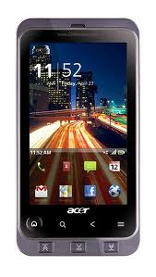
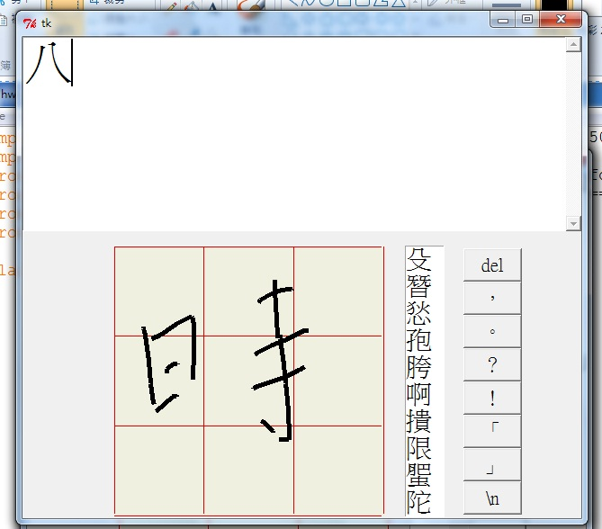
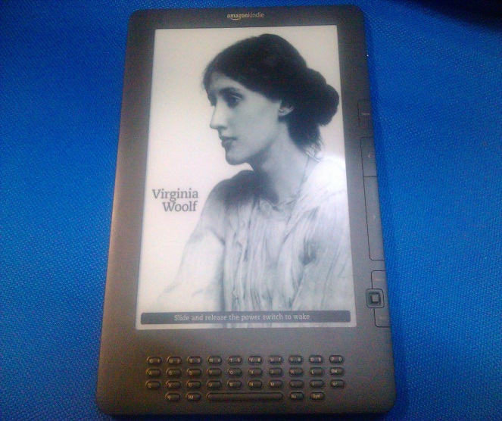
Chinese handwriting recognition algorithm in python
Web browser and GTK+ for Kindle DX
Chewing Chinese input for Kindle
Cracking kindle’s DRM
Hacking Acer Stream’s HDMI port
ClockWorkMod Recovery for Acer stream
Custom roms for Acer Stream
Unpacking tools for Bin format for Acer firmwares

Slide 5
On May 9, 2011
I was working on upgrading the kernel of Acer Stream, 90% done.
I remember I got a phone call, and have go out and to pause the work.
Then something happened and my life was never the same again.
Something about a night with blood, screaming women, knifes, scissors.

Slide 6
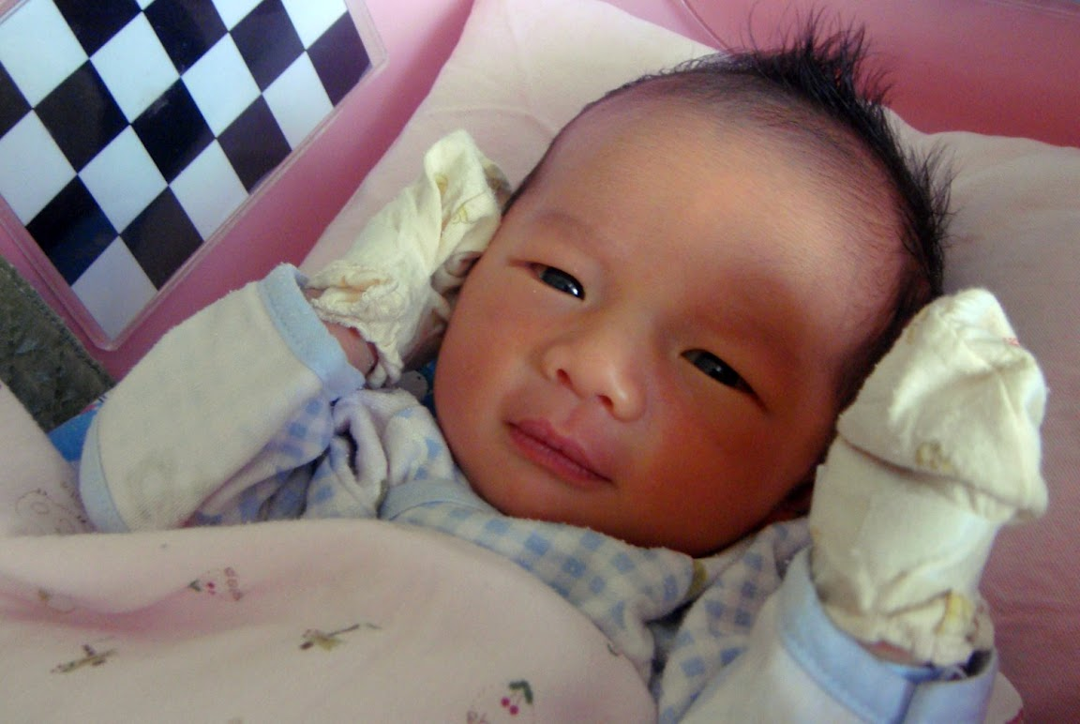
Something good.
But not a very good for other Acer stream owners.

Slide 7
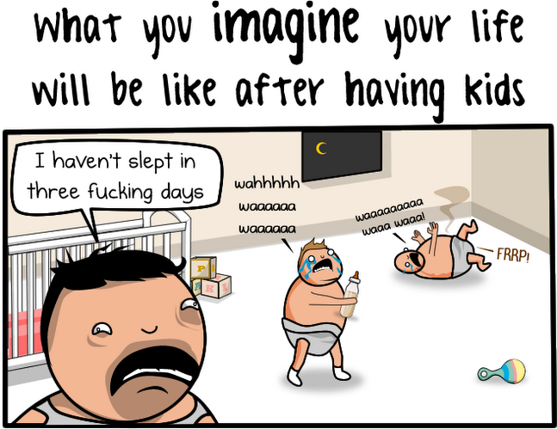

Slide 8


Slide 9
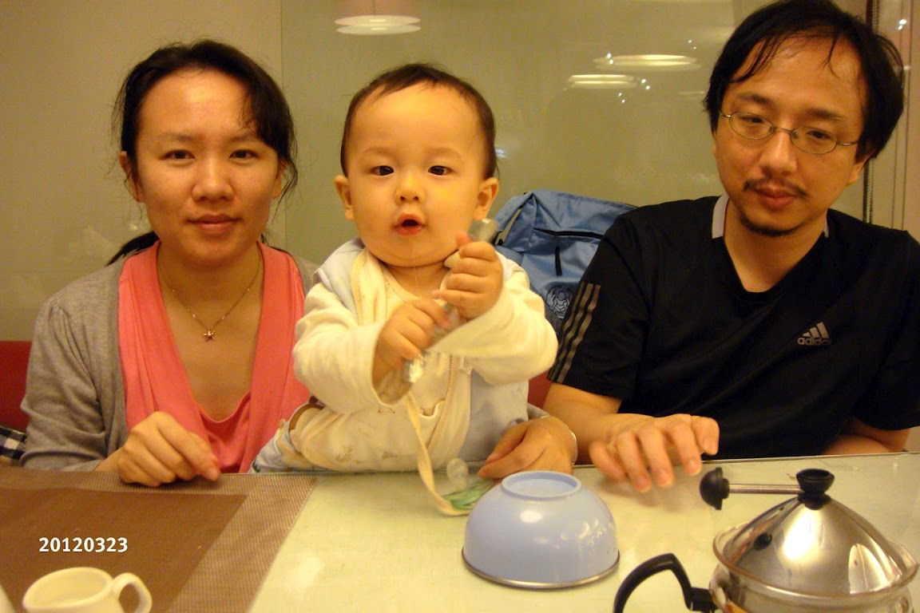
The next thing I remember was
Happy 10m old!

Slide 10
Not much time for hobby projects.
And free time are fragmented.
I choose Psx emulator as my project
because I don’t have much choice.
Modifying a kernel for a smart device is not possible.
need to concentrate for a fairly long time.

Slide 11
Writing a Psx emulator is different.
Each components like CPU, GPU, memory are fairly independent.
Each instruction of CPU are fairly independent.
Implement on demand
Seeing how far can the emulation go is kind of fun

Slide 12
bfc00000 : LUI 00000000 (t0), 0013 (19),
bfc00004 : ORI 00130000 (t0), 00130000 (t0), 243f (9279),
bfc00008 : LUI 00000000 (at), 1f80 (8064),
bfc0000c : SW 0013243f (t0), 1010 (1f800000 (at)) [1f801010]
bfc00010 : NOP
bfc00014 : ADDIU 0013243f (t0), 00000000 (r0), 0b88 (2952),
bfc00018 : LUI 1f800000 (at), 1f80 (8064),
bfc0001c : SW 00000b88 (t0), 1060 (1f800000 (at)) [1f801060]
bfc00020 : NOP
bfc00024 : NOP
bfc00028 : NOP
bfc0002c : NOP
bfc00030 : NOP
bfc00034 : NOP
bfc00038 : NOP
bfc0003c : NOP
bfc00040 : NOP
bfc00044 : NOP
bfc00048 : NOP
bfc0004c : NOP

Slide 13
Ctypes helps to load psemu plugins.
Pypy is 10x faster than CPython
Otherwise, the video can not fit in a lightening talk.
I use some ad hoc meta programming

Slide 14
What I wrote
self.optbl=[
"SPECIAL", "BCOND", "J", "JAL", "BEQ", "BNE", "BLEZ", "BGTZ",
"ADDI", "ADDIU", "SLTI", "SLTIU","ANDI", "ORI", "XORI", "LUI",
"COP0", "COP1", "COP2", "COP3"]+ [""]*12+[
"LB", "LH", "LWL", "LW", "LBU", "LHU", "LWR", "",
"SB", "SH", "SWL", "SW", "", "", "SWR", "",
"LWC0", "LWC1", "LWC2", "LWC3"]+ [""]*4+[
"SWC0", "SWC1", "SWC2", "SWC3"]+ [""]*4
...
@expand_dispatch
def run(self):
...
getattr(self, self.optbl[op])()

Slide 15
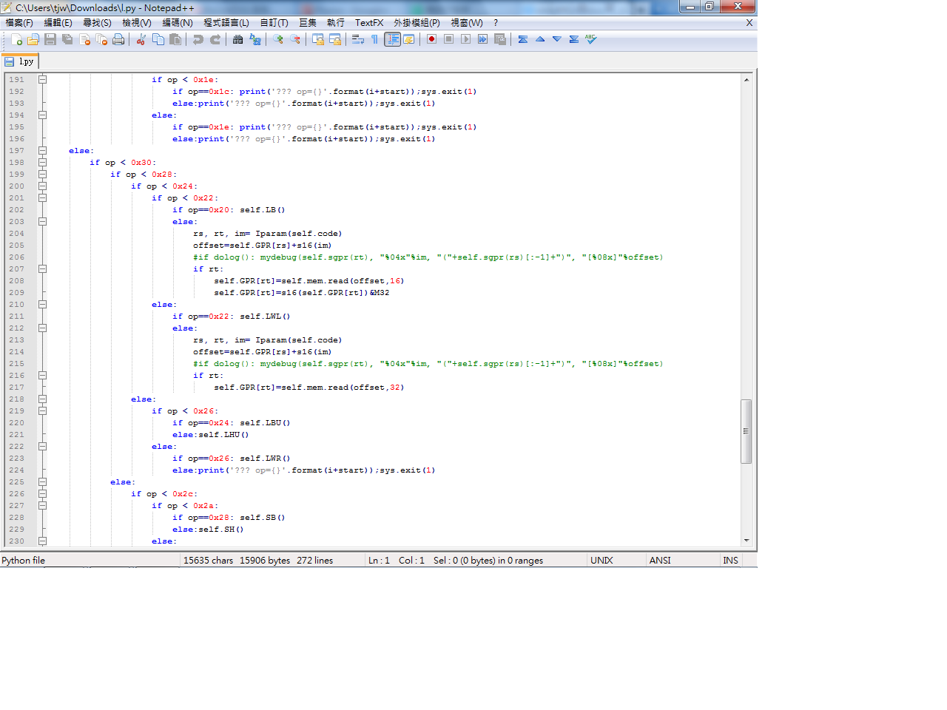
What Python Runs

Slide 16
Pypy’s rpython can “JIT” interpreters.
But it has only signed 32bit integers.
Using unsigned 32bit need to rewrite the code
The expanded “switch statement” works for shedskin.
But no ctypes in shedskin
Shedskin does not support nested functions.
Using opengl, sdl on shedskin is tricky.

Slide 17
TODO:
GTE
CDROM
HLE
Dynamic recompiling
Plugins in pure python

