Slide 1

Violent Python:
Python in the dark side
darkx
PyCON.tw 2013

Slide 2
About
a.k.a. xatier
平凡無奇的大學生
喜好自由軟體和資訊安全技術
Python 只是輔助 (?)

Slide 3
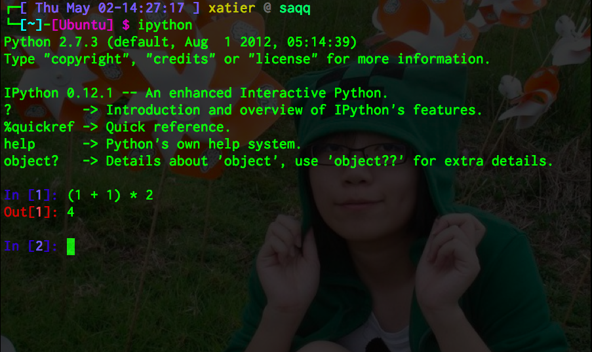
最常拿 Python 來...

Slide 4
We Love Python
Easy to Learn
Easy to Read
  Easy to Hack (?)
Cross platform
Builtin tools
Libraries

Slide 5
“This (Programming), of course, is the fundamental hacking skill. If you don't know any computer languages, I recommend starting with Python. It is cleanly designed, well documented, and relatively kind to beginners. Despite being a good first language, it is not just a toy; it is very powerful and flexible and well suited for large projects. ”
– How to become a hacker (ESR)

Slide 6
(compare to C) ….. “With today's machines as powerful as they are, this is usually a bad tradeoff — it's smarter to use a language that uses the machine's time less efficiently, but your time much more efficiently. Thus, Python.”
– How to become a hacker (ESR)

Slide 7
小試身手

Slide 8
decrypt

Slide 9
decrypt
import crypt
crypt.crypt(word, salt) -> string
word will usually be a user's password. salt is a 2-character string
which will be used to select one of 4096 variations of DES. The characters
in salt must be either ".", "/", or an alphanumeric character. Returns
the hashed password as a string, which will be composed of characters from
the same alphabet as the salt.

Slide 10
decrypt
Dictionary Attack
/usr/share/dict/words
GGvxb.e7YgnIg

Slide 11
Brute force
http://pvanhoof.be/files/bruteforce.c
import itertools

Slide 12
APIs
socket API跟 C 用起來幾乎一模一樣
ctypes 標準庫提供 C/dll/so 跨接的橋樑
物件、流程控制等可省下更多時間

Slide 13
Lots of tools
http://www.dirk-loss.de/python-tools.htm
scapy
dpkt
Immunity Debugger
IDAPython
lldb(llvm's debugger)
…...

Slide 14
python-nmap
http://xael.org/norman/python/python-nmap/
Nmap 工具的 Python binding
搭配 IPython shell一同服用
GPL licensed

Slide 15
Hacking Skype
main.db
你想要的通通都在這邊 （？
聯絡人、聊天紀錄... 等
Unix like 系統很棒的

Slide 16
Inspired by
Nicolle Neulist: Write your own tools with python! Derbycon2012
Gray Hat Python: Python Programming for Hackers and Reverse Engineers
Violent Python: A Cookbook for Hackers, Forensic Analysts, Penetration Testers and Security Engineers

Slide 17
Thank you
☺

