Slide 1
OpenStack Cinder Tutorial
Chia-Feng Kang, K.K.(康佳峰)
CCMA/ ITRI
2013/5/25

Slide 2
About K.K.
Chia-Feng Kang is a software engineer for cloud computing in CCMA/ITRI.
He works on cloud computing for more than 3 years and on OpenStack for 1 year.
He likes to use python to write some network utilities

Slide 3
Outline
OpenStack
Volume
OpenStack Cinder
Cinder driver status
References

Slide 4
OpenStack
An IAAS cloud computing project and open source software under Apache License.
Launched in Jul. 2010, and OpenStack Foundation managed it since Sep. 2012.
It consists of a series of interrelated project CODEs implemented by Python
Cloud computing management layer that integrate existing Linux technologies

Slide 5
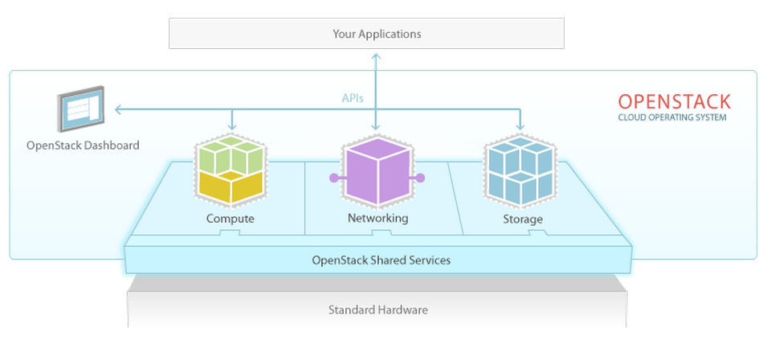
Service Architecture

Slide 6
OpenStack Code Names
Service | Code Name/Software Project
Compute | Nova
Image | Glance
Object Storage | Swift
Dashboard | Horizon
Identity | Keystone
Networking | Quantum
Volume | Cinder
… | …

Slide 7
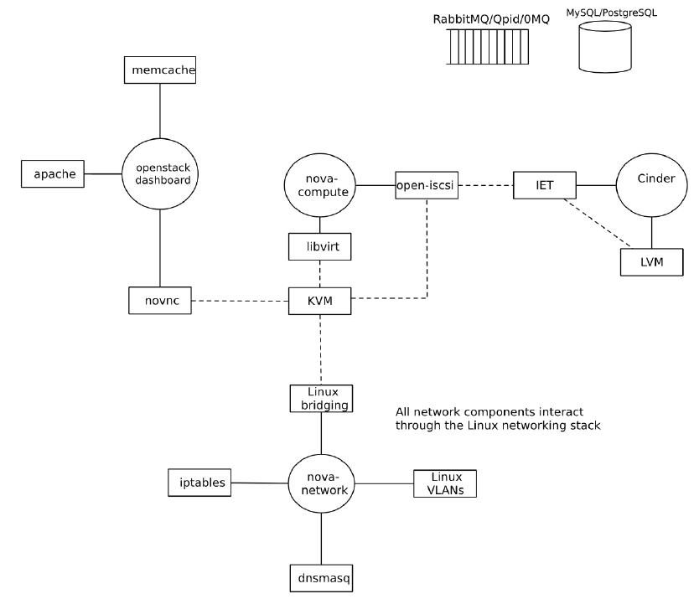
Technology Topologies
TGT

Slide 8
Volume
Physical Disk | Partition | Drive/Volume | Filesystem
Hard Disk 1 | Partition 1 | /dev/mapper/vol | ext3
 | Partition 2
Hard Disk 2 | Partition 1 | C: | NTFS
 | Partition 2 | D: | FAT32
A partition, physical drive, is a part of one physical hard disk. (Hardware concept)
A volume, logical drive, is a single accessible storage area with a single file system.
(Operation system concept)

Slide 9
OpenStack Cinder
Cinder allows you to give block level storage to your OpenStack Compute instances.
Storage Access Network (SAN)
Amazon EBS
The basic Cinder usage is iSCSI-exposed LVM volumes.
Two basic default components
lvm2
open-iscsi/iscsi-target
Current release:
Grizzly, May. 2013

Slide 10
Cinder Services
cinder-api
Authenticates and routes requests throughout the block storage system.
cinder-scheduler
Scheduling/routing volume create requests to the appropriate volume service.
cinder-volume
Managing block storage devices, specifically the back-end devices themselves.

Slide 11
Cinder Interaction
Openstack Compute API
Openstack Volume API
Volume User
nova-api
cinder-api
Libvirt, XenAPI, etc.
hypervisor
nova-compute
nova-scheduler
Queue
Volume Provider
cinder-schedler
cinder-db
volume driver
(iSCSI, etc.)
volume driver
(iSCSI, etc.)
cinder-volume
volume driver
(iSCSI, etc.)
cinder-volume
cinder-volume

Slide 12
Cinder Internal
Cinder deployment
Volume operations
Volume stack
LVM/iSCSI
Implementation
Driver Status

Slide 13
Cinder Deployment
https://github.com/mseknibilel/OpenStack-Grizzly-Install-Guide/blob/master/OpenStack_Grizzly_Install_Guide.rst
Install KeyStone
Install Nova
Install Cinder
[Note] Use “Puppet” on Folsom version

Slide 14
Volume Operations
Create/Delete volume
Create volume from snapshot
Clone volume
Create volume from image
Copy image to volume
Create/Delete snapshot
Attach/Detach volume

Slide 15
LVM/iSCSI Volume Stack
Cinder
(volume server)
Nova
(Volume client)
Cinder.API
Compute.API
Cinder.Scheduler
Compute.Scheduler
VolumeManager
ComputeManager
LVMVolumeDriver
virt.connection
LVMISCSIDriver
ComputeDriver( nova.virt.driver )
XenAPIConnection
LibvirtConnection
iscsi.TargetAdmin
LibVirtVolumeDriver
TgtAdm
utils
LibvirtNetVolumeDriver
LibvirtISCSIVolumeDriver
<Driver>
<libvirtDriver>
Utils
Utils

Slide 16
Implementation(1/2)
Create volume
User: POST http://volume1.server.itri:8776/v1/{tenant_id}/volumes
Cinder-API: CALL cinder.volume.API().create()
Cinder.volume.API: RPC CAST cinder.scheduler()
Cinder.scheduler: SCHEDULE volume host
Cinder.scheduler: RPC CAST cinder.volume.create_volume()
Cinder.volume.manager: CALL cinder.volume.driver.create_volume()
Cinder.volume.manager: CALL cinder.volume.driver.create_export()

Slide 17
Implementation(2/2)
Attach volume
User: POST http://novacompute1.itri:8774/v2/{tenant_id}/servers/{vm_uuid}/os--volume_attachments
Nova-API: CAST Nova.compute.API.attach_volume()
Nova.compute.api(): RPC CAST NOVA.compute.manager.attach_volume()
Nova.compute.manager. attach_volume: RPC CALL cinder.volume.initialize_connection()
Nova.compute.manager.attach_volume: RPC CALL virt volume driver attach_volume()
E.g. libvirt.driver.attach_volume() → volume_driver.connect_volume()
Nova.compute.manager.attach_volume: RPC CALL cinder.volume.attach()

Slide 18
Cinder Driver Status
SAN
LVM based IET or TGT
SAN ISCSI
EMC SMI-S
HP 3PAR/LeftHand
Huawei
IBM StorwizeSVC/XIV
NetApp iSCSI
Nextenta NexentarStor
Windows
SolidFire
Coraid
Solaris
Sheepdog
Zadara
…
NAS
GlusterFS
NetApp NFS
XenAPI
Coraid
Scality SOFS
…
Object
Ceph RBD
https://wiki.openstack.org/wiki/CinderSupportMatrix

Slide 19
Conclusions
OpenStack Cinder defines a set of common methods to model block storage solutions for virtual machine
Storage providers can easily integrate storage solution into Cinder for customer usage
Storage customer can easily adopt different storage product via Cinder

Slide 20
References
https://wiki.openstack.org/wiki/Cinder
http://docs.openstack.org/trunk/openstack-compute/admin/content/
https://launchpad.net/openstack
https://launchpad.net/nova
https://launchpad.net/cinder
http://docs.openstack.org/trunk/openstack-block-storage/admin/content/
http://docs.openstack.org/developer/cinder/

Slide 21
Q&A
康佳峰 (K.K.)
E-mail: joseph.cfk@gmail.com

