Slide 1
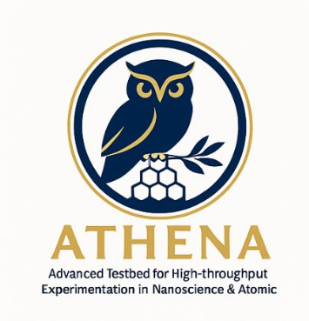
Building ML Controlled Instruments
Goals:
Develop a framework to unify automation of instruments
Avoid insular solutions with individual server-client interfaces
Flexible solution to be ready for advances in AI and ML tools

Slide 2
Motivation and Advantages of pyTango
Proxy server:
Coherent API for clients
Asynchronous server
Enables edge computing = Smart Proxy Server
Dynamic device-database
Model—context server (MCP) compatible to interface with large language model
Compatible to Bluesky-Project (orchestration – system)
Runs more than 10k devices at synchrotrons

Slide 3
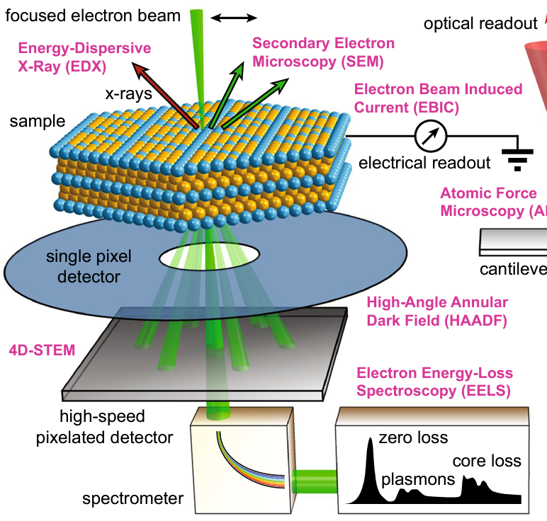
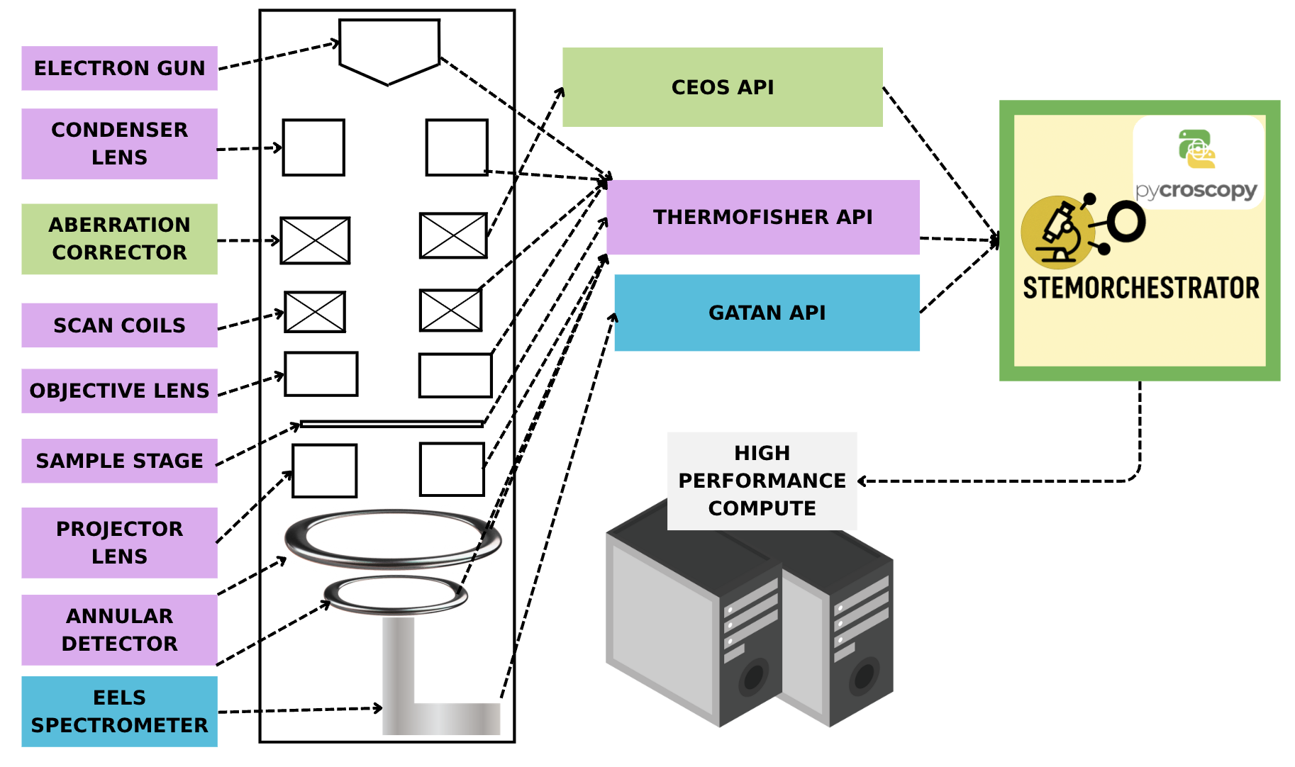
But: Many Manufacturers!
(a)
(b)
Image credit: Colin Ophus (LBNL), MRS Bulletin 2021
U. Pratiush et al, Rev. Sci. Instr. 95 (2024).
Instrument has detectors and cameras from multiple manufacturers
If you want to do anything useful, build APIs and orchestrators first!

Slide 4
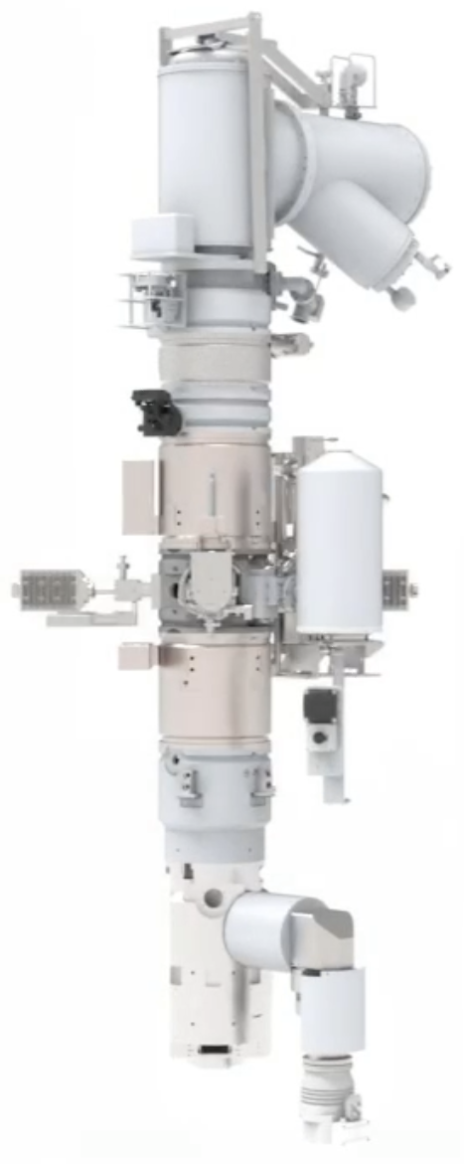
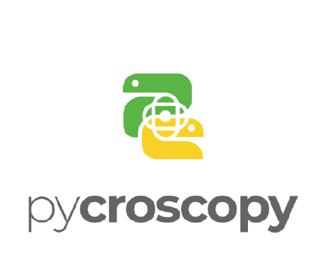
Asyncroscopy framework
AutoScript Scan
Scan
Model Context Protocol
AutoScript Stage
All communication (arrows) via PyTango database
Stage
LLM Agent
AutoScript Mic.
Microscope
Client
Electron Microscope
Vendor
agnostic
Ceos Corrector
Instrument
Aberration Corrector
Gatan Server
EELS
Separate data pipeline allows faster, asynchronous data streaming
Tiled Data Server
Local data
Notes:
User, microscope
Each box is a different server
Communication through PyTango

Slide 5
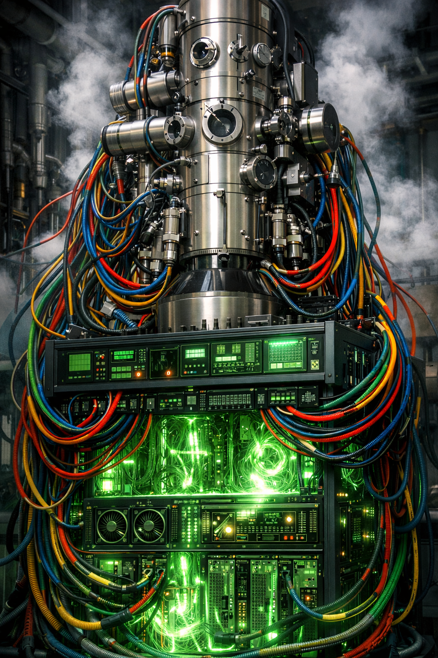
Digital Twins
DT Scan
Scan
Model Context Protocol
DT Stage
All communication (arrows) via PyTango database
Stage
LLM Agent
DT Microscope
Microscope
Client
Electron Microscope
DT Corrector
Instrument
Aberration Corrector
DT EELS
EELS
Model
Microscope
(abTEM)
Separate data pipeline allows faster, asynchronous data streaming
Tiled Data Server
Local data
Notes:
Model + Synchronization
Two use cases:
Debugging code offline
Stable benchmark

Slide 6
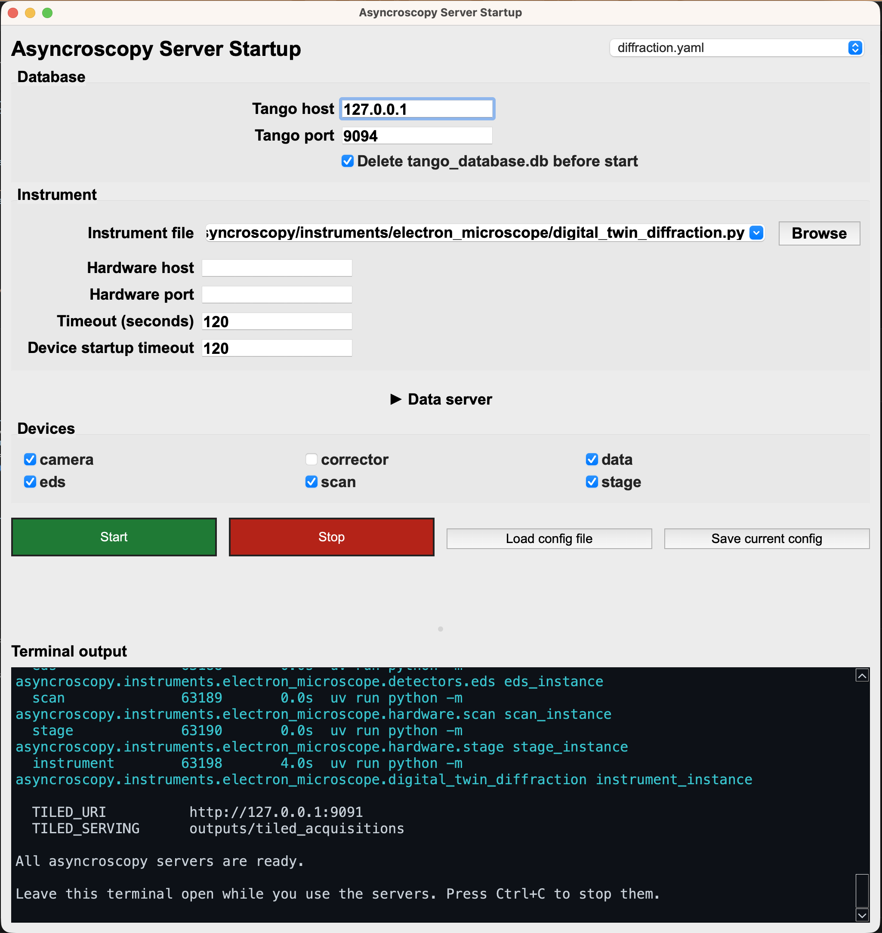
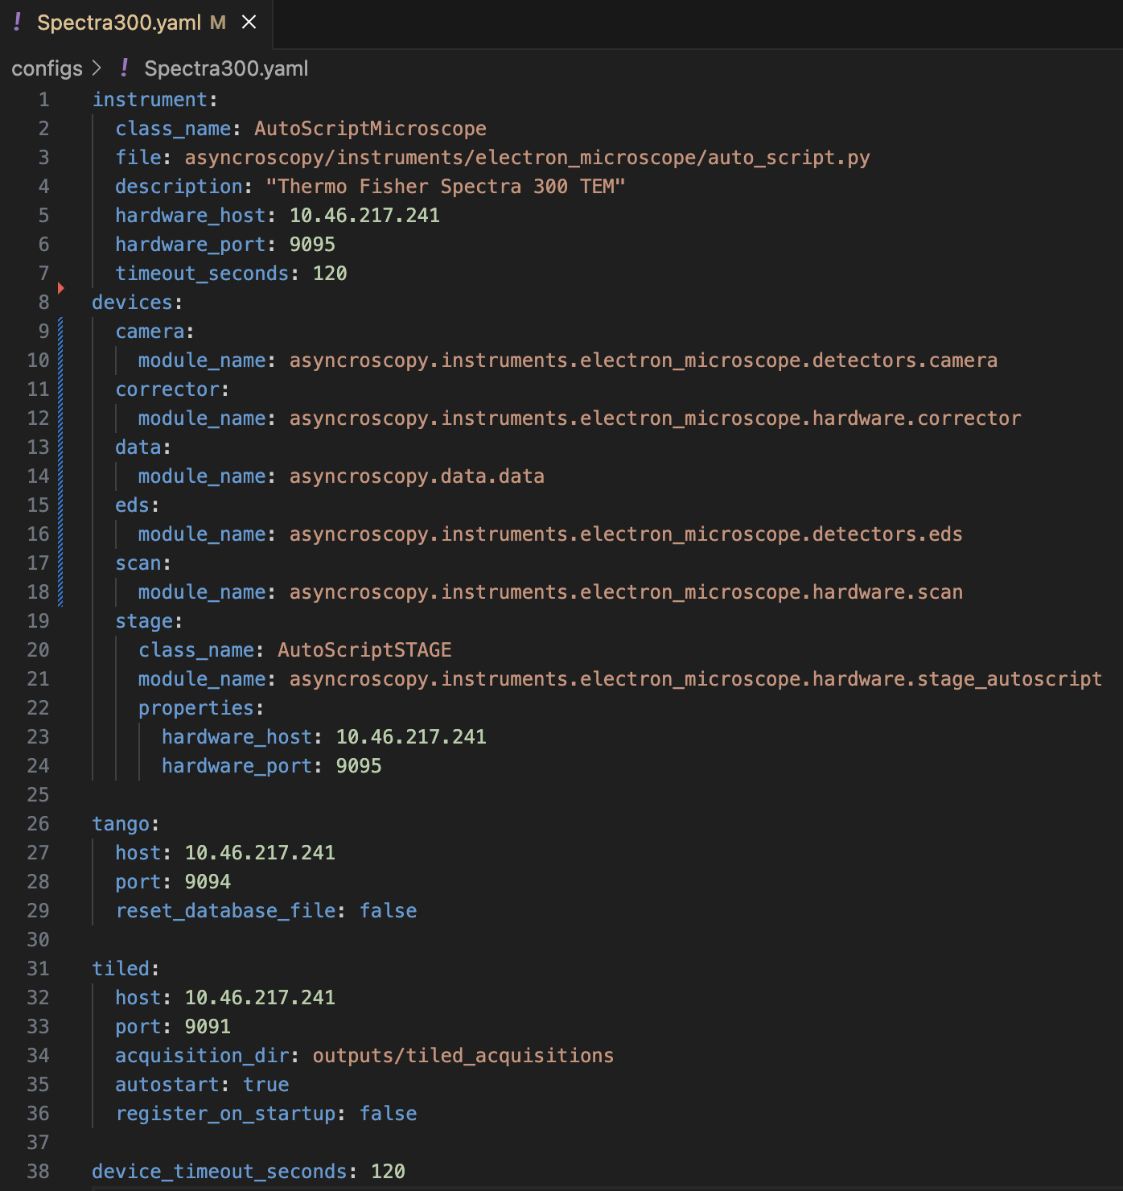
Starting the servers

Slide 7
Cloudified Instruments at UTK
TEM/STEM Spectra 300, Thermo Fisher
SPM Jupiter, Oxford Instruments
SPM Cypher, Oxford Instruments
Nano Indenter, KLA
SPM/SEM FusionScope, QuantumDesign

