Slide 1

DATA ANALYTICS AND VISUALIZATION(24DSB3101)
An Explainable AI-Driven Big Data Analytics Framework for Climate Prediction and Environmental Risk Assessment
Batch – 6
REVIEW-2
2420030591 – L. Mrudani
2420090003 – Sri Kruthi
2420090107 – P. Hasitha

Slide 2
Methodology:
1. Proposed Method / Approach
  Developed an Explainable AI-based Environmental Disaster Risk Prediction Framework.
  Combines historical environmental data, machine learning, risk scoring, and real-time weather data.
  The workflow includes data preprocessing → feature analysis → ML prediction → risk assessment → XAI → dashboard.
2. Dataset Collection & Data Preparation
  Collected and integrated three environmental datasets from different sources.
  Performed data cleaning, missing-value handling, feature selection, and normalization.
  Combined relevant environmental parameters such as temperature, humidity, rainfall, wind speed, pressure.
  Created additional seasonal/time-based features such as DOY_SIN and DOY_COS.
  Prepared the final dataset for disaster-risk classification.

Slide 3
Methodology:
3. ML Models & Model Combination
  Trained and evaluated multiple ML classification models on the prepared dataset.
  ML Models Used
    Logistic Regression
    Random Forest
    Support Vector Machine (SVM)
    Comparative evaluation of models
  Final Proposed Model: Hybridized Logistic Regression and Random Forest
  Compared their performance using Accuracy, Precision, Recall, F1-score, ROC-AUC, and Confusion Matrix.
  Explored combinations/ensemble approaches using 2–3 models to improve prediction reliability.
  Analyzed the influence of environmental features on disaster predictions.
4. Final Proposed Model
  Selected the final Logistic Regression-based model as the proposed prediction model.
  Applied class balancing, median imputation, and feature standardization.
  Used a tuned 0.71 decision threshold for disaster classification.
  Integrated the model with a historical environmental risk score + real-time weather API + XAI.
  Implemented the complete system through a Streamlit dashboard.

Slide 4
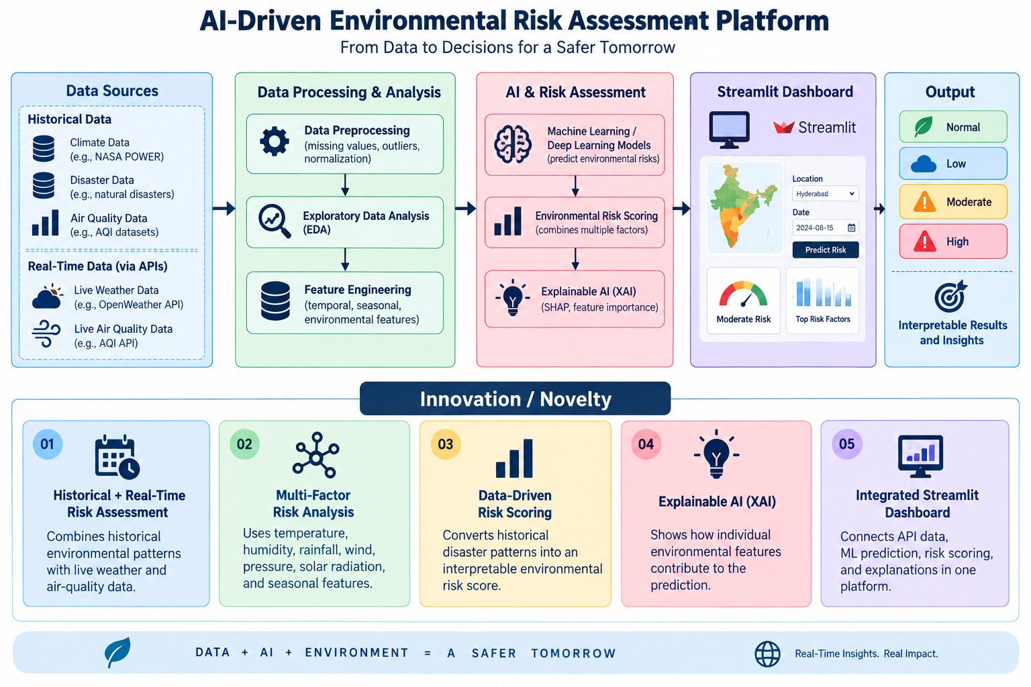
Innovation/ Novelty:
Historical + Real-Time Risk Assessment – Combines historical environmental patterns with live weather and air-quality data.
Multi-Factor Risk Analysis – Uses temperature, humidity, rainfall, wind, pressure, solar radiation, and seasonal features.
Data-Driven Risk Scoring – Converts historical disaster patterns into an interpretable environmental risk score.
Explainable AI (XAI) – Shows how individual environmental features contribute to the prediction.
Integrated Streamlit Dashboard – Connects API data, ML prediction, risk scoring, and explanations in one platform.
“Integration of Three Heterogeneous Datasets for Unified Environmental Disaster Risk Prediction.”

Slide 5
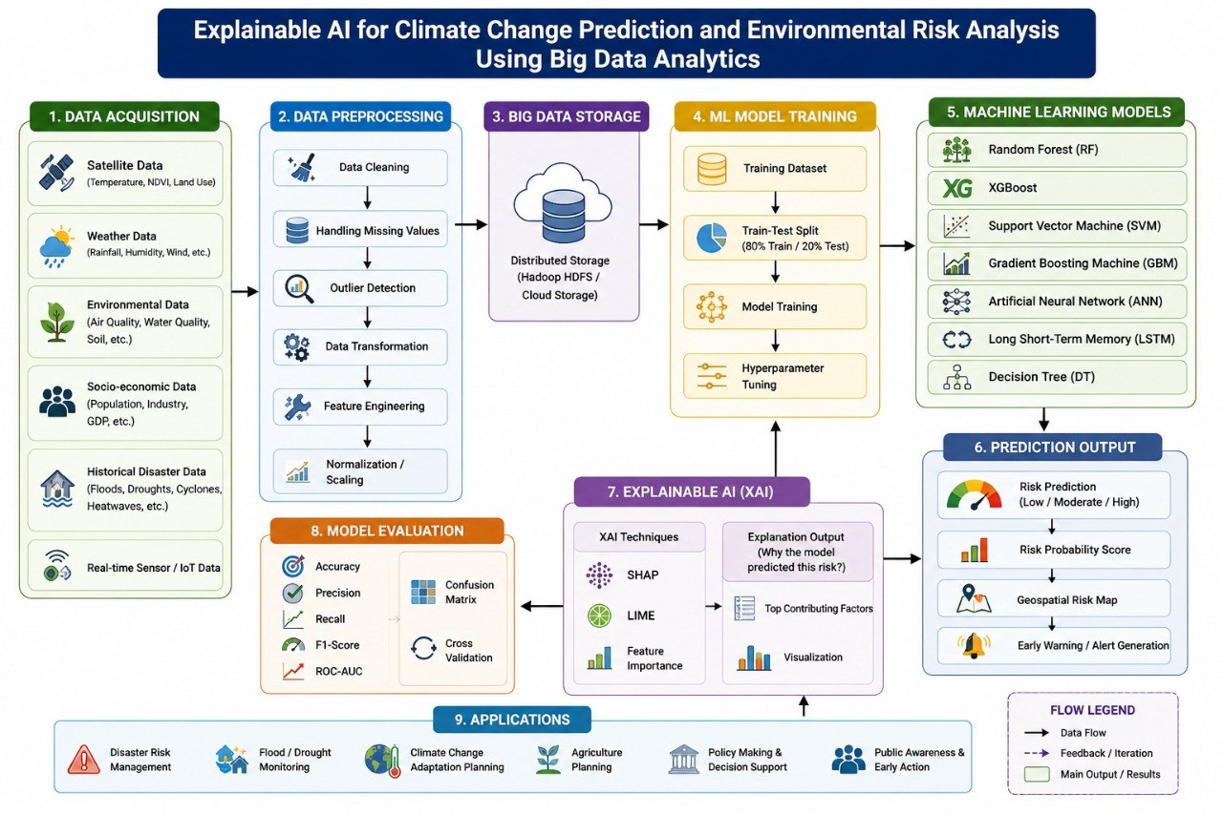
System Design and System Architecture

Slide 6
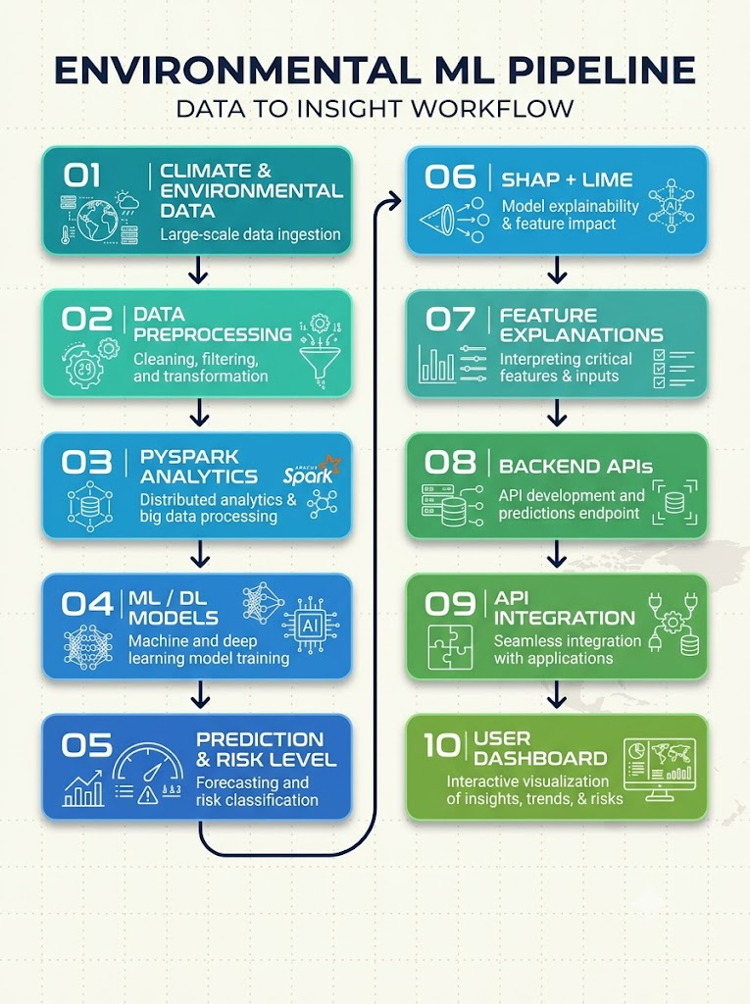
System Layers:
Data Layer
Processing & Analytics Layer
ML/DL Prediction Layer
XAI Layer
API Integration Layer
Visualization Layer
The framework combines Big Data processing, prediction, risk classification, XAI, and a dashboard.

Slide 7
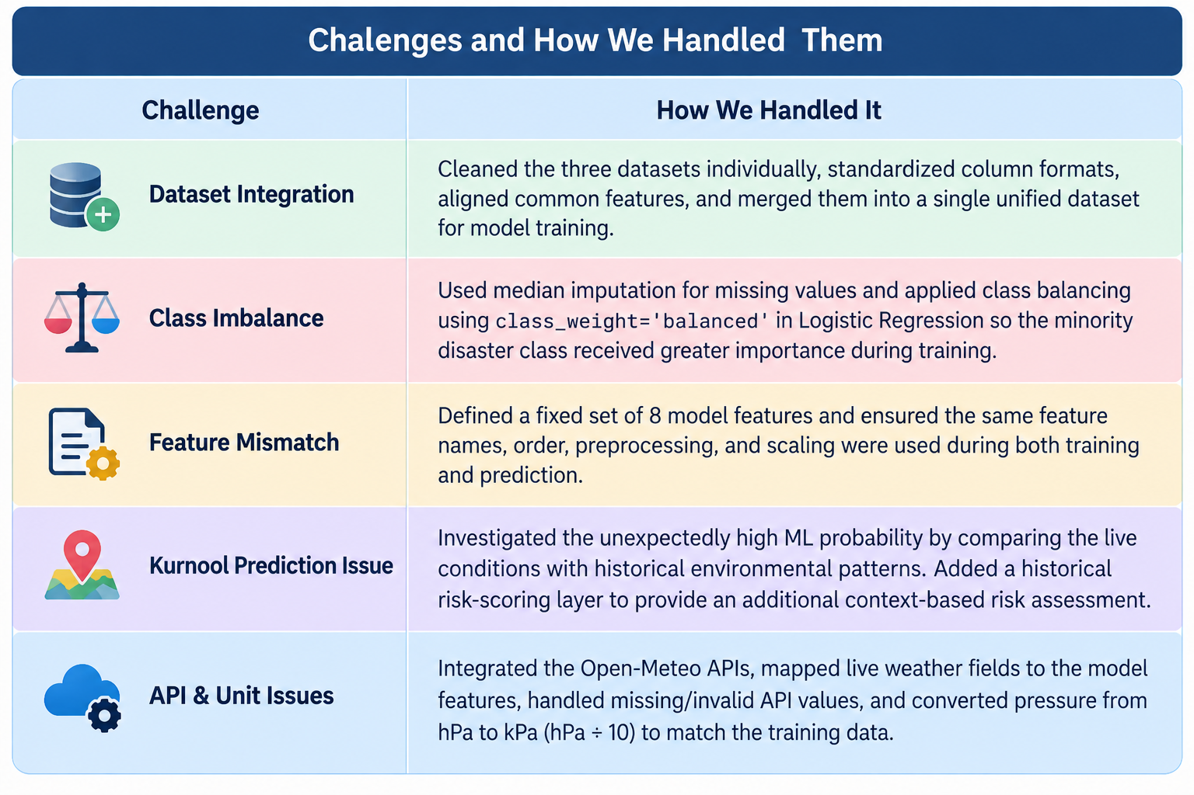
Project Difficulties & Error Handling:
Dataset Integration → Different datasets required cleaning and feature alignment.
Class Imbalance → Applied imputation and class-balancing techniques.
Feature Mismatch → Ensured identical training and prediction features.
Kurnool Prediction Issue → High ML probability led to investigation and addition of a historical risk-scoring layer.
API & Unit Issues → Handled real-time data formatting and hPa–kPa conversion.

Slide 8
Implementation:
Data Preparation
  Collect and clean environmental datasets and handled missing/inconsistent data
Big Data Processing
  Process datasets using PySpark
  Perform EDA and feature analysis
Model Development
  Train ML/DL prediction models (Random Forest, XGBoost,
  Logistic Regression, SVM)
  Hybridised Random Forest and Logistic Regression
  Generate environmental risk predictions
Explainability
  Apply SHAP and LIME
  Identify influential environmental factors
API Integration
  Expose prediction and risk outputs through APIs
  Connect ML outputs with the application interface
Dashboard
Display predictions, trends, risk levels, and explanations

Slide 9
Modern Tools & Technologies:
Python — Core programming and data analysis
Pandas & NumPy — Data preprocessing and analysis
PySpark — Large-scale Big Data processing
Scikit-learn — Machine Learning implementation
Random Forest & XGBoost — Predictive modelling
LSTM / DL Models — Time-series prediction
SHAP & LIME — Explainable AI
REST APIs — Communication between ML system and application
API Integration — Connects predictions with the user interface
Power BI / Python / Streamlit — Visualization and dashboard

Slide 10
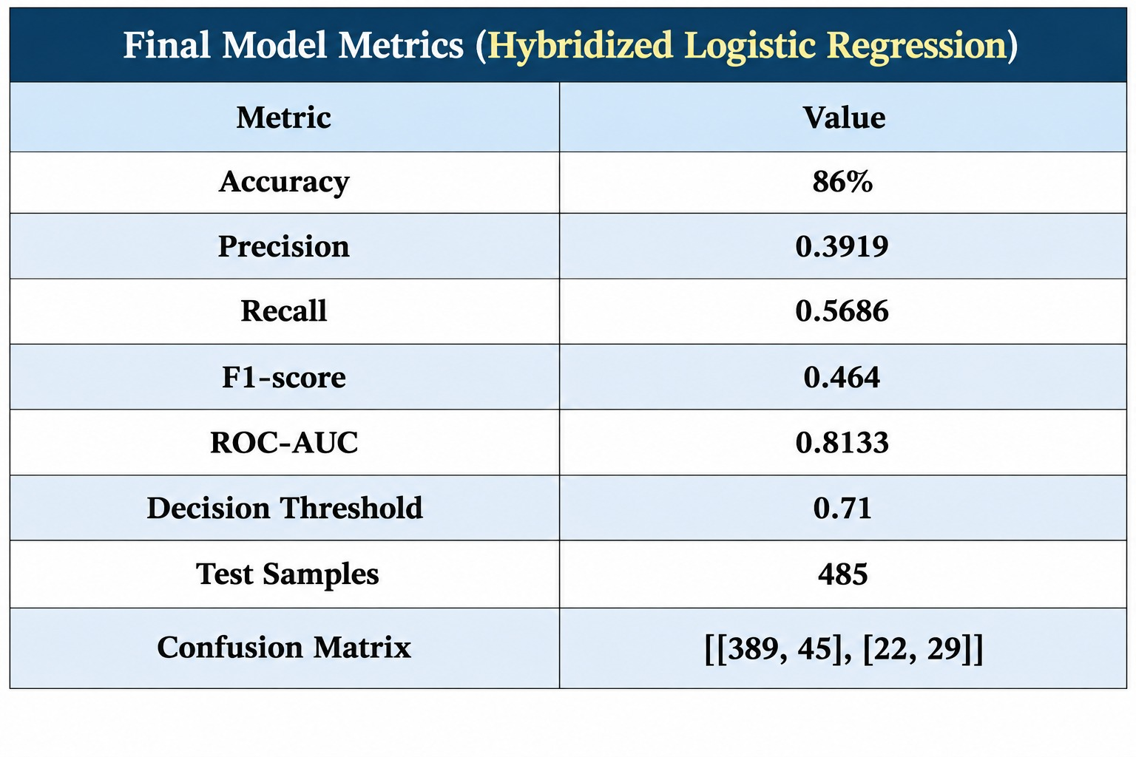
Results:
Processed and analyzed climate/environmental data
Identified patterns and relationships among environmental variables
Generated climate and environmental risk predictions
Classified environmental conditions into:
  Low Risk
  Medium Risk
  High Risk
Identified important factors influencing predictions
Generated interpretable explanations using SHAP and LIME
Integrated prediction results with the application through APIs
Presented results through an interactive dashboard

Slide 11
Performance Evaluation:
The system is evaluated across multiple dimensions:
Model Performance
  Compare different ML/DL models
  Evaluate prediction accuracy and error
Risk Classification
  Evaluate Low, Medium, and High risk predictions
Explainability
  Analyze feature importance using SHAP
  Interpret individual predictions using LIME
Scalability
  Evaluate large-scale data processing using PySpark
API Performance
  Verify successful communication between prediction services and application
System Validation
  Validate predictions, API responses, and dashboard outputs

Slide 12
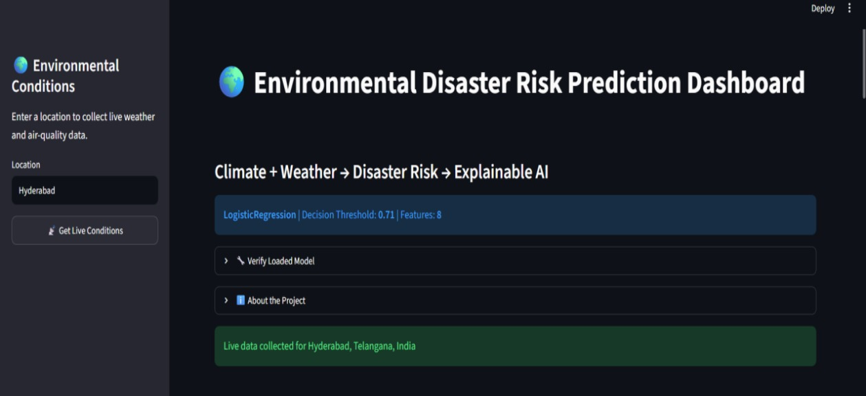
Project Outcome:

Slide 13
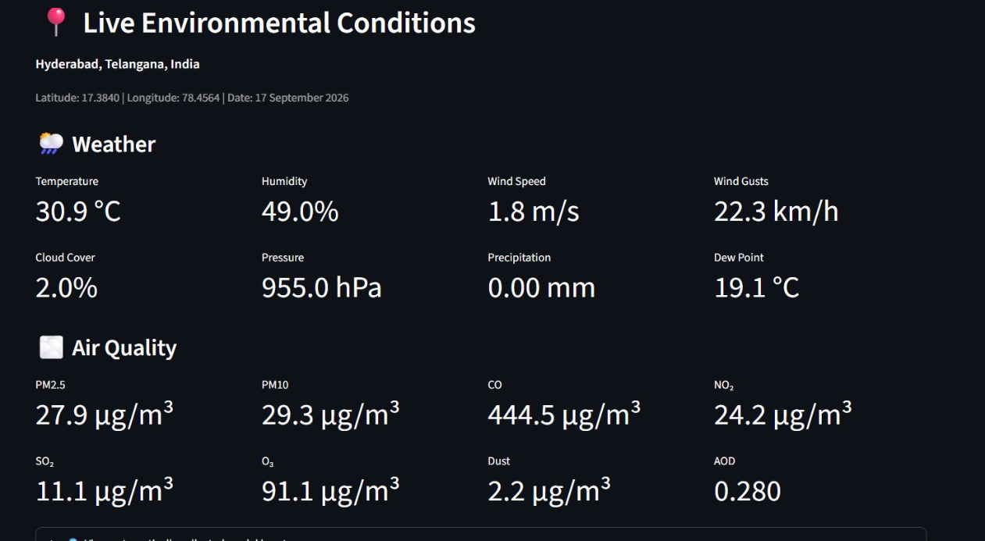
Project Outcome:

Slide 14
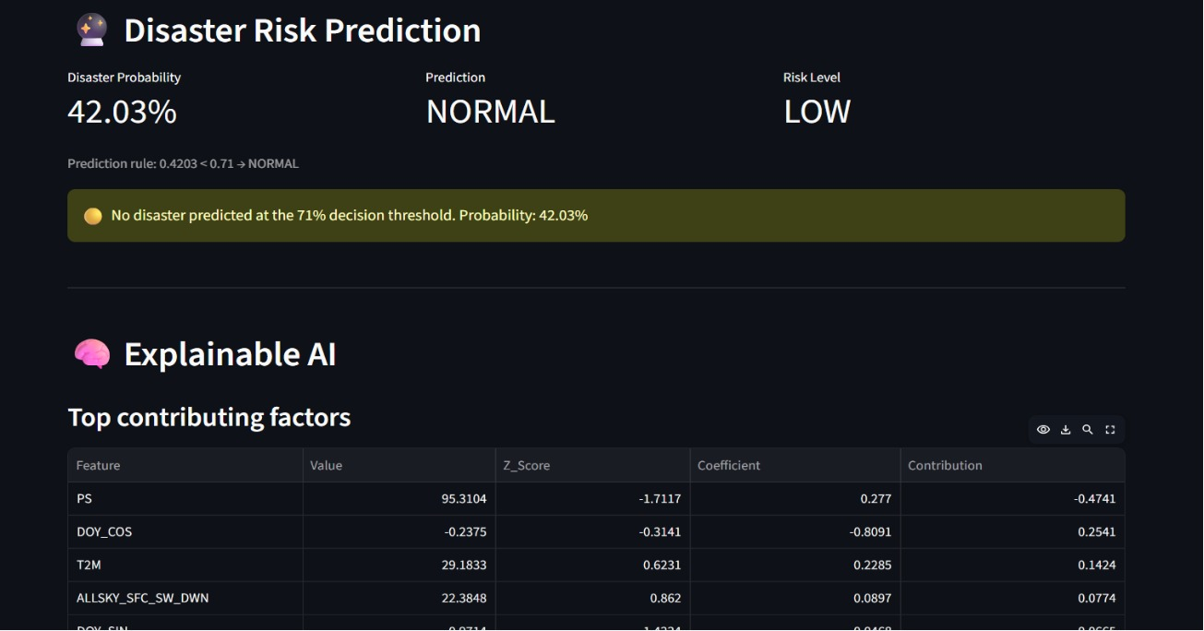
Project Outcome:

Slide 15
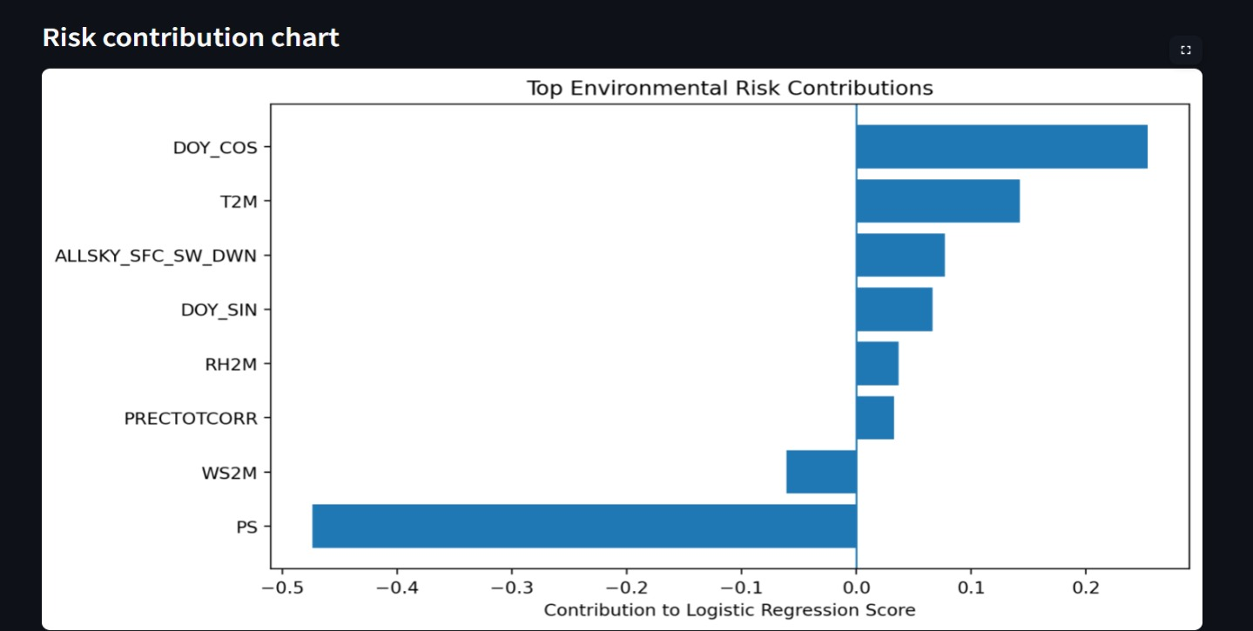
Project Outcome:

Slide 16
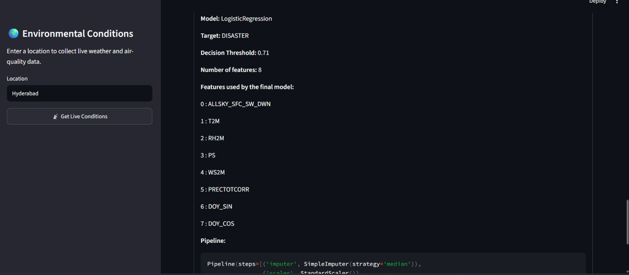
Project Outcome:

Slide 17
Thank You

