Slide 1
NASA Science
  NASA’s Science Mission Directorate gets a Make-over

Slide 2
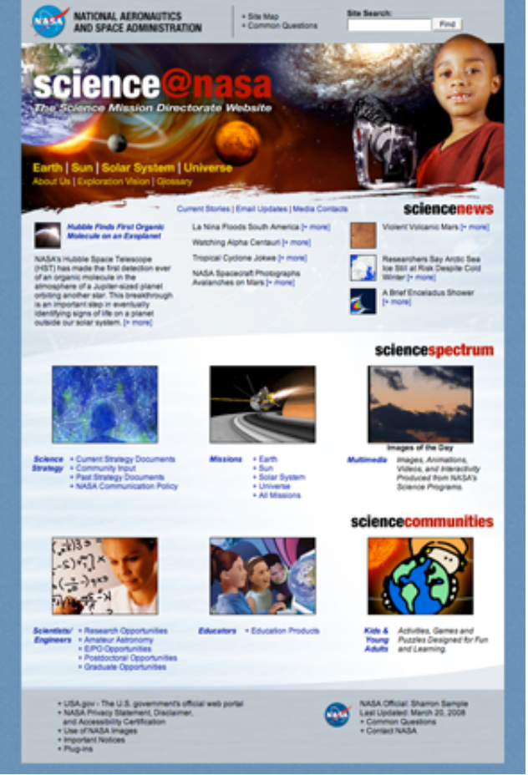
History of NASA Science
Original site, deployed late 90’s.
Notes:
* Site for Science Mission Directorate at NASA
* Won some award for web design back around 1999. No one cared since
* Originally deployed in raw HTML, a little bit of in-line CSS, and the rare Perl script.
* HTML site with the occasional application inserted
* Over time, overall look gave way to sub-sites
* Content needed some updating
* Needed a face lift!

Slide 3
Time for a new site
How do you sell a CMS?
Notes:
Selling - We all love CMS’s... But those that aren’t use to them for websites needed some selling.

Slide 4
Time for a new site
How do you sell a CMS?
What do you gain?
Notes:
Gain (we emphasized):
* Sharing of content
* Re-use content
* More complex interactions b/w data and interface (image of the day, news feeds, mission filters)‏
* Easier to change page layout/design

Slide 5
Time for a new site
How do you sell a CMS?
What do you gain?
What do you lose?
Notes:
Lose (what came up):
* Instant updates (HTML could be instantly updated. Not always the case in a CMS)‏
* Fast development (Photoshop one day, a website the next!)‏
* Small team (designers with photoshop): cheap and fast!

Slide 6
Why Plone?
Exploring various options
Notes:
Why did we choose Plone? We had a shop filled with any number of groups using all sorts of well known and esoteric tools, so how did we get around to choosing Plone?

Slide 7
Why Plone?
Other options:
  HTML
Notes:
The old site was HTML with a few CGI scripts. Working for years! Why change what was working? We could just implement the site again in HTML!
The Problems
--------------
1. Searching data on HTML is terrible.
2. No tagging.
3. Updating the design meant changing hundreds, thousands of pages, hence the existing old design.
4. Each article has to be vetted by a content person and a graphic designer before uploading.

Slide 8
Why Plone?
Other options:
  ColdFusion
Notes:
ColdFusion
==========
SMD had a small group of ColdFusion developers willing to take on the task, and some volunteered to write a CMS from scratch.
The Problems
---------------
1. Writing a CMS from scratch is deceptively hard. I've worked a couple projects trying to fix home grown CMS, wasting more money on maintenance than purchasing the most expensive CMS systems.
2. The open source ColdFusion CMS (Farcry) is not 508 compliant, a NASA requirement. Also possessed a table based design.
3. URLs are crufty unless you do lots of Apache configuration.
4. SMD wanted something that looked more modern than the current crop of SMD ColdFusion applications.

Slide 9
Why Plone?
Other options:
  .Net
Notes:
.NET
==========
SMD has a group of .NET developers. Sharepoint is a well-known Microsoft CMS. Why not combine the skills of the .NET developers with Sharepoint?
The Problems
-------------
1. Enterprise Sharepoint is said to be as complex as Plone.
2. Senior .NET developers already overloaded and had absolutely no time for other projects.
3. Concerns about scalability of Sharepoint raised by .NET developers

Slide 10
Why Plone?
Other options:
  eTouch
  Java CMS
Notes:
eTouch
==========
Tool of the main NASA portal system,
The Problems
-------------
1. Started after the NASA Science makeover began
2. SMD had its own set of requirements.
3. Different pools of money. Different goals, portal's being a main NASA gateway and NASA Science being gateway into NASA science.
4. We are starting to work with the NASA portal, mostly in infrastructure.

Slide 11
Why Plone?
Plone
  Local resources
  Stable
  Ease of use
  Standards compliant
  Many other reasons
Notes:
Plone
==========
Its Plone! Hooray! Lots of many reasons. Don't preach to the choir!

Slide 12
Designers
Killing Photoshop
Notes:
Many former HTML shops export from Photoshop (or another app), upload, and are done. We had to stop that, as it was difficult to make the comp on PS match what we needed to do in Plone.

Slide 13
Designers
Killing Photoshop
Turning designers into developers
  TAL
  Desktop Instances
  Standards
  SVN!
Notes:
We had to turn our designers into devs. We taught them TAL. We got Plone running on their machine. We went over Plone standard tags. We taught them SVN, and made them a part of the development process.

Slide 14
Designers
Killing Photoshop
Turning designers into developers
  TAL
  Desktop Instances
  Standards
  SVN!
Get a guru
Notes:
The most important thing we found was: a guru. Our CSS guru was named Bill Keeter, and he saved us. What the rest of us might struggle with for days or weeks, he had done in hours. He knew cross-browser compliance and tricks and how to really make CSS work.

Slide 15
IA: Learning the Science
Learning the science
  What does SMD do?
  Translating that to a website
Notes:
One thing we had to do is know the science. Sure, we’re programmers and designers, but we had to take time to understand what our customer did, and that meant getting comfortable with the science.
- What -does- SMD do?
- How do you translate that? How do you present the information, or represent it in a database? Missions!

Slide 16
IA: Learning the Science
Learning the science
  What does SMD do?
  Translating that to a website
Data in new ways and old ways
  Traditional structures
  New way of showing old data
Notes:
Do you need to present the data in the traditional way?
- Traditional: solar system model. Sun, earth, etc
- New ways: missions and experiments and knowledge bases and images and real projects that have people!

Slide 17
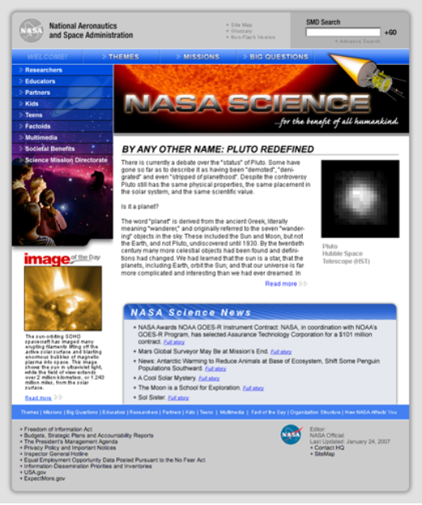
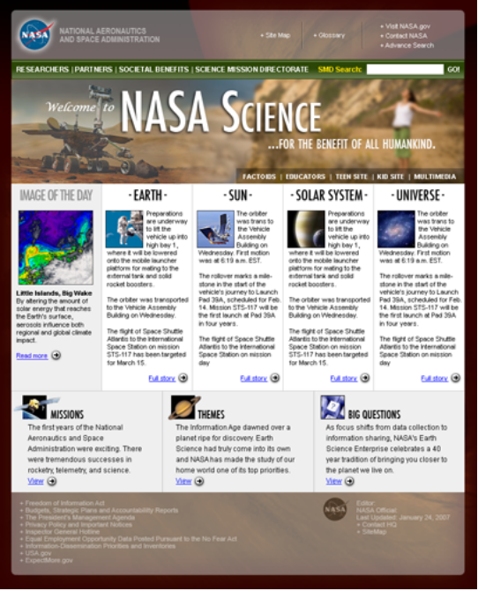
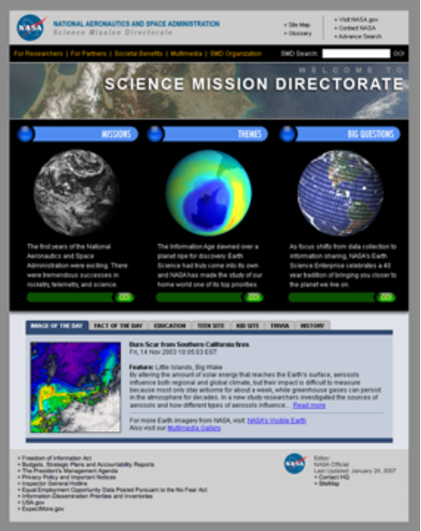
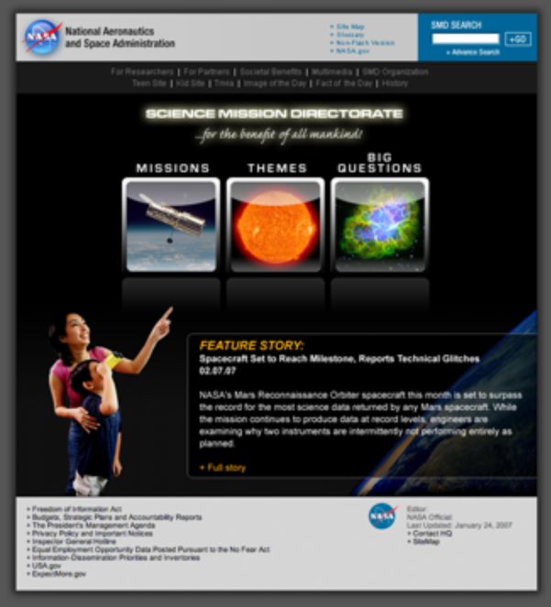
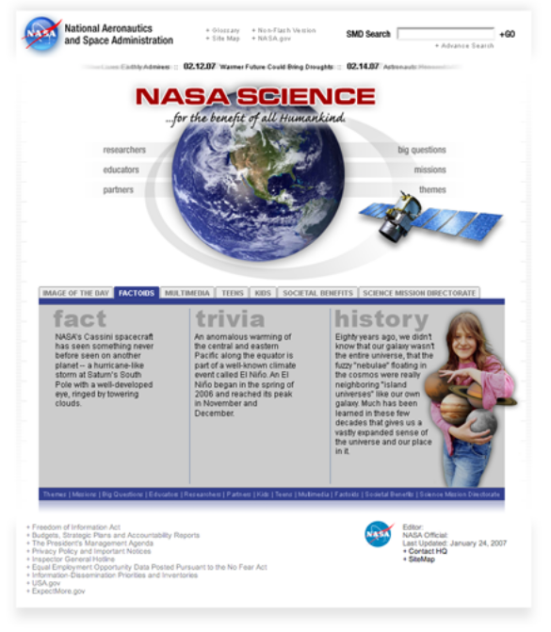
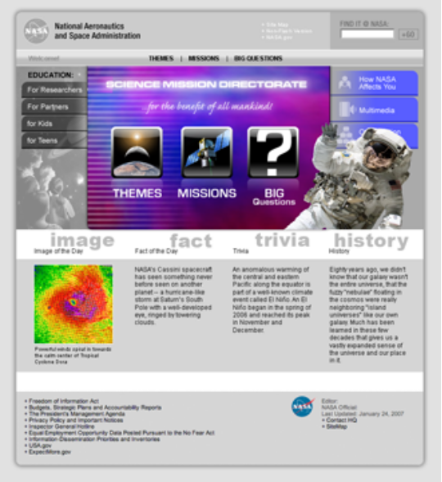
Brainstorming
Notes:
* Large project -> either lots of ideas, or none. We had LOTS!
* Ideas for new sections (Big Questions), rethinking how to approach the data (Nix the solar system)‏
- The days of brainstorming with walls and lots... And lots... Of stickies.
* And yes, new ways of presenting data

Slide 18
Usability
Lots of usability work!
  Card sort
  Design comparisons
  Navigation structure
  Questionnaires
  Independent Audits
Notes:
We did a LOT of usability testing. (Up to our fourth study)‏
* Card sort
* Design comparisons
* Navigation structure
* Questionnaires
* Independent Audits
Ongoing!
Neat findings:
The designs we THOUGHT were going to do well didn’t
People couldn’t always find the data we thought was obvious (Moon -- in Planetary or Earth)?
How quick people were to search (2 second look!)‏
Everyone came. Even developers, even designers, even documentation people.

Slide 19
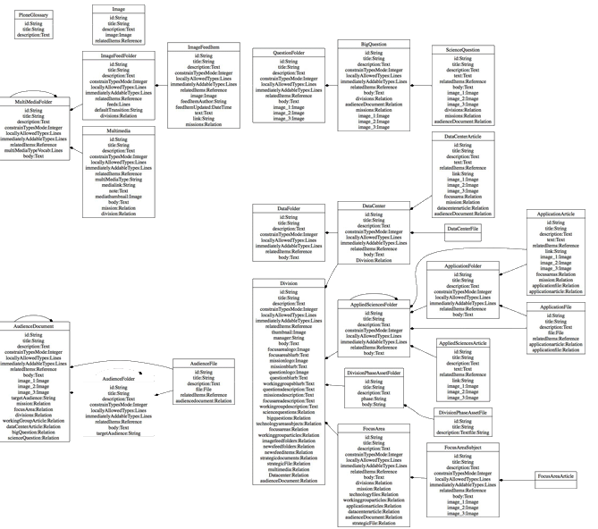
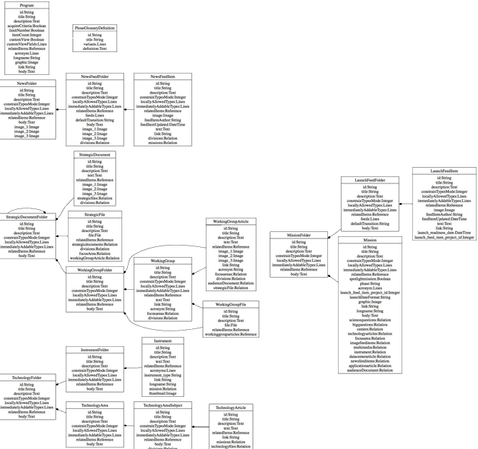
Site Architecture
Notes:
As you can see -- We had a complex site structure
- Modeled around data types unique to NASA SMD (missions, programs, technology)‏
- Ended up writing a product to keep up with the UML (UMLizer)‏
Also have:
- Built in feedback system (old system run by email, so built to eventually fail)‏
- Mini-products (added every release)‏
- Complex backend architecture for multiple QA and testing locations
- Phased restarts for zero downtime on new builds

Slide 20
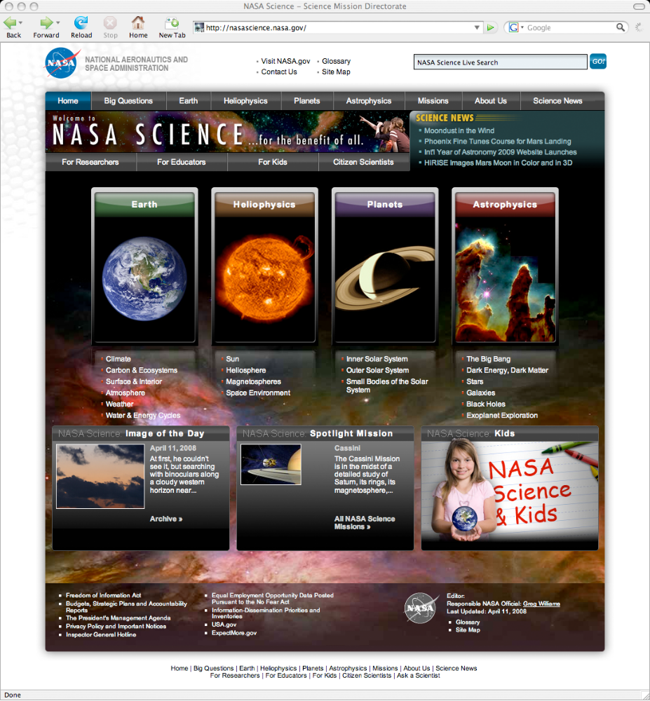
The Site Today
Notes:
Still growing
6 week develop/deploy cycles
New sections still coming in - Kids, technology, teens
Evolves as NASA’s missions evolve.
Also changes as NASA’s tech community comes together (RSS, shared hosting)‏

Slide 21
The Site Today
nasascience.nasa.gov

Slide 22
The Site Today
Interesting Details
  4 Zope Instances
  1 Zeo Instance
  Varnish
  Apache
  LDAP
  Trac
Notes:
Be quick and don't read the bullets
Tell people to track down Alex Clark, Chris Shenton and Reed O'Brien

Slide 23
Lessons learned
Requirements
go
two ways
Notes:
- Requirements - Get them and nail them first!

Slide 24
Lessons learned
Vetting
Notes:
- Vette the capabilities of your group
------------------------------------------
Make sure people can do what you need.
- CSS utility wizards != CSS layout skills (especially when 508 comes around)‏
- Real JavaScript, not cut-and-paste
- Managers need to understand your skillset! You also need to be vocal about what your skillset is.

Slide 25
Lessons learned
Training
is
worth
the
investment
Notes:
Get lots of training
---------------------
- Conferences
- Boot camps

Slide 26
Lessons learned
Use
the
community
Notes:
Anything you do that seems hard has been done
-----------------------------------------------
Plone (and Python) is built by people who like to tackle hard
problems. So odds are if you are doing it yourself someone else has already...
- ...done it better.
- ...done it according to some official specifications.

Slide 27
Lessons learned
Find
the
Masters
Notes:
Find a guru
------------
- Befriend them
- Show appreciation
- Buy them stuff

Slide 28
Lessons learned
Investigate
3rd
party
products
carefully
Notes:
Carefully evaluate any 3rd Party Products
------------------------------------------------
- Late night Alexander Limi: 'One measure of a Plone Developer's skill is their ability to evaluate what others have done'

Slide 29
Lessons learned
Untested Code
is
Broken Code
Notes:
Carefully evaluate any 3rd Party Products
------------------------------------------------
- Late night Alexander Limi: 'One measure of a Plone Developer's skill is their ability to evaluate what others have done'

Slide 30
Going Forward
Things in the works
Notes:
things to come

Slide 31
Going Forward
Migration to Plone 3
  Portlets!
  Generic Setup improvements
  Many awesome products
Notes:
Portlets mean we can do a lot of cleanup
We have older Zope so Generic Setup is not as powerful as we want
Access to all the Plone 3 goodness!

Slide 32
Going Forward
Migration to Plone 3
  Portlets!
  Generic Setup improvements
  Many awesome products
More syndication
  Incoming RSS feeds (FeedFeeder 2)‏
  Outgoing RSS/Atom feeds (Vice?)‏
Notes:
Work with the Van Rees to redo FeedFeeder to be more flexible with handling bad RSS feeds because we have 6 week development cycles.

Slide 33
Going Forward
Migration to Plone 3
  Portlets!
  Generic Setup improvements
  Many awesome products
More syndication
  Incoming RSS feeds (FeedFeeder 2)‏
  Outgoing RSS/Atom feeds (Vice?)‏
Embedding Videos
Notes:
Need to embed videos hosted on the NASA portal

Slide 34
Going Forward
Release Umlizer as Open Source
  http://nasascience.nasa.gov/contact-info
  Request that Umlizer be released under the NOSA license!
Notes:
Please for requests that Umlizer be released as open source to help the plone community

Slide 35
Going Forward
Migration to Plone 3
  Portlets!
  Generic Setup improvements
  Many awesome products
More syndication
  Incoming RSS feeds (FeedFeeder 2)‏
  Outgoing RSS/Atom feeds (Vice?)‏
Embedding Videos
Working with the NASA Portal team
Notes:
Infrastructure back end stuff

Slide 36
Going Forward
NASA SMD
is
happy!
(Which means other upcoming Plone projects)‏
Notes:
Most internal, some internal, more to come!

