Slide 1
Tools for Scientific Computing in Python
Travis Oliphant and Eric Jones
oliphant@enthought.com
eric@enthought.com
Enthought, Inc.
www.enthought.com
PyCon 2008

Slide 2
Scientific Tool Stack
NumPy
SciPy
IPython
Plotting -- Matplotlib or Chaco
3D Visualization Mayavi

Slide 3
SciPy

Slide 4
Overview
Available at www.scipy.org
Open Source BSD Style License
34 svn “committers” to the project
CURRENT PACKAGES
Special Functions (scipy.special)
Signal Processing (scipy.signal)
Image Processing (scipy.ndimage)
Fourier Transforms (scipy.fftpack)
Optimization (scipy.optimize)
Numerical Integration (scipy.integrate)
Linear Algebra (scipy.linalg)
Input/Output (scipy.io)
Statistics (scipy.stats)
Fast Execution (scipy.weave)
Clustering Algorithms (scipy.cluster)
Sparse Matrices (scipy.sparse)
Interpolation (scipy.interpolate)
More (e.g. scipy.odr, scipy.maxentropy)

Slide 5
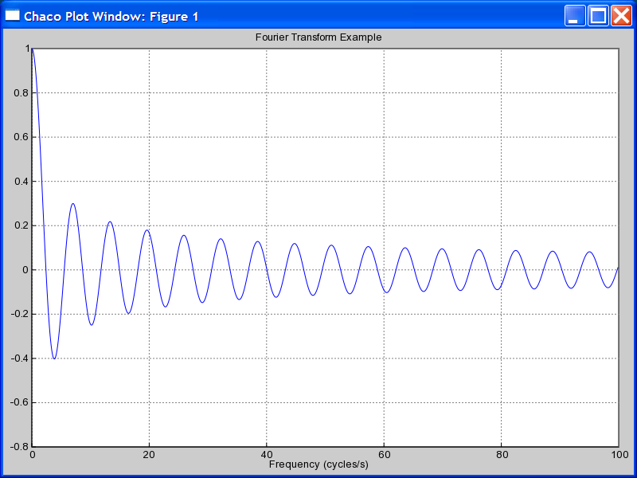
Special Functions
scipy.special
Includes over 200 functions:
Airy, Elliptic, Bessel, Gamma, HyperGeometric, Struve, Error, Orthogonal Polynomials, Parabolic Cylinder, Mathieu, Spheroidal Wave, Kelvin
FIRST ORDER BESSEL EXAMPLE
>>> from scipy import special
>>> x = r_[0:100:0.1]
>>> j0x = special.j0(x)
>>> plot(x,j0x)

Slide 6
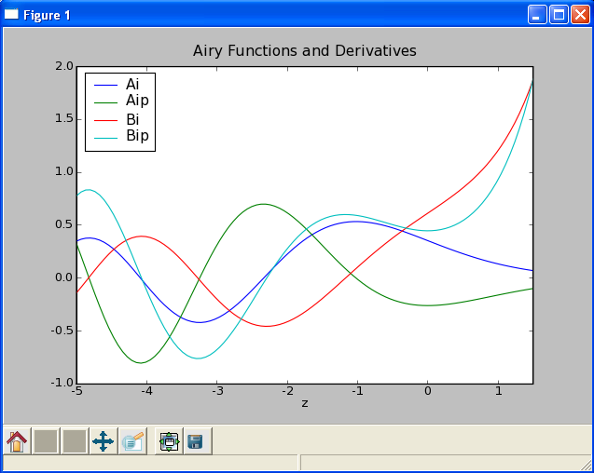
Special Functions
scipy.special
AIRY FUNCTIONS EXAMPLE
>>> z = r_[-5:1.5:100j]
>>> vals = special.airy(z)
>>> plot(z,array(vals).T)
>>> legend(['Ai', 'Aip', ‘Bi‘,'Bip'])
>>> xlabel('z’)
>>> title('Airy Functions and Derivatives‘)

Slide 7
Interpolation
scipy.interpolate --- General purpose Interpolation
1-d Interpolating Class
  Constructs callable function from data points and desired spline interpolation order.
  Function takes vector of inputs and returns interpolated value using the spline.
1-d and 2-d spline interpolation (FITPACK)
  Smoothing splines up to order 5
  Parametric splines

Slide 8
Interpolation Tools Available
# Interpolation is currently spread all over SciPy. Give people pointers on where to look for various capabilities.
Also, provide information about which methods work better for different kinds of data (especially multi-dimensional). Perhaps this is a separate slide.

Slide 9
1D Spline Interpolation
# Cover interp1d\ and all its options.

Slide 10
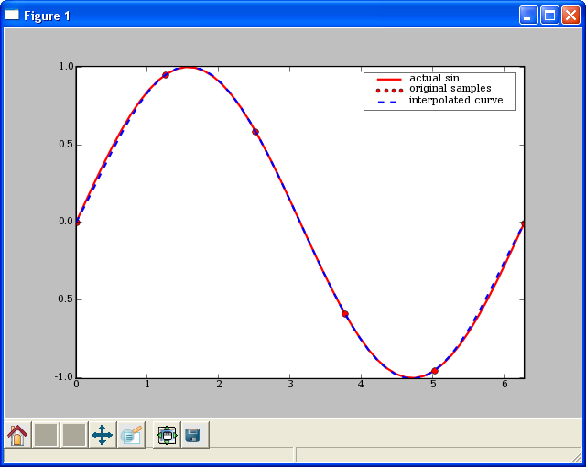
1D Spline Interpolation
# demo/interpolate/spline.py
from scipy.interpolate import interp1d
from pylab import plot, axis, legend
from numpy import linspace
# sample values
x = linspace(0,2*pi,6)
y = sin(x)
# Create a spline class for interpolation.
# kind=5 sets to 5th degree spline.
# kind=0 -> zeroth order hold.
# kind=1 or ‘linear’ -> linear interpolation
# kind=2 or
spline_fit = interp1d(x,y,kind=5)
xx = linspace(0,2*pi, 50)
yy = spline_fit(xx)
# display the results.
plot(xx, sin(xx), 'r-', x,y,'ro',xx,yy, 'b--',linewidth=2)
axis('tight')
legend(['actual sin', 'original samples', 'interpolated curve'])

Slide 11
2D Spline Interpolation
# Need an example for this.

Slide 12
Signal Processing
scipy.signal --- Signal and Image Processing
What’s Available?
Filtering
  General 2-D Convolution (more boundary conditions)
  N-D convolution
  B-spline filtering
  N-D Order filter, N-D median filter, faster 2d version,
  IIR and FIR filtering and filter design
LTI systems
  System simulation
  Impulse and step responses
  Partial fraction expansion

Slide 13
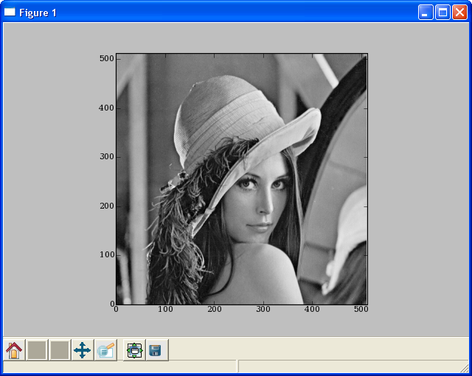
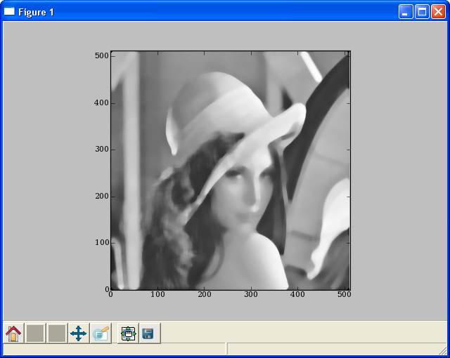
Image Processing
# The famous lena image is packaged with scipy
>>> from scipy import lena, signal
>>> lena = lena().astype(float32)
>>> imshow(lena, cmap=cm.gray)
# Blurring using a median filter
>>> fl = signal.medfilt2d(lena, [15,15])
>>> imshow(fl, cmap=cm.gray)
LENA IMAGE
MEDIAN FILTERED IMAGE

Slide 14
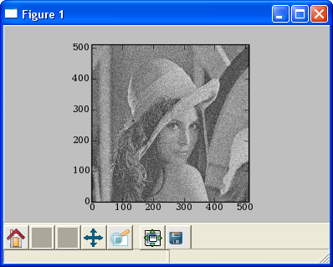
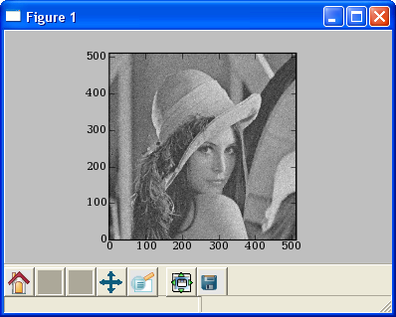
Image Processing
# Noise removal using wiener filter
>>> from scipy.stats import norm
>>> ln = lena + norm(0,32).rvs(lena.shape)
>>> imshow(ln)
>>> cleaned = signal.wiener(ln)
>>> imshow(cleaned)
NOISY IMAGE
FILTERED IMAGE

Slide 15
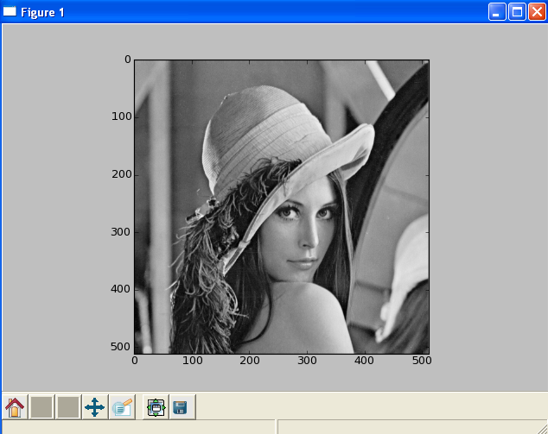
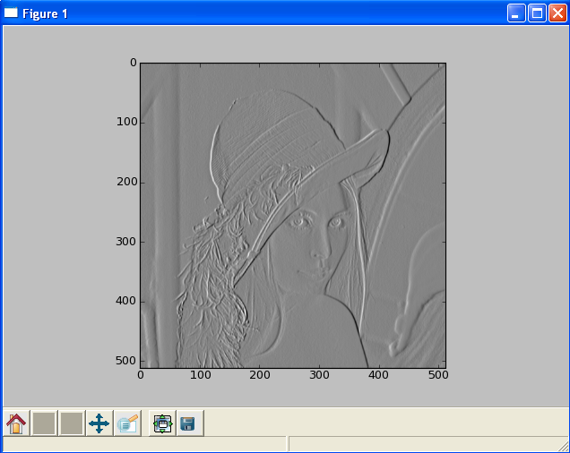
Image Processing
# Edge detection using Sobel filter
>>> from scipy.ndimage.filters import sobel
>>> imshow(lena)
>>> edges = sobel(lena)
>>> imshow(edges)
NOISY IMAGE
FILTERED IMAGE

Slide 16
Filter Design
# Use Remez and other tools to design various low and high pass filters.

Slide 17
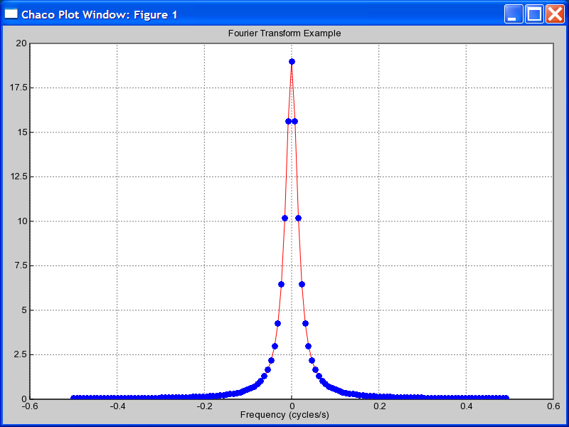
FFT
scipy.fft --- FFT and related functions
>>> n = fftfreq(128)*128
>>> f = fftfreq(128)
>>> ome = 2*pi*f
>>> x = (0.9)**abs(n)
>>> X = fft(x)
>>> z = exp(1j*ome)
>>> Xexact = (0.9**2 - 1)/0.9*z / \
... (z-0.9) / (z-1/0.9)
>>> f = fftshift(f)
>>> plot(f, fftshift(X.real),'r-',
... f, fftshift(Xexact.real),'bo')
>>> title('Fourier Transform Example')
>>> xlabel('Frequency (cycles/s)')
>>> axis(-0.6,0.6, 0, 20)

Slide 18
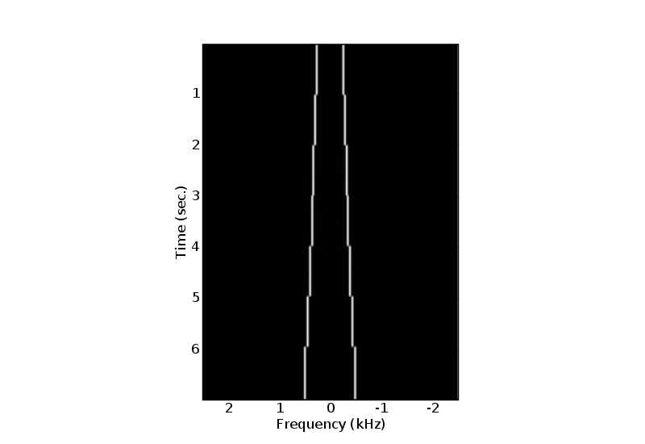
FFT
EXAMPLE --- Short-Time Windowed Fourier Transform
rate, data = read('scale.wav')
dT, T_window = 1.0/rate, 50e-3
N_window = int(T_window * rate)
N_data = len(data)
window = get_window('hamming', N_window)
result, start = [], 0
# compute short-time FFT for each block
while (start < N_data – N_window):
end = start + N_window
val = fftshift(fft(window*data[start:end]))
result.append(val)
start = end
lastval = fft(window*data[-N_window:])
result.append(fftshift(lastval))
result = array(result,result[0].dtype)

Slide 19
FFT Algorithms
Discuss
FFTW, fftpack, djbfft, etc.

Slide 20
FFT Methods
Discuss
Fftfreq, and the other functions available in the fft modules.

Slide 21
Hilbert Transform
Hilbert Transform, etc.

Slide 22
Signal/Image Tools Available
# Which libraries in SciPy have these functions? Where should people generally look for various capabilities.
Also, provide information about which methods work better for different kinds of data (especially multi-dimensional). Perhaps this is a separate slide.

Slide 23
Optimization
scipy.optimize --- unconstrained minimization and root finding
Unconstrained Optimization
  fmin (Nelder-Mead simplex), fmin_powell (Powell’s method), fmin_bfgs (BFGS quasi-Newton method), fmin_ncg (Newton conjugate gradient), leastsq (Levenberg-Marquardt), anneal (simulated annealing global minimizer), brute (brute force global minimizer), brent (excellent 1-D minimizer), golden, bracket
Constrained Optimization
  fmin_l_bfgs_b, fmin_tnc (truncated newton code), fmin_cobyla (constrained optimization by linear approximation), fminbound (interval constrained 1-d minimizer)
Root finding
  fsolve (using MINPACK), brentq, brenth, ridder, newton, bisect, fixed_point (fixed point equation solver)

Slide 24
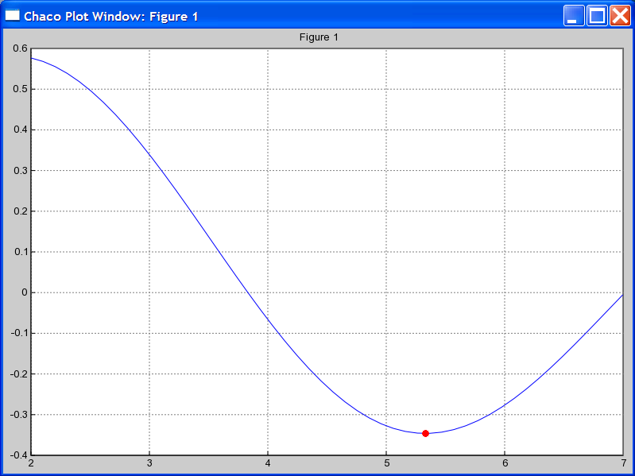
Optimization
EXAMPLE: MINIMIZE BESSEL FUNCTION
# minimize 1st order bessel
# function between 4 and 7
>>> from scipy.special import j1
>>> from scipy.optimize import \
fminbound
>>> x = r_[2:7.1:.1]
>>> j1x = j1(x)
>>> plot(x,j1x,’-’)
>>> hold(True)
>>> x_min = fminbound(j1,4,7)
>>> j1_min = j1(x_min)
>>> plot([x_min],[j1_min],’ro’)

Slide 25
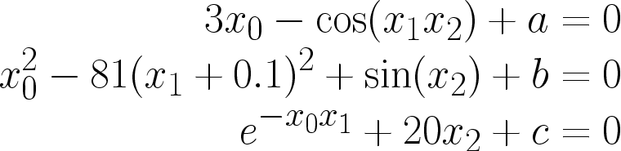
Optimization
EXAMPLE: SOLVING NONLINEAR EQUATIONS
Solve the non-linear equations
>>> def nonlin(x,a,b,c):
>>> x0,x1,x2 = x
>>> return [3*x0-cos(x1*x2)+ a,
>>> x0*x0-81*(x1+0.1)**2 + sin(x2)+b,
>>> exp(-x0*x1)+20*x2+c]
>>> a,b,c = -0.5,1.06,(10*pi-3.0)/3
>>> root = optimize.fsolve(nonlin, [0.1,0.1,-0.1],args=(a,b,c))
>>> print root
[ 0.5 0. -0.5236]
>>> print nonlin(root,a,b,c)
[0.0, -2.231104190e-12, 7.46069872e-14]
starting location for search

Slide 26
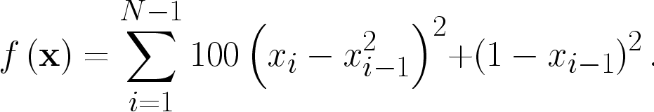
Optimization
EXAMPLE: MINIMIZING ROSENBROCK FUNCTION
Rosenbrock function
WITHOUT DERIVATIVE
USING DERIVATIVE
>>> rosen = optimize.rosen
>>> import time
>>> x0 = [1.3,0.7,0.8,1.9,1.2]
>>> start = time.time()
>>> xopt = optimize.fmin(rosen,
x0, avegtol=1e-7)
>>> stop = time.time()
>>> print_stats(start, stop, xopt)
Optimization terminated successfully.
Current function value: 0.000000
Iterations: 316
Function evaluations: 533
Found in 0.0805299282074 seconds
Solution: [ 1. 1. 1. 1. 1.]
Function value: 2.67775760157e-15
Avg. Error: 1.5323906899e-08
>>> rosen_der = optimize.rosen_der
>>> x0 = [1.3,0.7,0.8,1.9,1.2]
>>> start = time.time()
>>> xopt = optimize.fmin_bfgs(rosen,
x0, fprime=rosen_der, avegtol=1e-7)
>>> stop = time.time()
>>> print_stats(start, stop, xopt)
Optimization terminated successfully.
Current function value: 0.000000
Iterations: 111
Function evaluations: 266
Gradient evaluations: 112
Found in 0.0521121025085 seconds
Solution: [ 1. 1. 1. 1. 1.]
Function value: 1.3739103475e-18
Avg. Error: 1.13246034772e-10

Slide 27
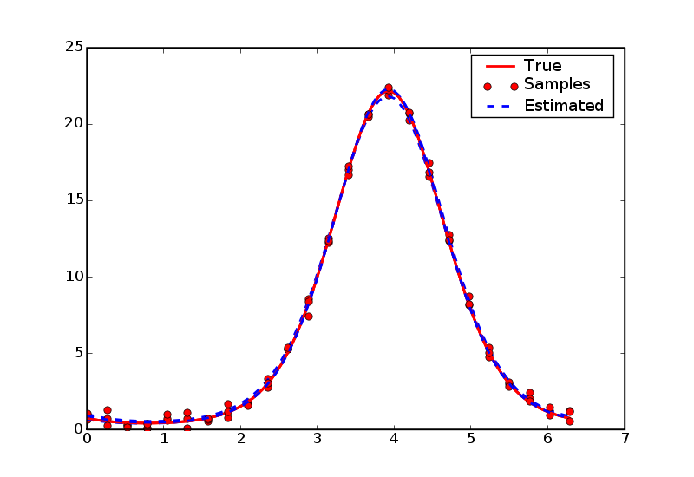
Optimization
EXAMPLE: Non-linear least-squares data fitting
# fit data-points to a curve
# demo/data_fitting/datafit.py
>>> from numpy.random import randn
>>> from numpy import exp, sin, pi
>>> from numpy import linspace
>>> from scipy.optimize import leastsq
>>> def func(x,A,a,f,phi):
return A*exp(-a*sin(f*x+pi/4))
>>> def errfunc(params, x, data):
return func(x, *params) - data
>>> ptrue = [3,2,1,pi/4]
>>> x = linspace(0,2*pi,25)
>>> true = func(x, *ptrue)
>>> noisy = true + 0.3*randn(len(x))
>>> p0 = [1,1,1,1]
>>> pmin, ier = leastsq(errfunc, p0,
args=(x, noisy))
>>> pmin
array([3.1705, 1.9501, 1.0206, 0.7034])

Slide 28
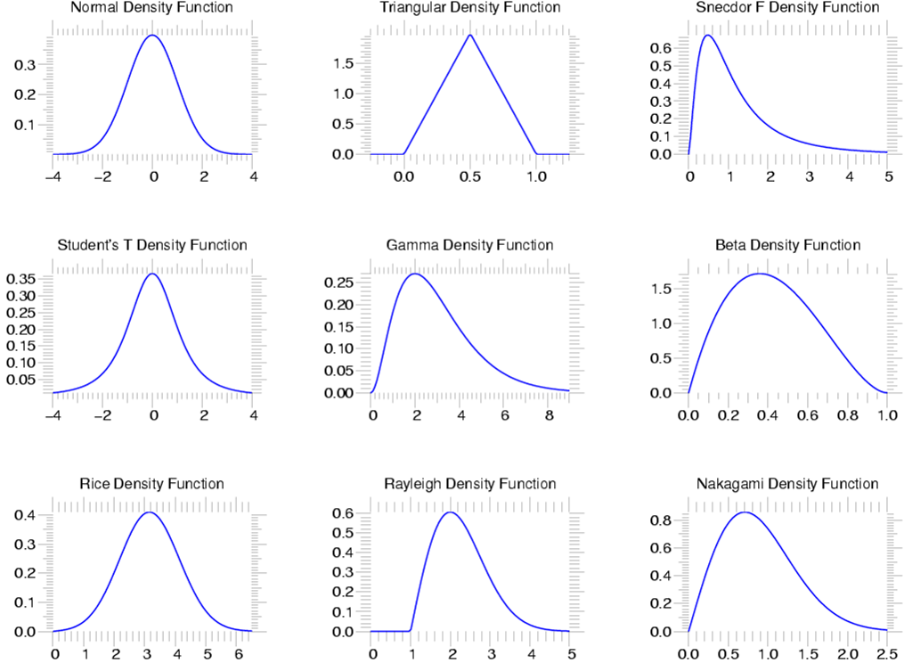
Statistics
scipy.stats --- CONTINUOUS DISTRIBUTIONS
over 80 continuous distributions!
METHODS
pdf
cdf
rvs
ppf
stats

Slide 29
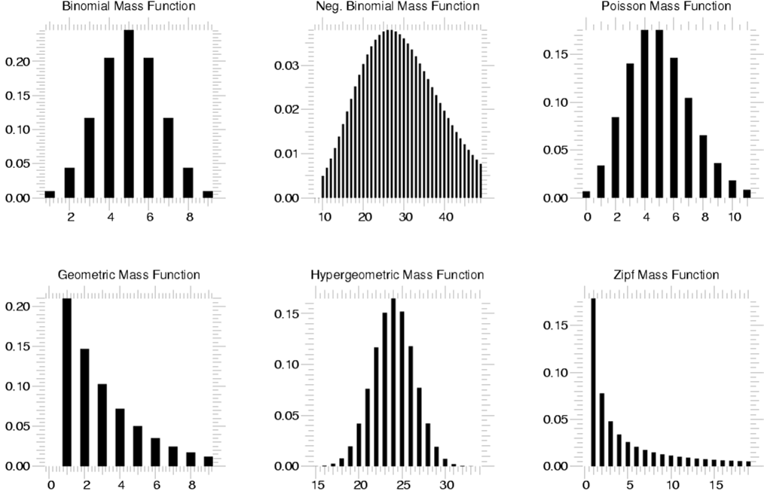
Statistics
scipy.stats --- Discrete Distributions
10 standard discrete distributions (plus any arbitrary finite RV)
METHODS
pdf
cdf
rvs
ppf
stats

Slide 30
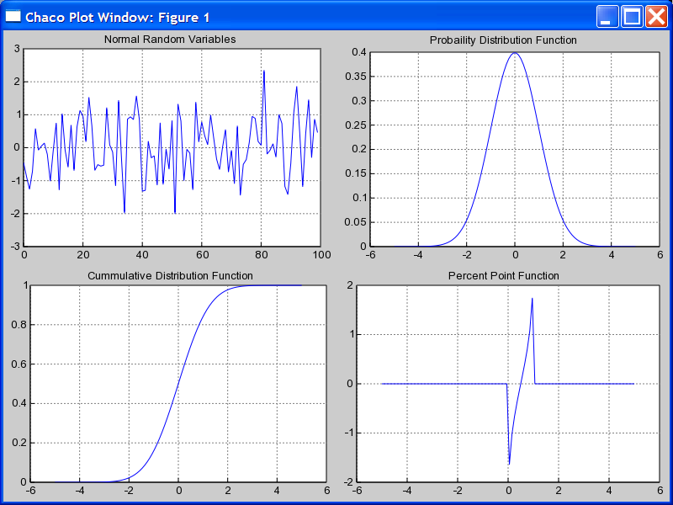
Using stats objects
DISTRIBUTIONS
# Sample normal dist. 100 times.
>>> samp = stats.norm.rvs(size=100)
>>> x = r_[-5:5:100j]
# Calculate probability dist.
>>> pdf = stats.norm.pdf(x)
# Calculate cummulative Dist.
>>> cdf = stats.norm.cdf(x)
# Calculate Percent Point Function
>>> ppf = stats.norm.ppf(x)

Slide 31
Statistics
scipy.stats --- Basic Statistical Calculations on Data
numpy.mean, numpy.std, numpy.var, numpy.cov
stats.skew, stats.kurtosis, stats.moment
scipy.stats.bayes_mvs --- Bayesian mean, variance, and std.
# Create “frozen” Gamma distribution with a=2.5
>>> grv = stats.gamma(2.5)
>>> grv.stats() # Theoretical mean and variance
(array(2.5), array(2.5))
# Estimate mean, variance, and std with 95% confidence
>>> vals = grv.rvs(size=100)
>>> stats.bayes_mvs(vals, alpha=0.95)
((2.52887906081, (2.19560839724, 2.86214972438)),
(2.87924964268, (2.17476164549, 3.8070215789)),
(1.69246760584, (1.47470730841, 1.95115903475)))
# (expected value and confidence interval for each of
# mean, variance, and standard-deviation)

Slide 32
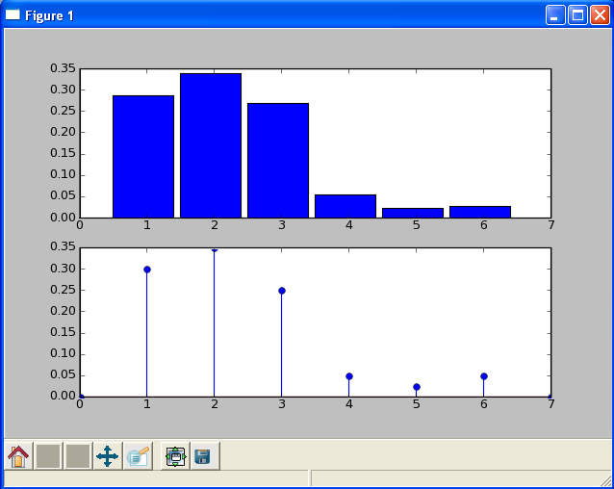
Using stats objects
CREATING NEW DISCRETE DISTRIBUTIONS
# Create a loaded dice.
>>> from scipy.stats import rv_discrete
>>> xk = [1,2,3,4,5,6]
>>> pk = [0.3,0.35,0.25,0.05,
0.025,0.025]
>>> new = rv_discrete(name='loaded',
values=(xk,pk))
# Calculate histogram
>>> samples = new.rvs(size=1000)
>>> bins=linspace(0.5,5.5,6)
>>> subplot(211)
>>> hist(samples,bins=bins,normed=True)
# Calculate pmf
>>> x = range(0,8)
>>> subplot(212)
>>> stem(x,new.pmf(x))

Slide 33
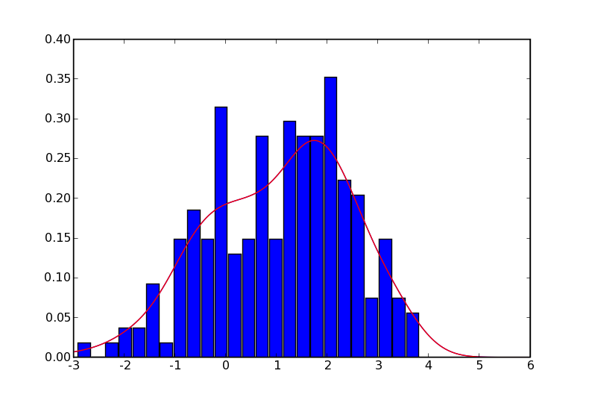
Statistics
Continuous PDF Estimation using Gaussian Kernel Density Estimation
# Sample normal dist. 100 times.
>>> rv1 = stats.norm()
>>> rv2 = stats.norm(2.0,0.8)
>>> samp = r_[rv1.rvs(size=100),
rv2.rvs(size=100)]
# Kernel estimate (smoothed histogram)
>>> apdf = stats.kde.gaussian_kde(samp)
>>> x = linspace(-3,6,200)
>>> plot(x, apdf(x),’r’)
# Histogram
>>> hist(x, bins=25, normed=True)

Slide 34
Linear Algebra
scipy.linalg --- FAST LINEAR ALGEBRA
Uses ATLAS if available --- very fast
Low-level access to BLAS and LAPACK routines in modules linalg.fblas, and linalg.flapack (FORTRAN order)
High level matrix routines
  Linear Algebra Basics: inv, solve, det, norm, lstsq, pinv
  Decompositions: eig, lu, svd, orth, cholesky, qr, schur
  Matrix Functions: expm, logm, sqrtm, cosm, coshm, funm (general matrix functions)

Slide 35
Linear Algebra
LU FACTORIZATION
EIGEN VALUES AND VECTORS
>>> from scipy import linalg
>>> a = array([[1,3,5],
... [2,5,1],
... [2,3,6]])
# time consuming factorization
>>> lu, piv = linalg.lu_factor(a)
# fast solve for 1 or more
# right hand sides.
>>> b = array([10,8,3])
>>> linalg.lu_solve((lu, piv), b)
array([-7.82608696, 4.56521739,
0.82608696])
>>> from scipy import linalg
>>> a = array([[1,3,5],
... [2,5,1],
... [2,3,6]])
# compute eigen values/vectors
>>> vals, vecs = linalg.eig(a)
# print eigen values
>>> vals
array([ 9.39895873+0.j,
-0.73379338+0.j,
3.33483465+0.j])
# eigen vectors are in columns
# print first eigen vector
>>> vecs[:,0]
array([-0.57028326,
-0.41979215,
-0.70608183])
# norm of vector should be 1.0
>>> linalg.norm(vecs[:,0])
1.0

Slide 36
Python as “Glue”

Slide 37
Why?
Interfacing with Legacy Code
Speed up “Hot spots” in existing code by moving them to C or Fortran.

Slide 38
A Case Study for Transitioning from F90 to Python

Slide 39
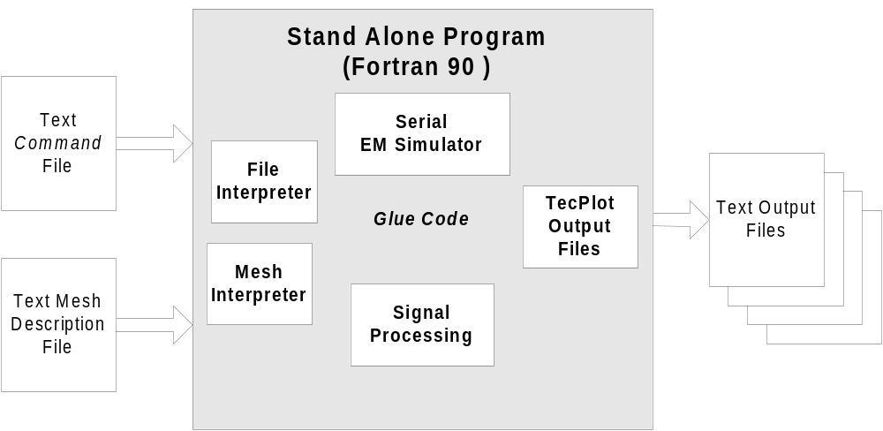
Legacy System

Slide 40
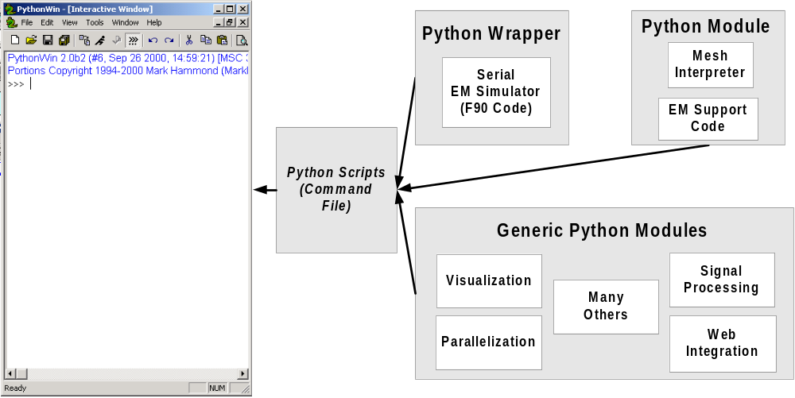
The Python Approach

Slide 41
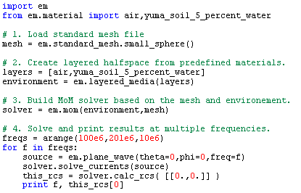
Simple Input Script

Slide 42
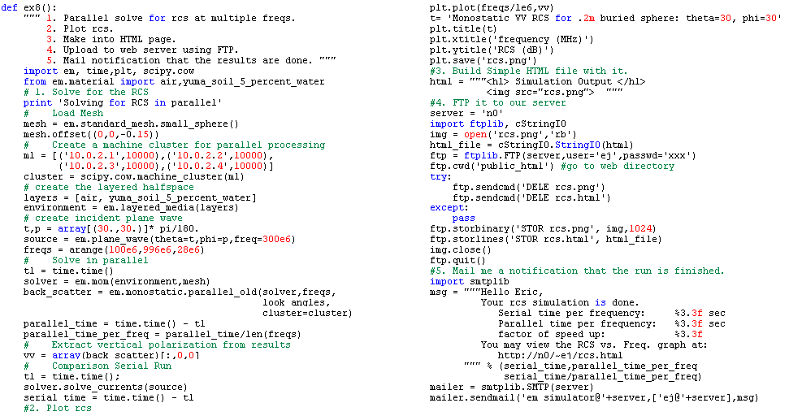
Electromagnetics Example
Parallel simulation
Create plot
Build HTML page
FTP page to Web Server
E-mail users that results are available.

Slide 43
General issues with Fortran
Fortran 77 encouraged the use of a large number of globals.
  causes states within wrapped modules.
  makes threading difficult
Legacy code is often not very modular.
  occasionally one or two very long functions that do absolutely everything.
Fortran 77 doesn’t handle memory allocation well
Fortran 90 objects don’t map easily to C structures (the underpinnings of Python)

Slide 44
Global variables – here’s the rub
MODULE WITH GLOBALS CALLED SAFELY…
# Global variables create states in modules
>>> import f90_module
# f1() returns an array and also quietly sets a global variable zzz
>>> a = f90_module.f1(5,6) # → zzz = 5
# f2() uses a AS WELL AS zzz
>>> f90_module.f2(a)
xxx # returns some value
AND THE HAVOC AN INTERMEDIATE CALL CAN CAUSE
# Users of interactive interpreters and scripting languages can and # do call functions in a variety of orders. As a result, they can
# unknowingly corrupt the internal state of the module.
>>> a = f90_module.f1(5,6) # → zzz = 5
# user makes additional call to f1 with different variables
>>> b = f90_module.f1(20,30) # → zzz = 20
# Now user calls f2 expecting to get same answer as above
>>> f90_module.f2(a)
yyy #Yikes! result is different because globals were different

Slide 45
Solutions to global variables
  Remove the ability of calling functions out of order by wrapping functions at the highest level.
# users call the following instead of f1 and f2 individually
def wrapper_for_f1_and_f2(a,b):
c = f90_module.f1_QUITELY_SETS_LOCAL_VARIABLES(a,b)
return f90_module.f2_that_uses_a_AND_GLOBAL_VARIABLES(c)
  2. Get rid of global variables and include them in the argument list for functions. (The best option, but potentially a lot of work)
# Return the affected global variables b, c, and d.
>>> a,b,c,d = f90_module.f1(5,6)
# Now call f2 passing in the variables that used to be global
>>> f90_module.f2 (a,b,c,d)

Slide 46
Problems with non-modularity
  Generally only want to wrap Fortran simulation engine and leave pre and post processing to Python.
  If input/engine/output are all closely coupled or live in one huge function (worst case), it is extremely difficult to find convenient places in the code to hook into the simulator

Slide 47
Solutions to modularity
  For codes not written with modularity in mind, this is a lot of work. Try and find logical boundaries in the code and rewrite long functions that do several things as multiple functions that do only one thing.
  Dividing the code into smaller functions has other advantages also. It generally leads to more readable and robust code, and it facilitates unit testing. A suite of unit tests can be run on each of the functions after code changes to quickly locate bugs.
  See PyUnit at http://pyunit.sourceforge.net/

Slide 48
The starting place for our code
  Fortunately, Norbert and Larry had written a very good piece of F90 software that is fairly modular and had only a few global variables – the impedance matrix being the main one.
  We chose to expose only three functions:
  tpm_hs_cfie_zcomplete()
  Given a problem description, this function creates the impedance matrix.
  tpm_hs_pwi_cfie_vdrive()
  Given a problem description and a source, calculate the right hand side.
  tpm_hs_ffs_pec_smatrix()
  Given the problem description and currents, calculate
  the far field in a given direction.

Slide 49
Memory allocation & generic math
All memory allocation is handled in Python
Mathematically general operations are left to Python.
  Linear Algebra is handled by a wrapper to netlib’s LAPACK.
  FFT’s are handled by a wrapper to netlib’s FFTPACK. FFTW wrappers are also available.

Slide 50
Long argument lists
  Fortran encourages long argument lists – unless you use globals which we did not allow. One of our typical functions has 21 arguments. This is unmanageable for an interactive interface.
subroutine tpm_hs_pwi_cfie_vdrive (alpha,i12,e0,cfreq,thi,phi,
epstj,muej,halfspace,tnj,
tnjmax,tnn,tnnmax,tnp,
tnpmax, tx3j,tj3p,tn6p,vmth,
vmph,errlog,errtxt)
  Black arguments affect the CFIE equation.
  Red arguments describe the source.
  Green arguments describe the environment.
  Orange arguments describe the target mesh.
  Blue arguments are return values from the function

Slide 51
Solution to long argument lists
Python wrappers alone remove the need for 9 arguments by removing array indices and return arguments.
vmth,vmph,errlog,errtxt = tpm_hs_pwi_cfie_vdrive(alpha,i12,
e0,cfreq,thi,phi,epstj,muej,
halfspace,tnn,tx3j,tj3p,tn6p)
Using classes to group the other arguments can further simply the interface and facilitate user interaction.

Slide 52

Object oriented view of problem
Problem Definition
  Environment
    free-space/ half-space, material types
  Target description
    mesh and perhaps material types
Source Signal
    near/far, time/frequency domain
An algorithm for solving the problem
    MoM, MLFMA, FDTD, etc
The words highlighted in blue indicate objects that are used as objects in the Python interface to the Duke MoM code.

Slide 53
Using the OO interface
# 1. Specify the mesh you would like to use.
>>> import em
>>> mesh = em.standard_mesh.small_sphere()
# 2. Perhaps burry it .15 meters underground.
# (sphere radius is 0.10 meters)
>>> mesh.offset((0,0,-0.15))
# 3. Specify the layers of materials in the environment.
>>> from em.material import air,yuma_soil_5_percent_water
>>> layers = [air, yuma_soil_5_percent_water]
>>> environment = em.layered_media(layers)
# 4. Build a MoM solver for this mesh and environment.
>>> solver = em.mom(environment,mesh)
# 5. Specify a source frequency and angle (in radians)
# and solve for the currents on the mesh.
>>> source = em.plane_wave(theta=0,phi=0,freq=50e6)
>>> solver.solve_currents(source)
# 6. Post process. Here we'll calculate the monostatic
# scattered field.
>>> angles = [[0.,0.]]
>>> rcs = solver.calc_rcs(angles)

Slide 54
Review
Reduce usage of globals as much as possible when ever practical.
Divide large functions in to smaller pieces to provide more control over simulator.
Use Python to allocate memory arrays. f2py will handle converting them to Fortran arrays.
Be careful about using F90 constructs. They are difficult to wrap.
Object Oriented interfaces hide low level array representations and allow users to work with the actual components of the problem.

Slide 55
Tools
C/C++ Integration
  SWIG www.swig.org
  ctypes python standard library
  Pyrex nz.cosc.canterbury.ac.nz/~greg/python/Pyrex
  Cython http://www.cython.org/
  boost www.boost.org/libs/python/doc/index.html
  weave http://www.scipy.org/Weave
FORTRAN Integration
  f2py cens.ioc.ee/projects/f2py2e/ (now part of numpy)

Slide 56
Hand Wrapping

Slide 57
Image…
An image explaining what an extension module is…

Slide 58
The Wrapper Function
fact.h
fact.c
#ifndef FACT_H
#define FACT_H
int fact(int n);
#endif
#include “fact.h”
int fact(int n)
{
if (n <=1) return 1;
else return n*fact(n-1);
}
WRAPPER FUNCTION
static PyObject* wrap_fact(PyObject *self, PyObject *args)
{
/* Python-C data conversion */
int n, result;
if (!PyArg_ParseTuple(args, "i", &n))
return NULL;
/* C Function Call */
result = fact(n);
/* C->Python data conversion */
return Py_BuildValue("i", result);
}

Slide 59
Complete Example
/* Must include Python.h before any standard headers! */
#include "Python.h"
#include "fact.h“
/* Define the wrapper functions exposed to Python (must be static) */
static PyObject* wrap_fact(PyObject *self, PyObject *args) {
int n, result;
/* Python->C Conversion */
if (!PyArg_ParseTuple(args, "i", &n))
return NULL;
/* Call our function */
result = fact(n);
/* C->Python Conversion */
return Py_BuildValue("i", result);
}
/* Method table declaring the names of functions exposed to Python */
static PyMethodDef ExampleMethods[] = {
{"fact", wrap_fact, METH_VARARGS, "Calculate the factorial of n"},
{NULL, NULL, 0, NULL} /* Sentinel */
};
/* Module initialization function called at "import example" */
PyMODINIT_FUNC initexample(void) {
{ (void) Py_InitModule("example", ExampleMethods); }

Slide 60

Compiling your extension
BUILD BY HAND (PYTHON, ENTHOUGHT EDITION ON WINDOWS)
C:\...\demo\hand_wrap> gcc –c -fpic fact.c fact_wrap.c –I. \
–Ic:\python25\include
C:\...\demo\hand_wrap> gcc -shared fact.o fact_wrap.o \
-Lc:\python25\libs -lpython25 -o example.pyd
BUILD BY HAND (UNIX)
~\...\demo\hand_wrap> gcc –c -fpic fact.c fact_wrap.c –I. \
–I\usr\include\python25\include
~\...\demo\hand_wrap> gcc -shared fact.o fact_wrap.o \
-L\usr\lib\python2.5\config -lpython25 \
-o example.pyd
Note that include and library directories are platform specific. Also, be
sure to link against the appropriate version of python (2.5 in these examples).

Slide 61
Using setup.py
SETUP.PY
# setup.py files are the Python equivalent of Make
from distutils.core import setup, Extension
ext = Extension(name='example', sources=['fact_wrap.c', 'fact.c'])
setup(name="example", ext_modules=[ext])
CALLING SETUP SCRIPTS
# Build and install the module
[eric@monster hand_wrap] setup.py build
[eric@monster hand_wrap] setup.py install
# Or
# Build the module “inplace” to ease testing.
[eric@monster hand_wrap] setup.py build_ext --inplace \
--compiler=mingw32
* Blue text only needed on windows

Slide 62
Weave

Slide 63
weave
weave.blitz()
  Translation of Numeric array expressions to C/C++ for fast execution
weave.inline()
  Include C/C++ code directly in Python code for on-the-fly execution
weave.ext_tools
  Classes for building C/C++ extension modules in Python

Slide 64
weave.inline
>>> from scipy import weave
>>> a=1
>>> weave.inline(‘return_val = a;',['a'])
<weave: compiling>
creating c:\docume…_12e837eb1ea3ab5199fbcc0e83015e3f
1
>>> weave.inline(‘return_val = a;',['a'])
1
>>> a='qwerty'
>>> weave.inline(‘return_val = a;',['a'])
<weave: compiling>
creating c:\docume…_12e837eb1ea3ab5199fbcc0e83015e3f
qwerty
>>> weave.inline(‘return_val = a;',['a'])
qwerty

Slide 65
Support code example
>>> from scipy import weave
>>> a = 1
>>> support_code = ‘int bob(int val) { return val;}’
>>> weave.inline(‘return_val = bob(a);’,['a'],support_code=support_code)
<weave: compiling>
creating: c:\...sc_19f0a1876e0022290e9104c0cce4f00c0
1
>>> a = 'string'
>>> weave.inline(‘return_val = bob(a);’,['a'],support_code = support_code)
<weave: compiling>
creating: c:\...sc_19f0a1876e0022290e9104c0cce4f00c1
C:\DOCUME~1\eric\LOCALS~1\Temp\python25_compiled\sc_19f0a1876e0022290e9104c0cce4
f00c1.cpp(417) : error C2664: 'bob' : cannot convert parameter 1 from 'class Py:
:String' to 'int' No user-defined-conversion operator available that can
perform this conversion, or the operator cannot be called
Traceback (most recent call last):
<snip>
weave.build_tools.CompileError: error: command '"C:\Program Files\Microsoft Visu
al Studio\VC98\BIN\cl.exe"' failed with exit status 2

Slide 66
ext_tools example
import string
from scipy.weave import ext_tools
def build_ex1():
ext = ext_tools.ext_module('_ex1')
# Type declarations - define a sequence and a function
seq = []
func = string.upper
code = """
py::tuple args(1);
py::list result(seq.length());
for(int i = 0; i < seq.length();i++)
{
args[0] = seq[i];
result[i] = func.call(args);
}
return_val = result;
"""
func = ext_tools.ext_function('my_map',code,['func','seq'])
ext.add_function(func)
ext.compile()
try:
from _ex1 import *
except ImportError:
build_ex1()
from _ex1 import *
if __name__ == '__main__':
print my_map(string.lower,['asdf','ADFS','ADSD'])

Slide 67
Efficiency Issues
PSEUDO C FOR STANDARD NUMERIC EVALUATION
FAST, IDIOMATIC C CODE
>>> c = a + b + c
// c code
// tmp1 = a + b
tmp1 = malloc(len_a * el_sz);
for(i=0; i < len_a; i++)
tmp1[i] = a[i] + b[i];
// tmp2 = tmp1 + c
tmp2 = malloc(len_c * el_sz);
for(i=0; i < len_c; i++)
tmp2[i] = tmp1[i] + c[i];
>>> c = a + b + c
// c code
// 1. loops “fused”
// 2. no memory allocation
for(i=0; i < len_a; i++)
c[i] = a[i] + b[i] + c[i];
tmp1
tmp2

Slide 68
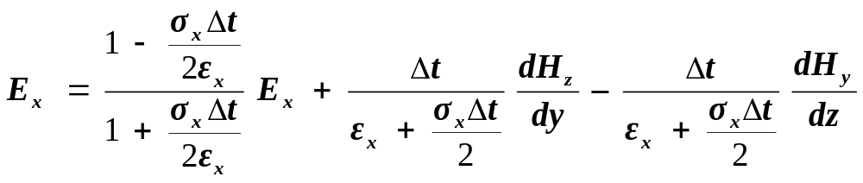
Finite Difference Equation
MAXWELL’S EQUATIONS: FINITE DIFFERENCE TIME DOMAIN (FDTD),
UPDATE OF X COMPONENT OF ELECTRIC FIELD
PYTHON VERSION OF SAME EQUATION, PRE-CALCULATED CONSTANTS
ex[:,1:,1:] = ca_x[:,1:,1:] * ex[:,1:,1:]
+ cb_y_x[:,1:,1:] * (hz[:,1:,1:] - hz[:,:-1,1:])
- cb_z_x[:,1:,1:] * (hy[:,1:,1:] - hy[:,1:,:-1])

Slide 69
weave.blitz
weave.blitz compiles array expressions to C/C++ code using the Blitz++ library.
WEAVE.BLITZ VERSION OF SAME EQUATION
>>> from scipy import weave
>>> # <instantiate all array variables...>
>>> expr = “ex[:,1:,1:] = ca_x[:,1:,1:] * ex[:,1:,1:]”\
“+ cb_y_x[:,1:,1:] * (hz[:,1:,1:] - hz[:,:-1,:])”\
“- cb_z_x[:,1:,1:] * (hy[:,1:,1:] - hy[:,1:,:-1])”
>>> weave.blitz(expr)
< 1. translate expression to blitz++ expression>
< 2. compile with gcc using array variables in local scope>
< 3. load compiled module and execute code>

Slide 70
weave.blitz benchmarks
Equation | Numeric (sec) | Inplace (sec) | compiler (sec) | Speed Up
Float (4 bytes)
a = b + c (512,512) | 0.027 | 0.019 | 0.024 | 1.13
a = b + c + d (512x512) | 0.060 | 0.037 | 0.029 | 2.06
5 pt. avg filter (512x512) | 0.161 | - | 0.060 | 2.68
FDTD (100x100x100) | 0.890 | - | 0.323 | 2.75
Double (8 bytes)
a = b + c (512,512) | 0.128 | 0.106 | 0.042 | 3.05
a = b + c + d (512x512) | 0.248 | 0.210 | 0.054 | 4.59
5 pt. avg filter (512x512) | 0.631 | - | 0.070 | 9.01
FDTD (100x100x100) | 3.399 | - | 0.395 | 8.61
Pentium II, 300 MHz, Python 2.0, Numeric 17.2.0
Speed-up taken as ratio of scipy.compiler to standard Numeric runs.
Notes:
Problem with this benchmark is that pickling and sending the large data array is much more expensive

Slide 71
weave.blitz benchmarks
Equation | Numpy 1.0.4 (sec) | Blitz (sec) | Speed Up
Float (4 bytes)
a = b + c (3000x3000) | 0.058 | 0.024 | 1.14
a = b + c + d (3000x3000) | 0.116 | .0756 | 1.54
5 pt. avg filter (3000x3000) | 0.314 | 0.211 | 1.49
FDTD (100x100x100) | - | - | -
Double (8 bytes)
a = b + c (3000x3000) | 0.114 | 0.093 | 1.22
a = b + c + d (3000x3000) | 0.230 | 0.139 | 1.65
5 pt. avg filter (3000x3000) | 0.586 | 0.183 | 3.20
FDTD (100x100x100) | - | - | -
Intel X5355 Xeon Quad Core, 2.66 GHz, 8 GB Memory
Linux, CentOS 5, Python 2.5.1, Numpy 1.0.4
Notes:
Problem with this benchmark is that pickling and sending the large data array is much more expensive

Slide 72
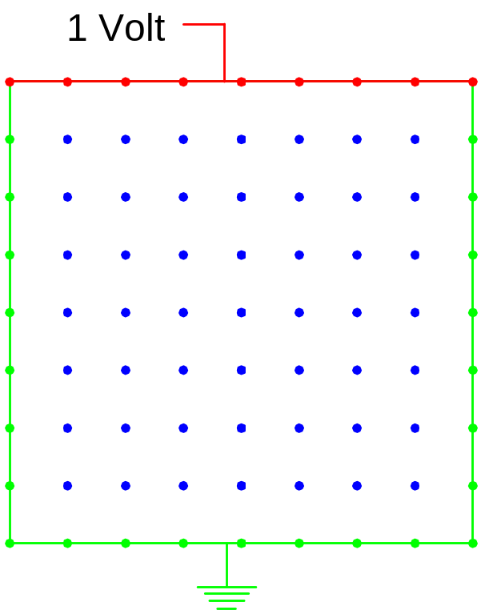
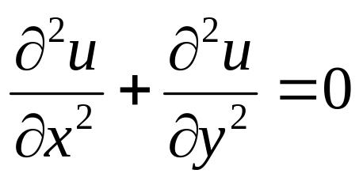
weave and Laplace’s equation
Weave case study: An iterative solver for Laplace’s Equation
PURE PYTHON 133 SECONDS
for i in range(1, nx-1):
for j in range(1, ny-1):
tmp = u[i,j]
u[i,j] = ((u[i-1, j] + u[i+1, j])*dy2 +
(u[i, j-1] + u[i, j+1])*dx2)
/ (2.0*(dx2 + dy2))
diff = u[i,j] – tmp
err = err + diff**2
Thanks to Prabhu Ramachandran for designing and running this
example. His complete write-up is available at:
http://www.scipy.org/PerformancePython

Slide 73
weave and Laplace’s equation
USING NUMPY 1.36 SECONDS
old_u = u.copy() # needed to compute the error.
u[1:-1, 1:-1] = ((u[0:-2, 1:-1] + u[2:, 1:-1])*dy2 +
(u[1:-1, 0:-2] + u[1:-1, 2:])*dx2)
* dnr_inv
err = sum(dot(old_u – u))
WEAVE.BLITZ 0.56 SECONDS
old_u = u.copy() # needed to compute the error.
expr = ””” \
u[1:-1, 1:-1] = ((u[0:-2, 1:-1] + u[2:, 1:-1])*dy2 +
(u[1:-1, 0:-2] + u[1:-1, 2:])*dx2)
* dnr_inv
”””
weave.blitz(expr,size_check=0)
err = sum((old_u – u)**2)

Slide 74
weave and Laplace’s equation
WEAVE.INLINE 0.25 SECONDS
code = """
#line 120 "laplace.py" (This is only useful for debugging)
double tmp, err, diff;
err = 0.0;
for (int i=1; i<nx-1; ++i) {
for (int j=1; j<ny-1; ++j) {
tmp = u(i,j);
u(i,j) = ((u(i-1,j) + u(i+1,j))*dy2 +
(u(i,j-1) + u(i,j+1))*dx2)*dnr_inv;
diff = u(i,j) - tmp;
err += diff*diff;
}
}
return_val = sqrt(err);
"""
err = weave.inline(code, ['u','dx2','dy2','dnr_inv','nx','ny'],
type_converters = converters.blitz,
compiler = 'gcc',
extra_compile_args = ['-O3','-malign-double'])

Slide 75
Laplace Benchmarks
Method | Run Time (sec) | Speed Up
Pure Python | ≈ 133.00 | ≈ 0.01
Numpy | 1.36 | 1.00
weave.blitz | 0.56 | 2.43
weave.inline | 0.28 | 4.85
weave.inline (fast) | 0.25 | 5.44
Python/Fortran (with f2py) | 0.25 | 5.44
Pyrex | 0.25 | 5.44
Pure C++ Program | 0.24 | 5.66
500x500 grid for 100 iterations
Intel X5355 Xeon Quad Core, 2.66 GHz, 8 GB Memory
Linux, CentOS 5, Python 2.5.1, Numpy 1.0.4
Notes:
Problem with this benchmark is that pickling and sending the large data array is much more expensive

Slide 76
f2py

Slide 77
f2py
Author: Pearu Peterson at Center for Nonlinear Studies Tallinn, Estonia
Automagically “wraps” Fortran 77/90/95 libraries for use in Python. Amazing.
f2py is specifically built to wrap Fortran functions using NumPy arrays.

Slide 78
Simplest f2py Usage
Python Extension
Module
fcopy.pyd
or
fcopymodule.so
Fortran File
fcopy.f
f2py –c –m fcopy fcopy.f –compiler=mingw32
Compile code
and build an
extension module
Name the
extension
module fcopy.
Specify the Fortran
file to use.
On windows,
specifying mingw32
uses gcc tool chain

Slide 79
Simplest Usage Result
Fortran file fcopy.f
C
SUBROUTINE FCOPY(AIN,N,AOUT)
C
DOUBLE COMPLEX AIN(*)
INTEGER N
DOUBLE COMPLEX AOUT(*)
DO 20 J = 1, N
AOUT(J) = AIN(J)
20 CONTINUE
END
Looks exactly like
the Fortran ---
but now it is callable
from Python.
>>> a = rand(1000) + 1j*rand(1000)
>>> b = zeros((1000,), dtype=complex128)
>>> fcopy.fcopy(a,1000,b)
>>> alltrue(a==b)
True

Slide 80
More Sophisticated
Fortran File
fcopy.f
Interface File
fcopy.pyf
hand edit
Python Extension Module
fcopymodule.so
f2py fcopy.f –h fcopy.pyf –m fcopy
f2py -c fcopy.pyf fcopy.f

Slide 81
More Sophisticated
Interface file fcopy2.pyf
! -*- f90 -*-
python module fcopy2 ! in
interface ! in :fcopy
subroutine fcopy(ain,n,aout) ! in :fcopy:fcopy.f
double complex dimension(n), intent(in) :: ain
integer, intent(hide),depend(ain) :: n=len(ain)
double complex dimension(n),intent(out) :: aout
end subroutine fcopy
end interface
end python module fcopy
! This file was auto-generated with f2py (version:2.37.233-1545).
! See http://cens.ioc.ee/projects/f2py2e/
Give f2py some
hints as to what
these variables are
used for and how
they may be
related in Python.
fcopy - Function signature:
aout = fcopy(ain)
Required arguments:
ain : input rank-1 array('D')
with bounds (n)
Return objects:
aout : rank-1 array('D') with
bounds (n)
# More pythonic behavior
>>> a = rand(5).astype(complex64)
>>> b = fcopy2.fcopy(a)
>>> alltrue(a==b)
True
# However, b is complex128, not
# 64 because of signature
>>> print b.dtype
dtype(‘complex128')

Slide 82
Simply Sophisticated
Fortran File
fcopy.f
hand edit
Python Extension Module
fcopymodule.so
f2py –c fcopy.f –m fcopy
Compile code and
build an extension module
Name the extension module
fcopy.

Slide 83
Simply Sophisticated
Directives help f2py interpret the source.
Fortran file fcopy2.f
C
SUBROUTINE FCOPY(AIN,N,AOUT)
C
CF2PY INTENT(IN), AIN
CF2PY INTENT(OUT), AOUT
CF2PY INTENT(HIDE), DEPEND(AIN), N=LEN(AIN)
DOUBLE COMPLEX AIN(*)
INTEGER N
DOUBLE COMPLEX AOUT(*)
DO 20 J = 1, N
AOUT(J) = AIN(J)
20 CONTINUE
END
The resulting interface is more Pythonic.
>>> import fcopy
>>> info(fcopy.fcopy)
fcopy - Function signature:
aout = fcopy(ain)
Required arguments:
ain : input rank-1 array('D') with bounds (n)
Return objects:
aout : rank-1 array('D') with bounds (n)
>>> a = rand(1000)
>>> import fcopy
>>> b = fcopy.fcopy(a)

Slide 84
Multidimensional array issues
Python and Numeric use C conventions for array storage (row major order). Fortran uses column major ordering.
Numeric:
A[0,0], A[0,1], A[0,2],…, A[N-1,N-2], A[N-1,N-1]
(last dimension varies the fastest)
Fortran:
A(1,1), A(2,1), A(3,1), …, A(N-1,N), A(N,N)
(first dimension varies the fastest)
f2py handles the conversion back and forth between the representations if you mix them in your code. Your code will be faster, however, if you can avoid mixing the representations (impossible if you are calling out to both C and Fortran libraries that are interpreting matrices differently).

Slide 85
numpy.distutils
How do I distribute this great new extension module?
  Recipient must have f2py and scipy_distutils installed (both are simple installs)
  Create setup.py file
  Distribute *.f files with setup.py file.
  Optionally distribute *.pyf file if you’ve spruced up the interface in a separate interface file.
Supported Compilers
  g77, Compaq Fortran, VAST/f90 Fortran, Absoft F77/F90, Forte (Sun), SGI, Intel, Itanium, NAG, Lahey, PG

Slide 86
Complete Example
In scipy.stats there (used to be…) a function written entirely in Python
  >>> help(stats.morestats._find_repeats)
  _find_repeats(arr)
  Find repeats in the array and return a list of the
  repeats and how many there were.
Goal: Write an equivalent fortran function and link it in to Python with f2py so it can be distributed with scipy_base (which uses scipy_distutils) and be available for stats.
Python algorithm uses sort and so we will need a fortran function for that, too.

Slide 87
The “Decorated” Fortran File
Fortran file futil.f
C Sorts an array arr(1:N) into
SUBROUTINE DQSORT(N,ARR)
CF2PY INTENT(IN,OUT,COPY), ARR
CF2PY INTENT(HIDE), DEPEND(ARR), N=len(ARR)
INTEGER N,M,NSTACK
REAL*8 ARR(N)
PARAMETER (M=7, NSTACK=100)
INTEGER I,IR,J,JSTACK, K,L, ISTACK(NSTACK)
REAL*8 A,TEMP
…
END
C Finds repeated elements of ARR
SUBROUTINE DFREPS(ARR,N,REPLIST,REPNUM,NLIST)
CF2PY INTENT(IN), ARR
CF2PY INTENT(OUT), REPLIST
CF2PY INTENT(OUT), REPNUM
CF2PY INTENT(OUT), NLIST
CF2PY INTENT(HIDE), DEPEND(ARR), N=len(ARR)
REAL*8 REPLIST(N), ARR(N)
REAL*8 LASTVAL
INTEGER REPNUM(N)
INTEGER HOWMANY, REPEAT, IND, NLIST, NNUM
…
END

Slide 88
setup.py
from numpy.distutils.core import Extension
# For f2py extensions that have a .pyf file.
futil1 = Extension(name='futil',
sources=['futil.pyf','futil.f'])
# fortran files with f2py directives embedded in them
# are processed by the build_src step of setup.py
futil2 = Extension(name='futil2',
sources=['futil2.f'])
if __name__ == "__main__":
from numpy.distutils.core import setup
setup(name=‘repeats_util',
description = "f2py example",
ext_modules = [futil1, futil2],
py_modules = ‘util.py’)
  Building:
  C:\demo\f2py_repeats> python setup.py build_src \
  build_ext --inplace --compiler=mingw32
  or
  C:\demo\f2py_repeats> python setup.py build_src \
  build_ext --compiler=mingw32 build

Slide 89
The Python “wrapper” function
# util.py
import futil2
def find_repeats(arr):
"""Find repeats in arr and return (repeats, repeat_count)
"""
v1,v2, n = futil2.dfreps(arr)
return v1[:n],v2[:n]
if __name__ == "__main__":
from scipy import stats, float64
a = stats.randint(1, 30).rvs(size=1000)
print a.astype(float64)
repeats, nums = find_repeats(a)
print 'repeats:'
print repeats
print 'nums:’
print nums

Slide 90
Complete Example
Try It Out!!
>>> from scipy import stats
>>> from util import find_repeats
>>> a = stats.randint(1,30).rvs(size=1000)
>>> reps, nums = find_repeats(a)
>>> print reps
[ 1. 2. 3. 4. 5. 6. 7. 8. 9. 10. 11.
12. 13. 14. 15. 16. 17. 18. 19. 20. 21. 22.
23. 24. 25. 26. 27. 28. 29.]
>>> print nums
[29 37 29 30 34 39 46 20 30 32 35 42 40 39 35 26 38 33 40
29 34 26 38 45 39 38 29 39 29]
New function is 25 times faster than the plain Python version

Slide 91
3D Visualization with VTK

Slide 92
Visualization with VTK
Visualization Toolkit from Kitware
  www.kitware.com
Large C++ class library
  Wrappers for Tcl, Python, and Java
  Extremely powerful, but…
  Also complex with a steep learning curve

Slide 93
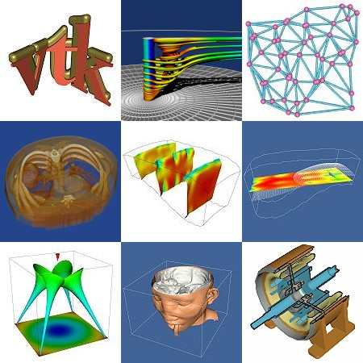
VTK Gallery

Slide 94
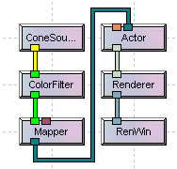
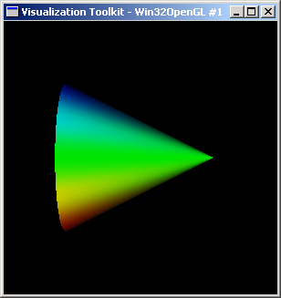
VTK Pipeline
PIPELINE
OUTPUT
Pipeline view from Visualization Studio at http://www.principiamathematica.com

Slide 95
Cone Example
SETUP
# VTK lives in two modules
from vtk import *
# Create a renderer
renderer = vtkRenderer()
# Create render window and connect the renderer.
render_window = vtkRenderWindow()
render_window.AddRenderer(renderer)
render_window.SetSize(300,300)
# Create Tkinter based interactor and connect render window.
# The interactor handles mouse interaction.
interactor = vtkRenderWindowInteractor()
interactor.SetRenderWindow(render_window)

Slide 96
Cone Example (cont.)
PIPELINE
# Create cone source with 200 facets.
cone = vtkConeSource()
cone.SetResolution(200)
# Create color filter and connect its input
# to the cone's output.
color_filter = vtkElevationFilter()
color_filter.SetInput(cone.GetOutput())
color_filter.SetLowPoint(0,-.5,0)
color_filter.SetHighPoint(0,.5,0)
# map colorized cone data to graphic primitives
cone_mapper = vtkDataSetMapper()
cone_mapper.SetInput(color_filter.GetOutput())

Slide 97
Cone Example (cont.)
DISPLAY
# Create actor to represent our
# cone and connect it to the
# mapper
cone_actor = vtkActor()
cone_actor.SetMapper(cone_mapper)
# Assign actor to
# the renderer.
renderer.AddActor(cone_actor)
# Initialize interactor
# and start visualizing.
interactor.Initialize()
interactor.Start()

Slide 98
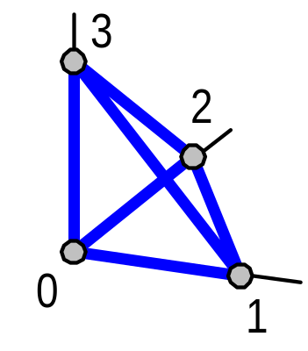
Mesh Generation
POINTS AND CELLS
# Convert list of points to VTK structure
verts = vtkPoints()
temperature = vtkFloatArray()
for p in points: verts.InsertNextPoint(p[0],p[1],p[2])
temperature.InsertNextValue(p[3])
# Define triangular cells from the vertex
# “ids” (index) and append to polygon list.
polygons = vtkCellArray()
for tri in triangles:
cell = vtkIdList()
cell.InsertNextId(tri[0])
cell.InsertNextId(tri[1])
cell.InsertNextId(tri[2])
polygons.InsertNextCell(cell)
points
id x y z temp
0 0 0 0 10
1 1 0 0 20
2 0 1 0 20
3 0 0 1 30
triangles
id x y z
0 0 1 3
1 0 3 2
2 1 2 3
3 0 2 1
Notes:
Any issue with vertex ordering according to normals?

Slide 99
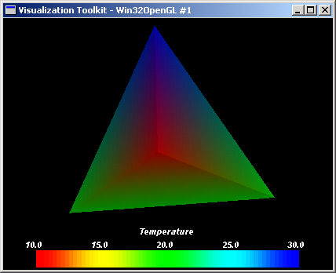
Mesh Generation
POINTS AND CELLS
# Create a mesh from these lists
mesh = vtkPolyData()
mesh.SetPoints(verts)
mesh.SetPolys(polygons)
mesh.GetPointData().SetScalars( \
... temperature)
# Create mapper for mesh
mapper = vtkPolyDataMapper()
mapper.SetInput(mesh)
# If range isn’t set, colors are
# not plotted.
mapper.SetScalarRange( \
... temperature.GetRange())
Code for temperature bar not shown.
Notes:
Should include entire code in handouts.
Mention that it works with wxPython on Windows, but still has problems on Linux.

Slide 100
TVTK – Simplified VTK interface
PREVIOUS EXAMPLE USING TVTK – MUCH LESS CODE
# Convert list of points to VTK structure
points = p[:,:3]
temp = p[:,-1]
traingles = t[:,1:]
# Create mapper for mesh
mesh = vtkPolyData()
mesh.points = points
mesh.polys = triangles
mesh.point_data.scalars = temp
# Create mapper for mesh
mapper = vtkPolyDataMapper()
mapper.input = mesh
mapper.scalar_range = amin(temp),amax(temp)
points
id x y z temp
0 0 0 0 10
1 1 0 0 20
2 0 1 0 20
3 0 0 1 30
triangles
id x y z
0 0 1 3
1 0 3 2
2 1 2 3
3 0 2 1
Notes:
Any issue with vertex ordering according to normals?

Slide 101
Mayavi Demo
Heart or Seismic Data

Slide 102
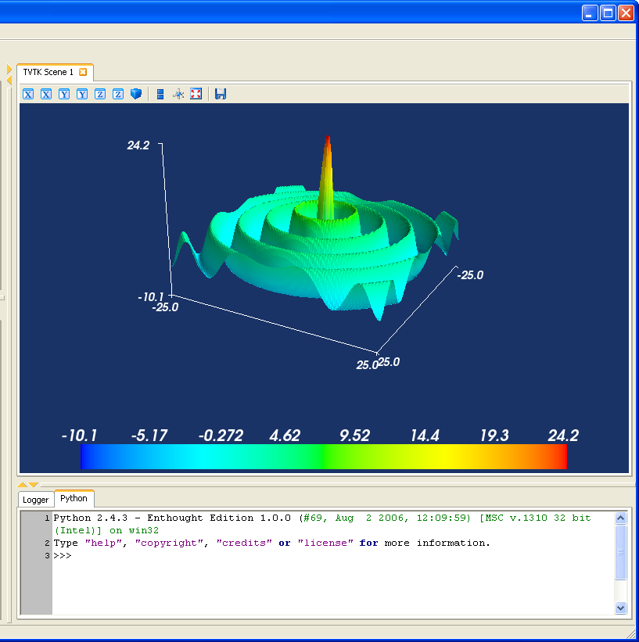
Surface plots with mlab
# Create 2d array where values
# are radial distance from
# the center of array.
>>> from numpy import mgrid
>>> from scipy import special
>>> x,y = mgrid[-25:25:100j,
... -25:25:100j]
>>> r = sqrt(x**2+y**2)
# Calculate bessel function of
# each point in array and scale
>>> s = special.j0(r)*25
# Display surface plot.
>>> from enthought.mayavi.tools \
import mlab
>>> mlab.surf(x,y,s)
>>> mlab.scalarbar()
>>> mlab.axes()

Slide 103
2D Plotting and Visualization

Slide 104
Plotting Libraries
Matplotlib
http://matplotlib.sf.net
Chaco
http://code.enthought.com/chaco
Dispyl
http://kim.bio.upenn.edu/~pmagwene/disipyl.html
Biggles
http://biggles/sf.net
Pyngl
http://www.pyngl.ucar.edu/
Many more…
http://www.scipy.org/Topical_Software

Slide 105
Recommendations
Matplotlib for day-to-day data exploration.
Matplotlib has a large community, tons of plot types, and is well integrated into ipython. It is the de-facto standard for ‘command line’ plotting from ipython.
Chaco for building interactive plotting applications
Chaco is architected for building highly interactive and configurable plots in python. It is more useful as plotting toolkit than for making one-off plots.

Slide 106
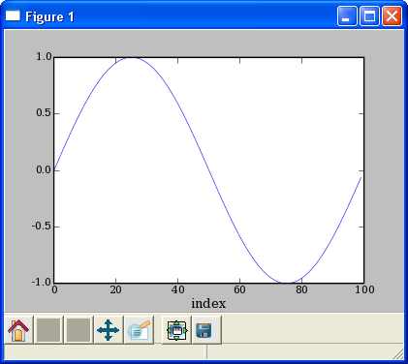
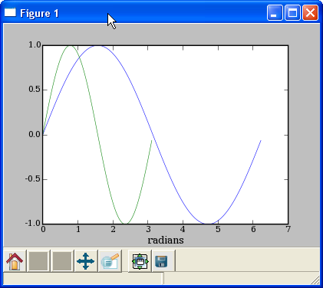
Line Plots
PLOT AGAINST INDICES
MULTIPLE DATA SETS
>>> x = arange(50)*2*pi/50.
>>> y = sin(x)
>>> plot(y)
>>> xlabel(‘index’)
>>> plot(x,y,x2,y2)
>>> xlabel(‘radians’)

Slide 107
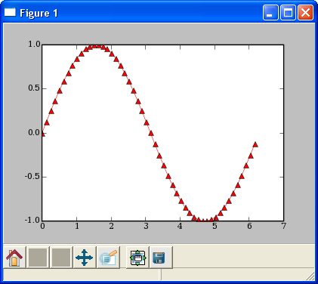
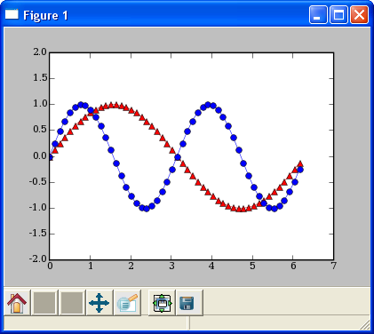
Line Plots
LINE FORMATTING
MULTIPLE PLOT GROUPS
# red, dot-dash, triangles
>>> plot(x,sin(x),'r-^')
>>> plot(x,y1,'b-o', x,y2), r-^')
>>> axis([0,7,-2,2])

Slide 108
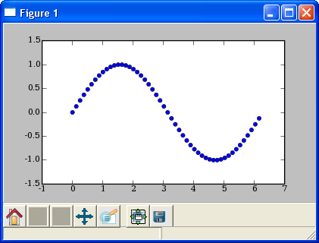
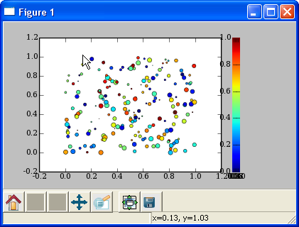
Scatter Plots
SIMPLE SCATTER PLOT
COLORMAPPED SCATTER
>>> x = arange(50)*2*pi/50.
>>> y = sin(x)
>>> scatter(x,y)
# marker size/color set with data
>>> x = rand(200)
>>> y = rand(200)
>>> size = rand(200)*30
>>> color = rand(200)
>>> scatter(x, y, size, color)
>>> colorbar()

Slide 109
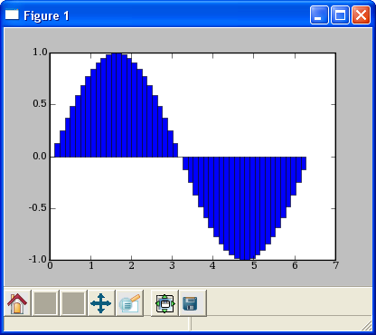
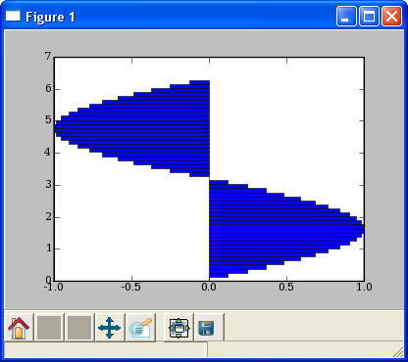
Bar Plots
BAR PLOT
HORIZONTAL BAR PLOT
>>> bar(x,sin(x),
... width=x[1]-x[0])
>>> bar(x,sin(x),
... height=x[1]-x[0])

Slide 110
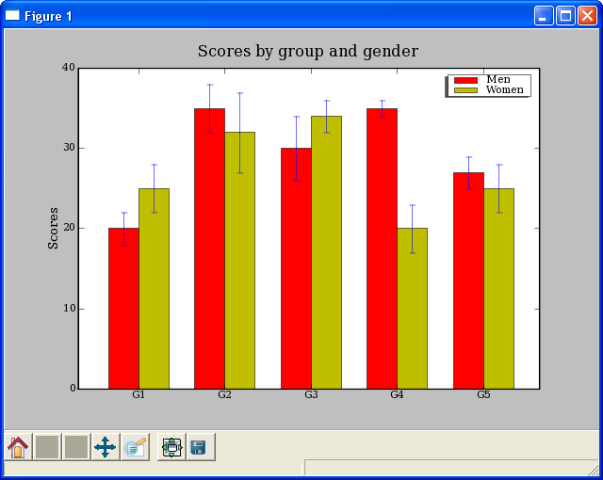
Bar Plots
DEMO/MATPLOTLIB_PLOTTING/BARCHART_DEMO.PY

Slide 111
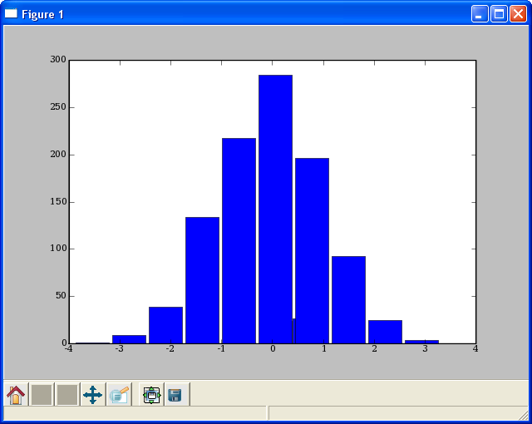
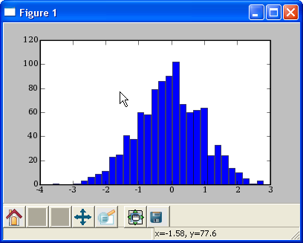
HISTOGRAMS
HISTOGRAM
HISTOGRAM 2
# plot histogram
# default to 10 bins
>>> hist(randn(1000))
# change the number of bins
>>> hist(randn(1000), 30)

Slide 112
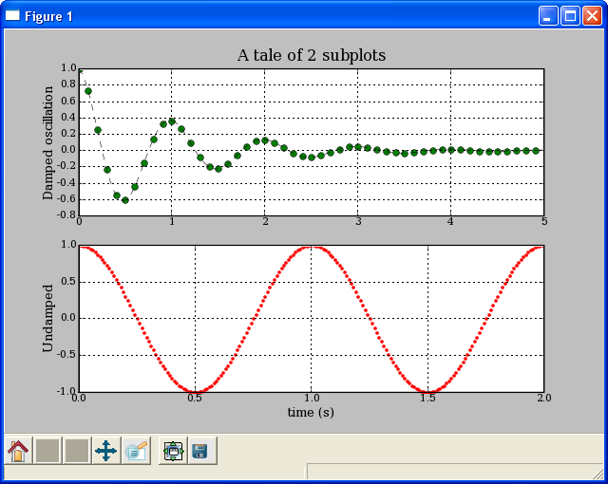
Multiple Plots using Subplot
DEMO/MATPLOTLIB_PLOTTING/EXAMPLES/SUBPLOT_DEMO.PY
def f(t):
s1 = cos(2*pi*t)
e1 = exp(-t)
return multiply(s1,e1)
t1 = arange(0.0, 5.0, 0.1)
t2 = arange(0.0, 5.0, 0.02)
t3 = arange(0.0, 2.0, 0.01)
subplot(211)
l = plot(t1, f(t1), 'bo', t2, f(t2),
'k--')
setp(l, 'markerfacecolor', 'g')
grid(True)
title('A tale of 2 subplots')
ylabel('Damped oscillation')
subplot(212)
plot(t3, cos(2*pi*t3), 'r.')
grid(True)
xlabel('time (s)')
ylabel('Undamped')
show()

Slide 113
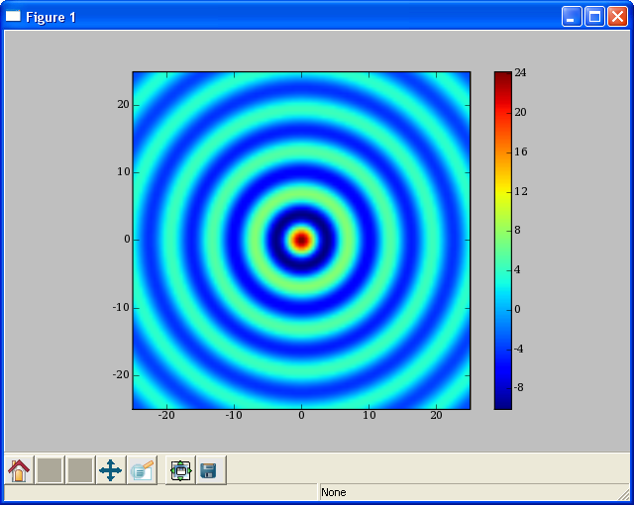
Image Display
# Create 2d array where values
# are radial distance from
# the center of array.
>>> from numpy import mgrid
>>> from scipy import special
>>> x,y = mgrid[-25:25:100j,
... -25:25:100j]
>>> r = sqrt(x**2+y**2)
# Calculate bessel function of
# each point in array and scale
>>> s = special.j0(r)*25
# Display surface plot.
>>> imshow(s, extent=[-25,25,-25,25])
>>> colorbar()

