Slide 1

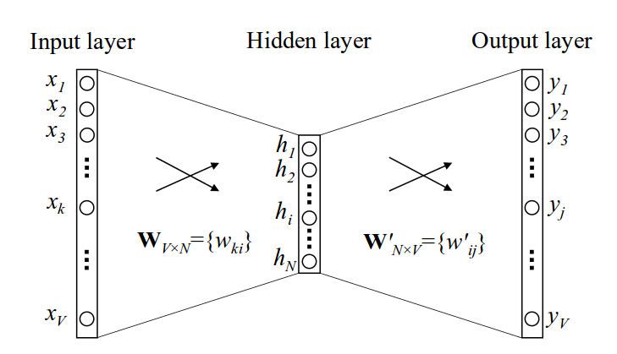



Analysing user comments with
Doc2Vec and Machine Learning
Robert Meyer Data Scientist at Flixbus
PyData Berlin 2017 robert.meyer@flixbus.com

Slide 2
What?
What can we learn from user comments on news sites?
  Scrape Online Comments
  Doc2Vec (& Word2Vec)
  Supervised (linear) Machine Learning

Slide 3
News Sites

Slide 4
Hypothesis
(slightly) smarter OMG srsly?

Slide 5
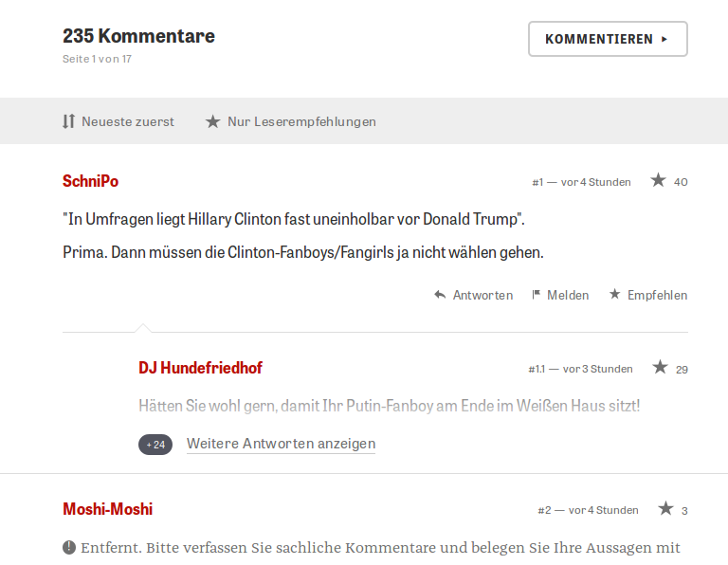

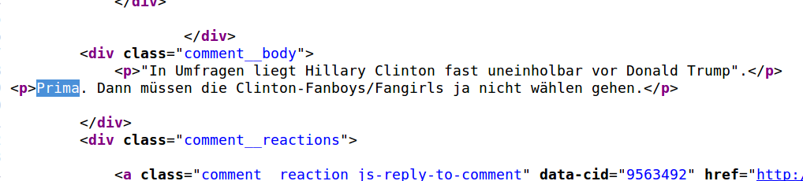
Scraping

Slide 6
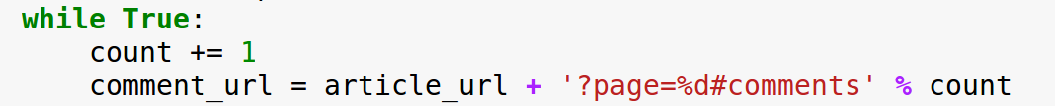
Scraping
http://www.zeit.de/politik/ausland/2016-10/donald-trump-hillary-clinton-tv-duell-umfrage-us-wahl?page=1#comments

Slide 7

Scraping
Comments from January 2014 till June 2016
  SPON ~280,000
  ZEIT ~170,000
  Focus ~50,000
    tokenized with

Slide 8
Preprocessing
“... an unseren Schulen Einigkeit und Recht und Freiheit für das deutsche Vaterland lehren soll.” /
'... teach unity and justice and freedom for our German Fatherland at our schools.' (Focus)
“Wenn ich nun aber überzeugter Vegetarier bin, dennoch aber ab und an einen Hamburger essen möchte ...” /
'If I was a staunch vegetarian, but I would like to eat a hamburger ...'
(ZEIT)
“Trump gewinnt US Wahl, die EU zerbricht nach dem Brexit ...” /
'Trump will win the US election, the EU will break down after the Brexit ...'
(SPON)
...

Slide 9
Preprocessing
“... an unseren Schulen Einigkeit und Recht und Freiheit für das deutsche Vaterland lehren soll.” /
'... teach unity and justice and freedom for our German Fatherland at our schools.' (Focus)
“Wenn ich nun aber überzeugter Vegetarier bin, dennoch aber ab und an einen Hamburger essen möchte ...” /
'If I was a staunch vegetarian, but I would like to eat a hamburger ...'
(ZEIT)
“Trump gewinnt US Wahl, die EU zerbricht nach dem Brexit ...” /
'Trump will win the US election, the EU will break down after the Brexit ...'
(SPON)
...
[..., an, unseren, schulen, einigkeit, und, recht, und, freiheit, für, das, deutsche, vaterland, lehren, soll]
(doc 1)
[wenn, ich, nun, aber, überzeugter, vegetarier, bin, dennoch, aber, ab, und, an, einen, hamburger, essen, möchte, ...]
(doc 2)
[trump, gewinnt, us, wahl, die, eu, zerbricht, nach, dem, brexit ...]
(doc 3)
...

Slide 10
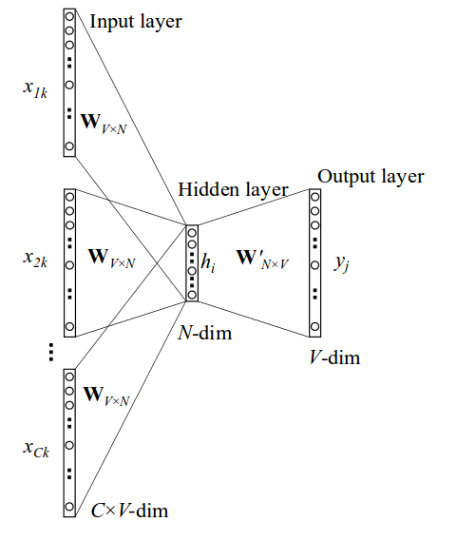
Doc2Vec / Word2Vec
[..., an, unseren, schulen, einigkeit, und, recht, und, freiheit, für, das, deutsche, vaterland, lehren, soll]
(doc 1)
[wenn, ich, nun, aber, überzeugter, vegetarier, bin, dennoch, aber, ab, und, an, einen, hamburger, essen, möchte, ...]
(doc 2)
[trump, gewinnt, us, wahl, die, eu, zerbricht, nach, dem, brexit ...]
(doc 3)
...
Amazing
Stuff!
Amazing
Stuff!

Slide 11
Doc2Vec / Word2Vec
[..., an, unseren, schulen, einigkeit, und, recht, und, freiheit, für, das, deutsche, vaterland, lehren, soll]
(doc 1)
[wenn, ich, nun, aber, überzeugter, vegetarier, bin, dennoch, aber, ab, und, an, einen, hamburger, essen, möchte, ...]
(doc 2)
[trump, gewinnt, us, wahl, die, eu, zerbricht, nach, dem, brexit ...]
(doc 3)
...
Amazing
Stuff!

Slide 12
Word2Vec
hamburger = (0.4, 12.1, 0, 10)^{T}
≈ (0.5, 13, 0, 9.8)^{T} = Cheeseburger
≠ (0.1, 7, 42.1, 0)^{T} = Flixbus

Slide 13
Word2Vec
hamburger = (0.4, 12.1, 0, 10)^{T}
≈ (0.5, 13, 0, 9.8)^{T} = Cheeseburger
≠ (0.1, 7, 42.1, 0)^{T} = Flixbus
hamburger
0

Slide 14
Word2Vec
hamburger = (0.4, 12.1, 0, 10)^{T}
≈ (0.5, 13, 0, 9.8)^{T} = cheeseburger
≠ (0.1, 7, 42.1, 0)^{T} = flixbus
hamburger
cheeseburger
0

Slide 15
Word2Vec
hamburger = (0.4, 12.1, 0, 10)^{T}
≈ (0.5, 13, 0, 9.8)^{T} = cheeseburger
≠ (0.1, 7, 42.1, 0)^{T} = flixbus
hamburger
cheeseburger
0
flixbus

Slide 16
Word2Vec
- mann / man
+ frau / woman
= königin / queen
könig / king
0

Slide 17
Word2Vec
1st word
2nd word
einigkeit / unity
einigkeit / unity
recht / justice
recht / justice
freiheit / freedom
freiheit / freedom
und / and
und / and
[Rong 2014]

Slide 18
Word2Vec
[... einigkeit, und, recht, und, freiheit, für, das, ...]
[... unity, and, justice, and, freedom, for, the, ...]
einigkeit / unity
0
0
0
...
1
...
0
1
0
0
...
0
...
0
0.9
0.3
1.8
...
-0.4
...
1.7
und / and
propagate
Input vector
Output vs Target vector
adjust weights
[Rong 2014]

Slide 19
Word2Vec
[... einigkeit, und, recht, und, freiheit, für, das, ...]
[... unity, and, justice, and, freedom, for, the, ...]
0
0
0
...
1
...
0
0
1
0
...
0
...
0
recht / justice
und / and
[Rong 2014]

Slide 20
Word2Vec
[... einigkeit, und, recht, und, freiheit, für, das, ...]
[... unity, and, justice, and, freedom, for, the, ...]
0
1
0
...
0
...
0
0
0
0
...
1
...
0
recht / justice
und / and
[Rong 2014]

Slide 21
Word2Vec
[... einigkeit, und, recht, und, freiheit, für, das, ...]
[... unity, and, justice, and, freedom, for, the, ...]
0
0
0
...
1
...
0
0
0
1
...
0
...
0
freiheit / freedom
und / and
[Rong 2014]

Slide 22
Word2Vec
0
0
0
...
1
...
0
0.1 recht / justice
0.1 freiheit / freedom
0.05 hand / hand
...
und / and
[Rong 2014]

Slide 23
Word2Vec
0
0
0
...
1
...
0
und / and
Fixed length (N=100-300) weight vector:
und / and => (0.9, 42.42, 3333, 1.01, ....)^{T}
[Rong 2014]

Slide 24
Word2Vec
n-kth word
n-k+1th word
...
nth word
n+kth word
[... einigkeit, und, recht, und, freiheit, für, das, ...]
[... unity, and, justice, and, freedom, for, the, ...]
[Rong 2014]

Slide 25
Word2Vec
und / and
recht / justice
...
und / and
für / for
[... einigkeit, und, recht, und, freiheit, für, das, ...]
[... unity, and, justice, and, freedom, for, the, ...]
[Rong 2014]

Slide 26
Word2Vec
spanien / spain
portugal / portugal
laufen / run
0
gehen / walk

Slide 27
Doc2Vec
'Alice in Wonderland' = (1.4, 2.1, 0)^{T}
≈ (1.5, 3, 0)^{T} = 'Through the Looking-Glass'
≠ (33, 7, 1.2)^{T} = 'Das Kapital'
Alice in
Wonderland
0

Slide 28
Doc2Vec
'Alice in Wonderland' = (1.4, 2.1, 0)^{T}
≈ (1.5, 3, 0)^{T} = 'Through the Looking-Glass'
≠ (33, 7, 1.2)^{T} = 'Das Kapital'
Alice in
Wonderland
Through the
Looking-Glass
0

Slide 29
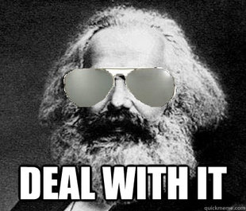
Doc2Vec
'Alice in Wonderland' = (1.4, 2.1, 0)^{T}
≈ (1.5, 3, 0)^{T} = 'Through the Looking-Glass'
≠ (33, 7, 1.2)^{T} = 'Das Kapital'
Alice in
Wonderland
Through the
Looking-Glass
0
Das Kapital

Slide 30
Doc2Vec
n-kth word
n-k+1th word
...
nth word
D
document
[Rong 2014]

Slide 31
Doc2Vec
n-kth word
n-k+1th word
...
nth word
D
document
[... einigkeit, und, recht, und, freiheit, für, das, ...]
[... unity, and, justice, and, freedom, for, the, ...]
[Rong 2014]

Slide 32
Doc2Vec
recht / justice
freiheit / freedom
und / and
D
P
doc 1
[... einigkeit, und, recht, und, freiheit, für, das, ...]
[... unity, and, justice, and, freedom, for, the, ...]
[Rong 2014]

Slide 33
Doc2Vec
recht / justice
freiheit / freedom
und / and
D
D
P
doc 1
Fixed length (N=100-300) weight vector:
doc 1 => (0.9, 42.42, 3333, 1.01, ....)^{T}
[Rong 2014]

Slide 34
Doc2Vec
recht / justice
freiheit / freedom
und / and
D
D
P
doc 1
Fixed length (N=100-300) weight vector:
freiheit / freedom => (0.4, 13.13, 0.1, 19, ....)^{T}
[Rong 2014]

Slide 35
Now what?
Training scraped online comments on Doc2Vec...

Slide 36
How?
donald trump gewinnt ...
(doc3)
donald
gewinnt / wins
trump
D
doc 3
donald = (2, 33, 42.7, ... )^{T}
doc 3 = (6, 0, 1.04, ...)^{T}

Slide 37
Doc2Vec
My Model
  Embedding with 256 dimensions
  and a window size of 8 context words
    ~450,000 documents
    Vocabulary of ~115,000 distinct words
  20 epochs
    ~4 hours of training
    with 13 cores
[wenn, ich, nun, aber, überzeugter, vegetarier, bin, dennoch, aber, ab, und, an, einen, hamburger, essen, möchte, ...]
[If I was a staunch vegetarian, but I would like to eat a hamburger ...]

Slide 38
What do we get?
Similarity
  Auto / car
    -> Fahrzeug / automobile (0.72)
  Lügenpresse / fake news
    -> Gutmensch / do-gooder (0.4)
    -> Putin-Versteher / Putin’s disciple (0.36)
    -> Verschwörungstheorie / (0.33)
    conspiracy theory
  NPD
    -> CDU (0.4)
    -> CSU (0.37)
    -> FIFA (0.34)
    ddd

Slide 39
What do we get?
Arithmetic
  Brexit – England + Griechenland / Greece =
    Schuldenschnitt / haircut (0.36)
    Grexit (0.34)
  Hitler + Putin =
    Erdogan (0.57)
  König / king – Mann / man + Frau / woman =
    Angela (0.59)

Slide 40
Supervised Learning
?
?
?
[trump, gewinnt, us, wahl, ...]
Doc2Vec
Embedding
(33, 1, 0, ..)^{T}
0.2 ZEIT
0.7 SPON
0.1 FOCUS
Machine Learning
Classifier
(33, 1, 0, ..)^{T}

Slide 41
Can we make predictions?
It's (very) difficult
“Es war klar, dass solche Dinge kommen würden.”
‘It's clear that these things would come.’

Slide 42
ML Classifier
Linear SGD Classifier with elasticnet penalty
  Doc2Vec embeddings as input
    ZEIT, SPON, Focus class labels as output
  Stratified training and test sets
    ~35,000 and ~15,000 comments per news site

Slide 43
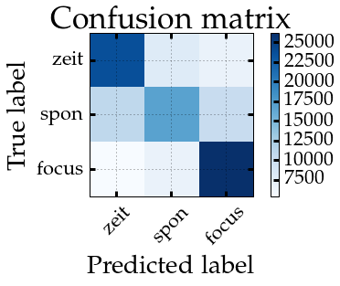
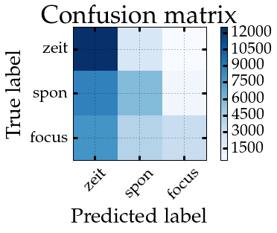
Can we make predictions?
Linear SGD Classifier
  Training Accuracy: 0.58 Test Accuracy: 0.47

Slide 44
Who is who?
Best representing:
“Es ist auch nicht nur zu eng für Lebewesen jenseits des Menschen, sondern letztendlich schon für uns selbst, weil es weniger anthroprozentrisch ist, als dass es eine sehr schmale Idee des Lebens impliziert...”
‘Nor is it just too tight for living things beyond man, but ultimately even for ourselves, because it is less anthropocentric, as it implies a very narrow idea of life...’

Slide 45
Who is who?
“Die von Ihnen verlinkten Quellen belegen mitnichten diese Zahlen. Eine differenzierte Betrachtung fällt aber sehr häufig jenen Menschen schwer, die "ganz vorne dabei" sind - aber immer nur in der Theorie und wenn es darum geht, andere zu belehren.”
‘The linked sources you provided prove by no means these numbers. A differentiated observation is very difficult to people who are "up front" - but always only in theory and when it comes to others.’

Slide 46
Who is who?
“Das gesparte Geld landet dann aber nicht beim Hersteller des alten Toasters, weswegen dieser eben doch die Sollbruchstelle dort setzt, wo selbst der Fachmann nur mit der Flex hinkommt.”
‘The manufacturer doesn't get the money saved on an old toaster, therefore the breaking point is placed where even the expert needs a Flex saw.’

Slide 47
Who is who?
“Diese frauenverachtenden Muslime verstehen nur eine harte Hand und gehören sofort ausgewiesen, sofern sie sich als Asylanten hier aufhalten. Was Frau Merkel uns mit ihrer Politik der offenen Grenzen eingebrockt hat...”
‘These misogynous Muslims understand only a hard hand and have to be deported immediately, if they reside as refugees here. This is what Mrs. Merkel got us with her open borders policy...’

Slide 48
Who is who?
“Das es nach 70 Jahren wieder progromähnliche Zustände in diesem Land gibt geht auf das Konto der rot-grünen Gutmenschen und multikulti Träumer. Der umgehemmte Zuzug arabisch-moslemischstämmoger MIgranten zeigt nun die unfassbaren Folgen.”
‘That there are progrom like conditions in our country is due to the red-green do-gooders and multi-cultural daydreamers. The uninhibited influx of arabic-muslim immigrants demonstrates these incredible consequences.’

Slide 49
Recap
Scrape comments from HTML source code
Train Doc2Vec on user comments
Interesting semantic relations
  Hitler + Putin = Erdogan
Reasonable performance of ML classifier
Hypothesis supported
(pseudo) smarter OMG srsly?

Slide 50
Thank You! Any Questions?
Scrape comments from HTML source code
Train Doc2Vec on user comments
Interesting semantic relations
  Hitler + Putin = Erdogan
Reasonable performance of ML classifier
Hypothesis supported
(pseudo) smarter OMG srsly?

Slide 51
robert.meyer@flixbus.com
Scrape comments from HTML source code
Train Doc2Vec on user comments
Interesting semantic relations
  Hitler + Putin = Erdogan
Reasonable performance of ML classifier
Hypothesis supported
(pseudo) smarter OMG srsly?

Slide 52
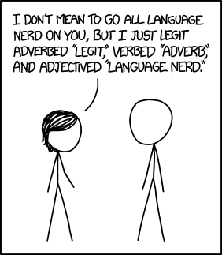
Thank You!

Slide 53
References
Rong 2014: “Word2Vec Parameter Learning Explained”
https://arxiv.org/pdf/1411.2738v4.pdf
Quoc and Nikolov 2014: “Distributed Representation of Sentences and Documents”
https://arxiv.org/pdf/1405.4053v2.pdf

