Slide 1
Planning ahead: using Markov decision processes to optimize your life
Eric Cotner
Data Scientist, American Tire Distributors
Email: 2.71828cotner@gmail.com

Slide 2
$ whoami
Former theoretical physicist – studied dark matter and black holes in grad school
Now I do data science at American Tire Distributors
Focus on supply chain and logistics problems
    Optimizing delivery routes/inventory
Enjoy hiking, astronomy, and scuba diving in my free time

Slide 3
Outline
What is a Markov decision process (MDP)?
How to quantify risk/reward?
Under the hood
  States, actions, transitions, rewards, policy, value functions
An example MDP
Solving MDP’s using pymdptoolbox – a demo
Working with more complex problems
Reinforcement learning

Slide 4

What is a Markov decision process?
Data
scientists
Descriptive/
predictive
analytics
Prescriptive
analytics

Slide 5
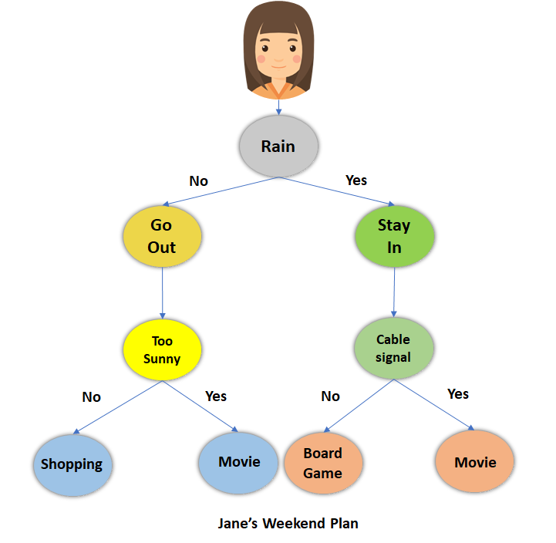
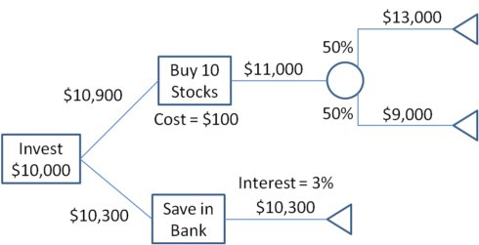
What is a Markov decision process?
Decision tree:
MDP:

Slide 6

What is a Markov decision process?
MDP’s are a mathematical formalism for solving sequential decision problems
  Satisfies the Markov property: all states and rewards do not depend on past history
Defined in terms of states, actions, rewards, and transitions, which are fixed by the nature of the problem/environment
  Capital letters denote random variables, lower case denote actual samples
Things to solve for are the policy (tells you which action to take) and value function(s) (how much reward you expect to get from taking an action)

Slide 7
How to quantify risk/reward/value?
Reward: some thing of value gained (money, game points, reddit karma, personal satisfaction, etc.) by achieving certain goals
Risk = (reward) x (probability of reward)
  Example: roll a 6-side die; {1,4}=-$2.15, {2,3,5,6}=+$1.34; risks associated with these two outcomes are (-$2.15)x(2/6)= -$0.72 and (+$1.34)x(4/6)=+$0.89
Value: sum of all risks; i.e. the expected/average reward
  Previous example: value = (-$0.72) + (+$0.89) = +$0.17

Slide 8
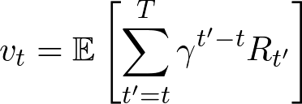
How to quantify risk/reward/value?
Previous example’s usefulness is limited
  What if you need to plan multiple steps ahead?
  What if rewards change with time or are random?
  What if there is more than one available course of action?
  What if actions don’t always result in intended consequences?
Value is (discounted) sum of expected future rewards:
How do you determine the optimal sequence of actions to take? → Use MDP’s!

Slide 9


States and actions
States represent the current state of the environment
  Usually denoted by symbols s, S_{t} (sometimes x in control theory); set of all states:
  Previous die example: s₁=1, s₂=2, …, s₆=6 (or s₁={1,4}, s₂={2,3,5,6})
Actions represent the decisions you can make which will cause you to transition from state to state
  Usually denoted by symbols a, A_{t} (sometimes u in control theory); set of all actions:
  Previous die example: a₁=roll, a₂=do nothing
s₀
s₁
s₂
a₁=roll
a₂=do nothing

Slide 10
State transitions and rewards
Only some states lead to other states; sometimes taking one action can lead to multiple potential states
Model this using the transition matrix/function T(s’;s,a)
  T(s’;s,a) = the probability to transition to state s’ given that you take action a from state s
  6-sided die example: T(s₁;s₀,a₁)=2/6, T(s₂;s₀,a₁)=4/6, T(s₀;*,a₂)=1, otherwise T=0
Sometimes rewards can be stochastic too; model this using reward matrix/function R(r;s,a)
  R(r;s,a) = probability of getting reward r when taking action a from state s
  If reward is deterministic, reward matrix R(s,a) = reward received from taking action a from state s
T=1
R=0
s₀
T=2/6
R=-$2.15
T=4/6
R=+$1.34
T=1
R=0
s₁
s₂
a₁=roll
a₂=do nothing

Slide 11


The policy
How do you decide what to do in a given state?
The policy function π determines which action to take
  Could be deterministic:
  Could be stochastic:
  (deterministic is special case of stochastic where all probability mass is located at one action)
The optimal policy is denoted by π*, which is the policy that maximizes the sum of future expected rewards (value function)

Slide 12

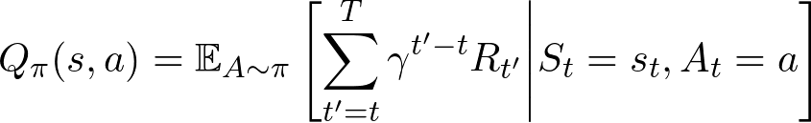
Value functions
Two kinds of value functions:
  The state-value function V_{π}(s): the future reward you expect when starting from state s and following policy π
  The action-value function Q_{π}(s,a): the future reward you expect when starting from state s and taking action a, and following policy π thereafter

Slide 13

How do you actually solve these equations?
Many different algorithms exist depending on size of state/action spaces, length of episodes, structure of reward/transition matrices…
All of them use some form of the Bellman equation:
Consider one of the simplest: value iteration:
  Randomly initialize Q(s,a)
  Select policy by maximizing value function:
  Use Bellman equation to update estimate of Q
  Repeat 2-3 until convergence

Slide 14
An example MDP
Let’s look at a relatively simple example to solve – roll or stay?
You have a 20-sided die, and you get to roll repeatedly until the sum of your rolls either gets as close as possible to 21 or you bust
Your score is the numerical value of the sum of your rolls; if you bust, you get zero.
What is the optimal strategy?
0
+0
9
+0
15
+0
16
+0
18
+15
+0
+9
+16
a₁=roll
a₂=stay
+0
Ø

Slide 15
Using pymdptoolbox
Let’s solve the example from the previous slide in python.
We will use pymdptoolbox, a toolkit for solving discrete-time MDP’s
For more details, see the github repo or the API documentation
Install with `pip install pymdptoolbox`
Check out my demo jupyter notebook

Slide 16
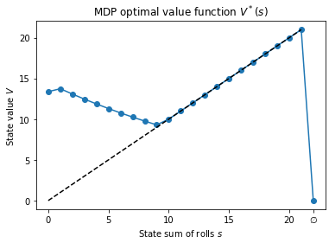
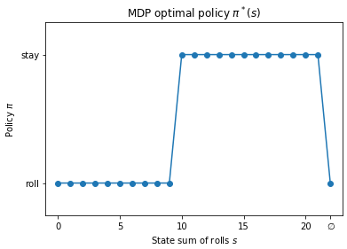
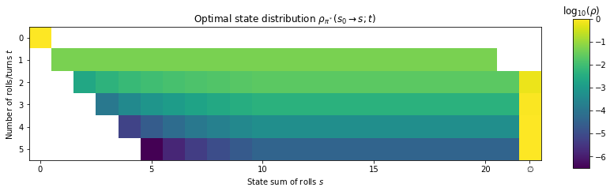
Example MDP solution

Slide 17
Working with more complex problems
How do you handle these more complex problems?
Previous example was very simple compared to most realistic problems
For example, maybe you’re trying to plan purchase orders for your supply chain
  If you have 10 warehouses, each with 1,000 different products which can have stocking levels between 0-100, and you want to plan your orders for the next couple months… that’s a 1M-dimensional state space and 1M-dimensional action space – would need a transition matrix with 10^18 elements...
For very large systems, you may have to resort to approximate solutions
  Bucket similar products together
  Find better state/action representations – use dimensional reduction
  Use function approximation to represent value/policy functions
Some problems have continuous state/action spaces and can’t be formulated with matrices at all
  For example: self-driving car - state is position+orientation+velocity vectors, actions are amount of gas/brake/wheel angle; all probably continuous variables
  Would need to use a completely different approach from the value iteration method we used

Slide 18
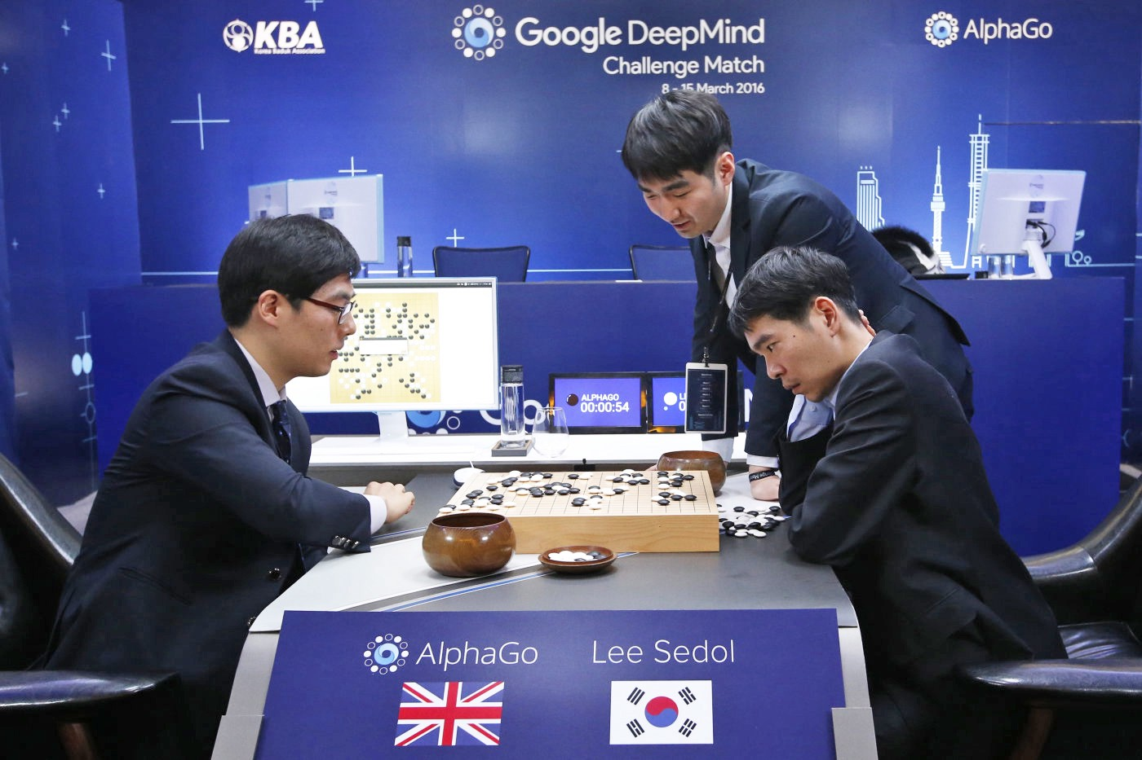
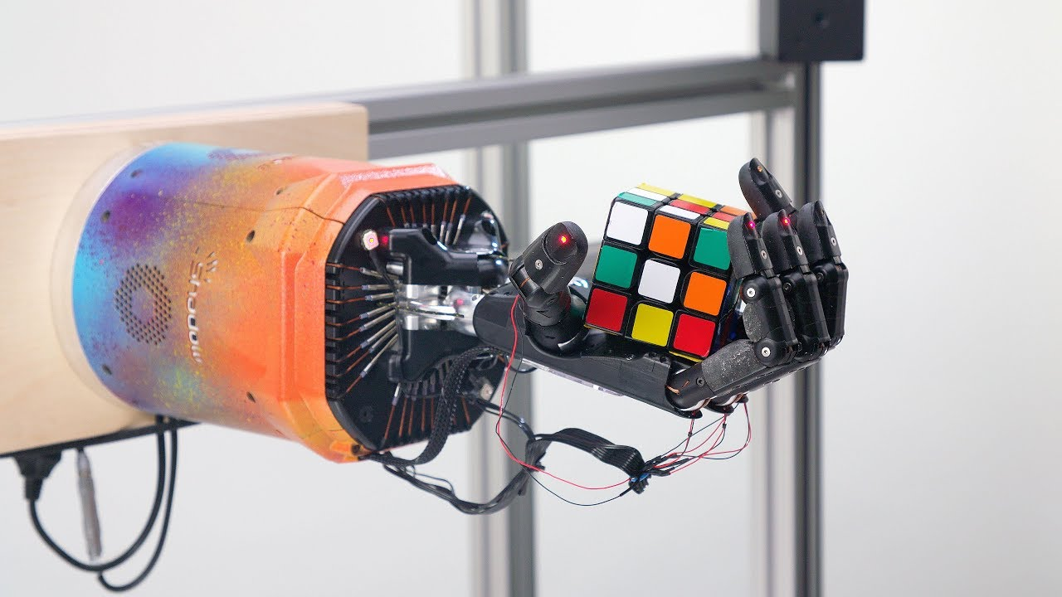
Reinforcement learning
MDP + ML = RL
Type of machine learning that learns how to act optimally in an environment to maximize rewards
MDP’s are the underlying mathematical framework for RL – if you know MDP’s you can easily learn RL

Slide 19
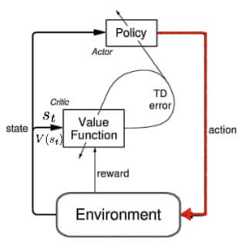
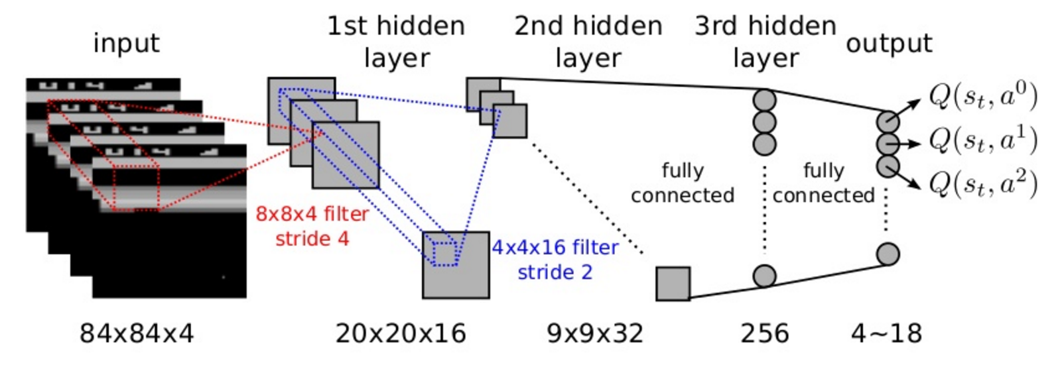
Reinforcement learning
Very advanced algorithms that try to solve MDP’s in environments with enormous state spaces by only sampling states and actions encountered in simulation
Can use neural networks to approximate complex value and/or policy functions
Deep Q-Network (DQN)
Actor-critic

Slide 20
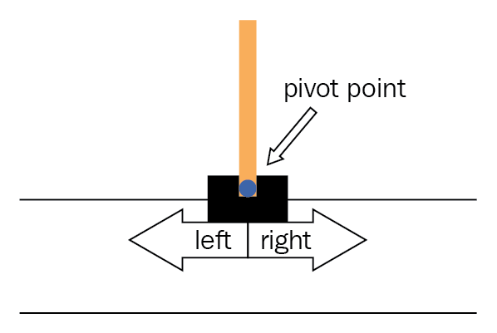
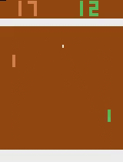
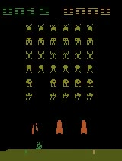
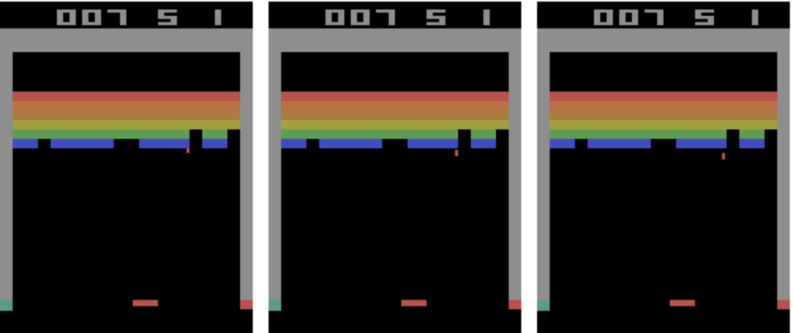
Reinforcement learning
You can get started with reinforcement learning by using OpenAI’s gym
Has out-of-the box environments you can experiment with
Can make your own custom
environments
Cart-pole
Pong
Space Invaders
Breakout

Slide 21
Reference material
pymdptoolbox; Steven Cordwell
  https://pymdptoolbox.readthedocs.io/en/latest/api/mdptoolbox.html
Introduction to Reinforcement Learning; Sutton, Barto:
  http://incompleteideas.net/sutton/book/the-book-2nd.html
gym; OpenAI
  https://gym.openai.com/
Spinning up in Deep RL; OpenAI
  https://spinningup.openai.com/en/latest/
r/reinforcementlearning; Reddit
  https://www.reddit.com/r/reinforcementlearning/

Slide 22
Thank you!

