Slide 1
Langchain: Building applications with OpenAI APIs
Noufal

Slide 2



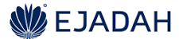



About Me
Noufal Samsudin
Principal Data Scientist , Dubai Holding
LinkedIn: https://www.linkedin.com/in/kvsnoufal/
Medium: https://medium.com/@noufalsamsudin
Github: https://github.com/kvsnoufal

Slide 3
Agenda
1
Introduction to Language Models
2
Explore OpenAI APIs
3
Langchain – Intro + Demo

Slide 4
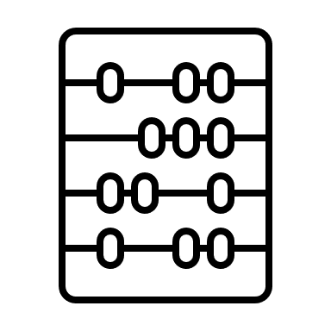
Language Models
Sequence to Sequence Models
Text Input + Text Output
Text Sequence
Continue Text Sequence
A quick brown fox
Jumps over the lazy old dog
Roses are red,
Violets are blue

Slide 5

Language Models - Training
Sequence to Sequence Models
Text Input + Text Output
Text Sequence
Continue Text Sequence
Dubai , Gulf Arabic pronunciation: [dəˈbaj]) is the most populous
city in the United Arab Emirates (UAE) and the capital of the Emirate of Dubai
Established in the 18th century as a small fishing village,
,the city grew rapidly in the early 21st century with a focus on tourism and luxury,
having the second most five-star hotels in the world,
and the tallest building in the world, the Burj Khalifa
In the eastern Arabian Peninsula on the coast of the Persian Gulf
it is also a major global transport hub for passengers and cargo
Dubai , Gulf Arabic pronunciation: [dəˈbaj]) is the most populous city in the United Arab Emirates (UAE) and the capital of the Emirate of Dubai, the most populated of the 7 emirates of the United Arab Emirates. Established in the 18th century as a small fishing village, the city grew rapidly in the early 21st century with a focus on tourism and luxury.having the second most five-star hotels in the world, and the tallest building in the world, the Burj Khalifa, which is 828 metres (2,717 ft) tall.
In the eastern Arabian Peninsula on the coast of the Persian Gulf it is also a major global transport hub for passengers and cargo. Oil revenue helped accelerating the development of the city, which was already a major mercantile hub. A center for regional and international trade since the early 20th century, Dubai's economy relies on revenues from trade, tourism, aviation, real estate, and financial services. Oil production contributed less than 1 percent of the emirate's GDP in 2018. The city has a population of around 3.49 million (as of 2021).
Trained over entire internet
Large Language Model (LLM)

Slide 6

Language Models
tokenize
decode
A quick brown fox
32, 412, 227, 11
12,238, 318
Jumps over the …
Main Output
encoder
embedding
decoder
Secondary Output

Slide 7
Language Model - Applications
Sequence Generation Engine
Continues your prompt
Customize it to our usecase by engineering the prompt to get the results we want
OpenAI provides APIs + playground to test prompts
Create free account – 5$ credit
Usecases
Translation
Q&A Bot
Summarization
Generate Minutes of Meeting
Chatbots

Slide 8
Language Model – Embeddings
Numerical representation of the prompt (multi-dimensional)
Holds semantic information
Text
encoder
embedding
Embedding Space
woman
queen
man
king

Slide 9
Language Model – Embeddings
News Articles from Khaleej Times
Text
encoder
embedding
Embedding Space
Ronaldo scores again winning the match
Biden – KSA visit updates
India vs Bangladesh draws
Brexit negotiations with EU…
Guardian of the Galaxy a big box office success
Oscar worthy performance by…

Slide 10
Language Model – Embeddings
News Articles from Khaleej Times
Who won the cricket match yesterday?
encoder
Embedding Space
Ronaldo scores again winning the match
Biden – KSA visit updates
India vs Bangladesh draws
Brexit negotiations with EU…
Guardian of the Galaxy a big box office success
Oscar worthy performance by…

Slide 11
Langchain
Python Package
Modularize application building
LLM
PromptTemplate
Chain
Agent

Slide 12
Demo

Slide 13
Further Reading
Langchain Documentation: https://python.langchain.com/en/latest/index.html
Prompt Engineering Best Practices: https://help.openai.com/en/articles/6654000-best-practices-for-prompt-engineering-with-openai-api
Codes for today’s workshop: https://github.com/kvsnoufal/langchainWorkshop

Slide 14
Questions?

